Slide 1
45 years of ozone observations at RMI: an overview
Roeland Van Malderen
Scientific Service “Observations”
Sub-service “Weather Instruments”
Co-funded by STCE
Thanks to Dirk De Muer, Hugo De Backer and all ozone sounding/Dobson operators!

Slide 2
Outline
Motivation and introduction
Measuring ozone at Uccle
Total ozone trends at Uccle
Vertical ozone profiles at Uccle
Conclusions and outlook

Slide 3
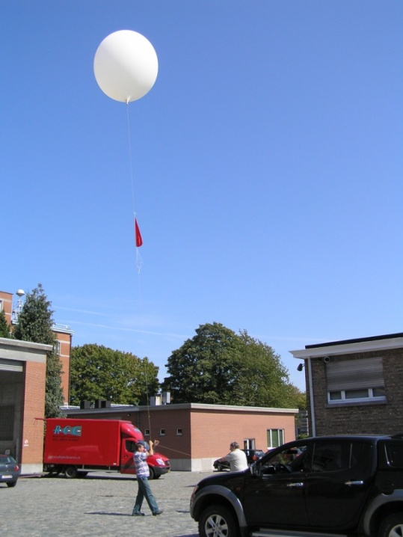
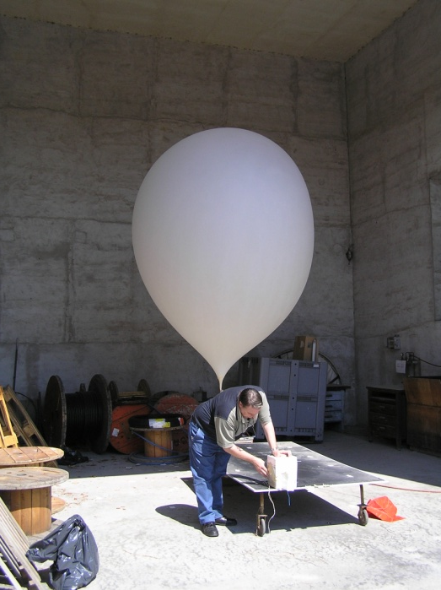
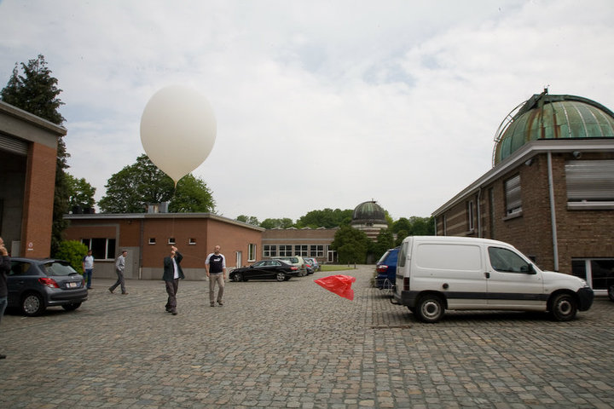
Motivation & introduction
Measuring O₃ @ Uccle
Total O₃ trends @ Uccle
Ozonesondes
Conclusions & outlook
Motivation
Most of you are familiar with …
… but why balloon soundings? Which research is done with those measurements? What is the relevance of the Uccle series?
RMI conference 25/11/2015

Slide 4

Motivation & introduction
Measuring O₃ @ Uccle
Total O₃ trends @ Uccle
Ozonesondes
Conclusions & outlook
Ozone (O₃)
In 1840 Christian Friedrich Schoenbein at the University of Basel had discovered the presence of a specific odor while performing the electrolyse of water. He called this property “ozon” (in German) from the Greek word “ozein” for smell.
The presence of ozone in the atmosphere was reported in 1858 by Auguste Houzeau in Rouen, France.
In the 1920’s the British scientist, Gordon.M.B. Dobson (Oxford University) developed a spectrograph and later a spectrophotometer that for many years remained the only accurate method to measure the ozone column abundance.
Erich Regener and his son Victor who measured the solar ultraviolet absorption from a stratospheric balloon in 1934, showed that the ozone maximum is located near 25 km.
From Brasseur G., RMI Centenary Conference, 26 Sept 2013
RMI conference 25/11/2015

Slide 5
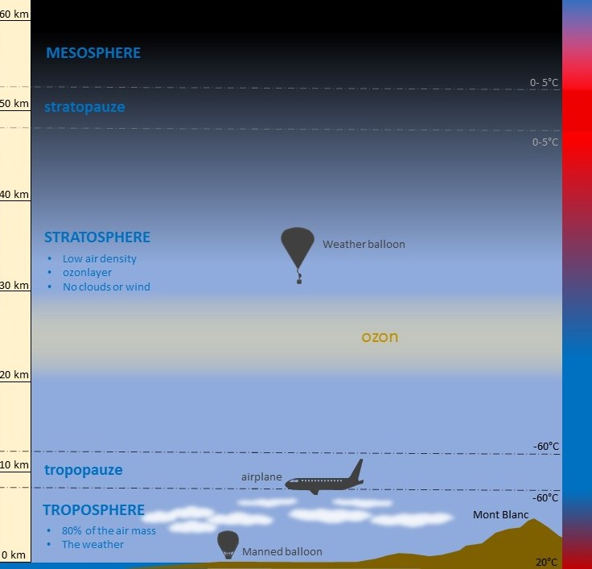
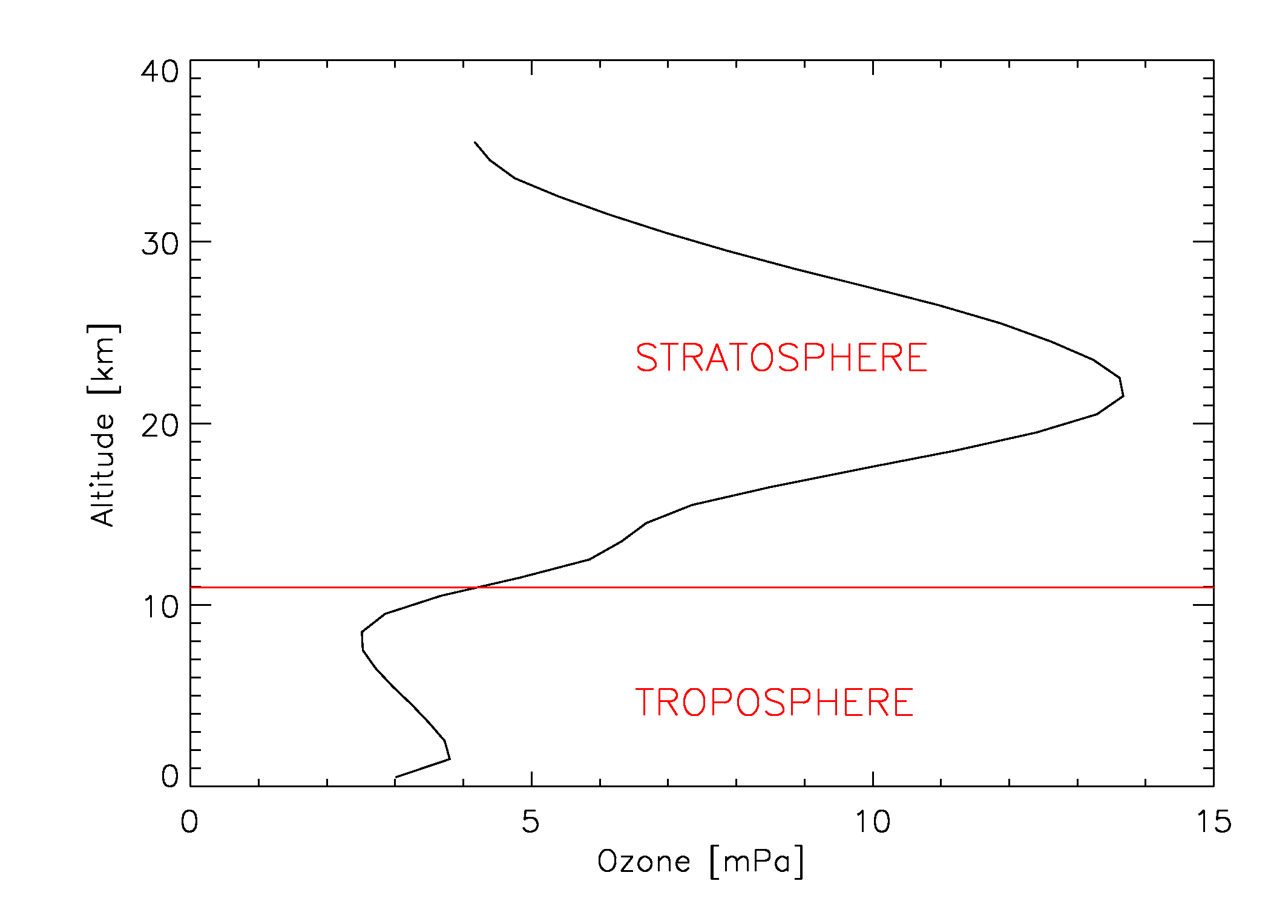
Motivation & introduction
Measuring O₃ @ Uccle
Total O₃ trends @ Uccle
Ozonesondes
Conclusions & outlook
Ozone in the atmosphere
Average ozone profile at Uccle
ozone
ozone layer
STRATOSPHERE
‘good’ ozone
ozone = greenhouse gas
TROPOSPHERE
‘smog’, ‘bad’ ozone
Courtesy of Pieter Mestdagh, ESA-ESERO
RMI conference 25/11/2015

Slide 6
Motivation & introduction
Measuring O₃ @ Uccle
Total O₃ trends @ Uccle
Ozonesondes
Conclusions & outlook
Ozone in the atmosphere
Average ozone profile at Uccle
90 % of atmospheric ozone
formed by a balance between sunlight that creates ozone and chemical reactions that destroy it
beneficial role: acts as primary UV radiation shield
ozone layer
STRATOSPHERE
‘good’ ozone
10 % of atmospheric ozone
forms when nitrogen oxide gases from vehicle and industrial emissions react with volatile organic compounds (VOCs)
harmful impact: toxic effects on humans, animals and vegetation
ozone = greenhouse gas
TROPOSPHERE
‘smog’, ‘bad’ ozone
RMI conference 25/11/2015

Slide 7




Motivation & introduction
Measuring O₃ @ Uccle
Total O₃ trends @ Uccle
Ozonesondes
Conclusions & outlook
Effect of ozone on Earth
O₃ concentrations ↘ in stratosphere
UV radiation ↗
increase of eye diseases (cataract)
more skin cancers
smaller crop yields
less food (food shortage)
HUMAN BODY
AGRICULTURE
plankton damage
CO₂ ↗
biodiversity disappearance
some materials (e.g. rubber) will break down faster
faster and more replacement purchases
OCEANS
ECONOMY
RMI conference 25/11/2015

Slide 8
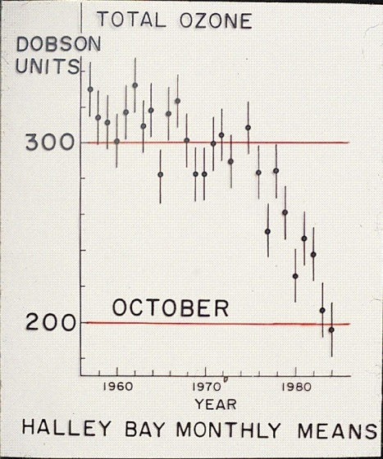

Motivation & introduction
Measuring O₃ @ Uccle
Total O₃ trends @ Uccle
Ozonesondes
Conclusions & outlook
Ozone destruction
In the stratosphere, ozone is destroyed when it reacts with molecules containing nitrogen, hydrogen, chlorine or bromine
increased levels of human-produced gases such as CFCs (chlorofluorocarbons) and halons have led to increased rates of ozone destruction
In 1985, Joseph Farman and colleagues noted a drastic depletion of the ozone layer over the Antarctic, the "ozone hole"
Paul Crutzen, Mario Molina and Sherwood Rowland were awarded the Nobel Price in Chemistry in 1995 for their contributions explaining how ozone is formed and decomposes through chemical processes in the atmosphere
RMI conference 25/11/2015

Slide 9
Motivation & introduction
Measuring O₃ @ Uccle
Total O₃ trends @ Uccle
Ozonesondes
Conclusions & outlook
Ozone destruction
1997 peak value
EESC
= equivalent effective = stratospheric chlorine
= a relative measure of the = potential for stratospheric = ozone depletion that = combines the contributions of = chlorine and bromine from = surface observations from = Ozone Depleting Substances (ODS)
Montreal Protocol (1989)
the Montréal Protocol (signed in 1987) regulated the global production and consumption of ODS.
due to the long lifetimes of some CFCs and halons (50-100 years) in the stratosphere, the decline is rather slow.
RMI conference 25/11/2015

Slide 10
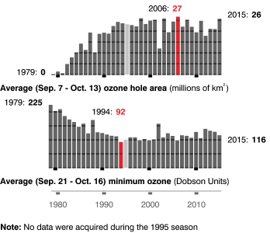
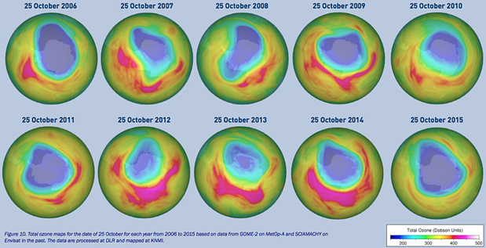
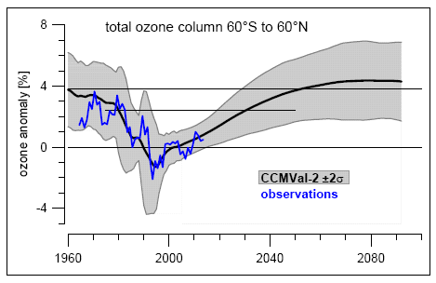
Motivation & introduction
Measuring O₃ @ Uccle
Total O₃ trends @ Uccle
Ozonesondes
Conclusions & outlook
Ozone Recovery?
Antarctica
onset of ozone recovery?
full recovery not earlier than 2050
surface warming/ozone loss → stratospheric cooling → slow down/speed up O₃ recovery
climate change also affects circulations (e.g. Brewer-Dobson), which affects ozone recovery
Globally
From WMO Scientific Assessment of Ozone Depletion, 2014

Slide 11
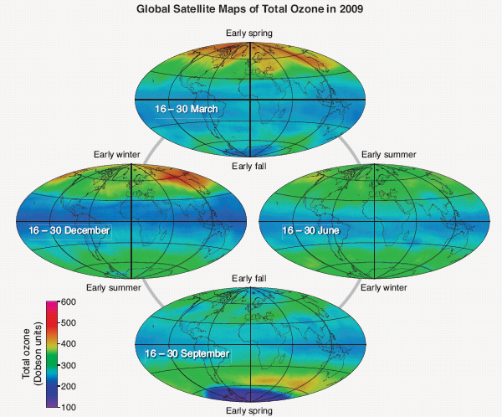
Motivation & introduction
Measuring O₃ @ Uccle
Total O₃ trends @ Uccle
Ozonesondes
Conclusions & outlook
Global distribution of total ozone
total ozone is generally lowest at the equator and highest in polar regions
ozone production is highest in the tropics (high solar UV), but this ozone is transported towards the poles by large-scale stratospheric circulation of air.
this transport of ozone is strongest during late fall and winter and in NH.
ozone hole in the Antarctic in September-October (low temperatures for PSC formation + UV)
RMI conference 25/11/2015

Slide 12
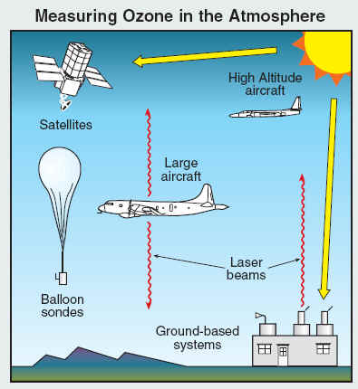

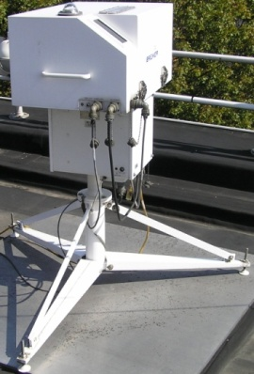
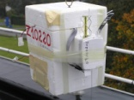
Motivation & introduction
Measuring O₃ @ Uccle
Total O₃ trends @ Uccle
Ozonesondes
Conclusions & outlook
Measuring ozone
from ground-based instruments, from satellites, on board aircraft, from high-altitude balloons
optical techniques (with Sun and lasers as light sources) or using chemical reactions that are unique to ozone
At RMI:
  total O₃ column measurements with Dobson or Brewer spectrophotometers in the UV (280-360 nm) since 1971
  vertical ozone profiles with ozonesondes since 1969
RMI conference 25/11/2015

Slide 13
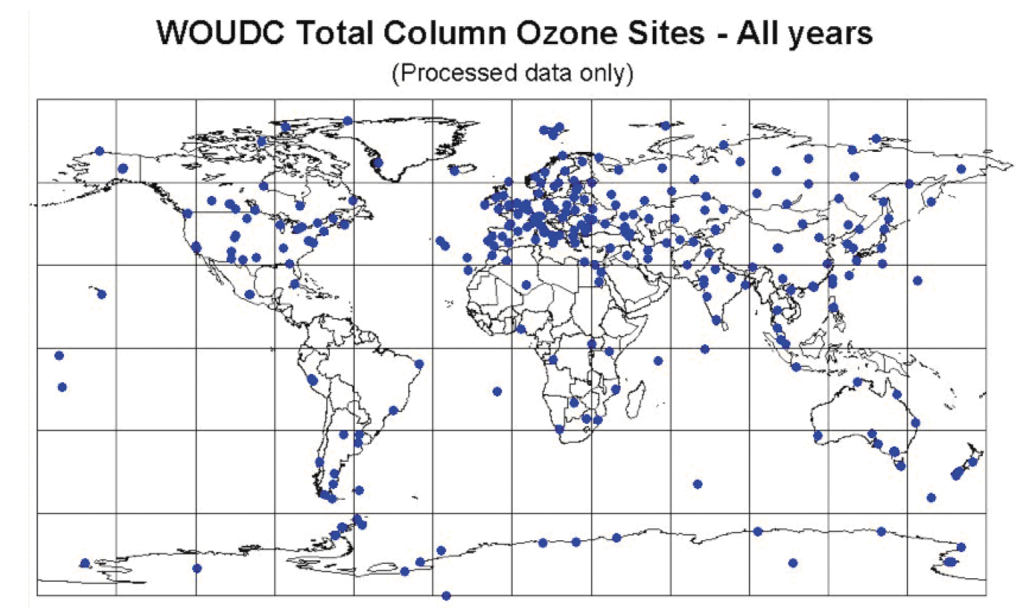
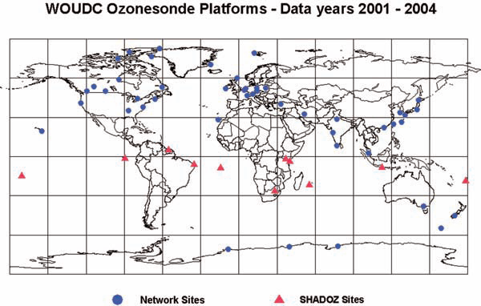
Motivation & introduction
Measuring O₃ @ Uccle
Total O₃ trends @ Uccle
Ozonesondes
Conclusions & outlook
Uccle in the world
Total ozone column measurements
about 100 sites worldwide
longest time series: Arosa (1926)
many new stations between 1957-1962 (Canada, Antarctica, US, Hawai) due to the IPY and IGY
Uccle, Dobson #40 operational since 1971, Brewer #16/#178 since 1984/2001.
Brewer #100 at PE in Antarctica since Dec 2010
Ozonesonde observations
around 60 sites worldwide
earliest launches around 1965 in Boulder and Resolute
“the big three”: Hohenpeissenberg (1967), Uccle (1969), Payerne (1970)
e.g. De Bilt, only since Nov. 1992
RMI conference 25/11/2015

Slide 14
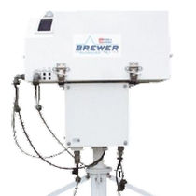
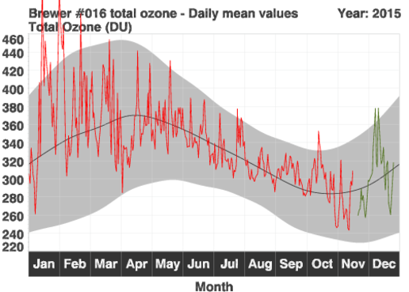
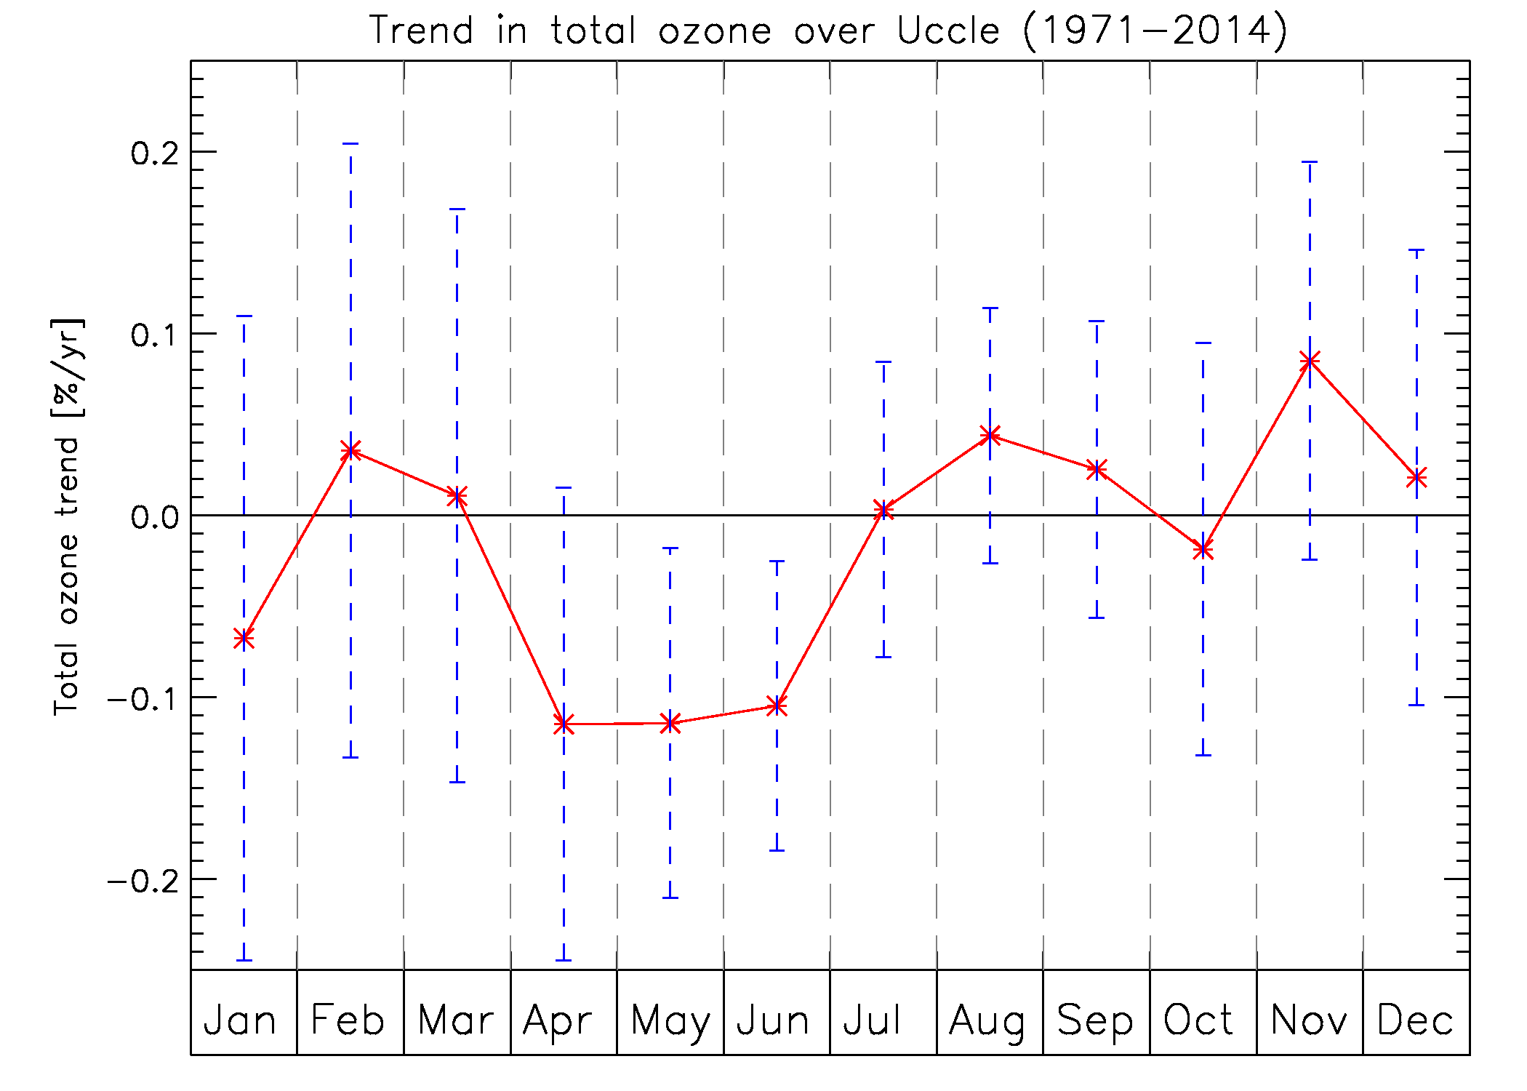
Motivation & introduction
Measuring O₃ @ Uccle
Total O₃ trends at Uccle
Ozonesondes
Conclusions & outlook
Total ozone seasonal variation
in general, highest values in spring, lowest values in fall
Total ozone monthly trends
only in late spring-early summer (Apr-June): significant negative trends in total ozone at Uccle
RMI conference 25/11/2015

Slide 15
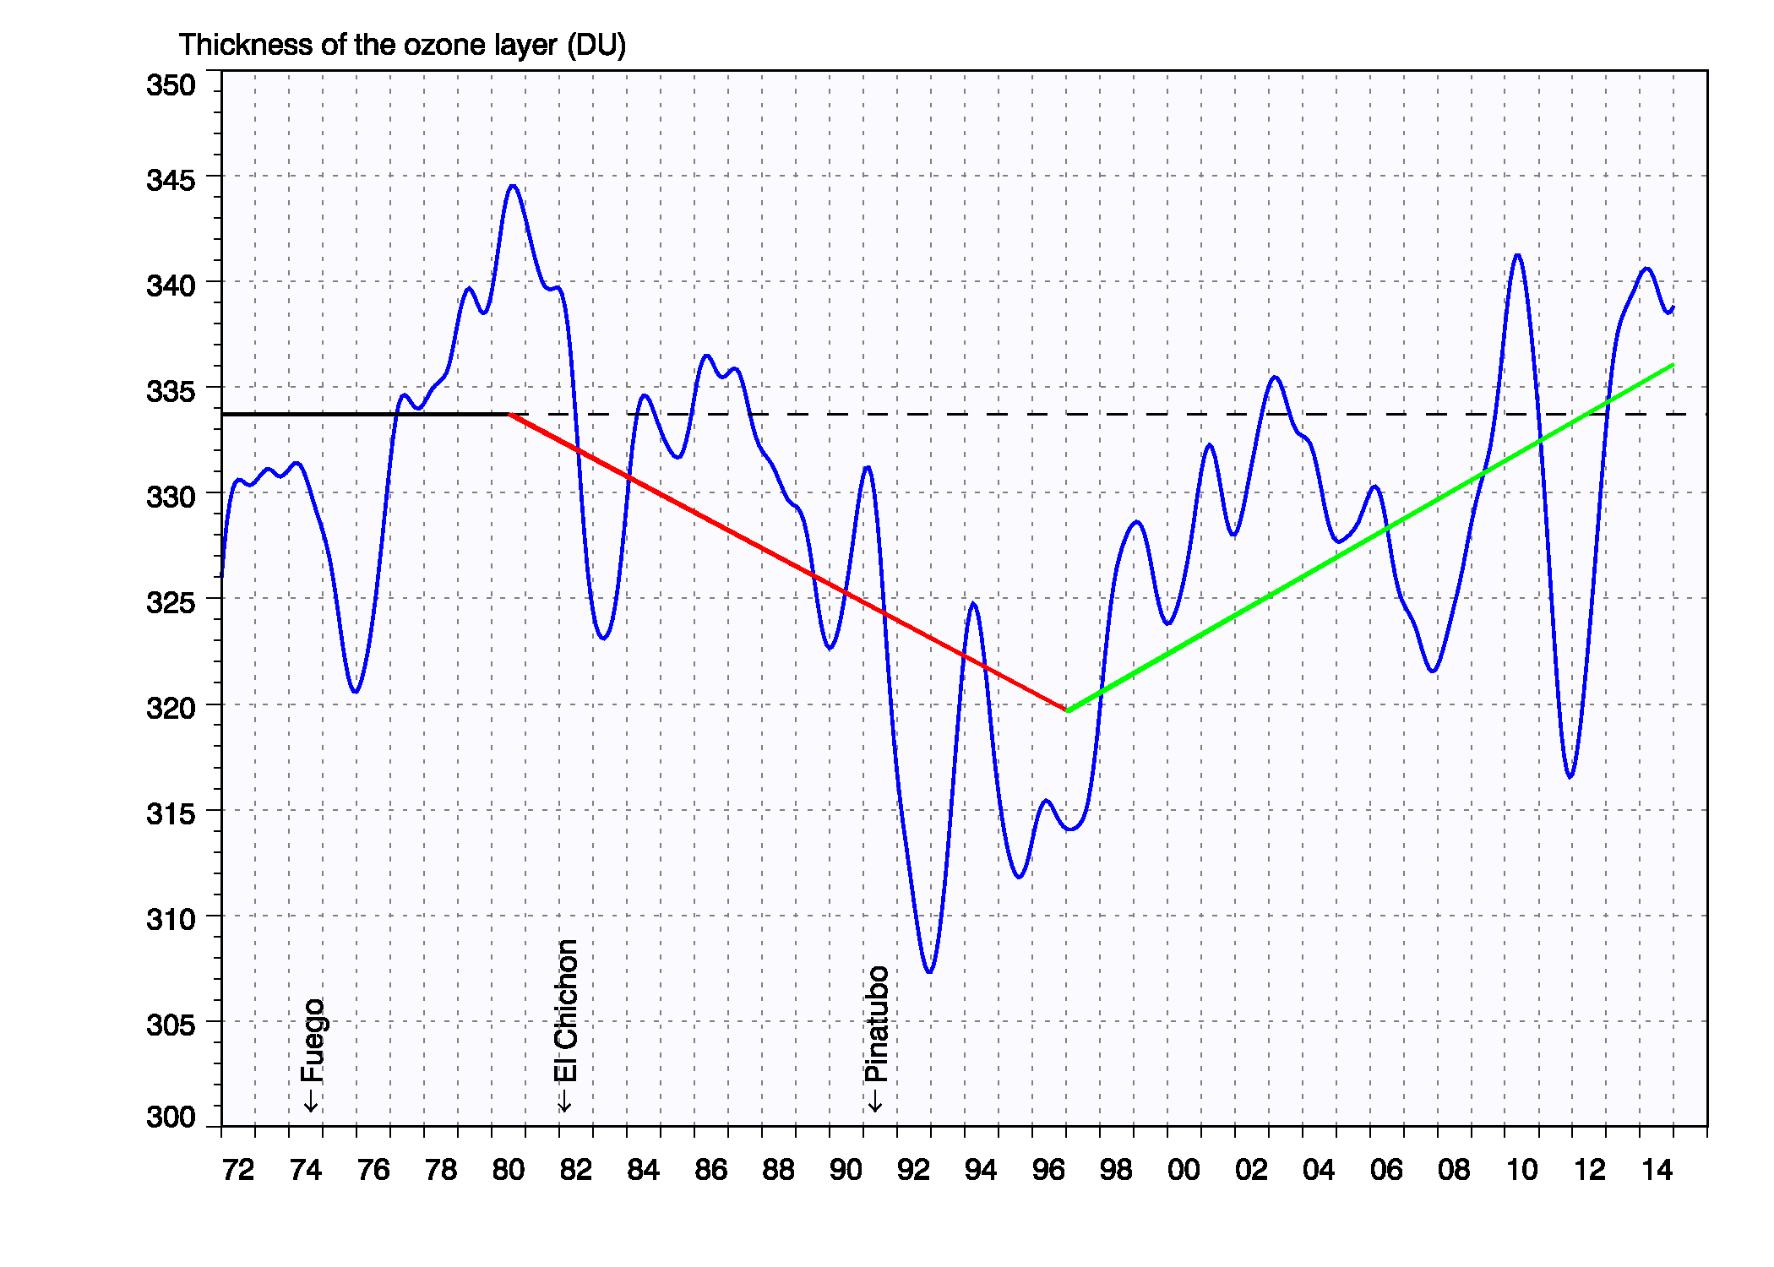
Motivation & introduction
Measuring O₃ @ Uccle
Total O₃ trends at Uccle
Ozonesondes
Conclusions & outlook
Total ozone trend at Uccle
O₃ ↘ -0.26±0.05 %/yr (1980-1996)
O₃ ↗ +0.28±0.05 %/yr (1997-2014)
full recovery at Uccle?
impact of volcanic eruptions on ozone!
other processes responsible for the O₃ time variability?
RMI conference 25/11/2015

Slide 16
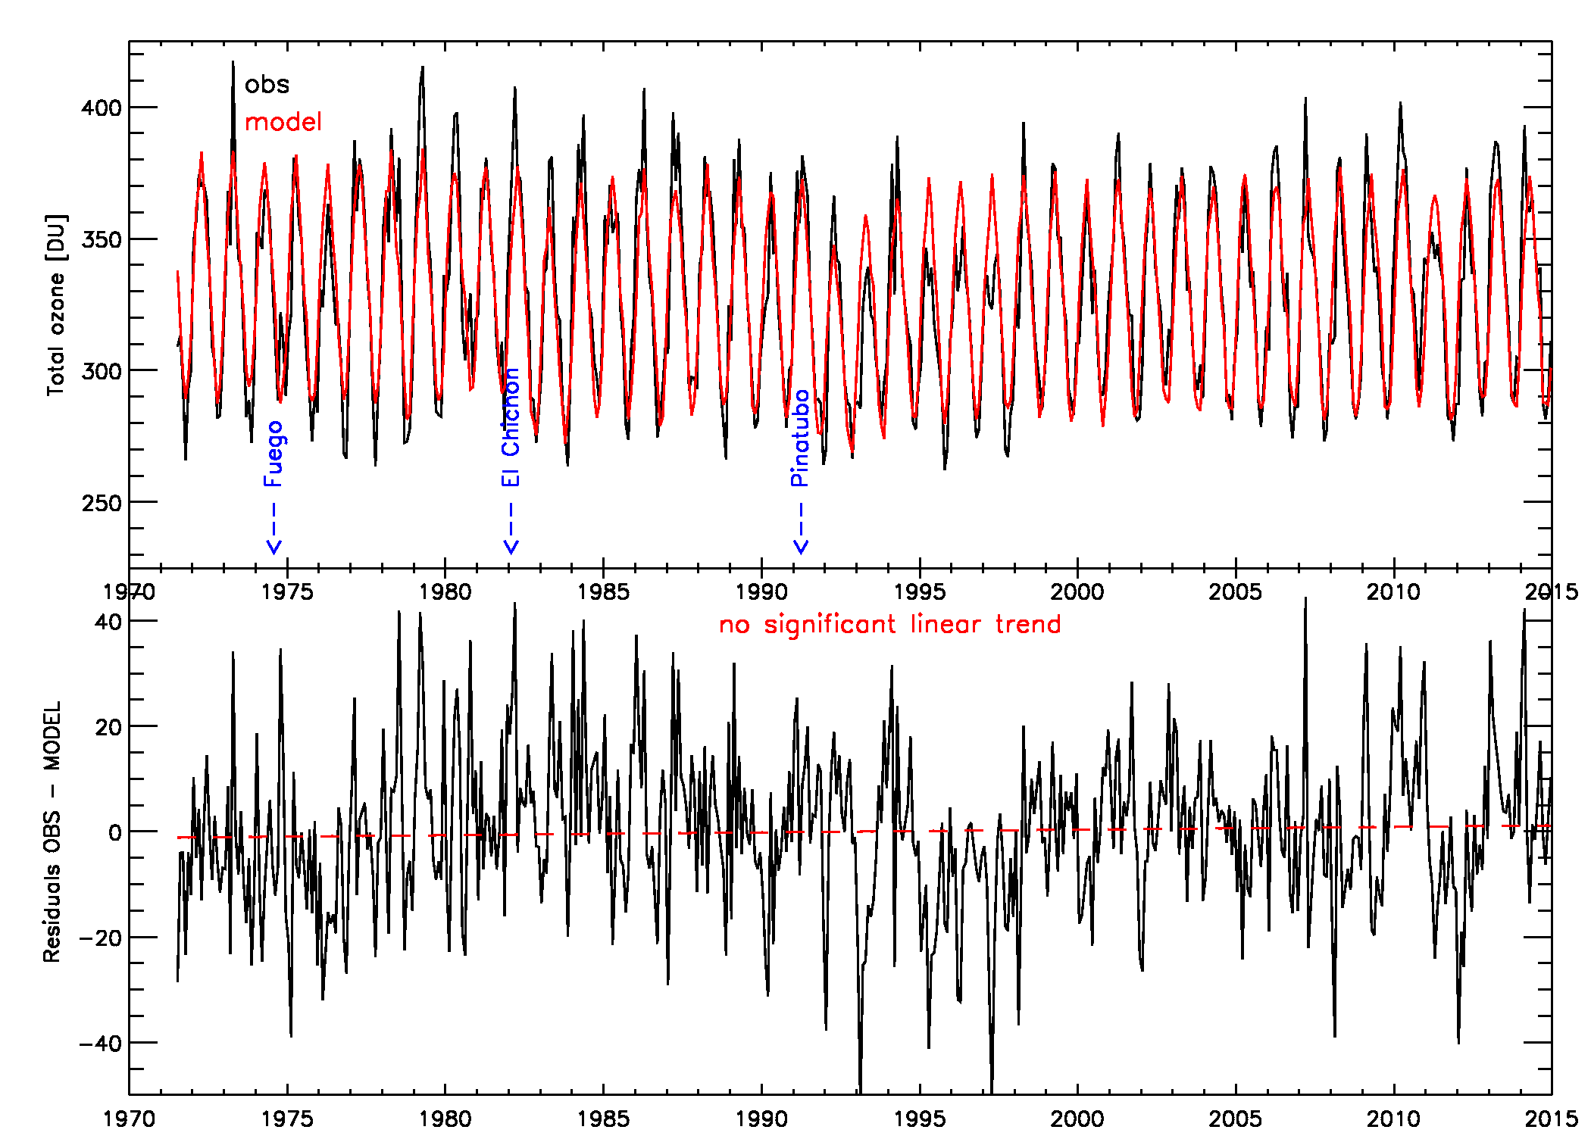
Motivation & introduction
Measuring O₃ @ Uccle
Total O₃ trends at Uccle
Ozonesondes
Conclusions & outlook
Multiple stepwise linear regression with proxies:
means/harmonic, linear, piecewise linear, EESC, solar flux, NAO, ENSO, QBO, aerosols
mean, NAO, aerosols, EESC
R² = 0.895, 80.2% variability explained
long-term trend can be explained by EESC variation alone

Slide 17
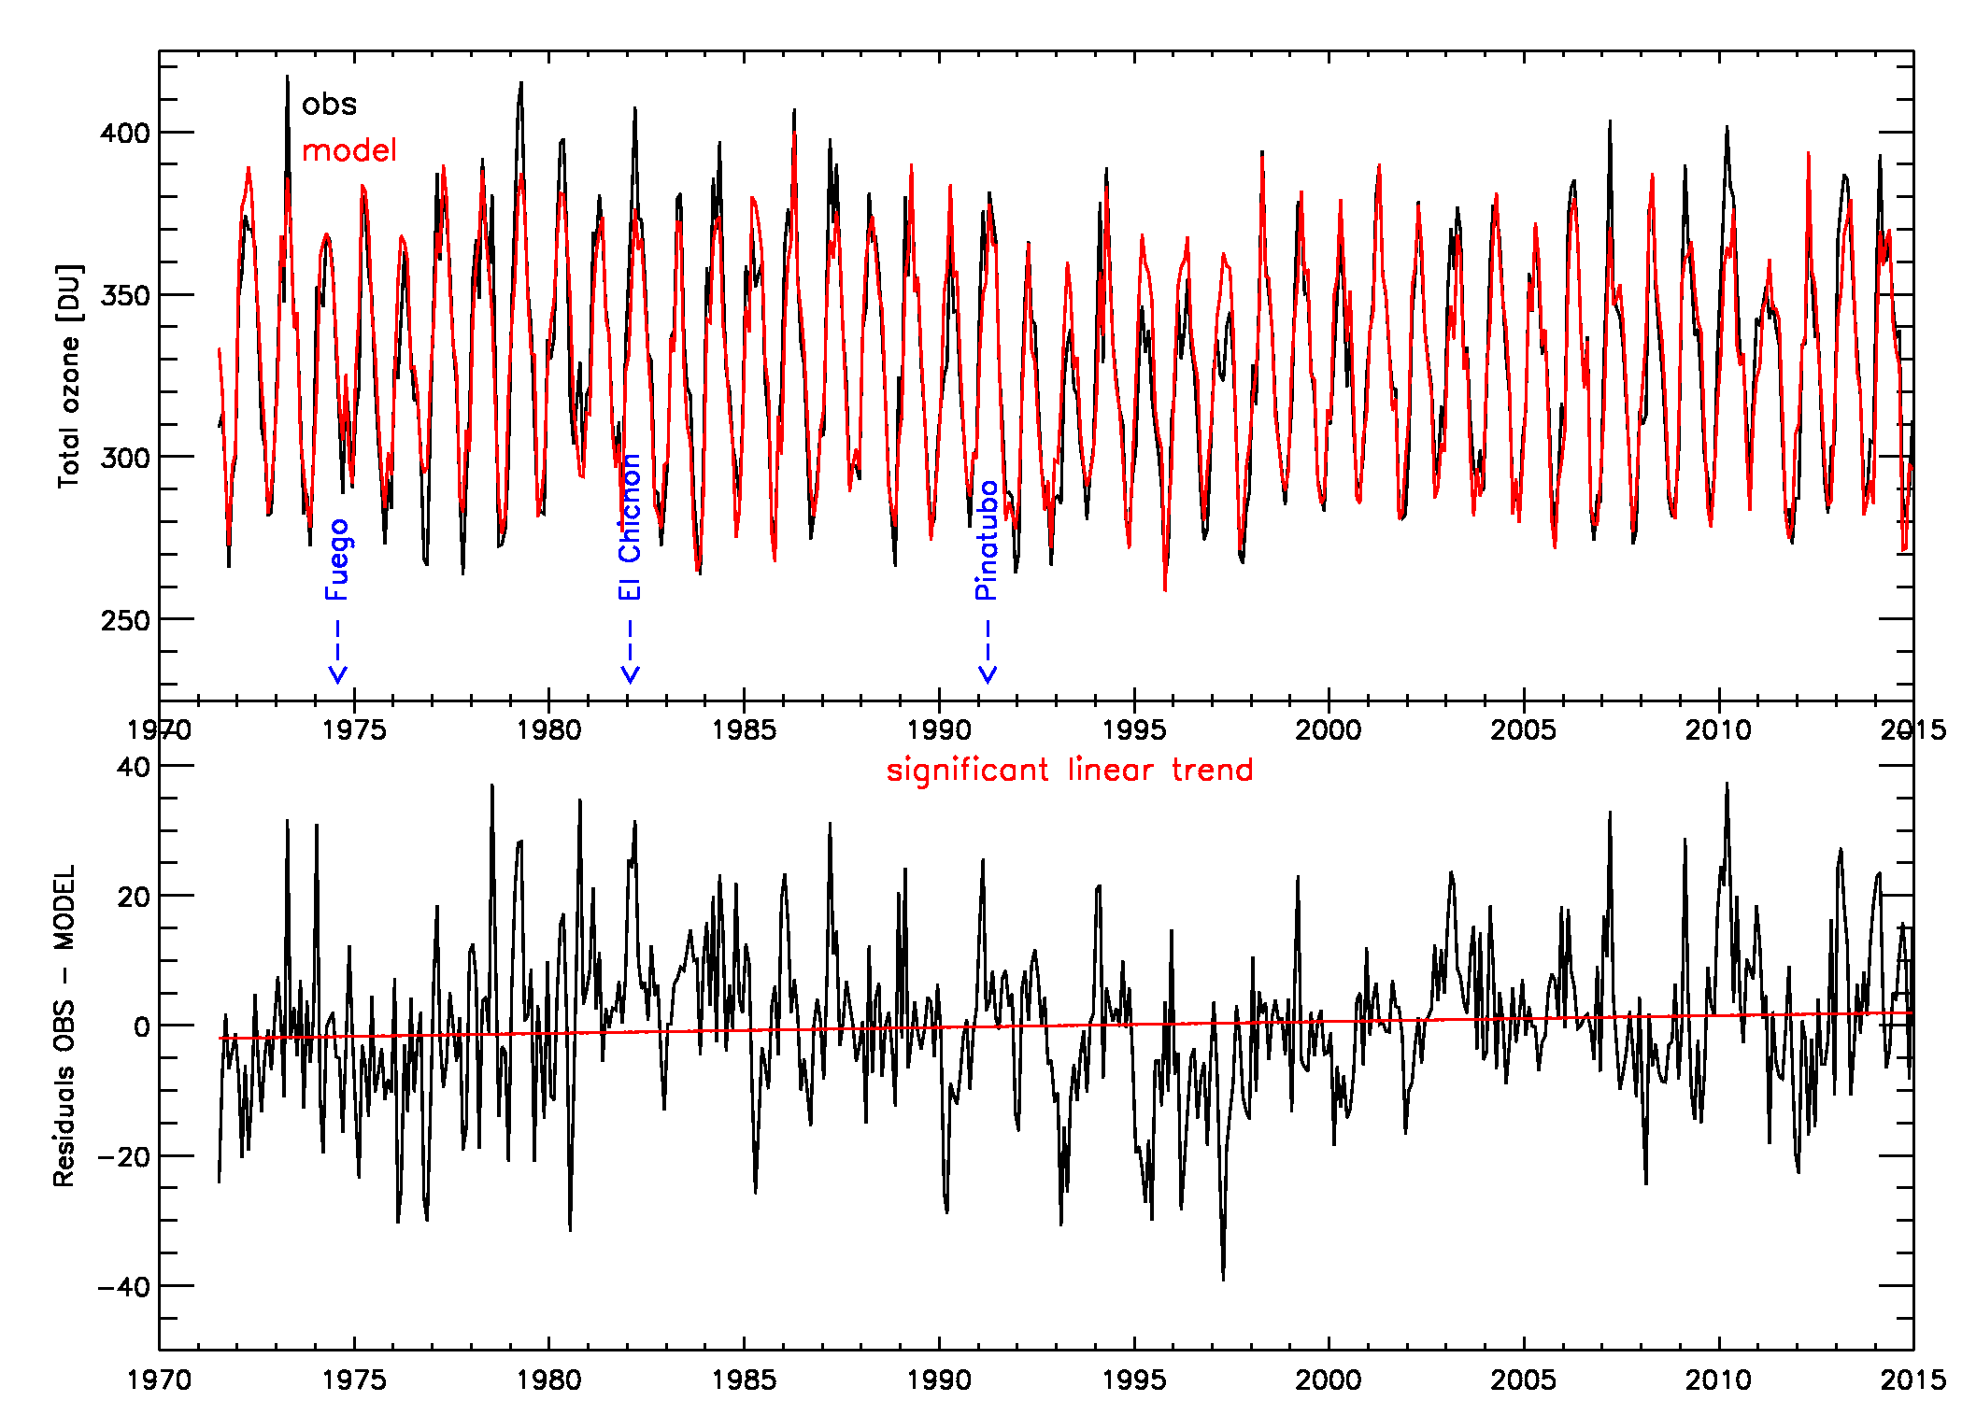
Motivation & introduction
Measuring O₃ @ Uccle
Total O₃ trends at Uccle
Ozonesondes
Conclusions & outlook
Multiple stepwise linear regression with proxies:
means/harmonic, linear, piecewise linear, EESC, solar flux, NAO, ENSO, QBO, aerosols, tropopause pressure, T @ 100hPa
mean, tropopause p, T100, aerosols, EESC
R² = 0.940, 88.0% variability explained
remaining significant linear trend in the residuals

Slide 18
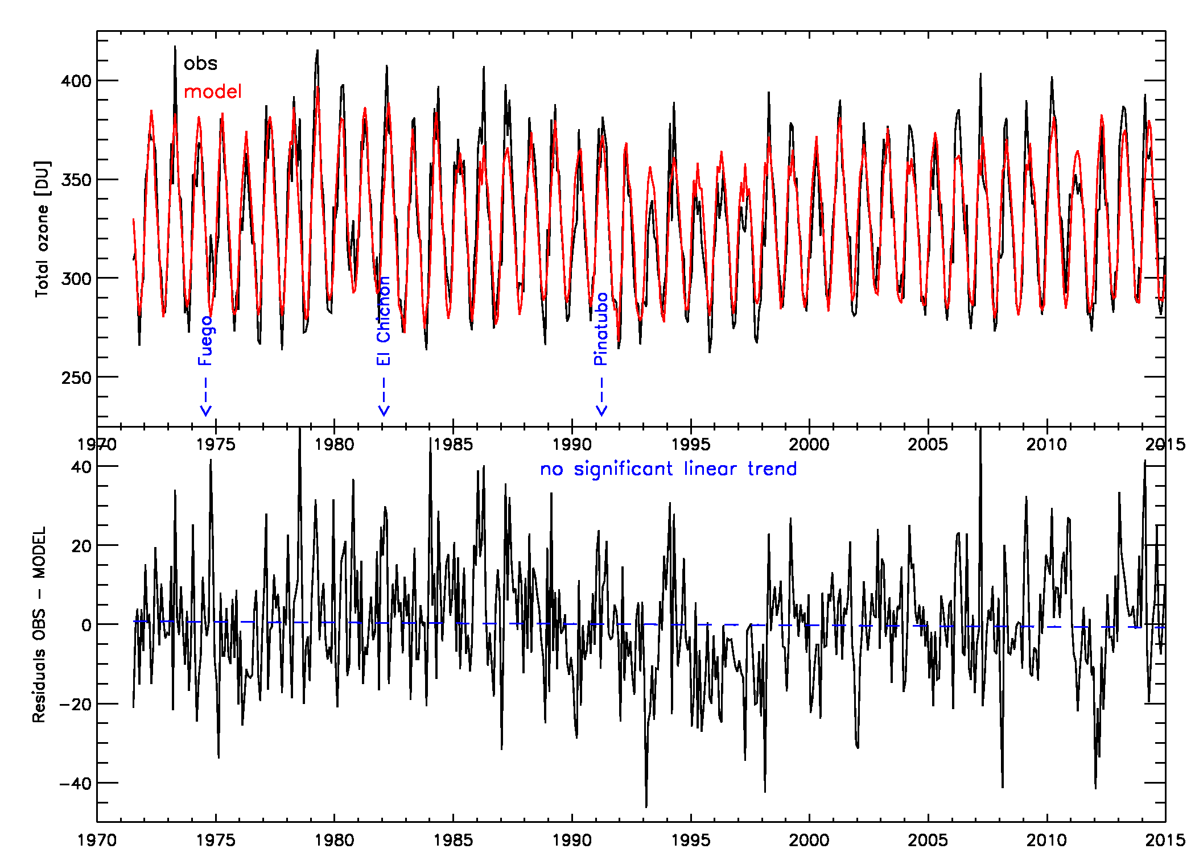
Motivation & introduction
Measuring O₃ @ Uccle
Total O₃ trends at Uccle
Ozonesondes
Conclusions & outlook
Multiple stepwise linear regression with proxies:
means/harmonic, linear, piecewise linear, EESC, solar flux, NAO, ENSO, QBO, aerosols … for each season separately
winter: mean, aerosol, NAO (58.7%)
spring: EESC, mean, solar flux, NAO, QBO, linear (30.6%)
summer: mean (58.1%)
fall: mean, NAO, aerosol, solar flux (16.1%)
R² = 0.903
summer and winter well explained by long-term mean
EESC only impact in spring

Slide 19
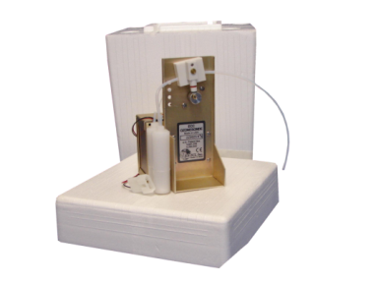
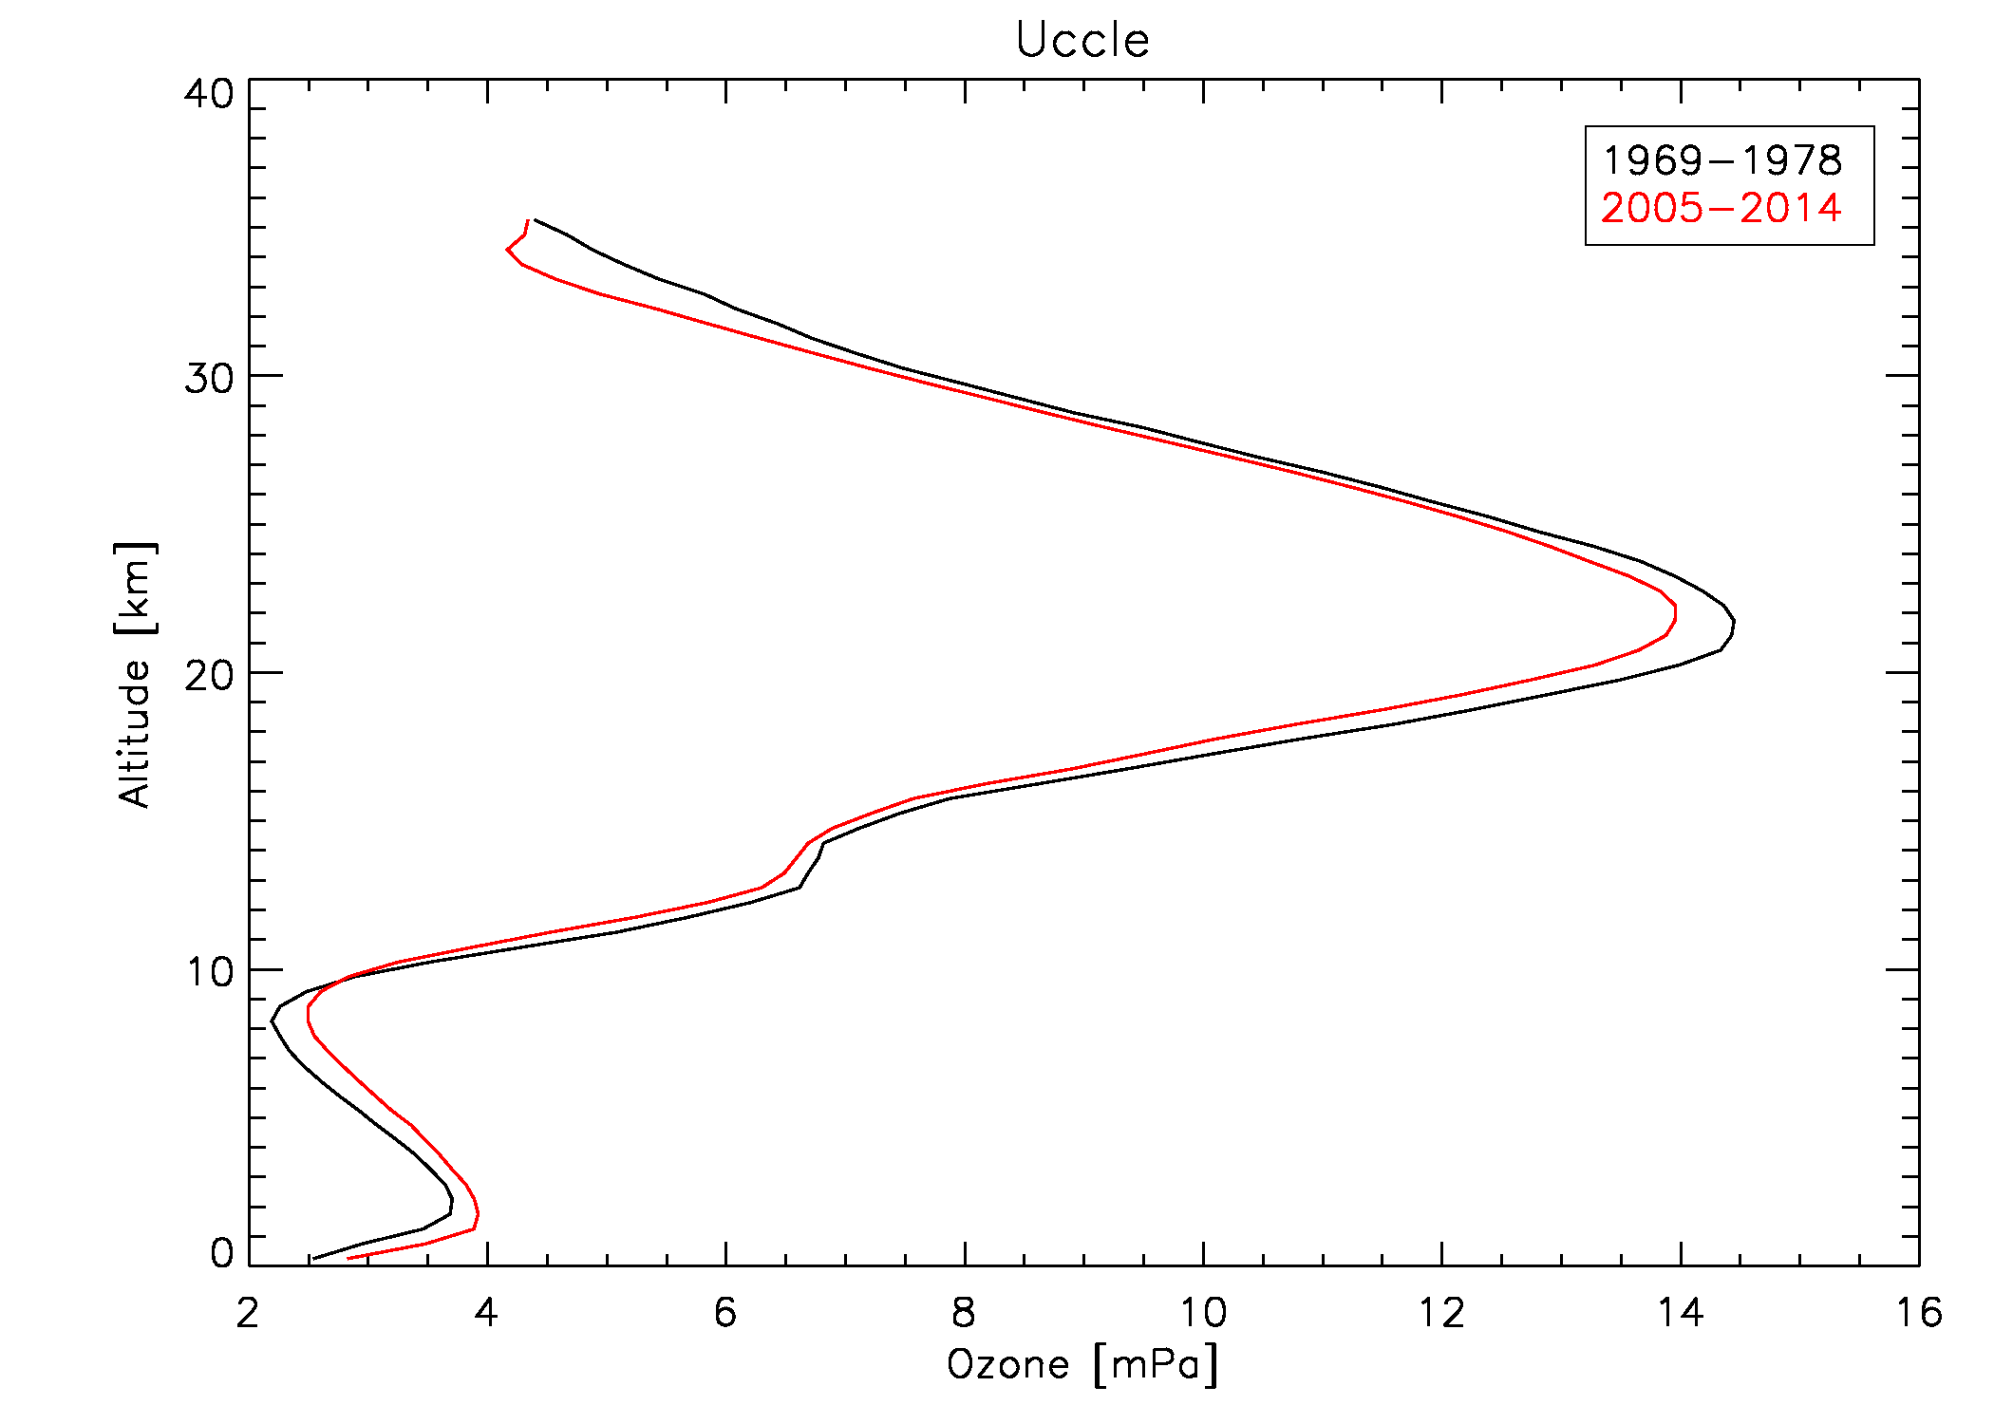
Motivation & introduction
Measuring O₃ @ Uccle
Total O₃ trends @ Uccle
Ozonesondes
Conclusions & outlook
Vertical ozone distribution at Uccle
➔ stratospheric O₃ ↘
➔ tropospheric O₃ ↗
RMI conference 25/11/2015

Slide 20
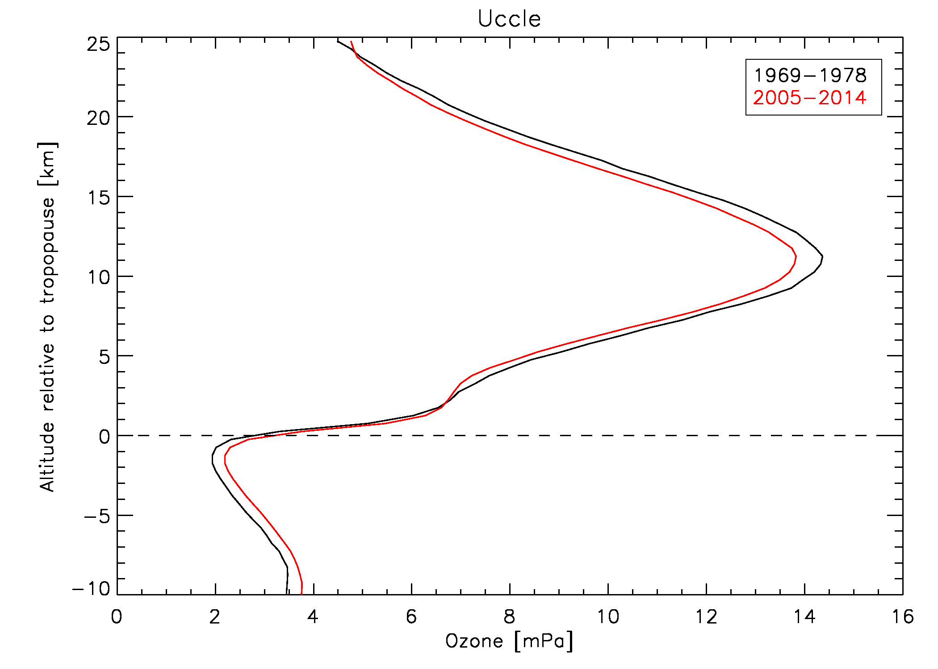
Motivation & introduction
Measuring O₃ @ Uccle
Total O₃ trends @ Uccle
Ozonesondes
Conclusions & outlook
Vertical ozone distribution at Uccle
➔ stratospheric O₃ ↘
➔ tropospheric O₃ ↗
BUT: different periods = different ozonesonde types!
= BM & ECC
RMI conference 25/11/2015

Slide 21
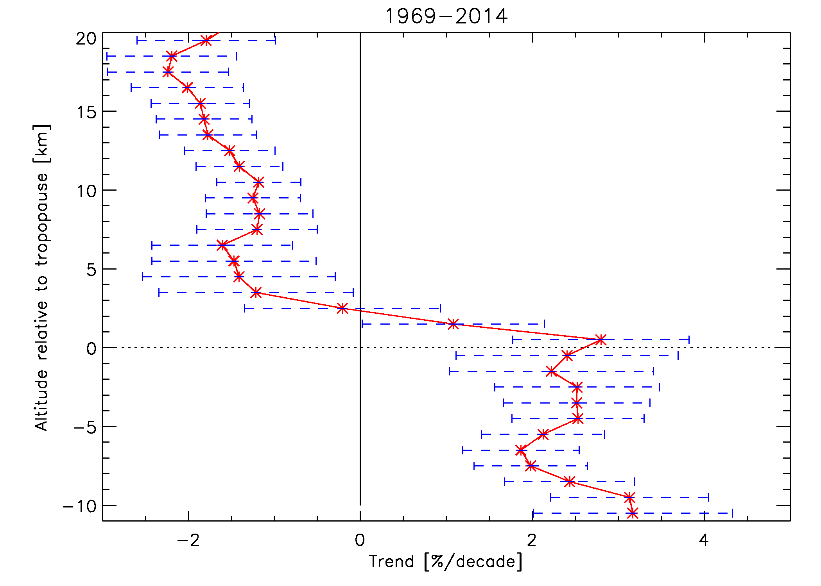
Motivation & introduction
Measuring O₃ @ Uccle
Total O₃ trends @ Uccle
Ozonesondes
Conclusions & outlook
Vertical ozone distribution at Uccle
➔ stratospheric O₃ ↘
at around -2%/decade
➔ tropospheric O₃ ↗
at around +2%/decade
Impact of the different ozonesonde types on the trends?
RMI conference 25/11/2015

Slide 22
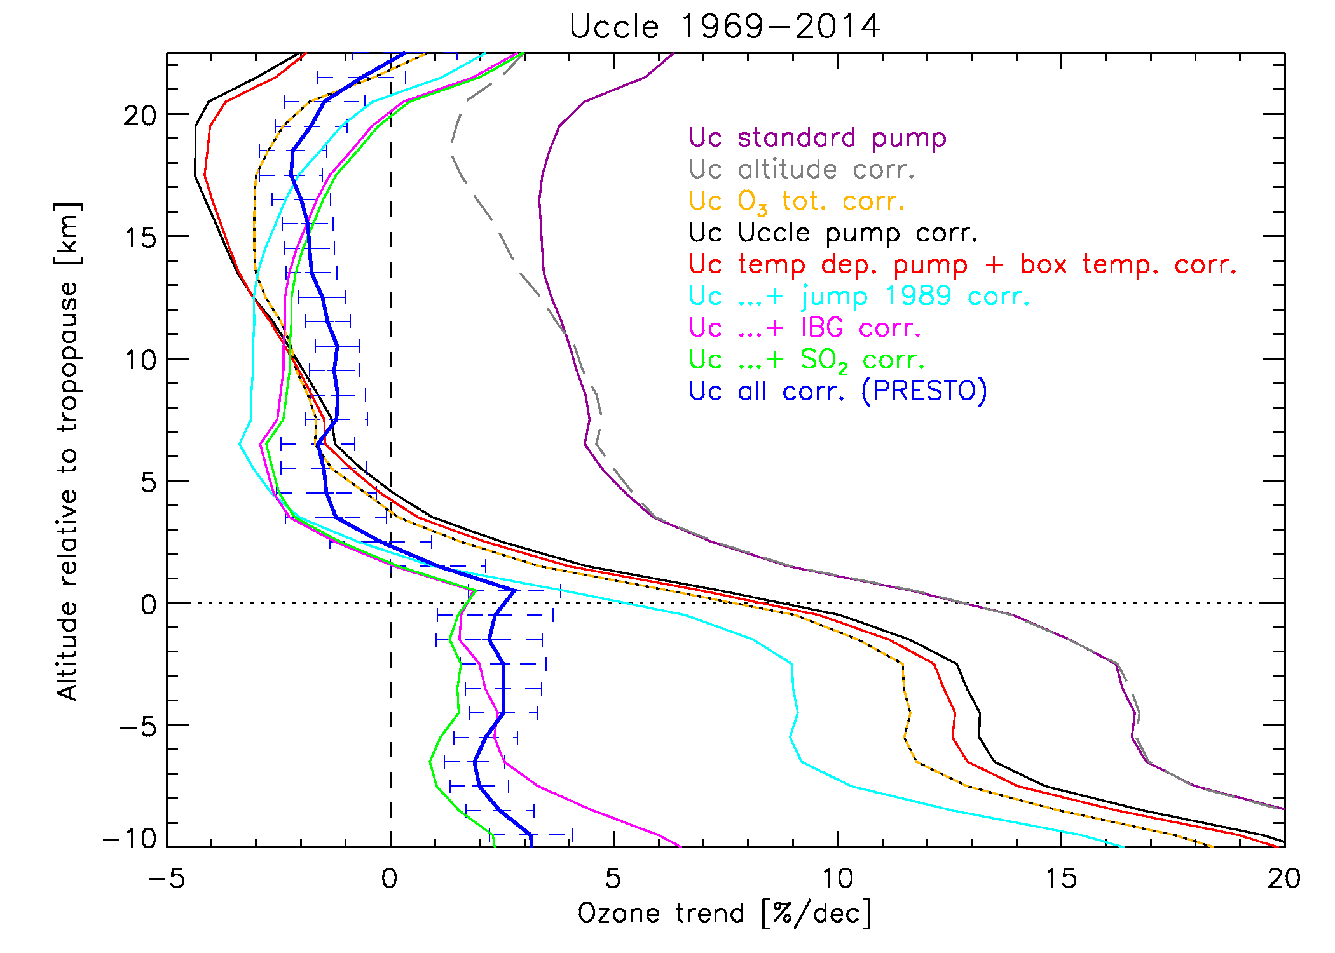
Motivation & introduction
Measuring O₃ @ Uccle
Total O₃ trends @ Uccle
Ozonesondes
Conclusions & outlook
Vertical ozone distribution at Uccle
different colours
=
different corrections applied to the data
Impact of the different post-processing corrections on the trends?
RMI conference 25/11/2015

Slide 23

Motivation & introduction
Measuring O₃ @ Uccle
Total O₃ trends @ Uccle
Ozonesondes
Conclusions & outlook
The pitfalls of ozonesonde time series:
different ozonesonde types (BM, ECC)
different ECC ozonesonde type manufacturers (ENSCI/DMT, Science Pump)
differences between ozonesonde production batches
different operating procedures (e.g. measurement of background current, sensing solution/buffer strengths)
different post-processing correction algorithms (e.g. normalizing the profile to the total ozone measurements at the same site)
These differences occur both between sites and at one site!
➔ need for homogenisation (Ozonesonde Data Quality Assessment (O3S-DQA))
RMI conference 25/11/2015

Slide 24
Motivation & introduction
Measuring O₃ @ Uccle
Total O₃ trends @ Uccle
Ozonesondes
Conclusions & outlook
The pitfalls of Uccle ozonesonde time series:
different ozonesonde types (BM, ECC)
different ozonesonde type manufacturers (ENSCI/DMT, Science Pump)
differences between ozonesonde production batches
different operating procedures (e.g. measurement of background current, sensing solution buffer strengths)
different post-processing correction algorithms (e.g. normalizing the profile to the total ozone measurements at the same site): PRESTO (Pressure and Temperature dependent total Ozone normalisation)
Uccle takes part in the O3S-DQA
RMI conference 25/11/2015

Slide 25
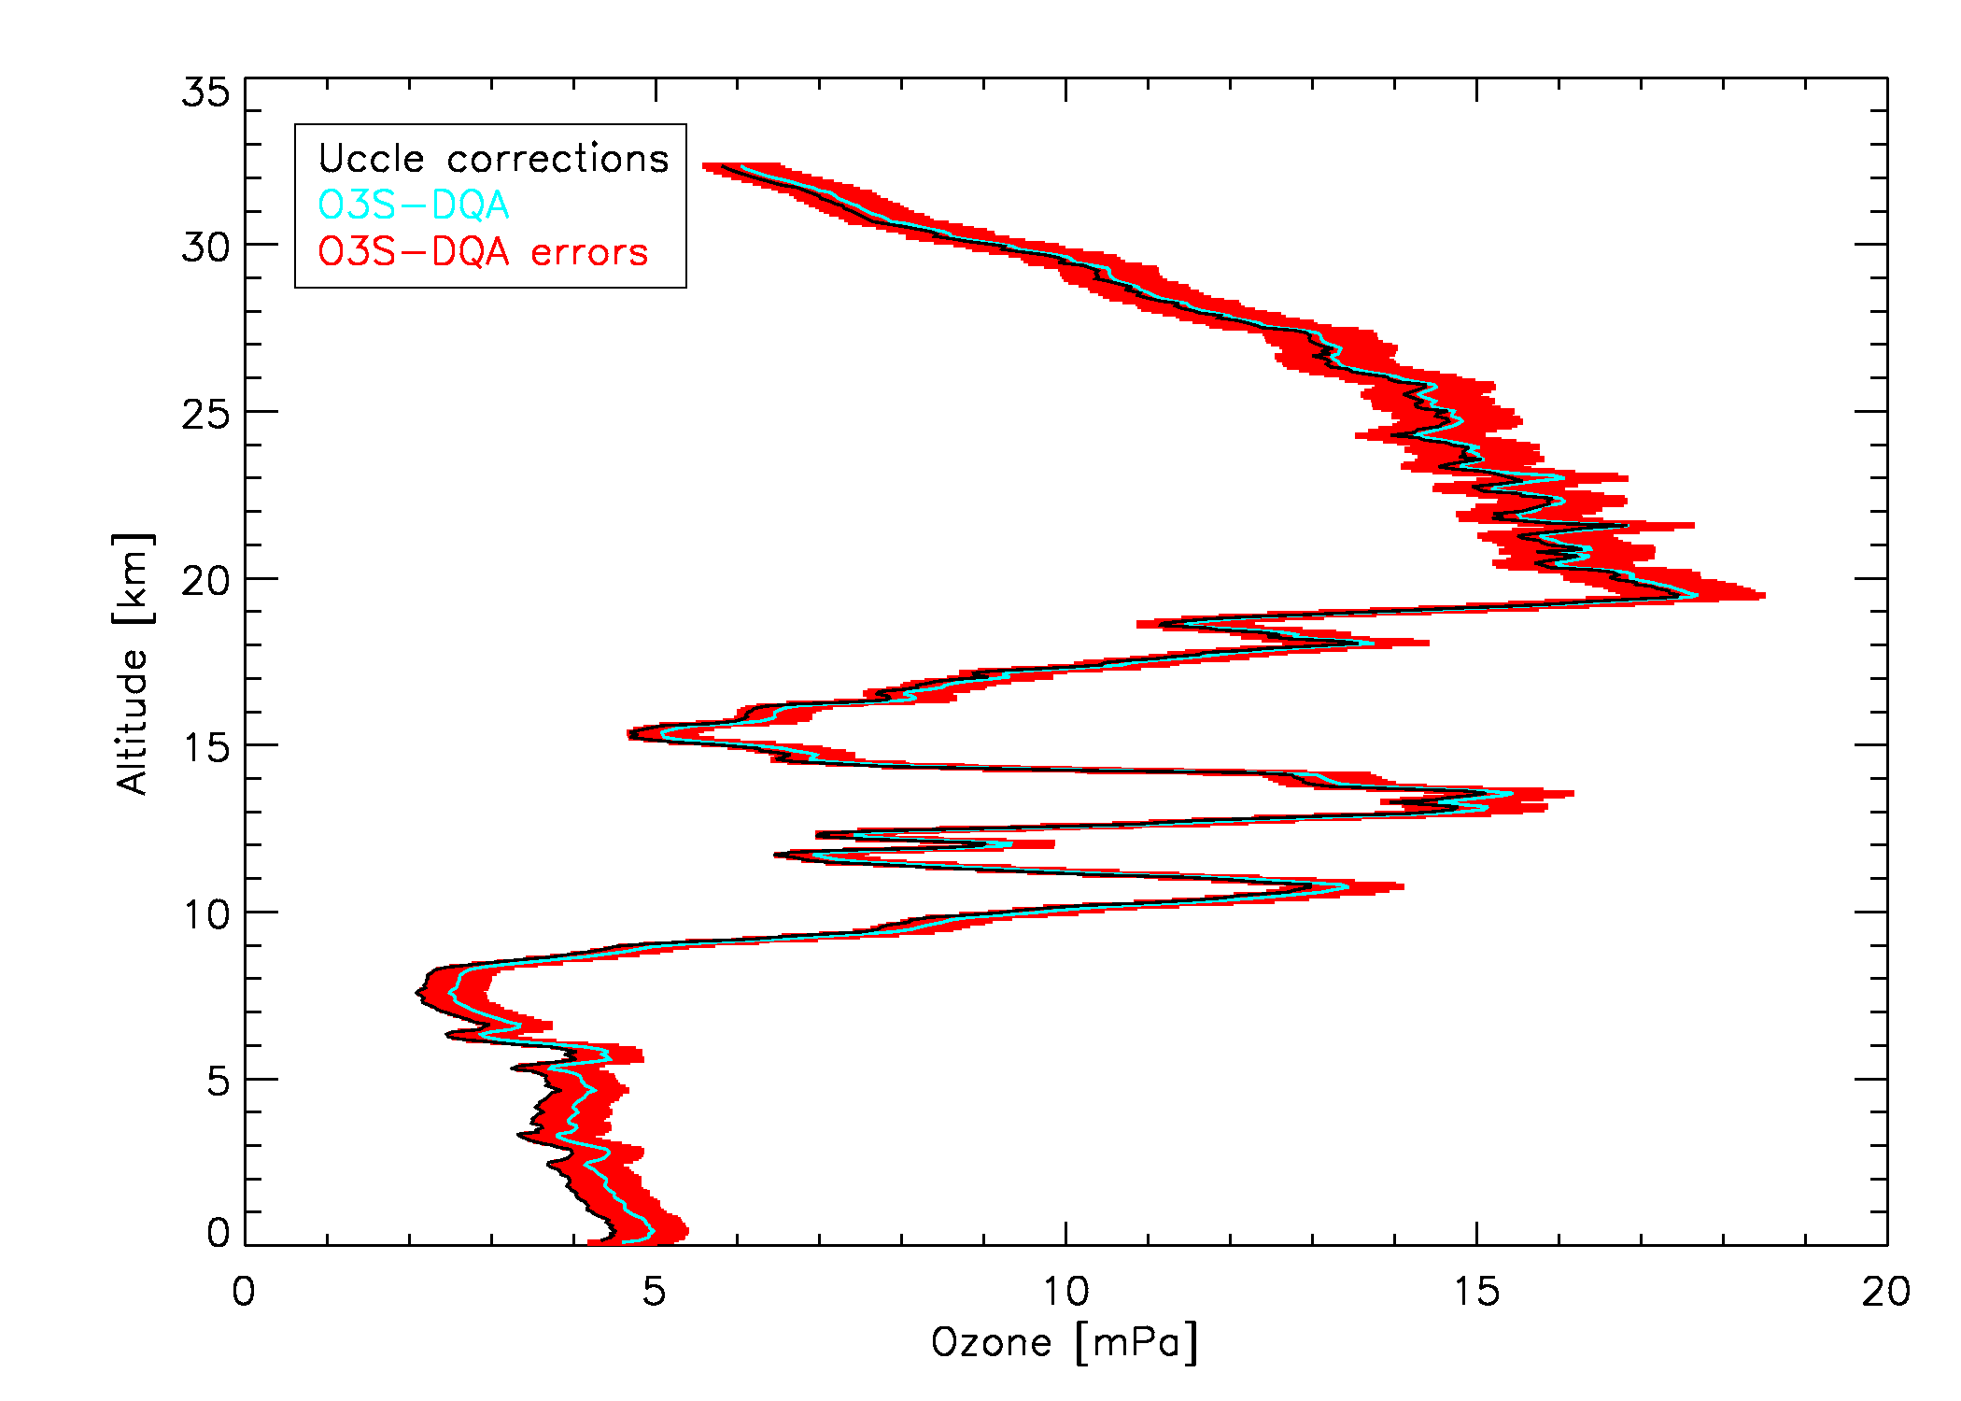
Motivation & introduction
Measuring O₃ @ Uccle
Total O₃ trends @ Uccle
Ozonesondes
Conclusions & outlook
O3S-DQA principles (only for ECC):
standard operating procedures
guidelines for metadata collection
two standards are set: ENSCI 0.5% SST & Science Pump 1% SST (ratio is 1.0 within 1%)
transfer functions to those standards, based on double soundings/simulation chamber experiments
standard correction algorithms
uncertainty estimate for every data point:
(revised) worldwide, homogenous,
consistent dataset to be used for
satellite validation and trend analysis
16/04/2012
RMI conference 25/11/2015

Slide 26

Motivation & introduction
Measuring O₃ @ Uccle
Total O₃ trends @ Uccle
Ozonesondes
Conclusions & outlook
Uccle and De Bilt
only about 175 km from each other
  horizontal ozone correlation lengths: 500 km (tropo), 1500 km (strato)
  timescales of ozone autocorrelation: 1.5-3.5 days (tropo),2-6 days (strato)
each station represent one ECC standard
differences in operating procedures (e.g. background current measurement)
both stations apply operationally different correction strategies
unique testbed for the O3S-DQA corrections
impact of operating procedures and corrections on the (average) profile
impact of operating procedures and corrections on the trends!
RMI conference 25/11/2015

Slide 27
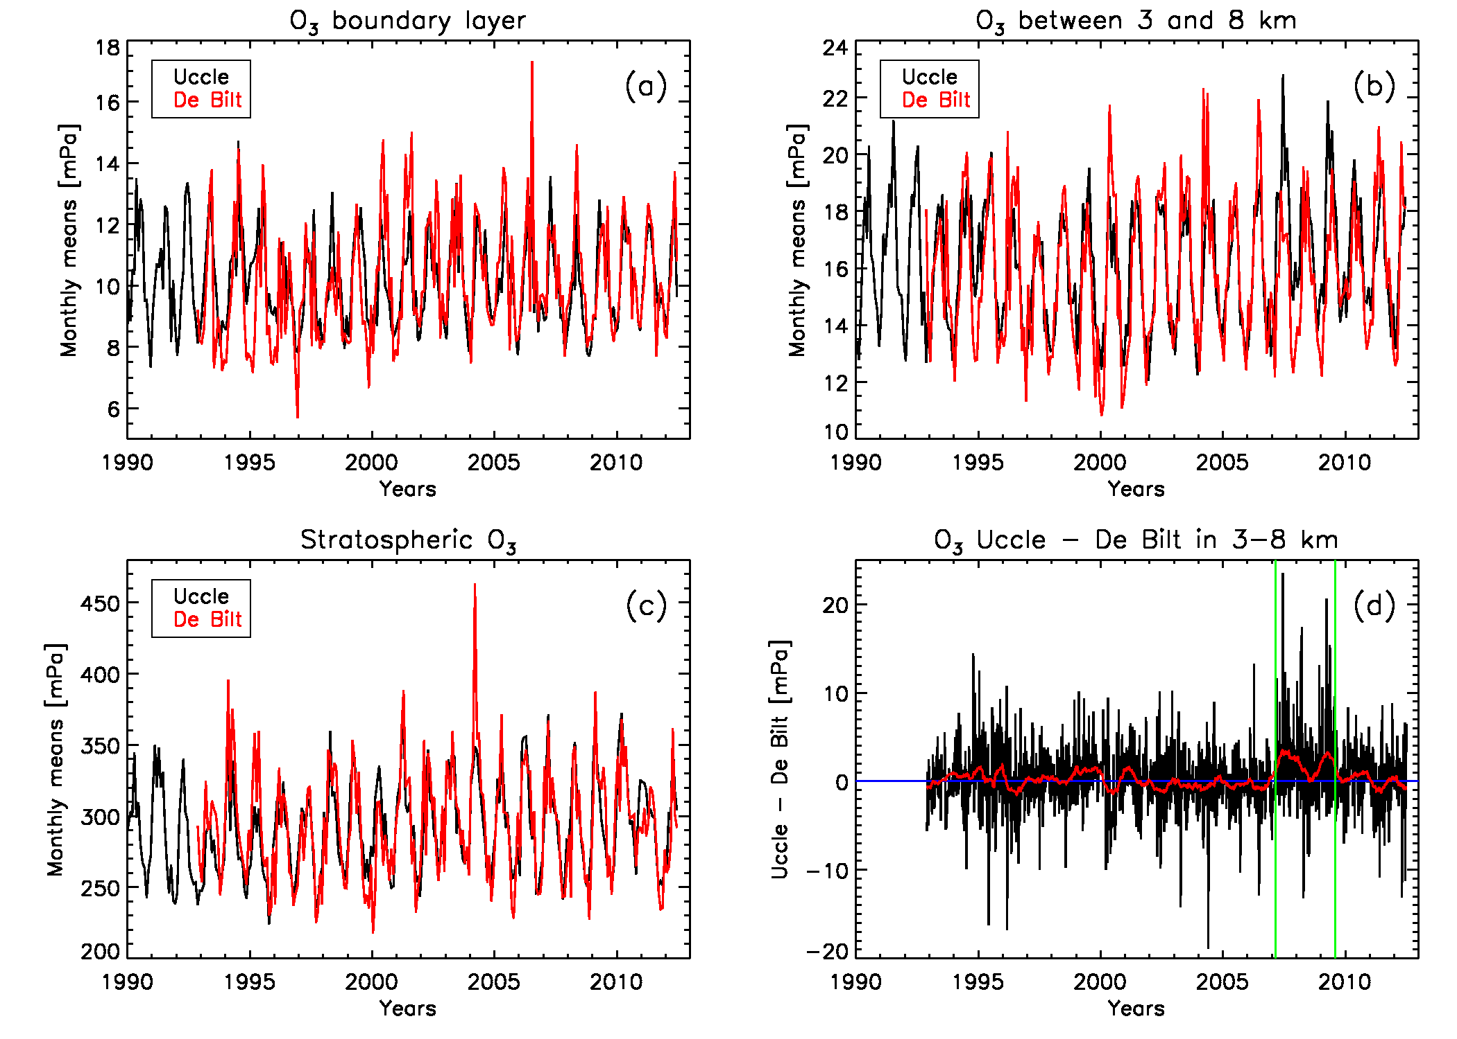
Motivation & introduction
Measuring O₃ @ Uccle
Total O₃ trends @ Uccle
Ozonesondes
Conclusions & outlook
Uccle and De Bilt
very similar time variability, at different atmospheric layers
larger spread at De Bilt due to lower frequency of launches
sometimes surprises: anomalous high tropospheric O₃ at Uccle in 2007-2009 → no single/clear explanation
From Van Malderen, R., De Backer, H., Delcloo, A. and Allaart, M.: Identifying the Origin of Anomalous High Tropospheric
Ozone in the Ozonesonde Data at Uccle by Comparison with Nearby De Bilt, Atmosphere-Ocean, 2014, Ozone Special Issue
RMI conference 25/11/2015

Slide 28
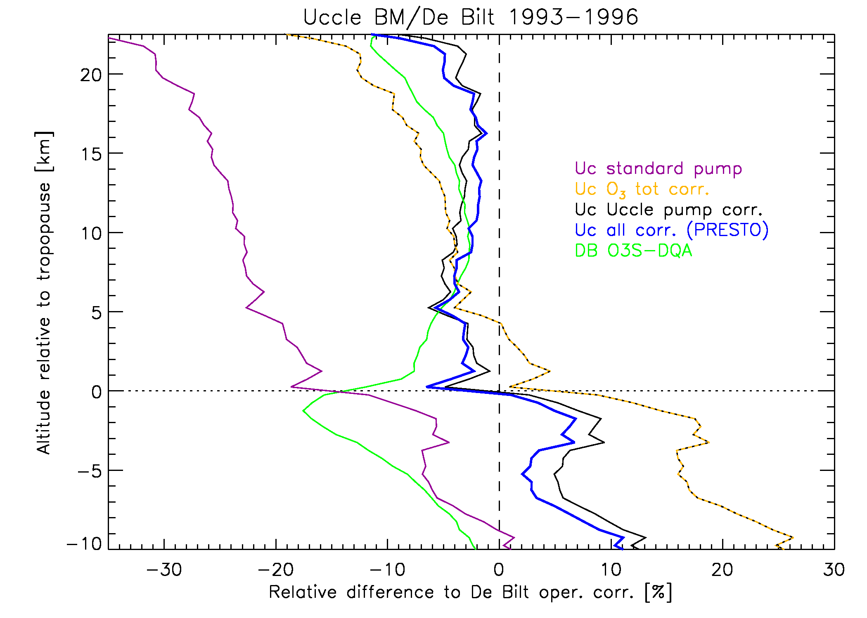
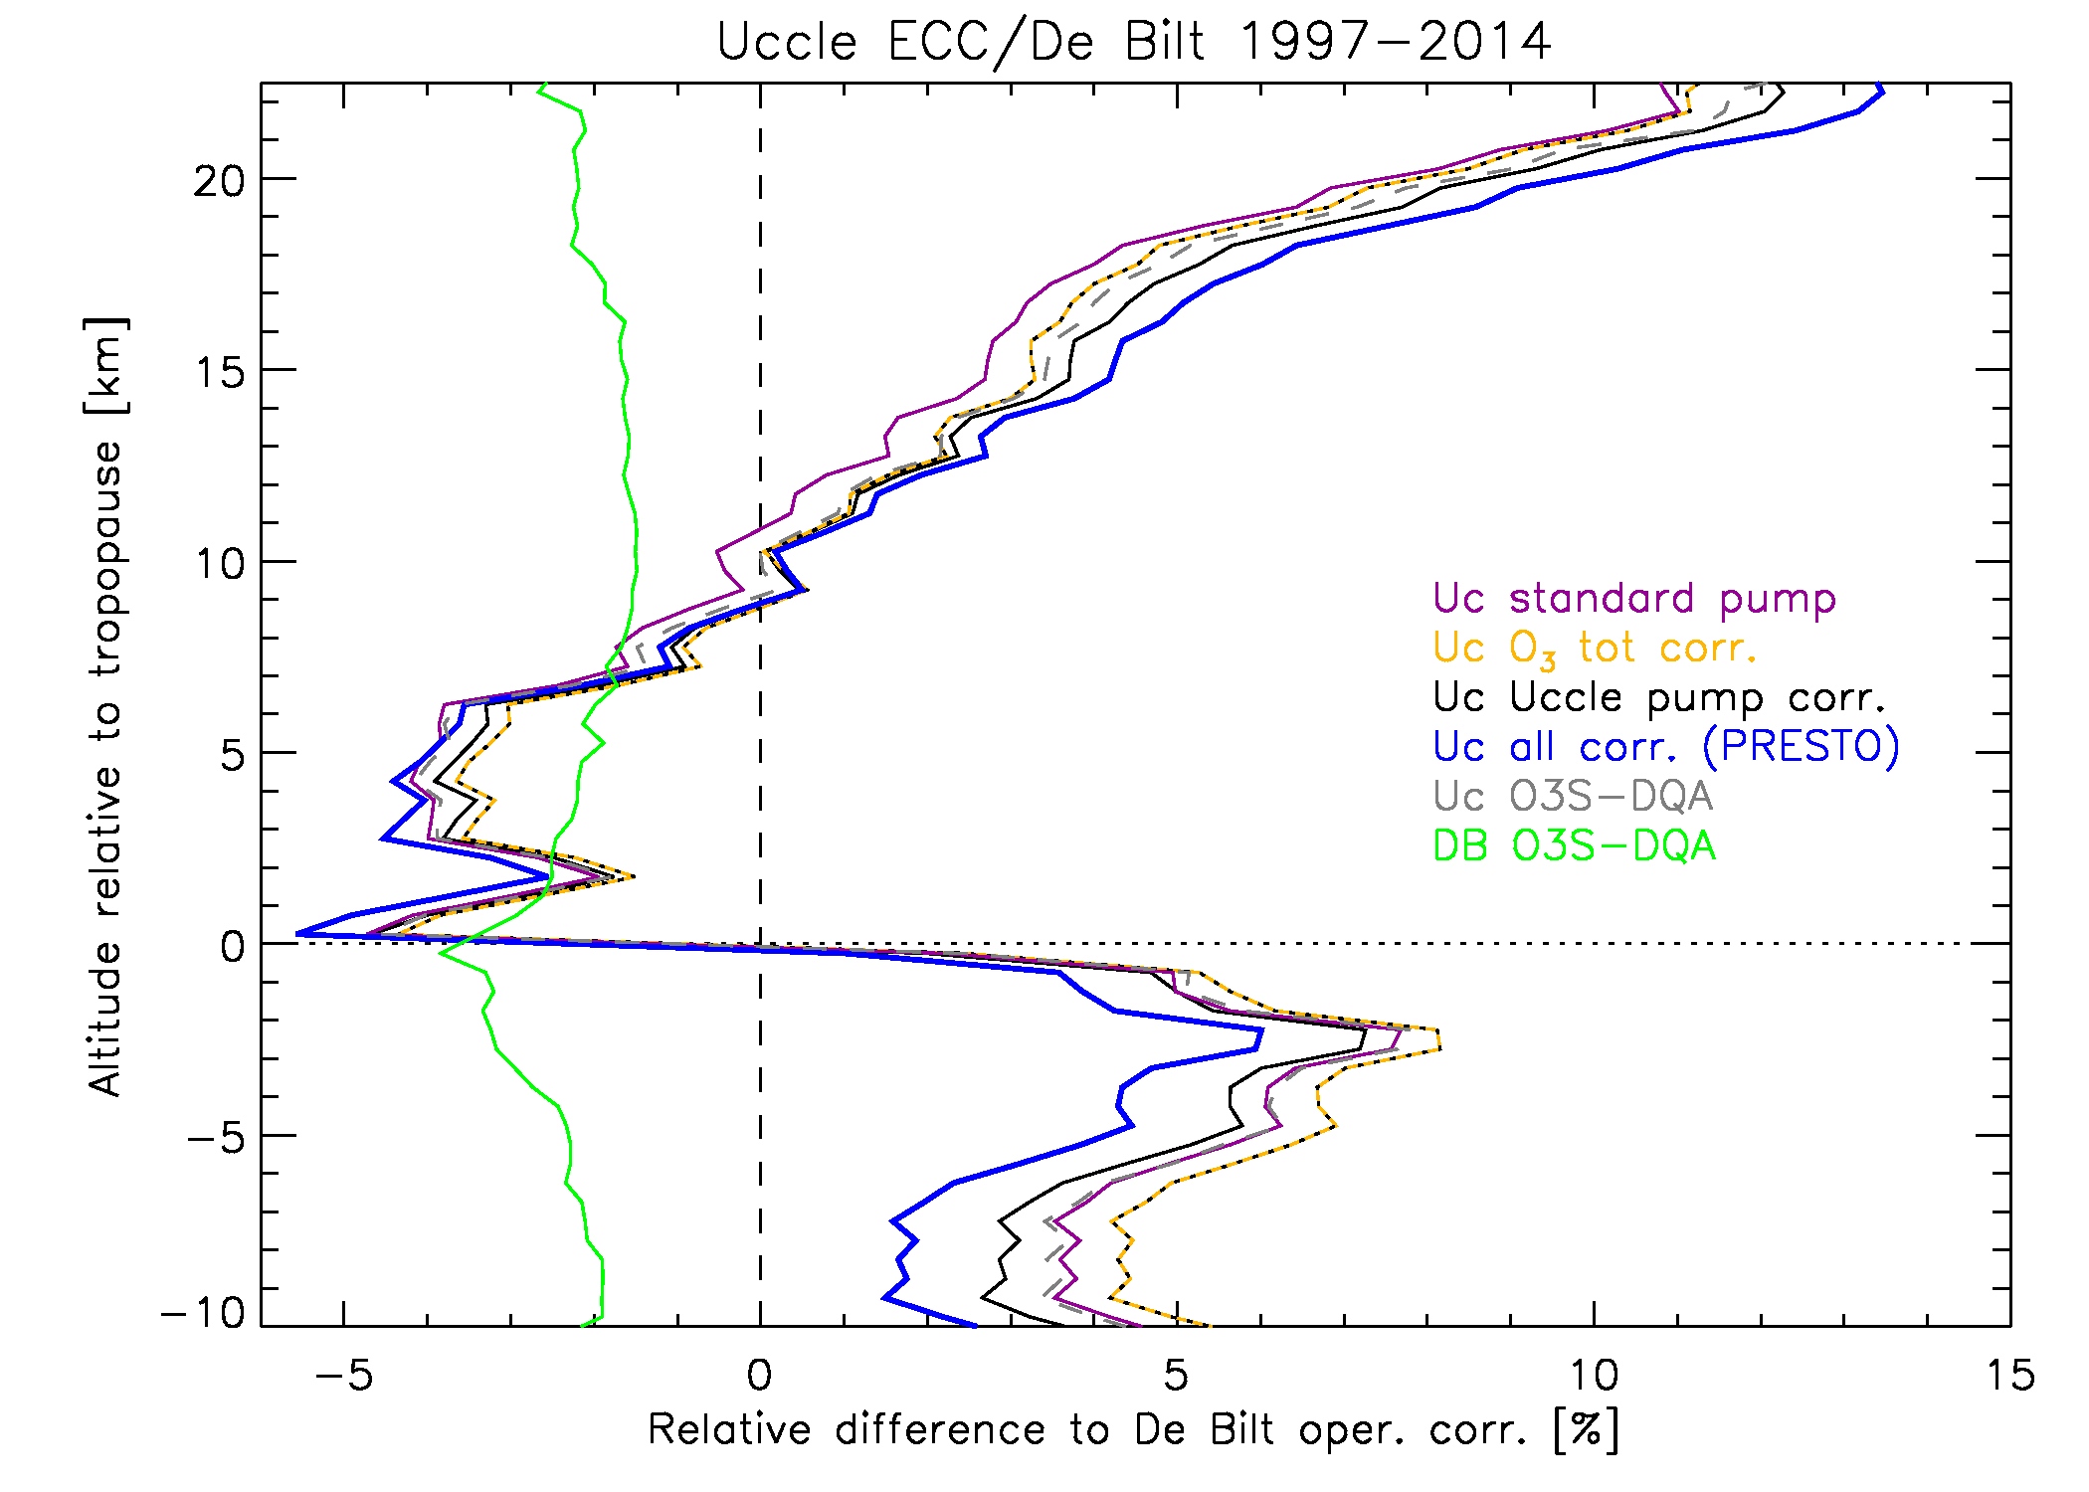
Motivation & introduction
Measuring O₃ @ Uccle
Total O₃ trends @ Uccle
Ozonesondes
Conclusions & outlook
Average ozone profiles
Uccle oper. corr. (blue) reduces O₃ differences to within 5%
BM sondes have a typical response equivalent to about 80% of the actual ozone amount
large differences (UT: >15%) between both De Bilt corrections
differences between different Uccle correction strategies are within 3%, within 4% for De Bilt
O3S-DQA corrections: better agreement between Uccle and De Bilt only in lower stratosphere (below O₃ maximum)
O3S-DQA correction at Uccle: better agreement with De Bilt above O₃ maximum
Van Malderen, R., Allaart, M., De Backer, H., Smit, H., and De Muer, D., submitted to AMT
RMI conference 25/11/2015

Slide 29
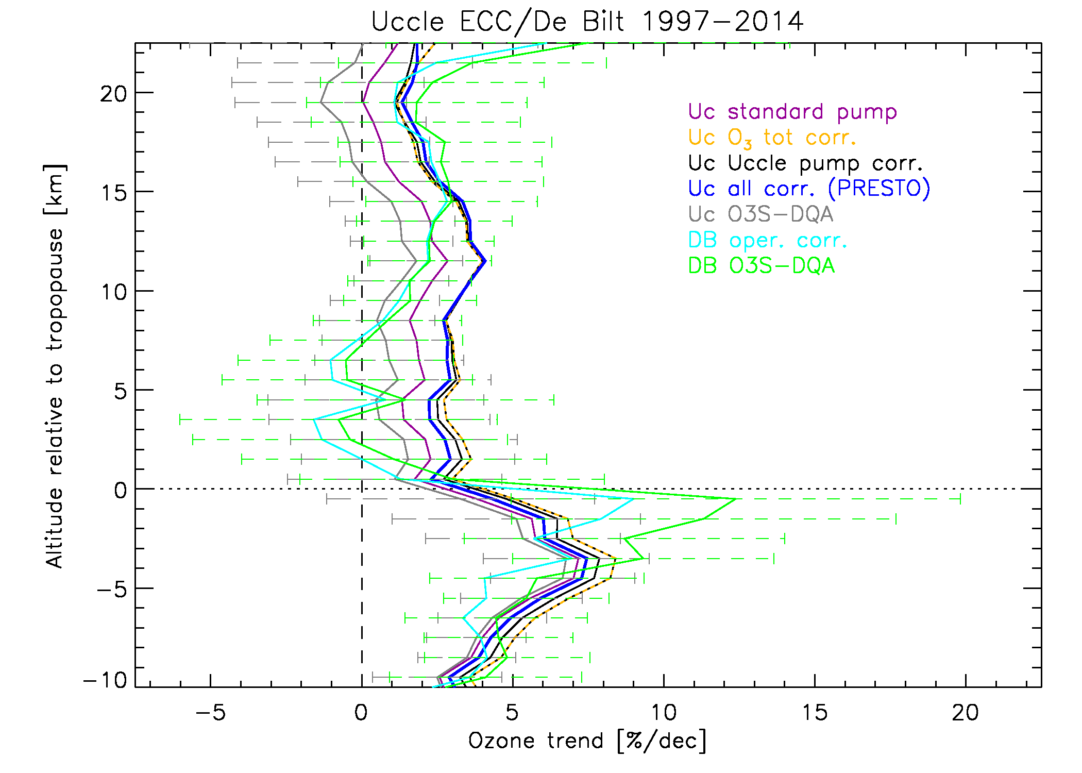
Motivation & introduction
Measuring O₃ @ Uccle
Total O₃ trends @ Uccle
Ozonesondes
Conclusions & outlook
Vertical ozone trends
trend differences between different Uccle correction strategies are within 3%/dec (UStr), within 4%/dec for De Bilt (UTr)
O3S-DQA corrections: better agreement between Uccle and De Bilt trends in LStr and LTr, but not significantly different!
O3S-DQA corrections: lower trends in Uccle, higher trends in De Bilt!
differences between different Uccle correction strategies are within 3%, within 4% for De Bilt
O3S-DQA corrections: better agreement between Uccle and De Bilt only in lower stratosphere (below O₃ maximum)
O3S-DQA correction at Uccle: better agreement with De Bilt above O₃ maximum
Van Malderen, R., Allaart, M., De Backer, H., Smit, H., and De Muer, D., submitted to AMT
RMI conference 25/11/2015

Slide 30
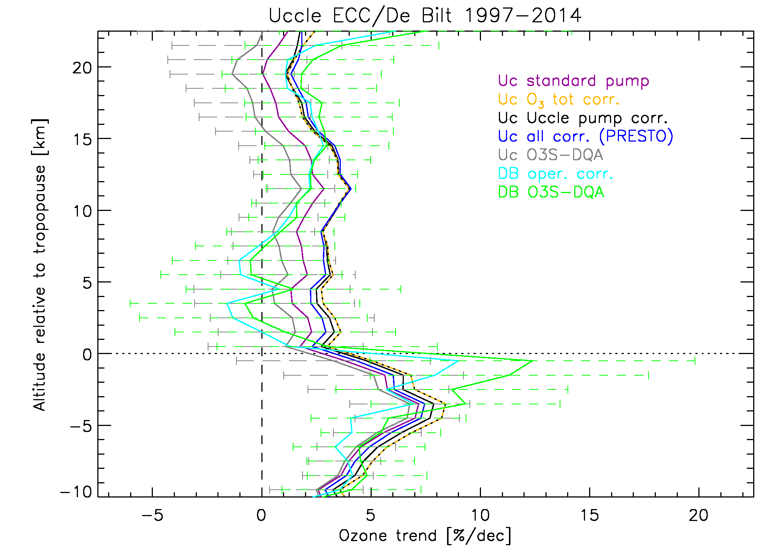
Motivation & introduction
Measuring O₃ @ Uccle
Total O₃ trends @ Uccle
Ozonesondes
Conclusions & outlook
Vertical ozone trends
Ozone recovery?
period starts with maximum peak value in EESC (1997)
only in troposphere: O₃ trends significantly different from zero!
sign of the O₃ trend in the strato-sphere depends on the station and on the applied data processing!
➔ caution is needed when using → terminology like “the onset of ozone → recovery!”
trend differences between different Uccle correction strategies are within 3%/dec (UStr), within 4%/dec for De Bilt (UTr)
O3S-DQA corrections: better agreement between Uccle and De Bilt trends in LStr and LTr, but not significantly different!
O3S-DQA corrections: lower trends in Uccle, higher trends in De Bilt!
Van Malderen, R., Allaart, M., De Backer, H., Smit, H., and De Muer, D., submitted to AMT
RMI conference 25/11/2015

Slide 31
Motivation & introduction
Measuring O₃ @ Uccle
Total O₃ trends @ Uccle
Ozonesondes
Conclusions & outlook
Conclusions: total ozone
The Uccle ozone measurements series are invaluable due to their length, frequency of observations, continuity, consistency, homogeneity and developed data processing tools.
Total ozone at Uccle does not show a clear trend over the entire 1971-2014 period: the 1980-1996 decline seems to be compensated by the 1997-2014 rise.
This long term variability seems to follow the EESC time behaviour, especially in the spring season (maximum ozone).
On the other hand, atmospheric dynamics (tropopause pressure and stratospheric temperature) are important explanatory variables!
The total ozone trend is composed by a stratospheric ozone decline of -2%/dec and a tropospheric ozone increase at +2%/dec.
RMI conference 25/11/2015

Slide 32
Motivation & introduction
Measuring O₃ @ Uccle
Total O₃ trends @ Uccle
Ozonesondes
Conclusions & outlook
Conclusions: vertical ozone profile
To serve the climate and satellite communities, an international ozonesonde data quality assessment activity was initiated.
The close ozonesonde stations Uccle and De Bilt provide a unique testbed for this homogeneity activity.
Still, natural differences in the vertical distribution of ozone between Uccle and De Bilt are likely to occur (→ needs more investigation!).
The O3S-DQA corrections do not give an overall better agreement of the average profiles and trends between both stations.
The impact of the correction strategies on the trends can make the difference between the onset of ozone recovery or not.
RMI conference 25/11/2015

Slide 33
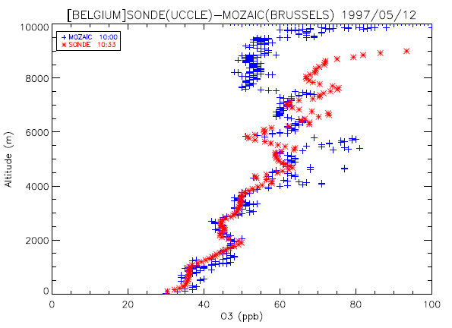
Motivation & introduction
Measuring O₃ @ Uccle
Total O₃ trends @ Uccle
Ozonesondes
Conclusions & outlook
Outlook
guarantee the operation and data quality of the ozone measurements at Uccle
comparison of the Uccle tropospheric ozone profiles with ozone aircraft measurements gathered above Brussels airport (and Frankfurt?) → topic of internship by Nicoleta Pateraki in Mar-May 2016.
566 profiles!
RMI conference 25/11/2015

Slide 34
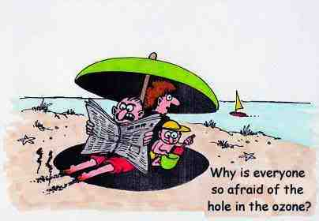
Thank you for your attention
Questions?
RMI conference 25/11/2015

Slide 35
Extra slides
RMI conference 25/11/2015

Slide 36
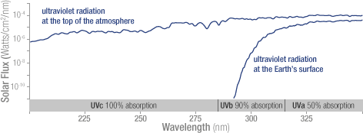
RMI conference 25/11/2015

Slide 37
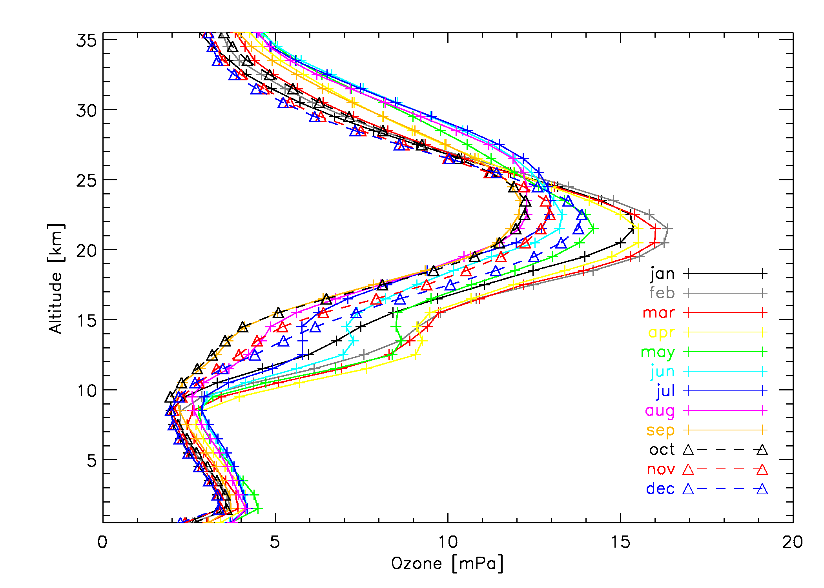
Seasonal variation of average Uccle O₃ profile
RMI conference 25/11/2015

Slide 38
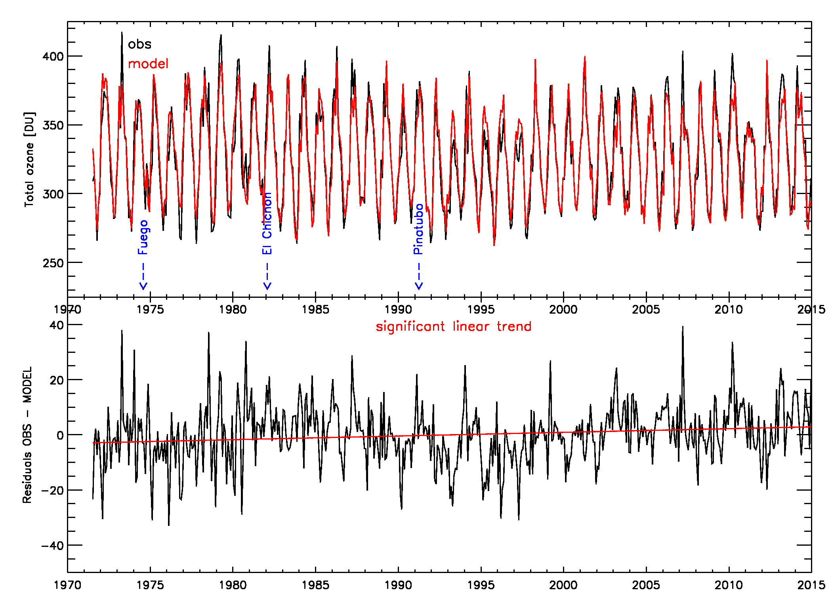
Total ozone at Uccle
Multiple stepwise linear regression with explanatory variables:
means/harmonic, linear, piecewise linear, EESC, solar flux, NAO, ENSO, QBO, aerosols, tropopause pressure, T @ 100hPa … for each season separately
winter: T100, mean, tropopause p, aerosol, NAO (79.9%)
spring: tropopause p, T100, mean, solar flux, NAO, QBO (56.2%)
summer: mean, T100 (76.9%)
fall: T100, tropopause p, mean, aerosol, solar flux (56.8%)
R² = 0.948

Slide 39
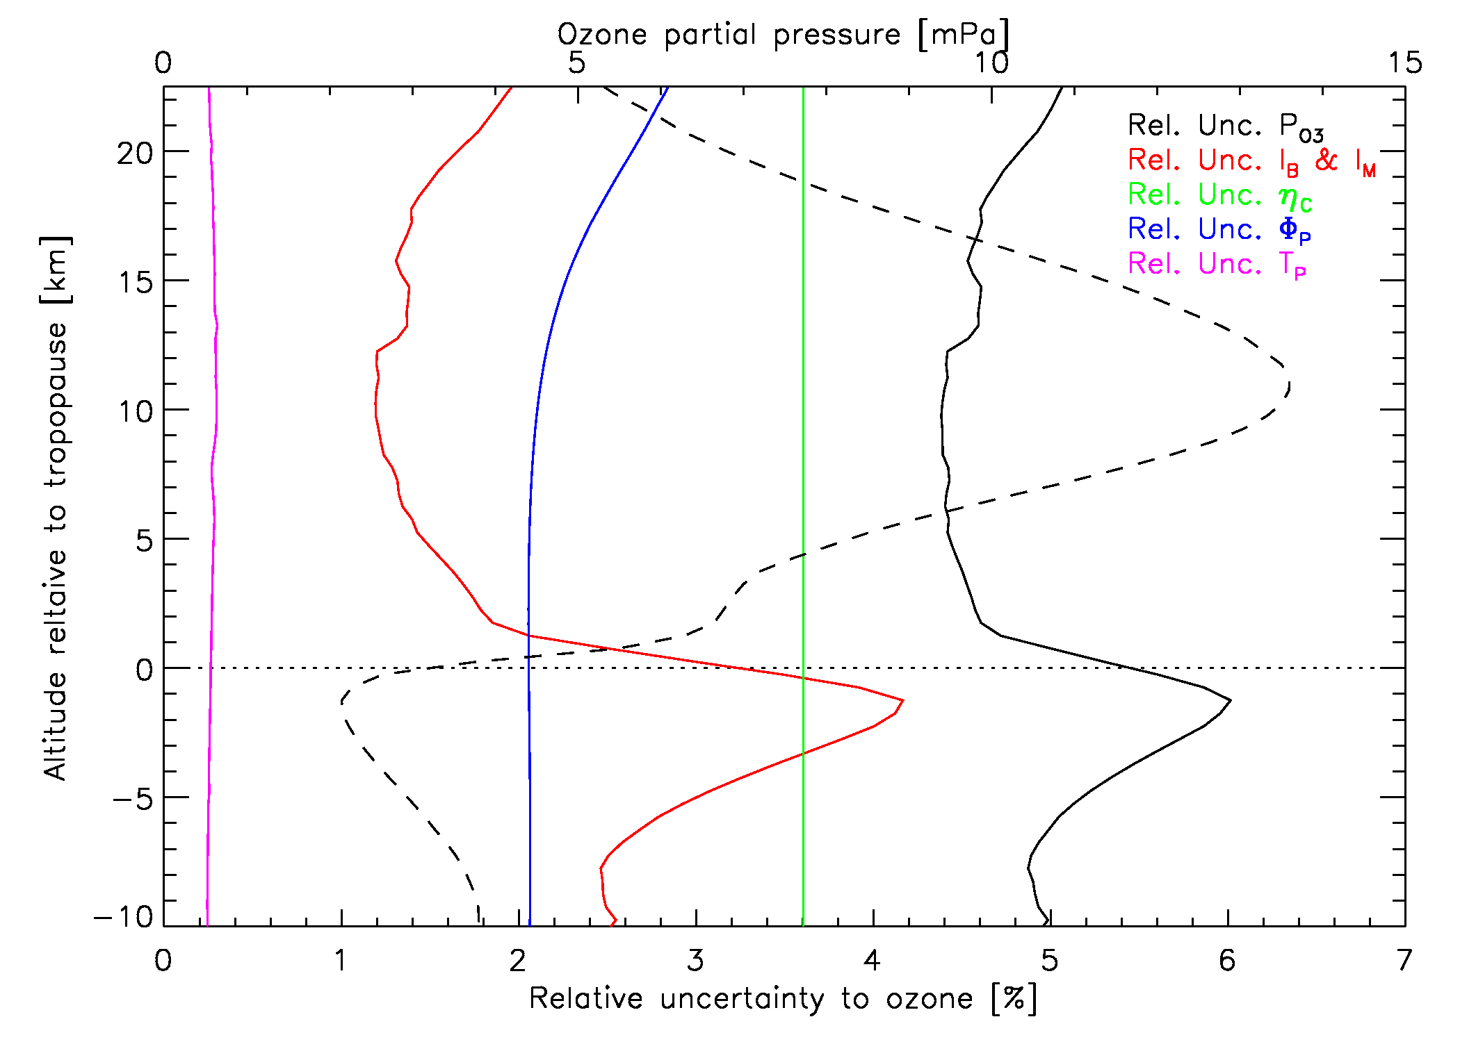
Average uncertainties of the Uccle O₃ profile
RMI conference 25/11/2015

Slide 40
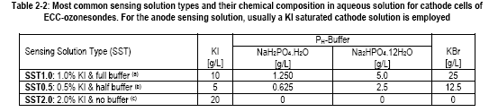
Sensing solution strengths (SST)
RMI conference 25/11/2015

Slide 41
Motivation & introduction
Measuring O₃ @ Uccle
Total O₃ trends @ Uccle
Ozonesondes
Conclusions & outlook
Ozone in the atmosphere
90 % of atmospheric ozone
formed by a balance between sunlight that creates ozone and chemical reactions that destroy it
beneficial role: acts as primary UV radiation shield
current issues:
  long-term global trend
  springtime antarctic ozone hole each year
  springtime artic ozone losses in several recent years
Average ozone profile at Uccle
STRATOSPHERE
ozone layer
STRATOSPHERE
‘good’ ozone
10 % of atmospheric ozone
forms when nitrogen oxide gases from vehicle and industrial emissions react with volatile organic compounds (VOCs)
Harmful impact: toxic effects on humans, animals and vegetation
current issues:
  episodes of high surface ozone in urban and rural areas
ozone = greenhouse gas
TROPOSPHERE
‘smog’, ‘bad’ ozone
TROPOSPHERE
RMI conference 25/11/2015

