Slide 1
Synthetic benchmark datasets for homogenization of IWV time series
retrieved by GPS
Anna Klos¹, Eric Pottiaux², Roeland Van Malderen³,
Olivier Bock⁴, and Janusz Bogusz¹
¹⁾ Military University of Technology (MUT), Faculty of Civil Engineering and Geodesy, Warsaw, Poland,
anna.klos@wat.edu.pl, janusz.bogusz@wat.edu.pl
²⁾ Royal Observatory of Belgium (ROB), Brussels, Belgium, eric.pottiaux@observatoire.be
³⁾ Royal Meteorological Institute of Belgium (RMI), Brussels, Belgium, roeland@meteo.be
⁴⁾ IGN LAREG, University Paris Diderot, Sorbonne Paris, France, olivier.bock@ign.fr

Slide 2
MOTIVATION DATA METHODOLOGY REAL DATA BENCHMARK DATASET CONCLUSIONS
What we did is…
We analysed and characterized the Integrated Water Vapour differences retrieved by GPS using ERA-Interim for IGS stations:
  homogenisation,
  analysis of significant frequencies,
  noise model.
We built a synthetic datasets:
  „Easy”,
  „Less-complicated”,
  „Fully-complicated”
  which will be tested with various statistical tools by homogenisation community.
The aim: to test various homogenization methods
(statistical vs. manual) using a benchmark.

Slide 3
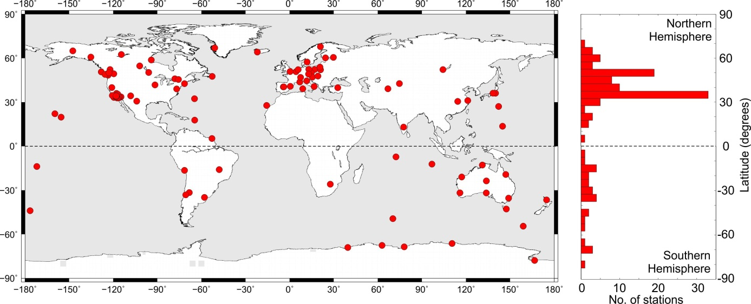
MOTIVATION DATA METHODOLOGY REAL DATA BENCHMARK DATASET CONCLUSIONS
IGS „repro1” troposphere products screened and converted to Integrated Water Vapour (IWV) by O. Bock.
120 stations, daily observations, period of 1995-2010.

Slide 4
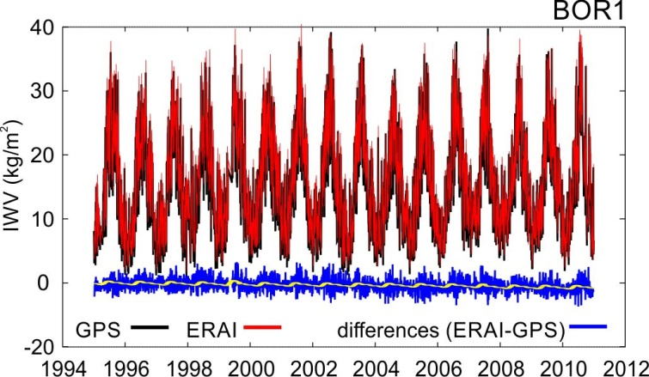
MOTIVATION DATA METHODOLOGY REAL DATA BENCHMARK DATASET CONCLUSIONS
IGS „repro1” troposphere products screened and converted to Integrated Water Vapour (IWV) by O. Bock.
We focused on the differences: ERAI-GPS, which may reveal artificial breaks.

Slide 5
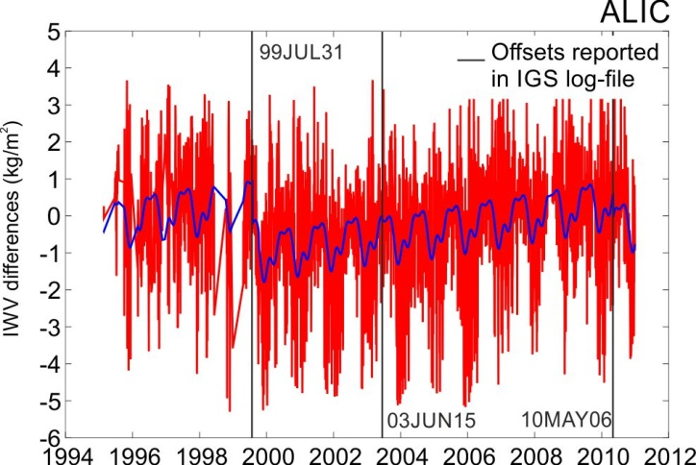
MOTIVATION DATA METHODOLOGY REAL DATA BENCHMARK DATASET CONCLUSIONS
Manual homogenisation:
1029 epochs which were reported in the IGS log files (ftp://igs.ign.fr/pub/igs/igscb/station/log/ and ftp://igs.ign.fr/pub/igs/igscb/station/oldlog/, changes in R=receiver, A=antenna,
D=radome).
We averaged the epochs
from log files from 1029
to 970 epochs: 164 offsets
validated manually.
57 offsets were additionally
reported during manual
checking.
Finally: 221 epochs.

Slide 6
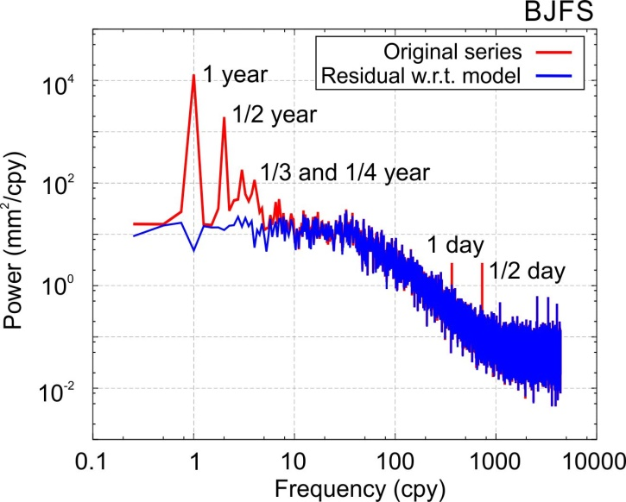
MOTIVATION DATA METHODOLOGY REAL DATA BENCHMARK DATASET CONCLUSIONS
Significant oscillations:
PSD of ZTD for BJFS (Beijing, China).
Reproduced from Klos et al. (2016)
If significant frequencies were not accounted for, it may lead to wrong trend estimates.
Computations were performed with Maximum Likelihood Estimation (MLE) in the Hector software.

Slide 7
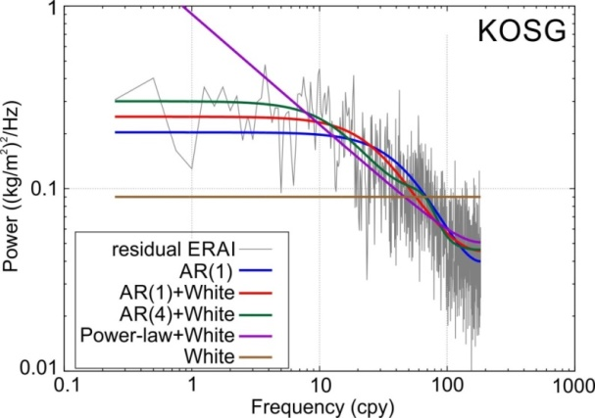
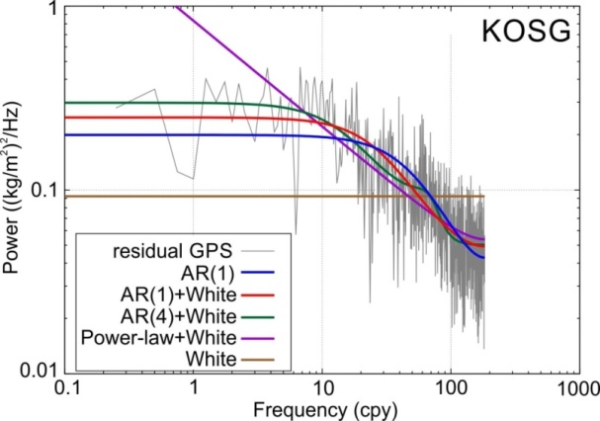
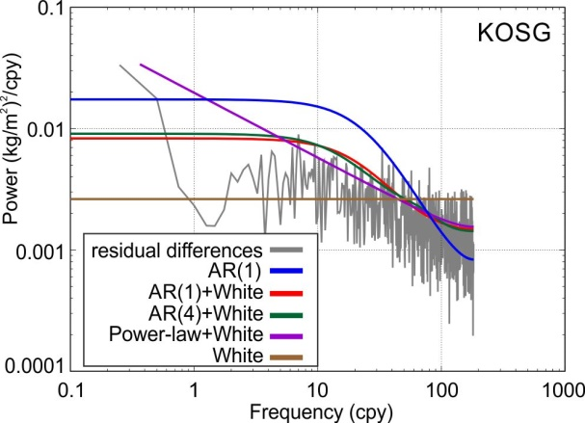
MOTIVATION DATA METHODOLOGY REAL DATA BENCHMARK DATASET CONCLUSIONS
Noise model:
Combination of autoregressive process of first order plus white noise (AR(1)+WN) characterized by: AR: a coefficient, fraction and amplitude, WN: amplitude.

Slide 8
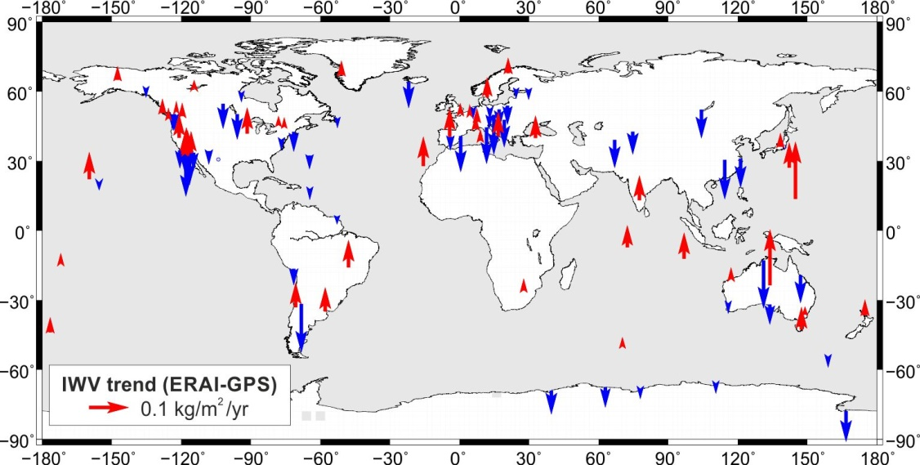
MOTIVATION DATA METHODOLOGY REAL DATA BENCHMARK DATASET CONCLUSIONS
Real data characteristics:
Trends in IWV differences.

Slide 9
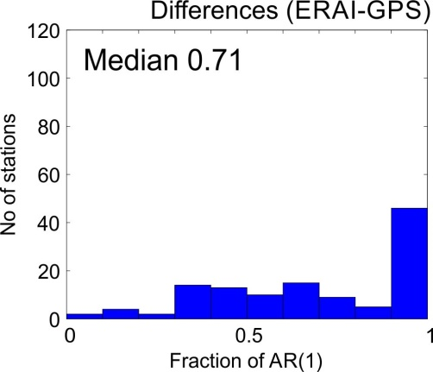
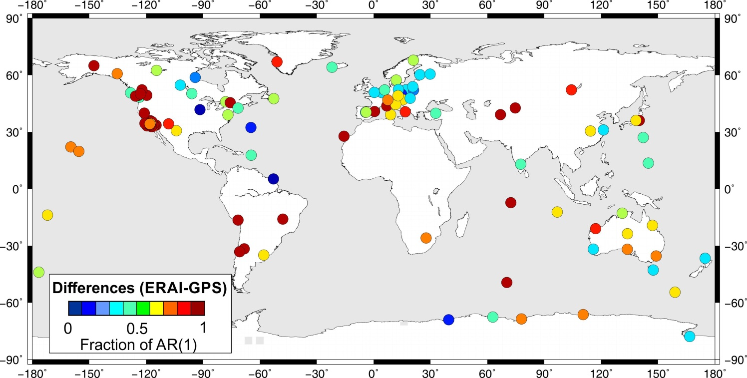
MOTIVATION DATA METHODOLOGY REAL DATA BENCHMARK DATASET CONCLUSIONS
Real data characteristics:
Noise: fraction of AR(1), coefficient of AR(1), amplitudes of WN and AR(1).

Slide 10
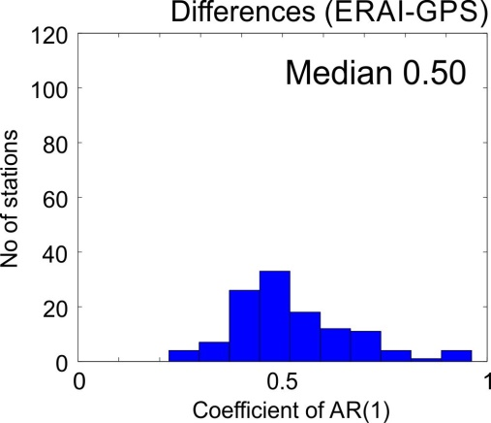
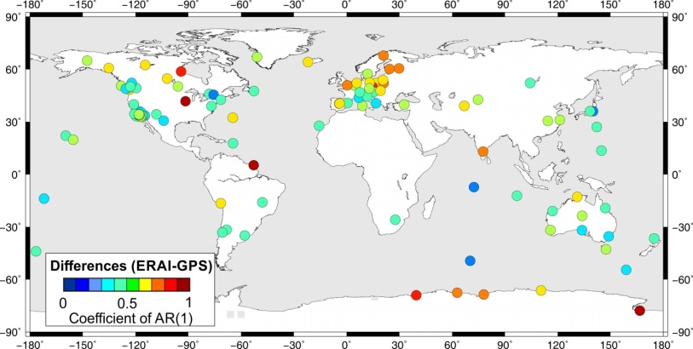
MOTIVATION DATA METHODOLOGY REAL DATA BENCHMARK DATASET CONCLUSIONS
Real data characteristics:
Noise: fraction of AR(1), coefficient of AR(1), amplitudes of WN and AR(1).

Slide 11
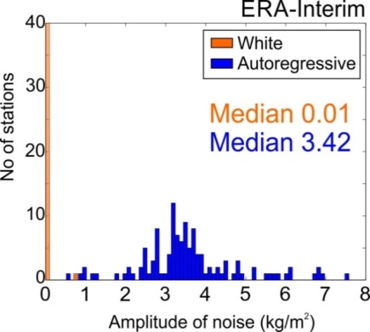
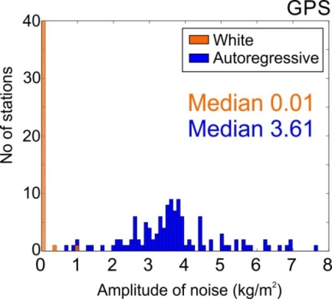
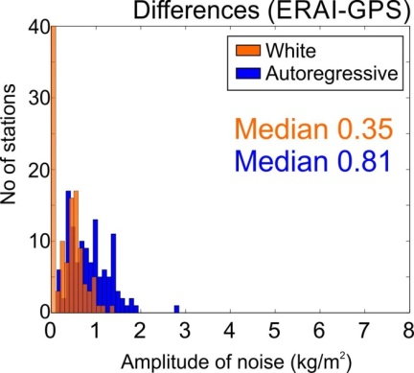
MOTIVATION DATA METHODOLOGY REAL DATA BENCHMARK DATASET CONCLUSIONS
Real data characteristics:
Noise: fraction of AR(1), coefficient of AR(1), amplitudes of WN and AR(1).

Slide 12
MOTIVATION DATA METHODOLOGY REAL DATA BENCHMARK DATASET CONCLUSIONS
Generation of the benchmark dataset:
generation of IWV from ERA-Interim (ERAI_synt), GPS (GPS_synt) and IWV differences ERAI-GPS (DIFF_synt),
estimates of IWV differences from synthetic GPS and ERAI (ERAI_synt-GPS_synt),
we examined the character of all above-mentioned,
we found that some part of the power for series from (2) cannot be played back,
the safest way: generating the synthetic IWV differences.

Slide 13
MOTIVATION DATA METHODOLOGY REAL DATA BENCHMARK DATASET CONCLUSIONS
Generation of the benchmark dataset (DIFF_synt):
Three variants of the benchmark dataset were constructed:
‘Easy’ dataset: it includes seasonal signals (annual, semi-annual,
ter- and quater-annual, if present for a particular station) + offsets + white noise (WN),
‘Less-complicated’ dataset: … + autoregressive process of the first order + white noise (AR(1)+WN),
‘Fully-complicated’ dataset: …+trend + gaps.

Slide 14
MOTIVATION DATA METHODOLOGY REAL DATA BENCHMARK DATASET CONCLUSIONS
Generation of the benchmark dataset:
120 synthetic dataset simulated,
mathematical model of data taken directly from real differences: trend, seasonal signals, noise,
offsets simulated randomly,
number of offsets and exact epochs are blinded.

Slide 15
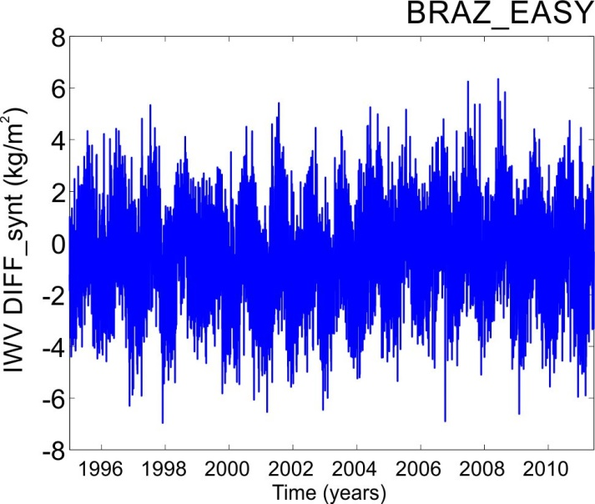
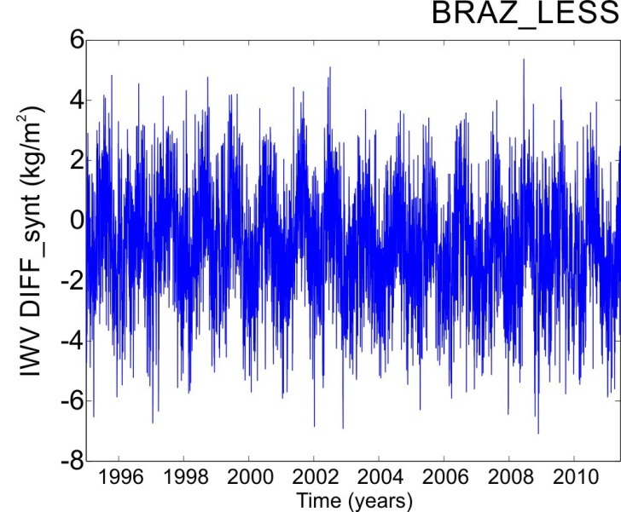
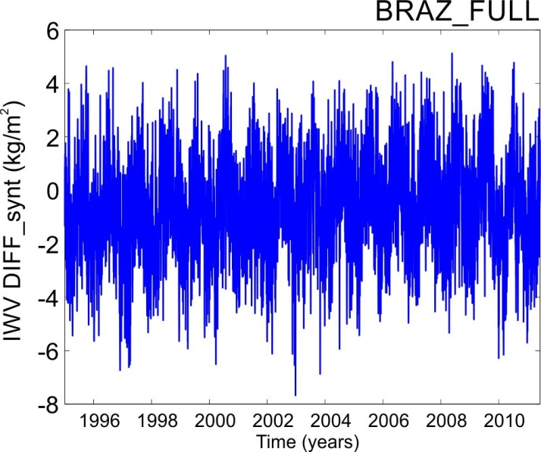
MOTIVATION DATA METHODOLOGY REAL DATA BENCHMARK DATASET CONCLUSIONS
Generation of the benchmark dataset (DIFF_synt):
Three variants of the benchmark dataset were constructed:

Slide 16
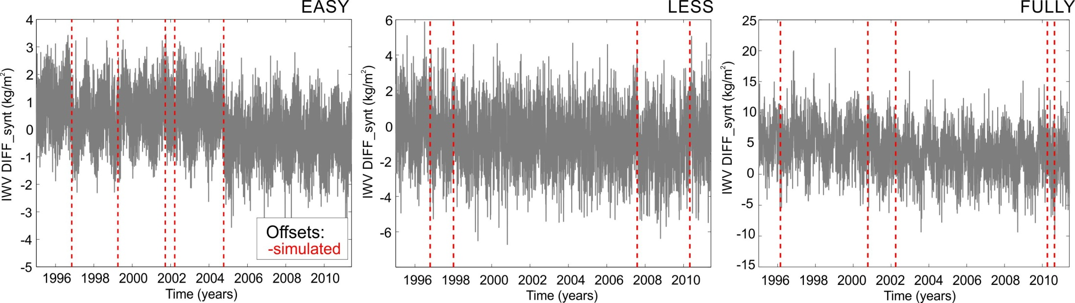
MOTIVATION DATA METHODOLOGY REAL DATA BENCHMARK DATASET CONCLUSIONS
Generation of the benchmark dataset (DIFF_synt):
Three variants of the benchmark dataset were constructed:

Slide 17
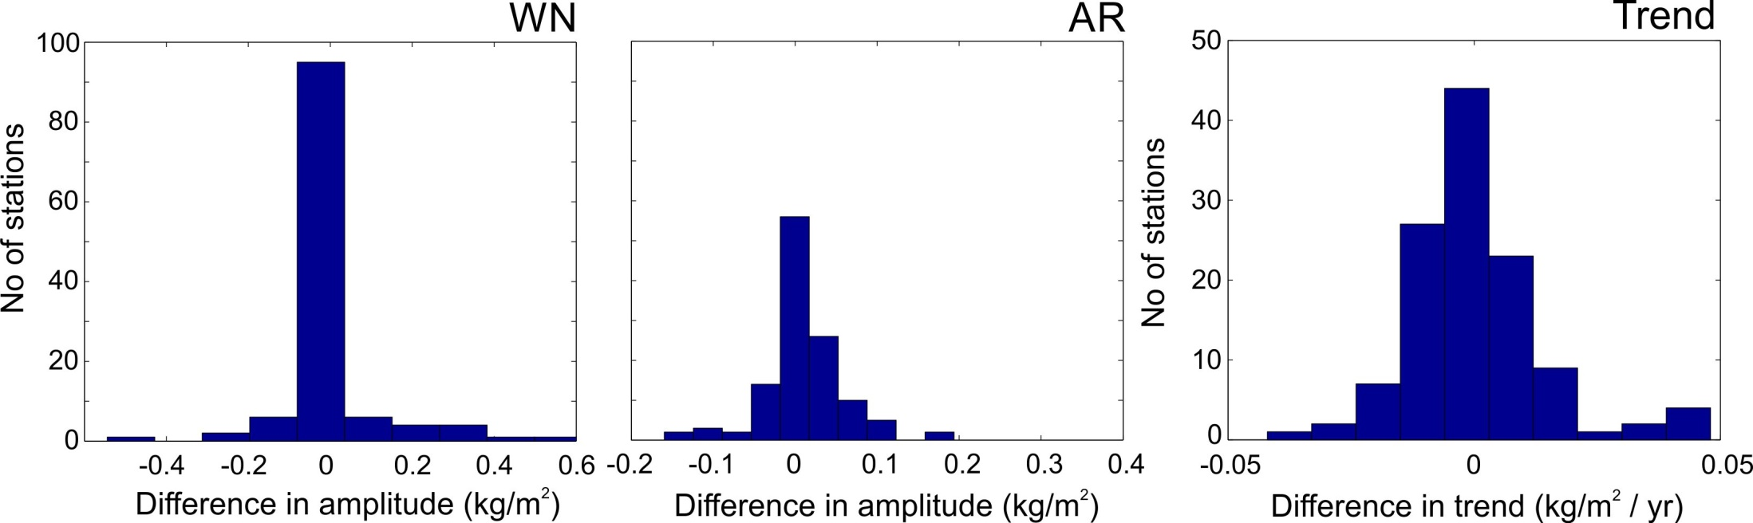
MOTIVATION DATA METHODOLOGY REAL DATA BENCHMARK DATASET CONCLUSIONS
Verification of benchmark w.r.t. original differences (DIFF_synt):
FULLY-COMPLICATED
Coefficients of AR agree within 0.05.
Amplitudes agree with – see histograms.

Slide 18
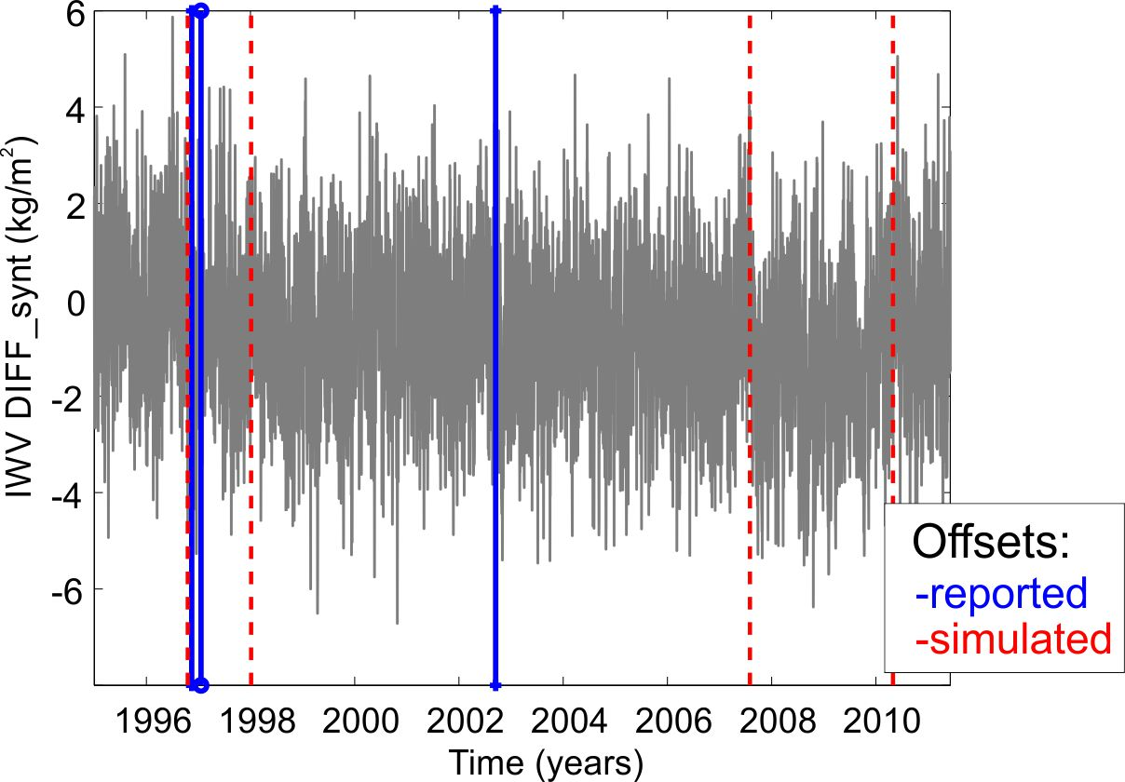
MOTIVATION DATA METHODOLOGY REAL DATA BENCHMARK DATASET CONCLUSIONS
What we aim at?
Evident regime-like shifts can be noticed. These should not be corrected and interpreted as real breaks due to climate change or any changes related to GPS instrument.
  Only real breakpoints not regime-like shifts should be corrected!

Slide 19
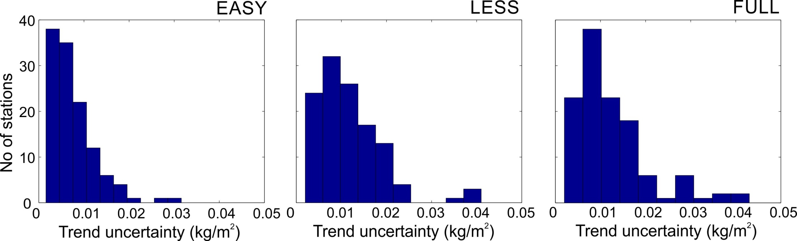
MOTIVATION DATA METHODOLOGY REAL DATA BENCHMARK DATASET CONCLUSIONS
Expected trend uncertainty
Preliminary estimation of which trend uncertainty can be expected from real differences, based on synthetic differences (DIFF_synt).

Slide 20
MOTIVATION DATA METHODOLOGY REAL DATA BENCHMARK DATASET CONCLUSIONS
Workplan and priorities:
„Fully-complicated” dataset has the highest priority for the comparison of the identified breaks by the different groups,
the other variants are test datasets, but the comparison of the results between those datasets will also learn us on the impact of e.g. the autoregressive process, trends, and gaps on the functioning of the different homogenization tools,
the trend estimates (and their uncertainties) of the Fully-complicated synthetic GPS IWV dataset will be estimated, so that we can also undertake an assessment of the different trend estimation tools in use in the community.

Slide 21
MOTIVATION DATA METHODOLOGY REAL DATA BENCHMARK DATASET CONCLUSIONS
Summing up:
Test different statistical approaches to give a clear answer if we are able (or not) to report offsets with statistical approaches, being aware of the autoregressive noise in a stochastic part of the IWV data.
Find the optimal statistical approach to homogenise the IWV series.
Use this tool (or tools) to homogenise the IGS repro1 dataset.

Slide 22
MOTIVATION DATA METHODOLOGY REAL DATA BENCHMARK DATASET CONCLUSIONS
Acknowledgments:
Anna Klos was supported by COST Action ES1206 GNSS4SWEC (gnss4swec.knmi.nl) during her stay at the Royal Observatory of Belgium (ROB) and the Royal Meteorological Institute of Belgium (RMI).
Janusz Bogusz was supported by the Polish National Science Centre, grant No.
UMO-2016/21/B/ST10/02353
Thank you!

