Slide 1

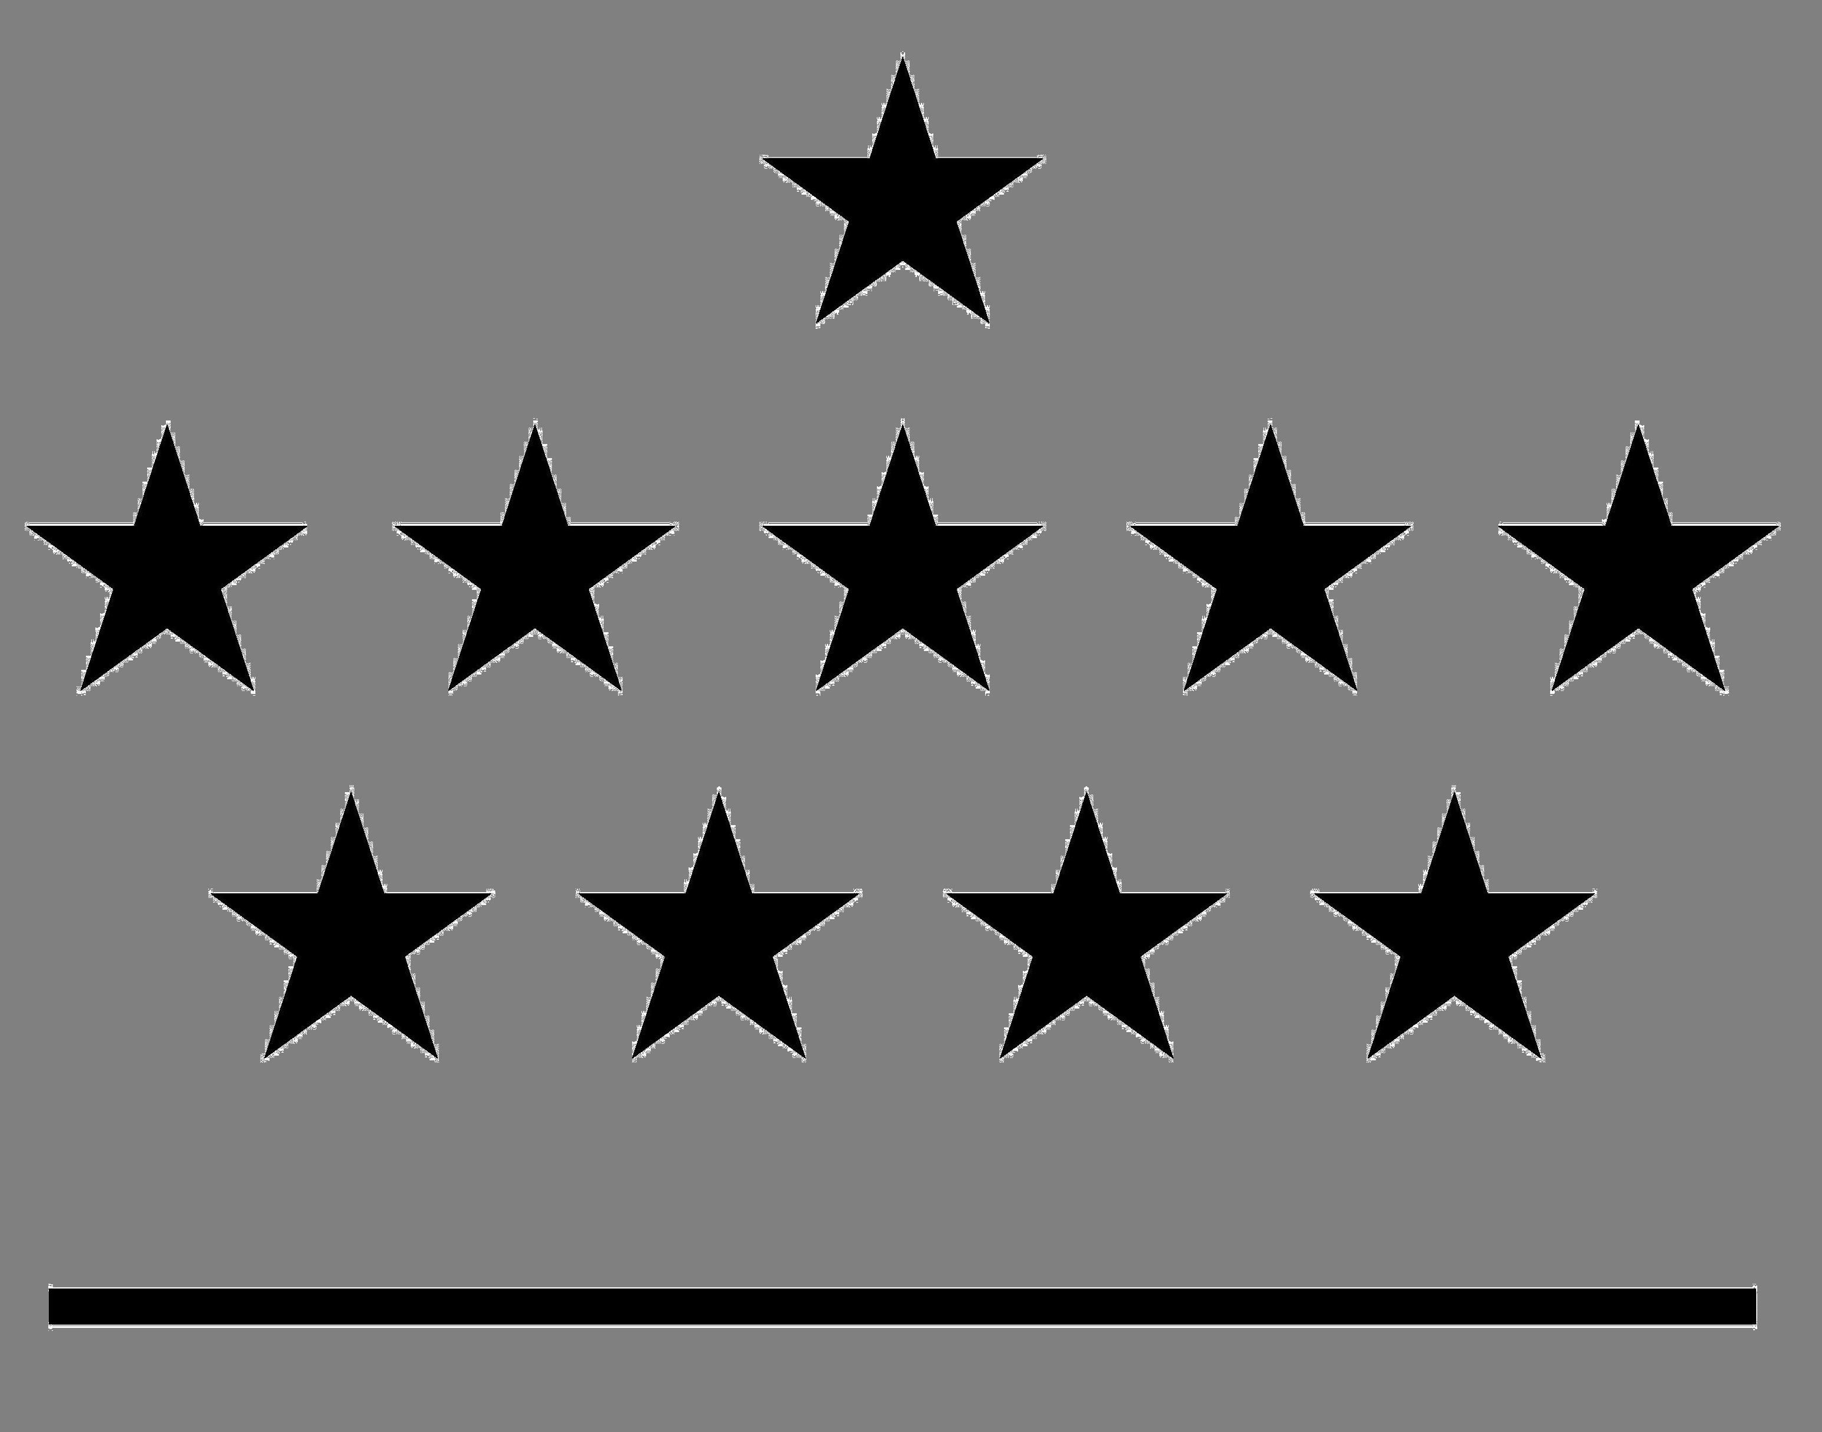



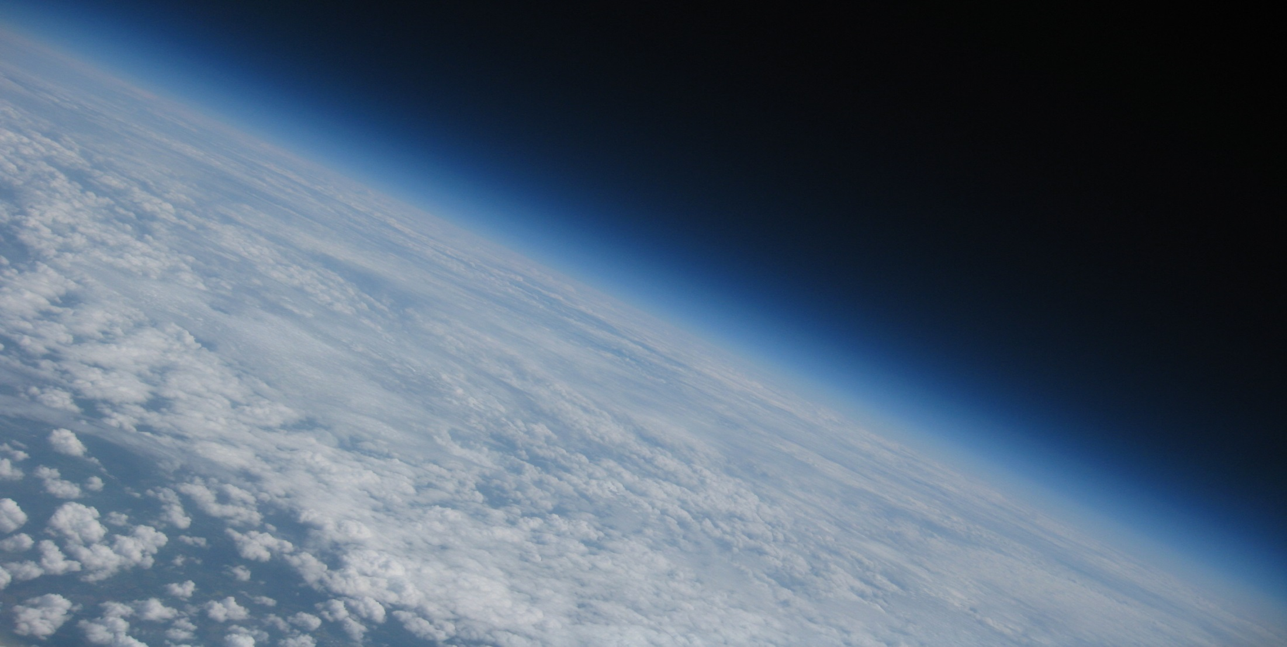
Royal Meteorological
Institute of Belgium
Royal Observatory
of Belgium
Vilnius University
Max Planck Institute
for Chemistry
Royal Belgian Institute
for Space Aeronomy
Solar-Terrestrial Centre of Excellence
1
2
3
4
5
6
A world-wide analysis of the time variability of Integrated Water Vapour, based on ground-based GNSS and GOMESCIA satellite retrievals, and with reanalyses as auxiliary tools
R. Van Malderen^{1,6}, E. Pottiaux^{2,6}, G. Stankunavicius³, S. Beirle⁴,
J. Legrand², H. Brenot^{5,6}, T. Wagner ⁴, H. De Backer¹, and C. Bruyninx^{2,6}
EMS Annual Meeting, Dublin, 04-08/09/2017

Slide 2

Outline
Objective
Data
Seasonal behaviour
Trends
Linear regression
Discussion
EMS Annual Meeting
Dublin, Ireland 4-8 September 2017

Slide 3
Objective
Data
Seasonal behaviour
Trends
Linear Regression
Objective
Surface warming affects the water vapour amount in the atmosphere (Clausius-Clapeyron equation).
We want to compare the time variability of the integrated water vapour amount (IWV～TCWV～PWV) among 3 different datasets:
  diurnal variability
  seasonal variability (seasonal cycle)
  intra-seasonal & inter-seasonal variability
  inter-annual variability
  decadal variability
  given the length and the time frequency of our datasets, we will focus on…
EMS Annual Meeting
Dublin, Ireland 4-8 September 2017

Slide 4
Objective
Data
Seasonal behaviour
Trends
Linear Regression
Objective
Surface warming affects the water vapour amount in the atmosphere (Clausius-Clapeyron equation)
We want to compare the time variability of the integrated water vapour amount (IWV～TCWV～PWV) among 3 different datasets
  diurnal variability
  seasonal variability (seasonal cycle)
  intra-seasonal & inter-seasonal variability
  inter-annual variability
  decadal variability
  given the length and the time frequency of our datasets, we will focus on…
EMS Annual Meeting
Dublin, Ireland 4-8 September 2017

Slide 5
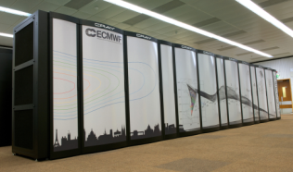
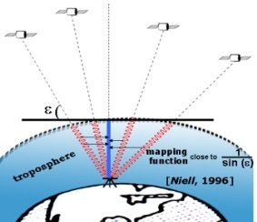

Objective
Data
Seasonal behaviour
Trends
Linear Regression
Objective
Surface warming affects the water vapour amount in the atmosphere (Clausius-Clapeyron equation)
We want to compare the time variability of the integrated water vapour amount (IWV～TCWV～PWV) among 3 different datasets
ground-based GNSS
ERA-interim
GOMESCIA
120 sites worldwide with homogeneous data processing from 1995-Mar 2011 (IGS repro 1)
time delay measurement, ZTD → IWV needs P_{surf} and T_{mean}
Δt = 5’, but in practice: every 6h
worldwide reanalysis from the ECMWF
  IWV from surface fields, corrected to GNSS station height, horizontal interpolation
Δt = 6h
nadir spectroscopy of back-scattered light (around 700 nm for water vapour)
global coverage, GOME/SCIAMACHY/GOME-2 satellite overpass measurements at GNSS stations
mid 1995 to present
Δt = 1 month (climate product)
➔ monthly means

Slide 6
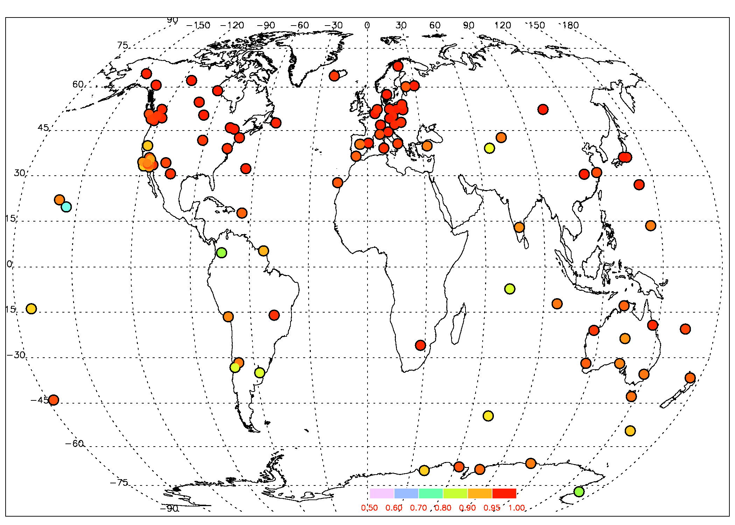
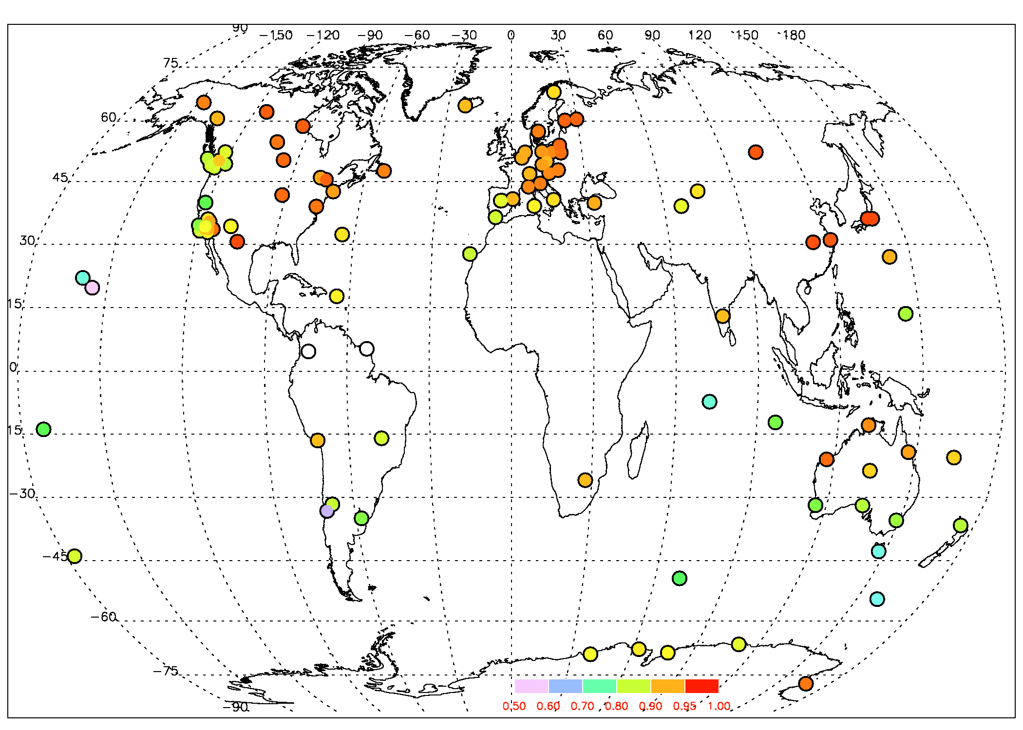
Objective
Data
Seasonal behaviour
Trends
Linear Regression
Correlations between datasets
R² between GNSS and ERAinterim
R² between GOMESCIA and ERAinterim
very high correlation between ERA-interim and GNSS, except at some island and coastal sites (➔ bad spatial representation by ERA-interim?)
lower correlation coefficients between ERA-interim and GOMESCIA, and dry bias of GOMESCIA w.r.t. ERA-interim
➔ best coherence between GNSS and GOMESCIA at eastern USA & EU
EMS Annual Meeting
Dublin, Ireland 4-8 September 2017

Slide 7
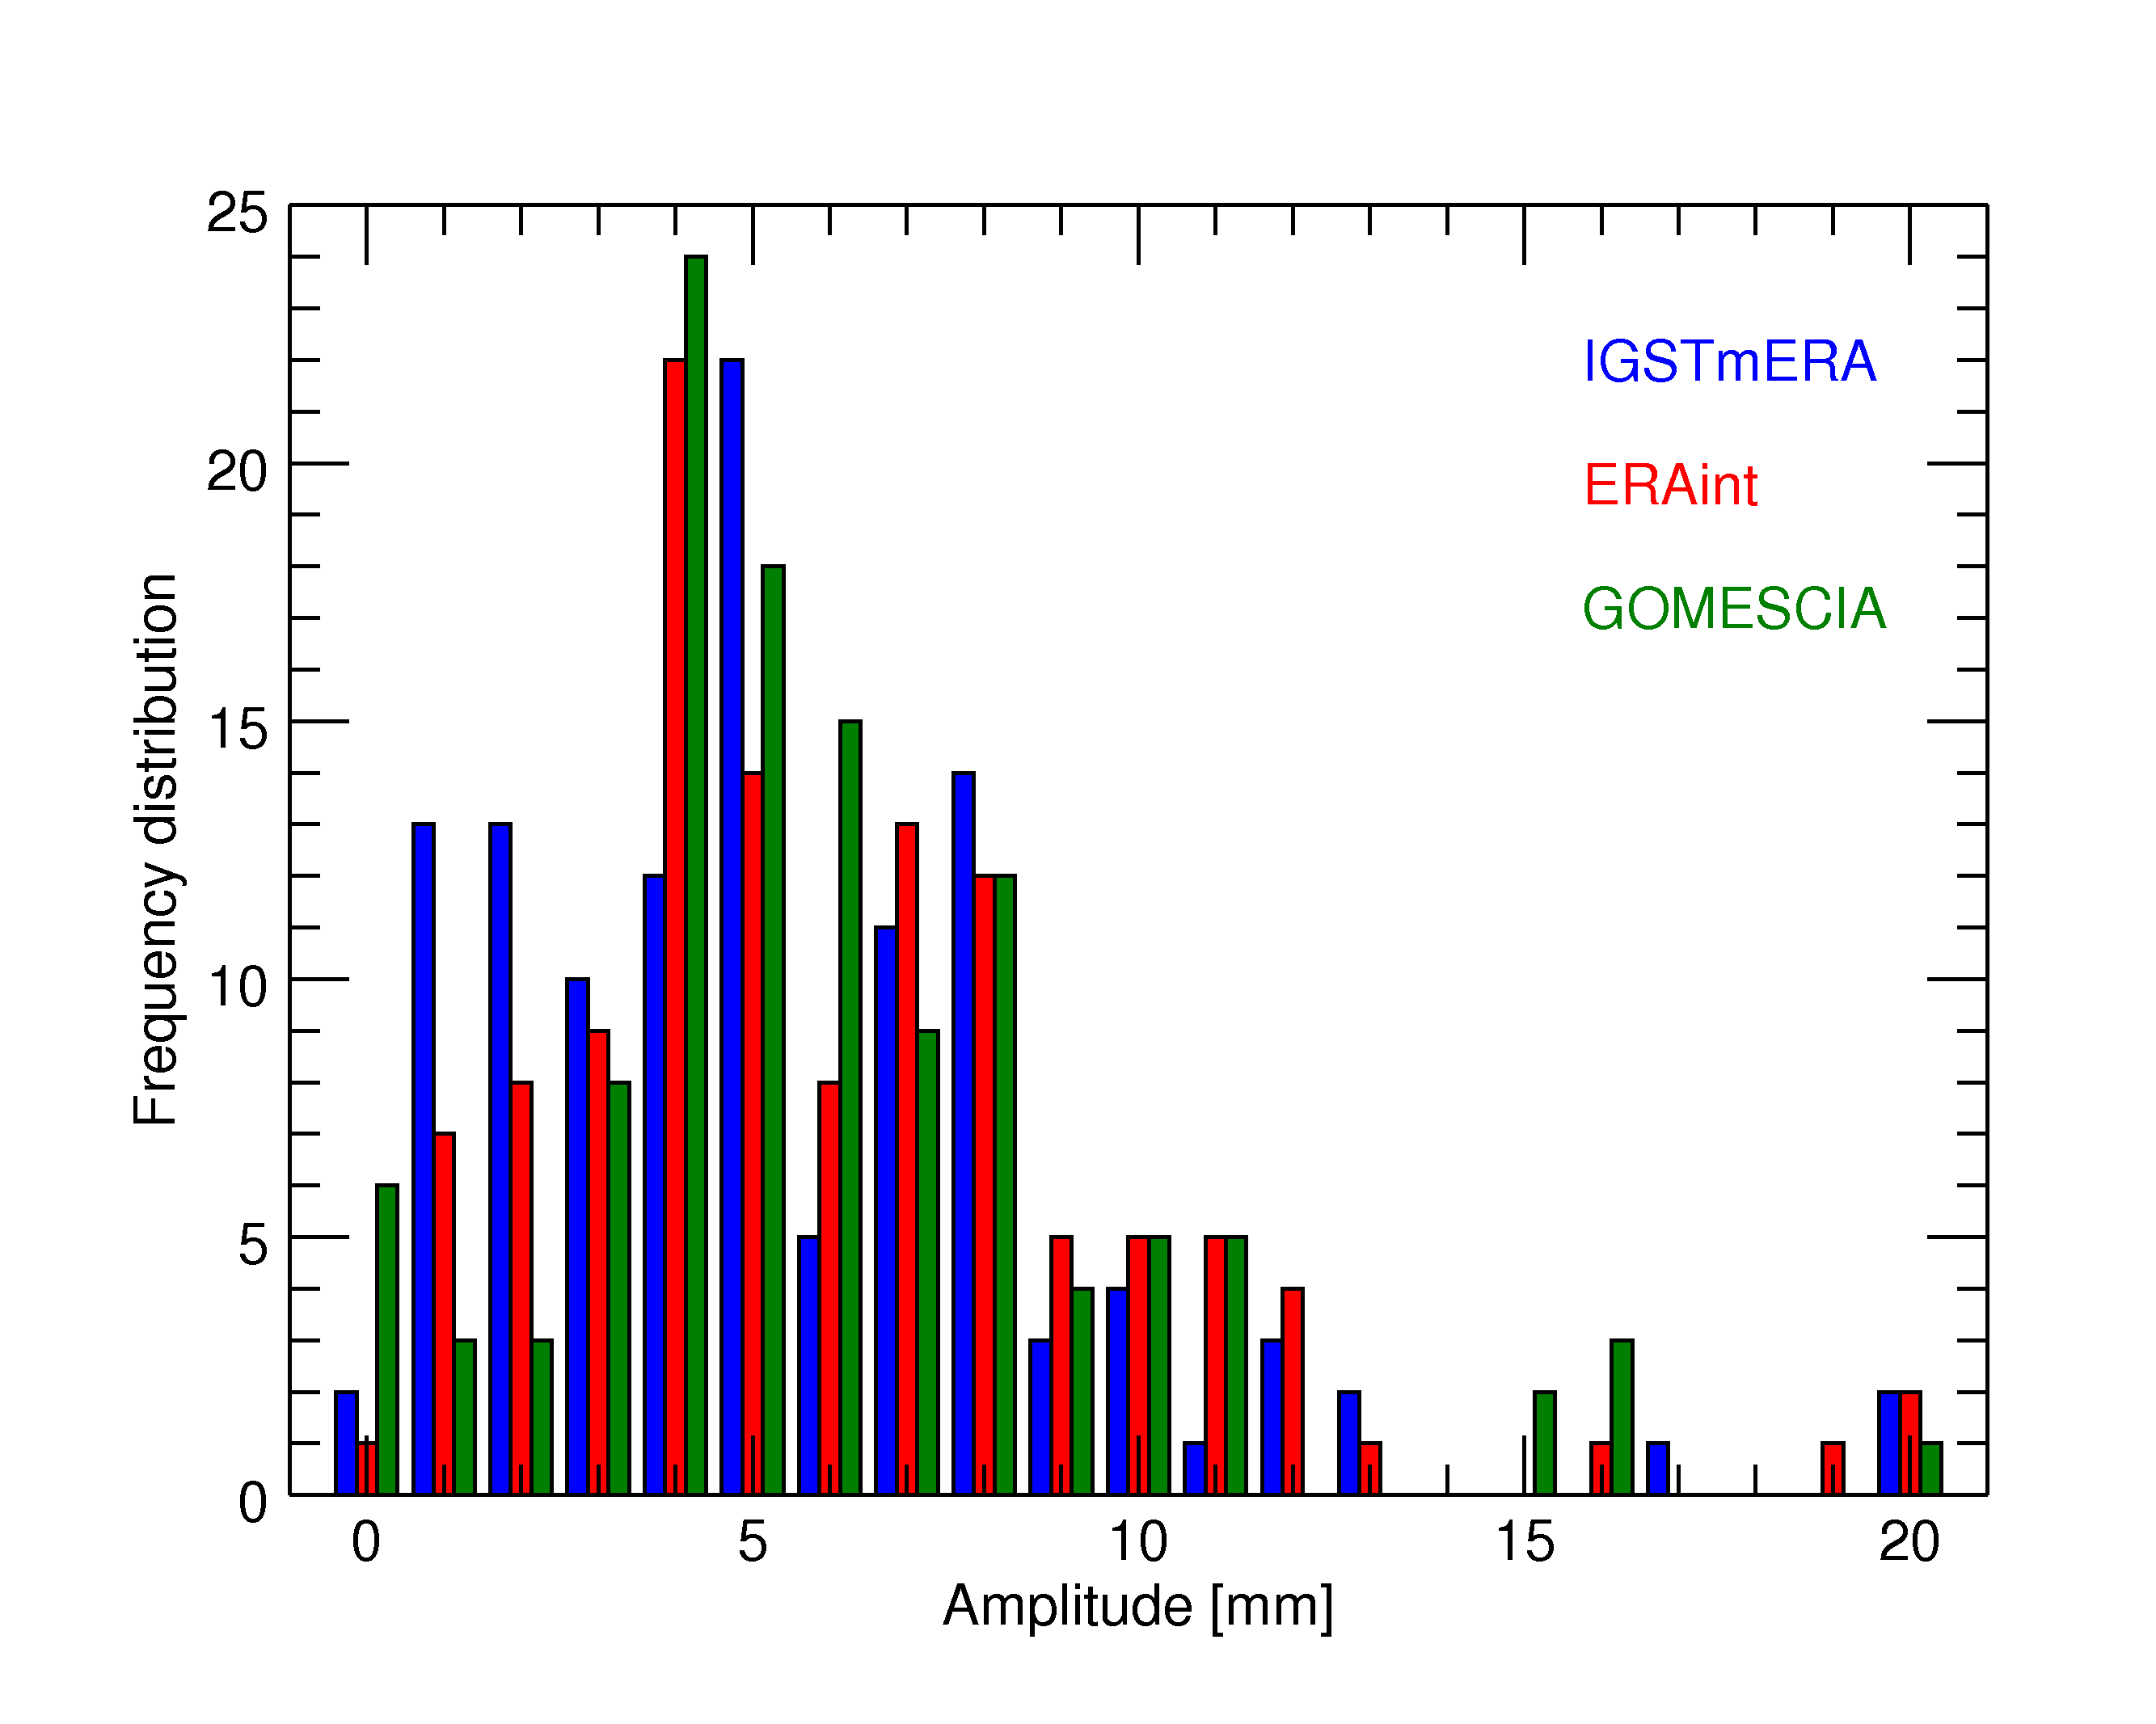
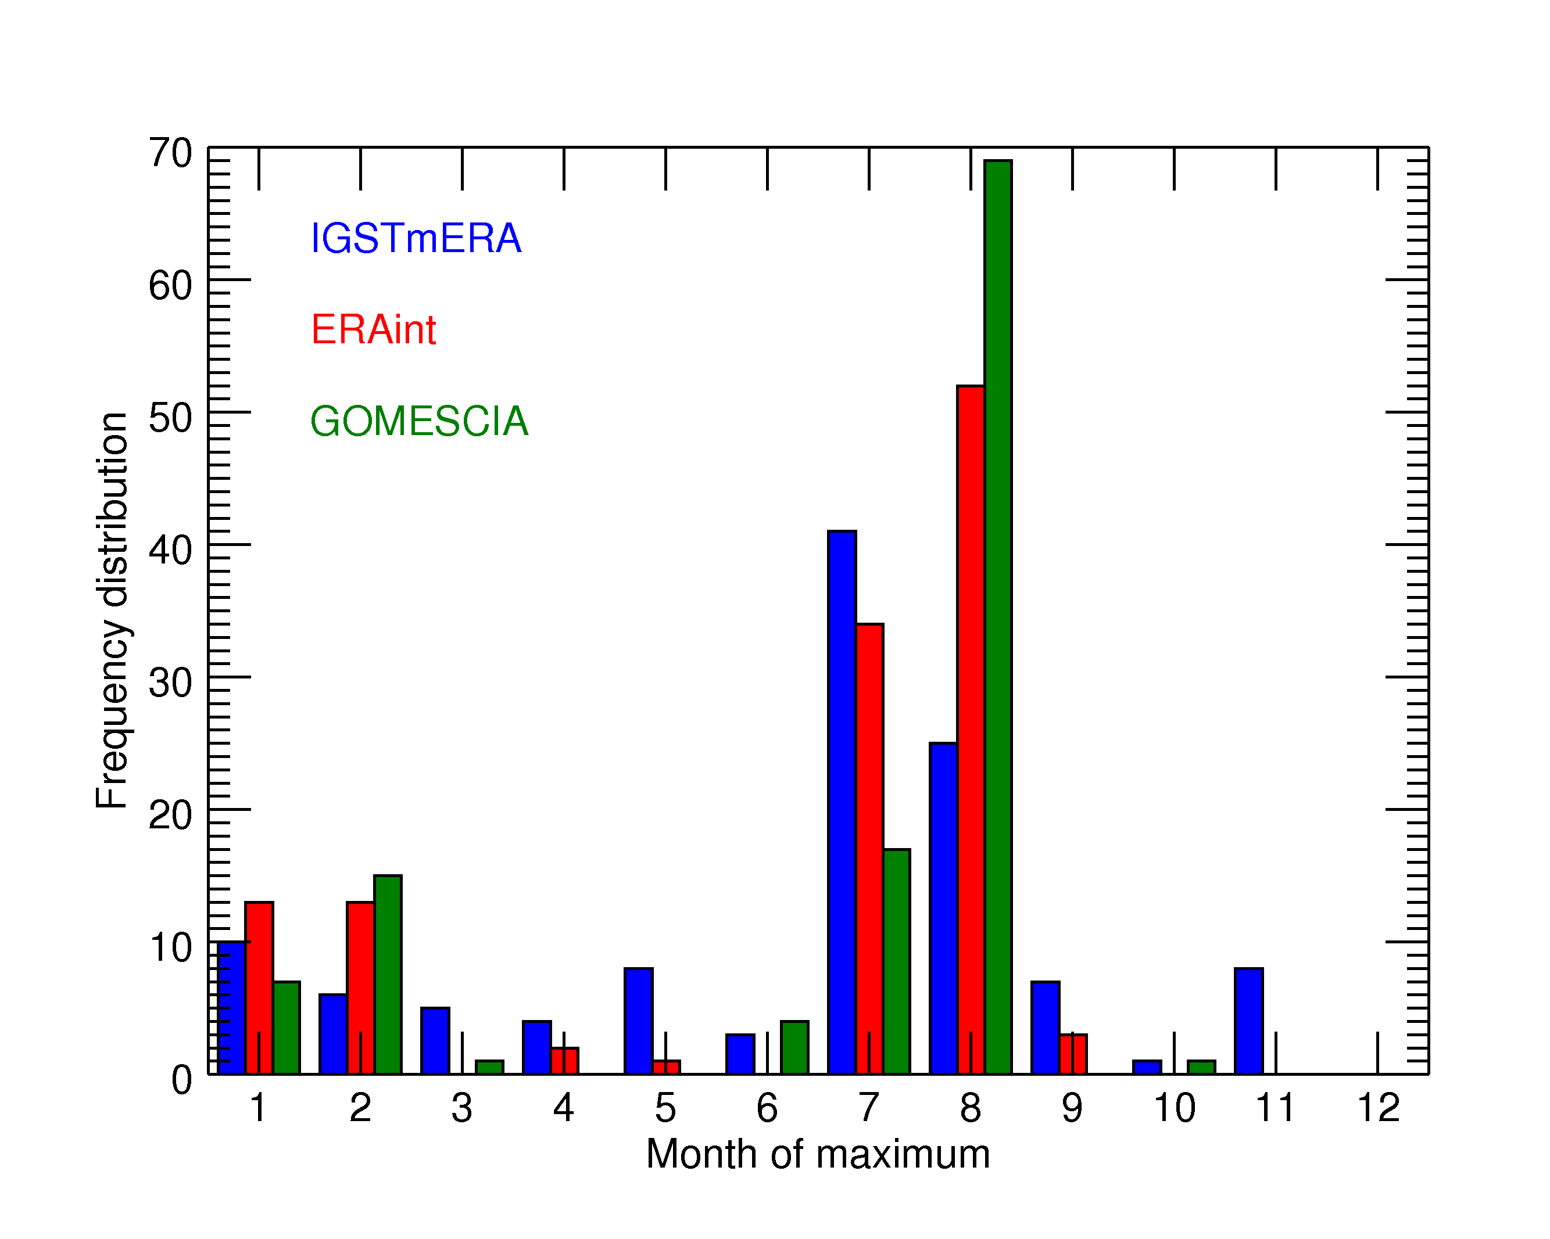
Objective
Data
Seasonal behaviour
Trends
Linear Regression
Seasonal behaviour
GOMESCIA and GNSS deviate in their representation of the lowest amplitudes (IWV ≤ 5 mm).
The phase of the maximum peaks one month later in the NH in GOMESCIA w.r.t. GNSS.
EMS Annual Meeting
Dublin, Ireland 4-8 September 2017

Slide 8
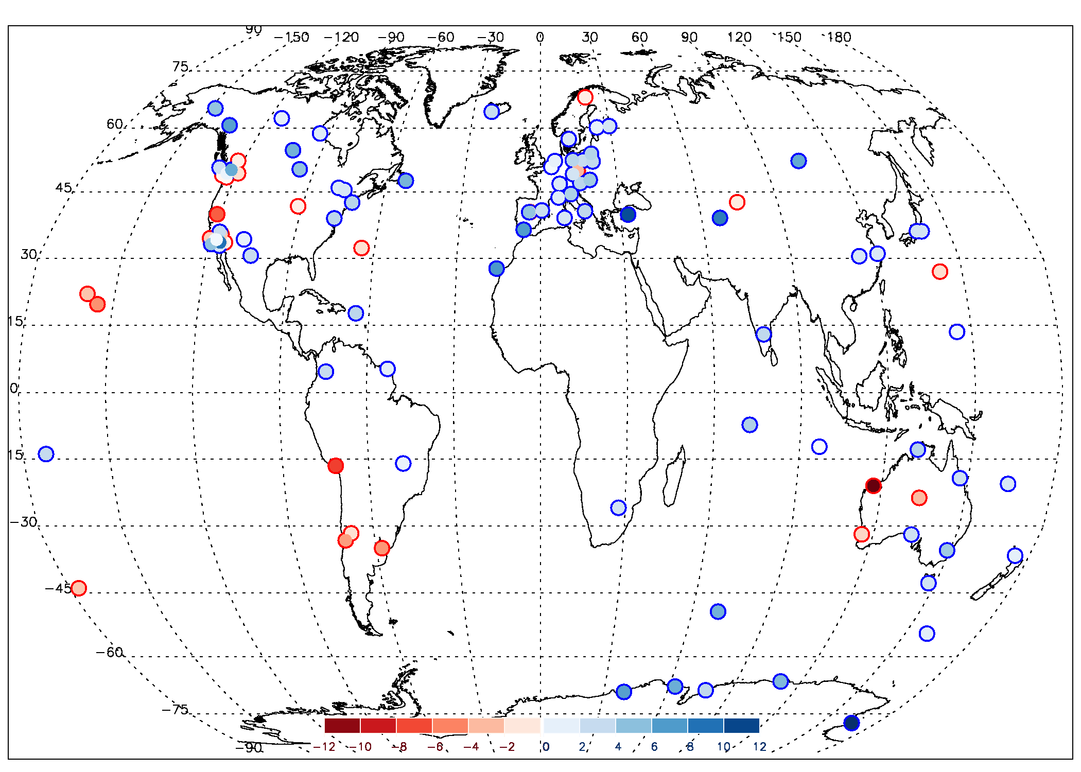
Objective
Data
Seasonal behaviour
Trends
Linear Regression
IWV trends [%/dec] (January 1996-Dec 2010)
GNSS

Slide 9
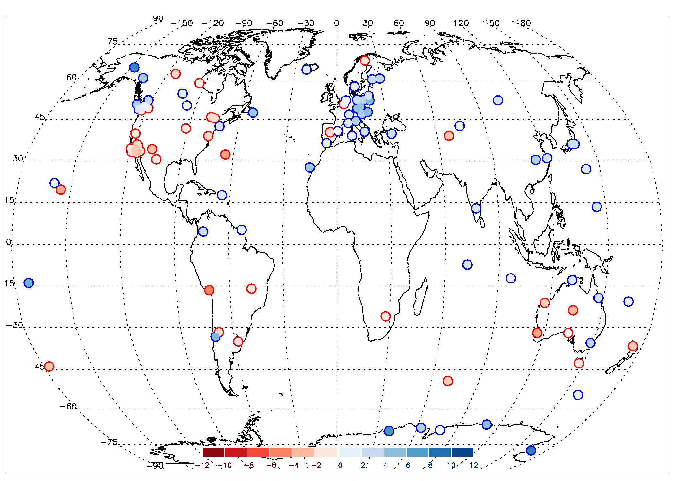
Objective
Data
Seasonal behaviour
Trends
Linear Regression
IWV trends [%/dec] (January 1996-Dec 2010)
GOMESCIA

Slide 10
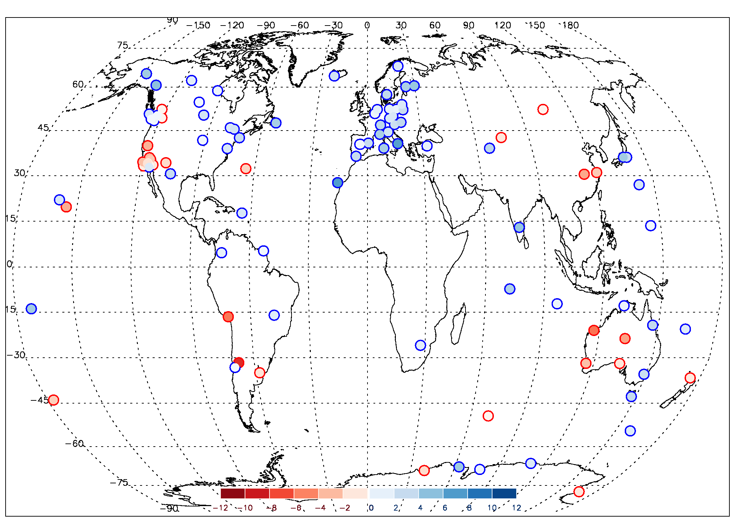
Objective
Data
Seasonal behaviour
Trends
Linear Regression
IWV trends [%/dec] (January 1996-Dec 2010)
ERAinterim

Slide 11
Objective
Data
Seasonal behaviour
Trends
Linear Regression
IWV trends [%/dec] (January 1996-Dec 2010)
GNSS

Slide 12
Objective
Data
Seasonal behaviour
Trends
Linear Regression
GNSS
GOMESCIA
ERAinterim
GNSS has highest number of sites with (statistically significant) positive trends in IWV (2/3th → 1/6th)
GOMESCIA has highest number of sites with negative trends in IWV (about half).
IWV is increasing over Europe, decreasing over West Australia
in other regions: picture less clear among the different datasets (→ inhomogeneities?)
EMS Annual Meeting
Dublin, Ireland 4-8 September 2017

Slide 13
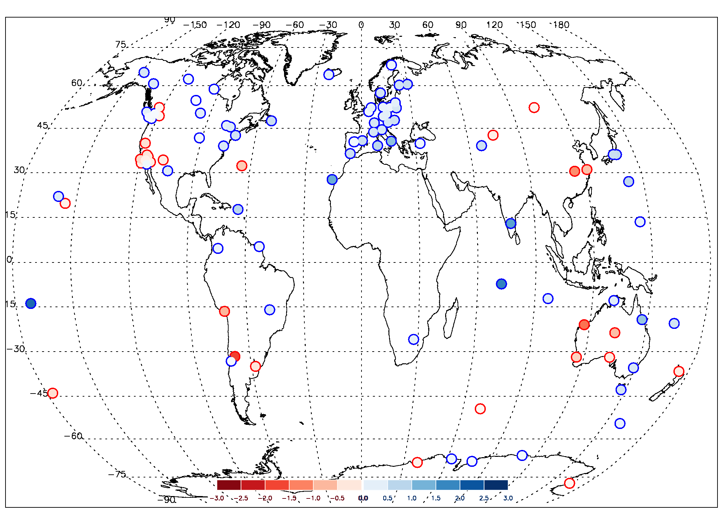
Objective
Data
Seasonal behaviour
Trends
Linear Regression
GNSS
GOMESCIA
ERAinterim
T_{s}, ERAinterim
= ?

Slide 14
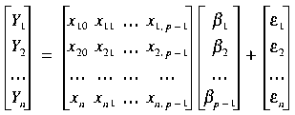
Objective
Data
Seasonal behaviour
Trends
Linear Regression
Main focus in this presentation:
What are the main drivers of the seasonal variability and long-term time behaviour of the IWV time series?
How can this scientific question be assessed?
  running climate models and study the underlying processes (e.g. validation of climate models with GNSS IWV retrievals → see e.g. talk by Julie Berckmans et al., OSA1.4, yesterday)
  “poor man’s approach”: stepwise multiple linear regression, with representations (=time series, in particular monthly means) of circulation patterns (e.g. ENSO) and lower-atmospheric oscillations (e.g. NAO): means (or harmonics), T_{surf}, P_{surf}, P_{tropo}, all teleconnection patterns (with lead times) → OVERSHOOT!!!
Y = β₀ + β₁x₁ + β₂x₂ + …+ β_{p-1} X_{p-1} + ε
means
T_{surf}
residuals
EMS Annual Meeting
Dublin, Ireland 4-8 September 2017

Slide 15
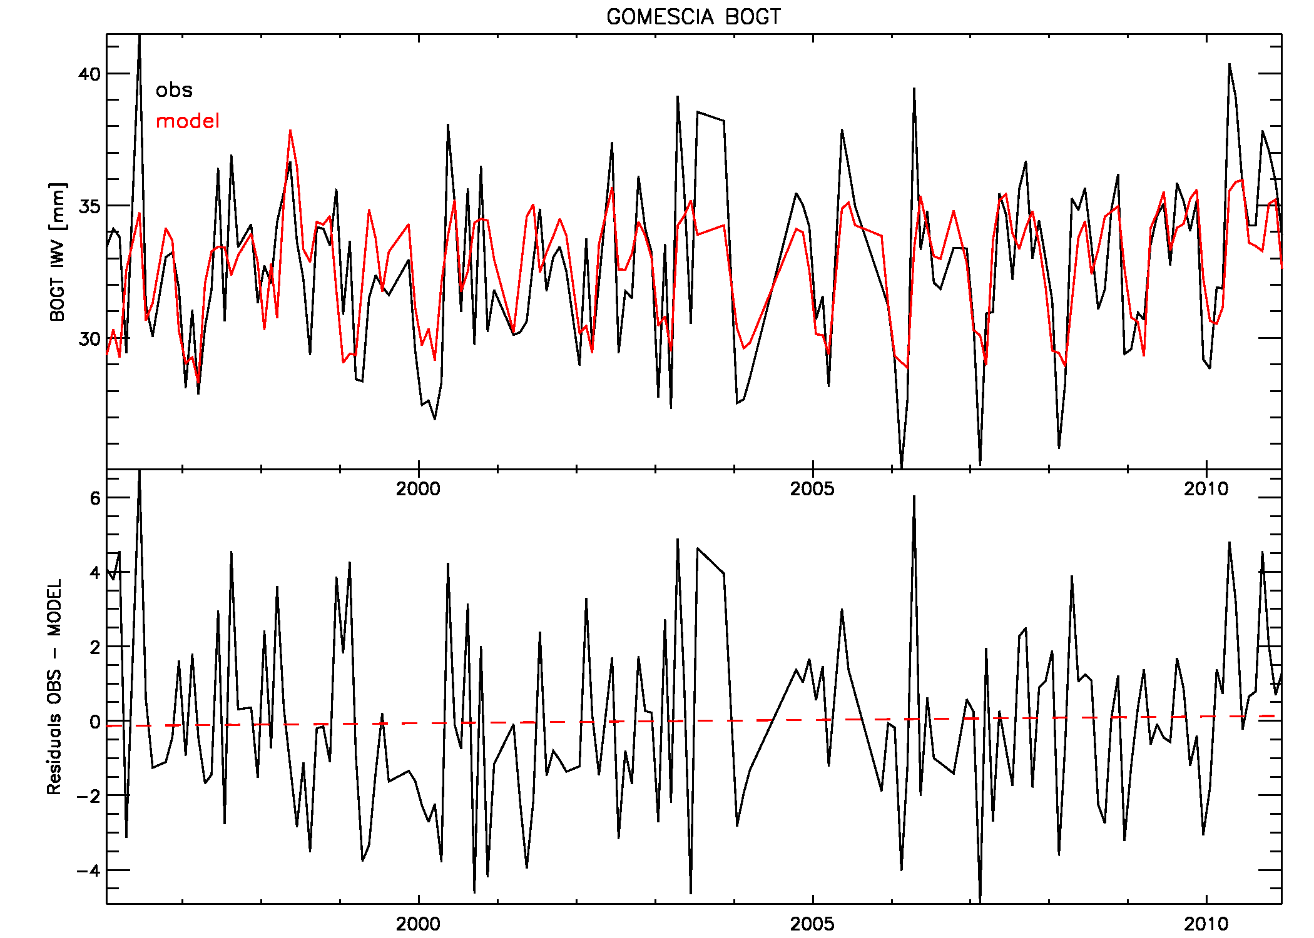
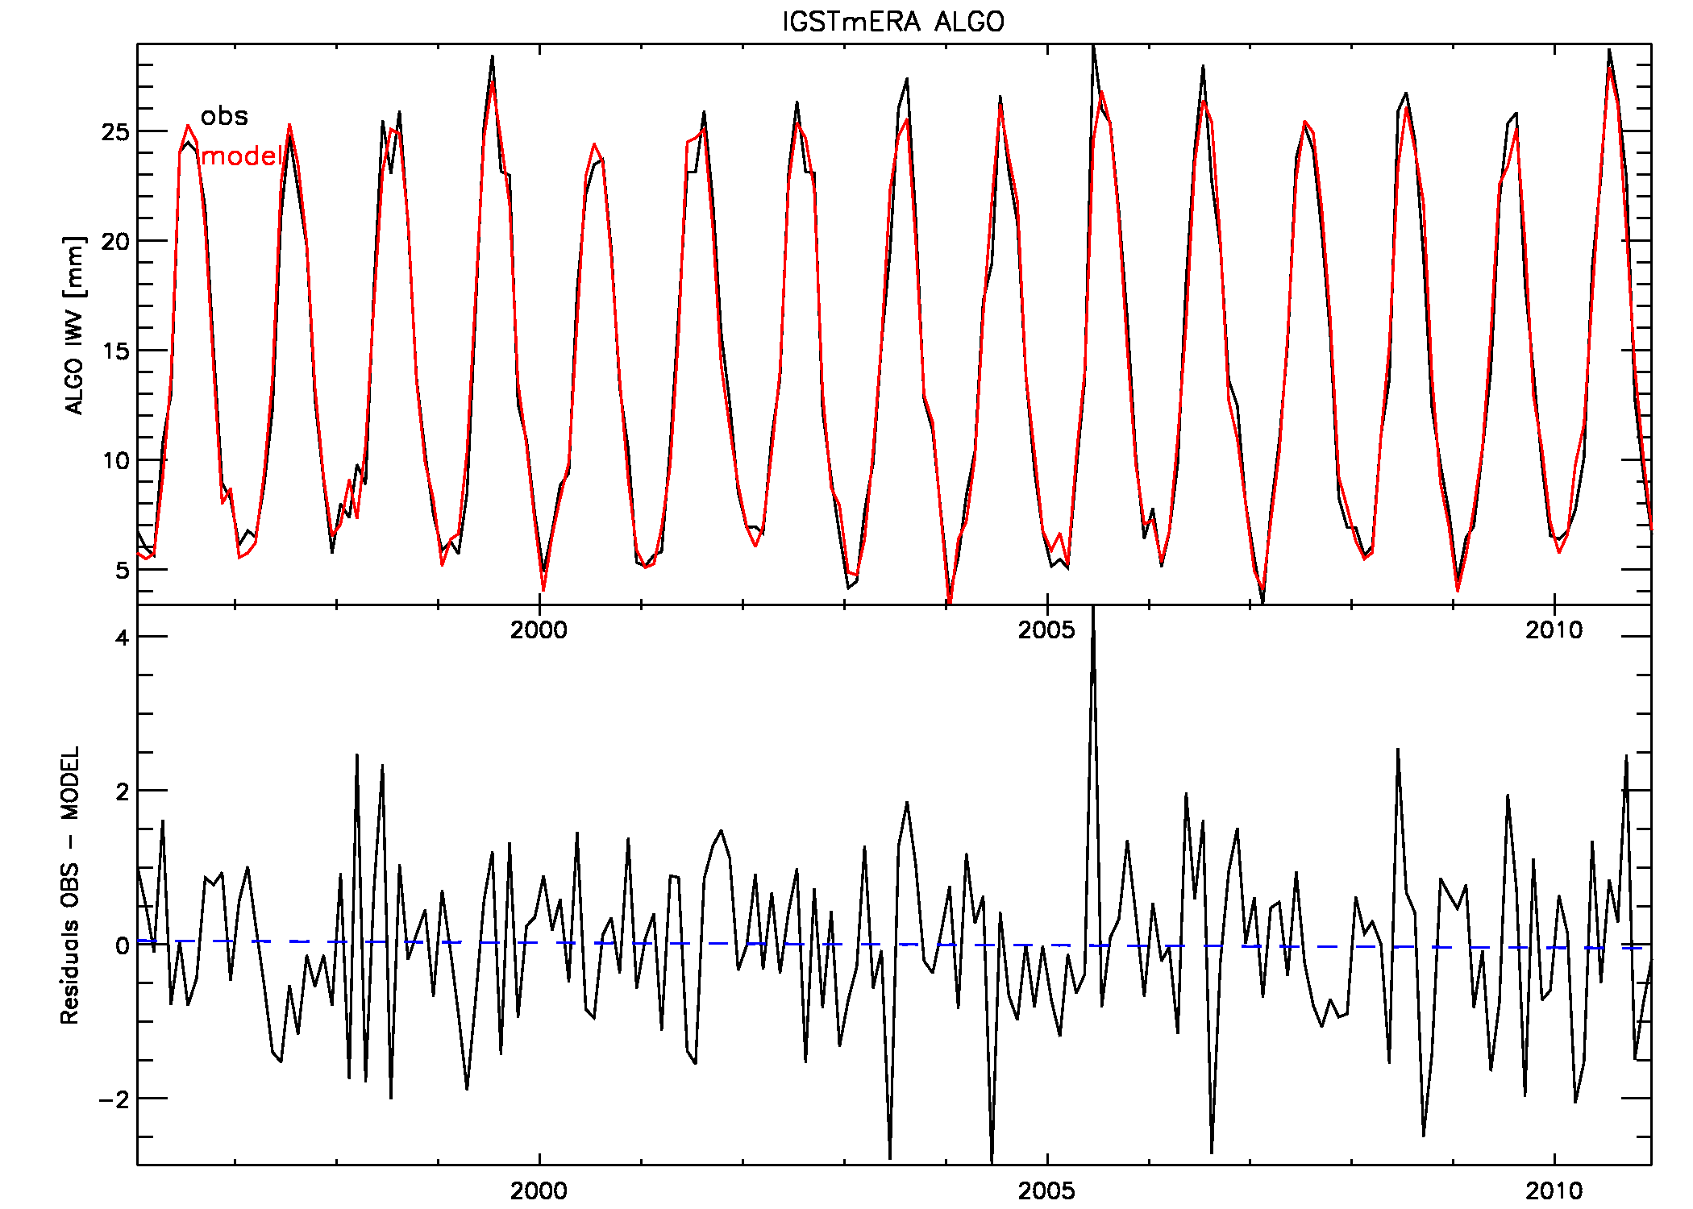
Objective
Data
Seasonal behaviour
Trends
Linear Regression
Examples of the linear regression fit
Bad fit: Bogota (Colombia) for GOMESCIA
Good fit: Algonquin Park (Canada) for GNSS
explanatory variables used: means, East Atlantic/West Russia pattern (1m leading), Polar/Eurasia pattern (6m leading)
44.5% of variability can be explained, R² = 0.665
explanatory variables used: means, T_{surf} , P_{tropo} , EP flux, Tropical/Northern Hemisphere pattern, East Atlantic/West Russia pattern (4m leading), Polar/Eurasia pattern, Pacific Transition pattern
97.9% of variability can be explained, R² = 0.989

Slide 16
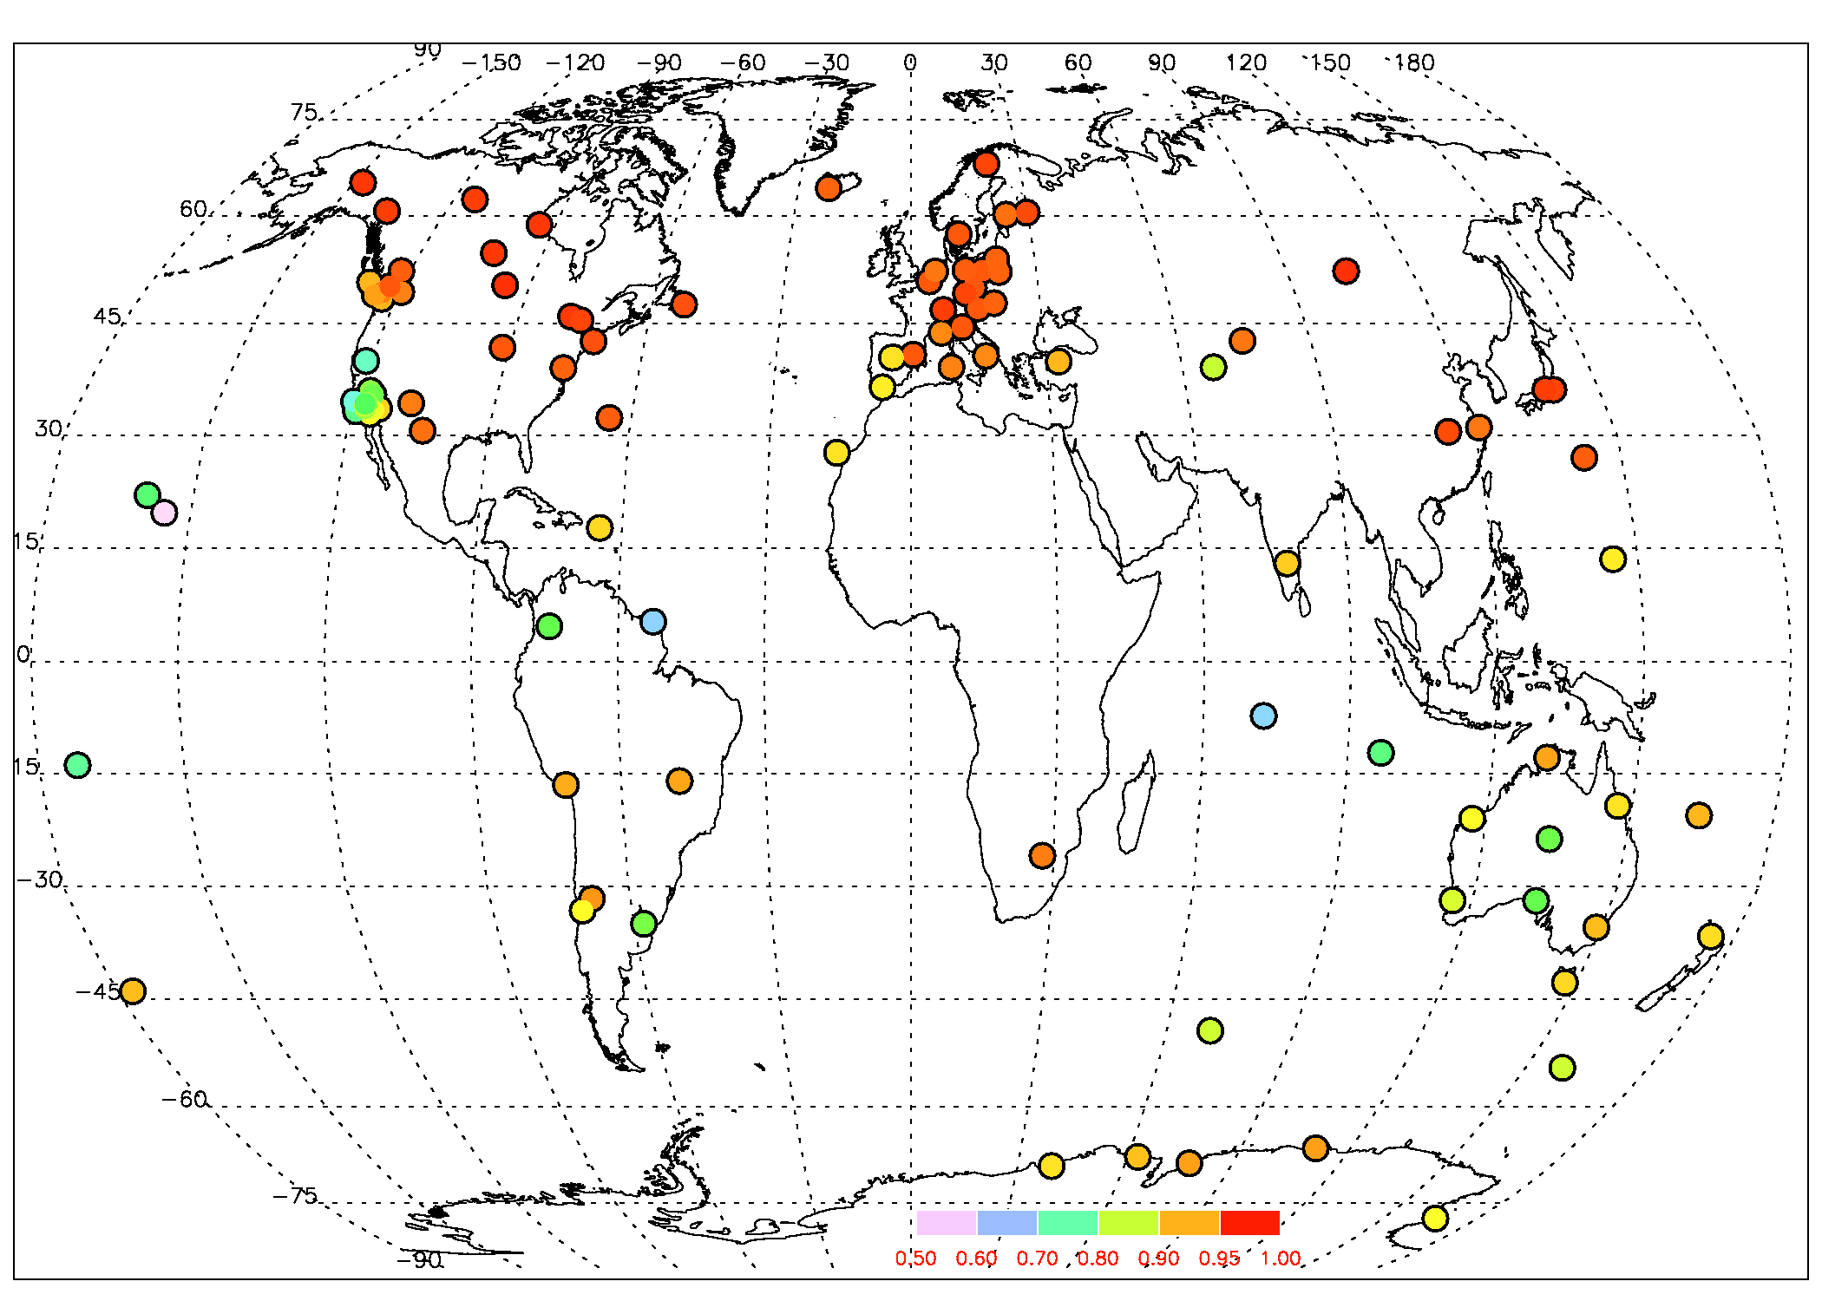

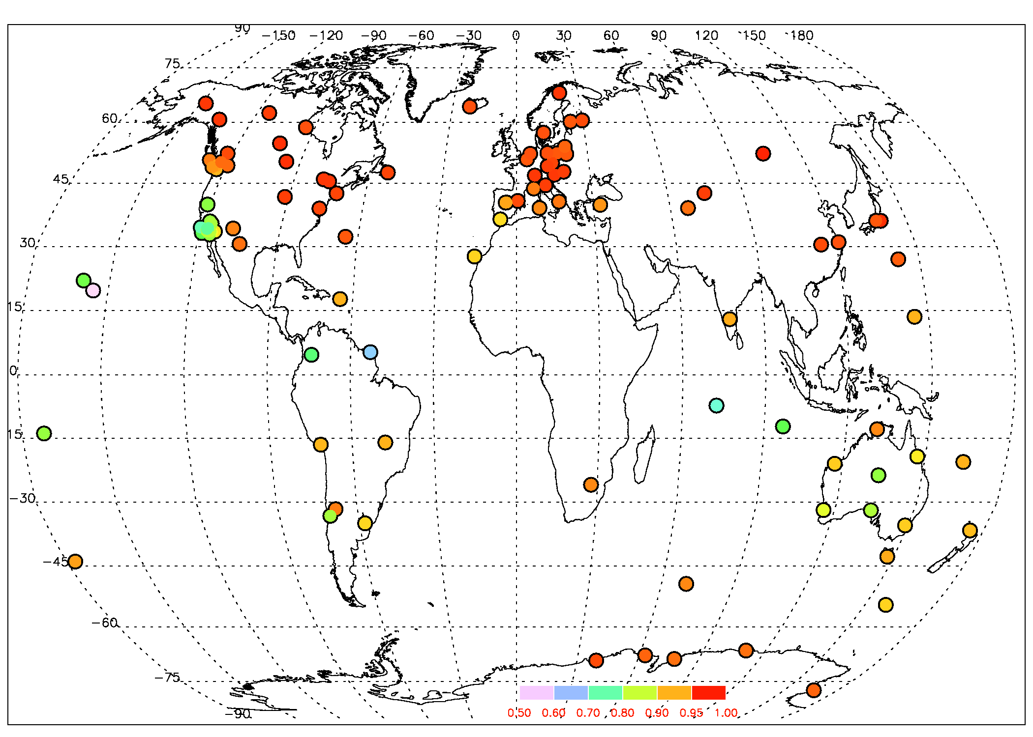
Objective
Data
Seasonal behaviour
Trends
Linear Regression
GNSS
GOMESCIA
ERAinterim
ERA-interim time series are best fitted (but: T_{surf} and P_{surf} ← ERA-interim), GOMESCIA worst
best fit (highest R²) in Europe and USA (except southern west coast) → due to the choice of proxies (NH teleconnection patterns)?
EMS Annual Meeting
Dublin, Ireland 4-8 September 2017

Slide 17
Objective
Data
Seasonal behaviour
Trends
Linear Regression
mean, T_{surf}, P_{surf}, P_{tropo}, NAO, EP flux, PT, TNH
mean, T_{surf}, P_{surf}, P_{tropo}, EA, POL, TNH
mean, T_{surf}, P_{surf}, EAWR, PDO, WHWP
mean, T_{surf}, P_{surf}, EP flux, TNH
mean, T_{surf}, P_{tropo}, QBO, POL, AMO
mean, T_{surf}, P_{surf}, EAWR
mean, T_{surf}, P_{surf}, ENSO, PNA
mean, T_{surf}, P_{surf}, QBO, AO, TNH, AMO

Slide 18
Objective
Data
Seasonal behaviour
Trends
Linear Regression
Discussion
The bulk of the variability is explained by the surface temperature (after accounting for the seasonal cycle by long term means or harmonics) → long term variability (Claussius-Clapeyron) and/or remaining seasonality?
Other important proxies: P_{surf}, EP flux, P_{trop}, TNH.
There is some regional consistency in the use of the proxies (ENSO in Australia, NAO in USA/Canada, EA in Europe), but not always (AO in Antarctica, PNA in Australia) or always not ☺ . Some more work needed to guide the selection of the proxies.
A linear trend was retained as explanatory variable only for few sites. The residuals only show for a limited number of sites a significant trend. The stepwise multiple linear regression fits are hence able to capture the (overall positive) trend in IWV.
Every used dataset has its strengths and weaknesses, combining the three of them has the potential to characterize the IWV time variability.
EMS Annual Meeting
Dublin, Ireland 4-8 September 2017

Slide 19
painting by Jess Sutton
Thank you!
EMS Annual Meeting
Dublin, Ireland 4-8 September 2017

