Slide 1
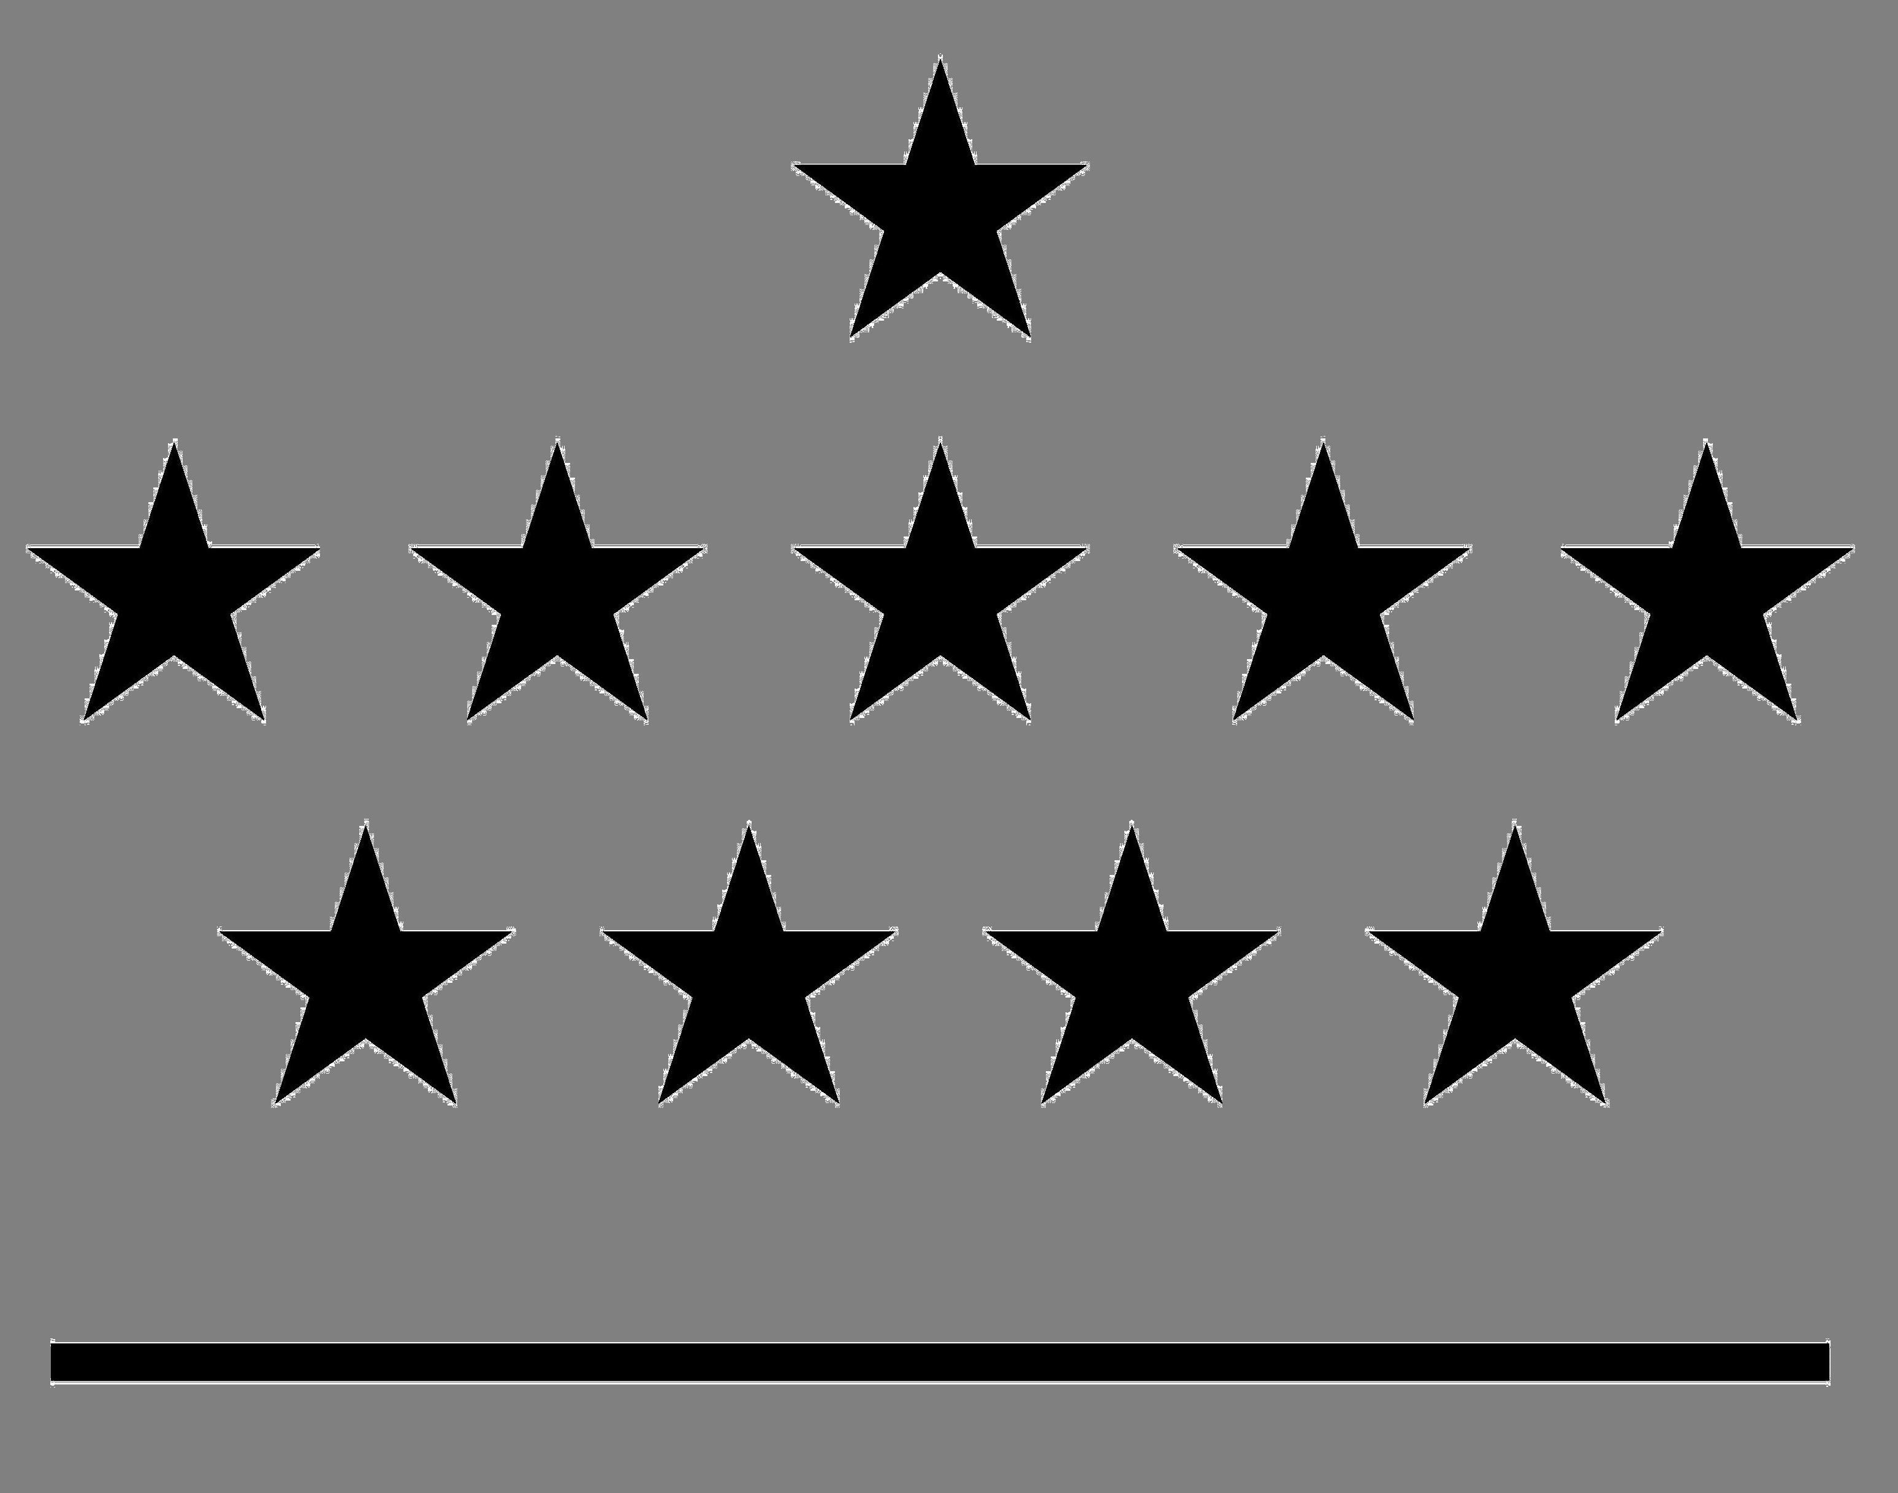



The Integrated Water Vapour project in Belgium: techniques intercomparison and time series analysis
Royal Meteorological Institute of Belgium
Royal Observatory of Belgium
Belgian Institute for Space Aeronomy
Max Planck Institute for Chemistry
Solar-Terrestrial Centre of Excellence
1
2
3
4
5
R. Van Malderen^{1,5}, E. Pottiaux^{2,5}, H. Brenot^{3,5}, S. Beirle⁴, C. Hermans³, M. De Mazière³, T. Wagner⁴, H. De Backer¹ and C. Bruyninx^{2,5}

Slide 2




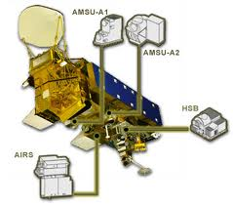

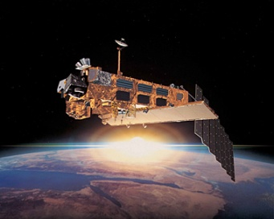


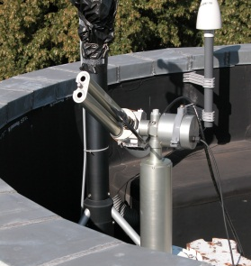
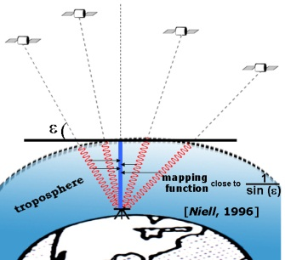
ROB
IWV techniques intercomparison
GOME/SCIAMACHY/GOME-2
satellite
AIRS
NASA
total column water vapour
ground-based
CIMEL sun photometer
GPS (IGS)
radiosondes
GNSS4SWEC, WG3
Valencia, Spain
16-17 October 2013
Techniques intercomparison

Slide 3
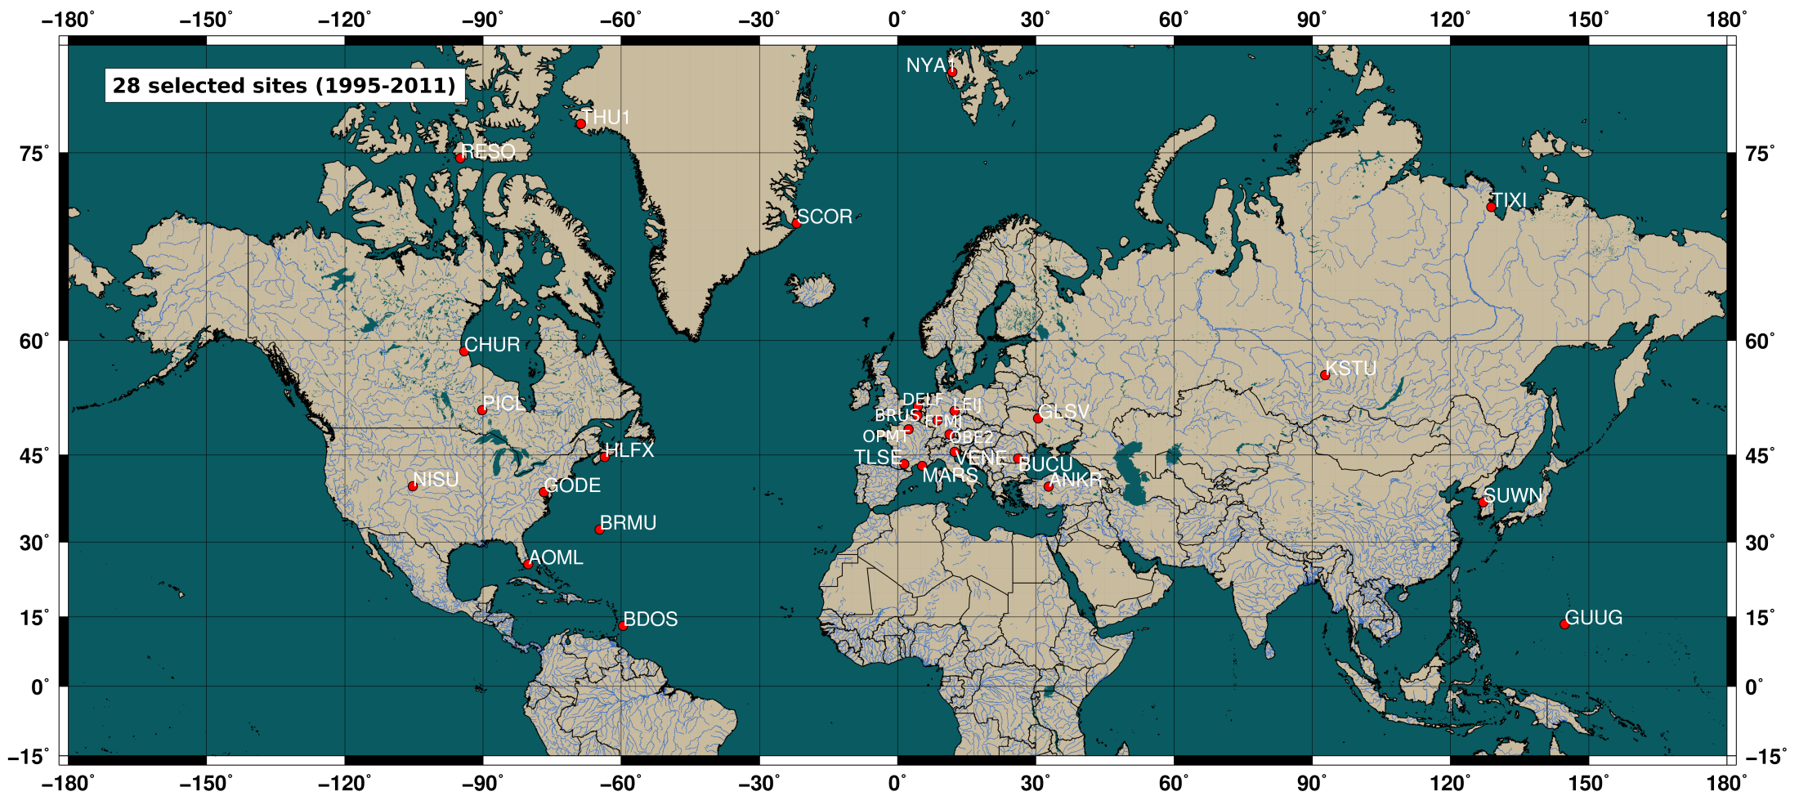
ROB
selection of 28 sites world-wide (NH), with focus on CIMEL-GPS co-location and based on meteo data availability (GPS)!
altitude correction between data (raw data, meteo data and IWV data) gathered at sites with different altitudes!
GNSS4SWEC, WG3
Valencia, Spain
16-17 October 2013
Techniques intercomparison

Slide 4
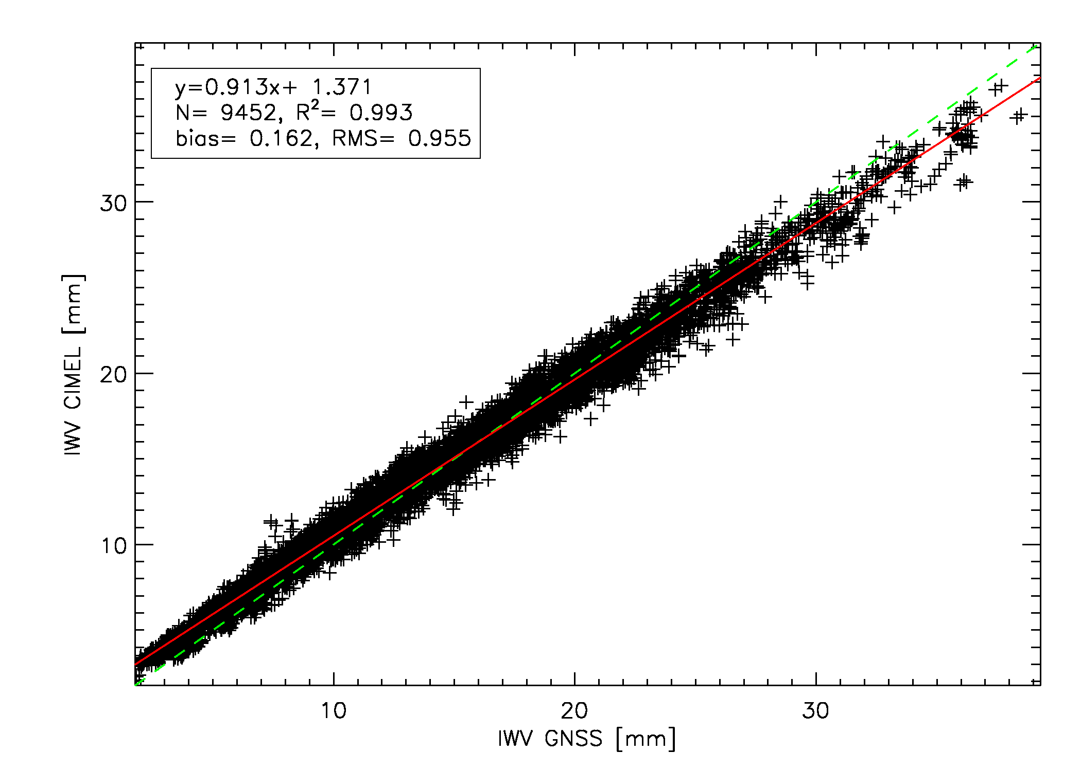
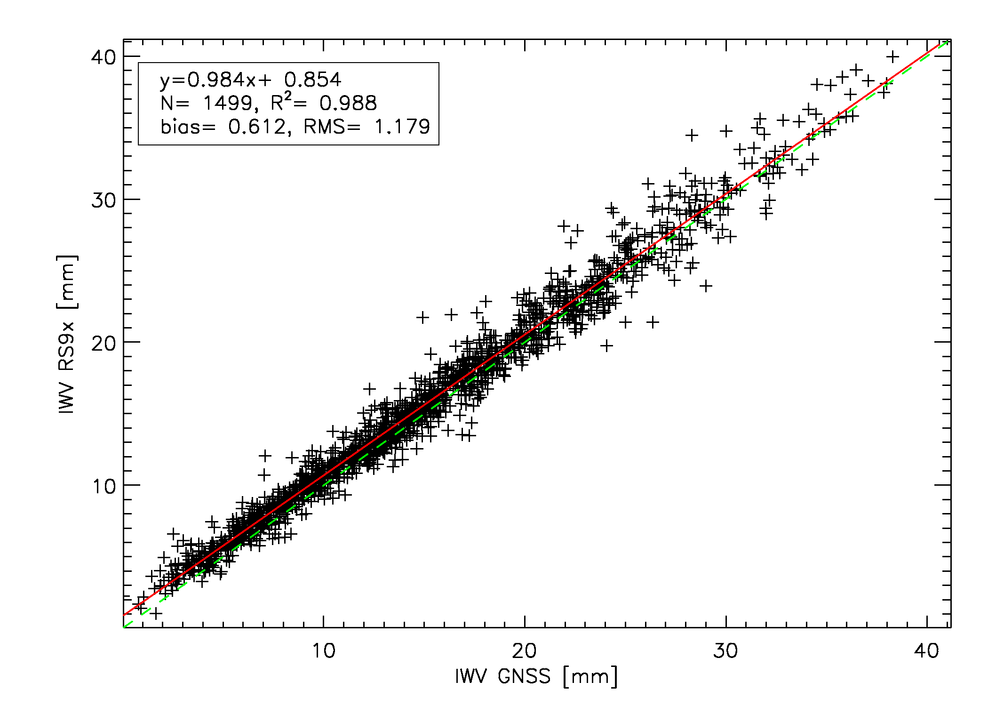
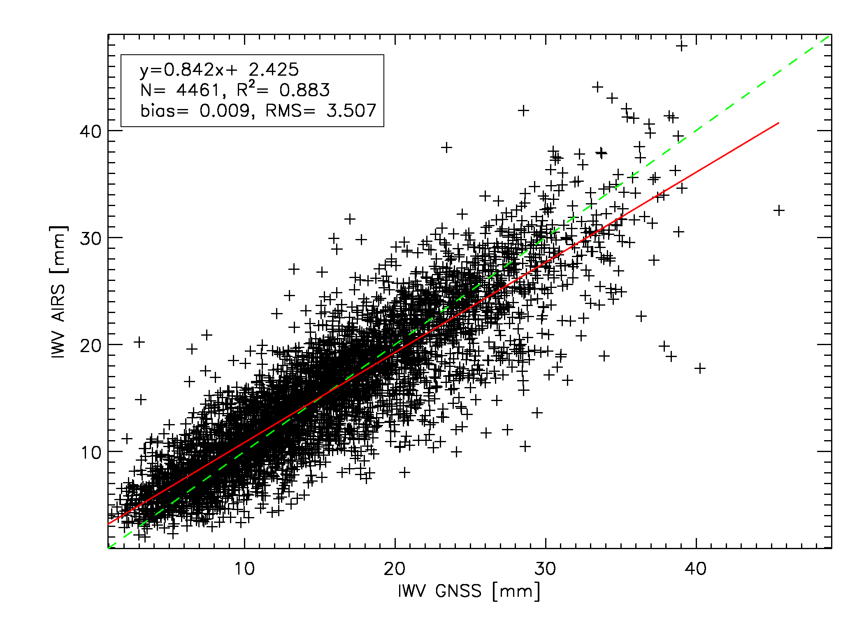
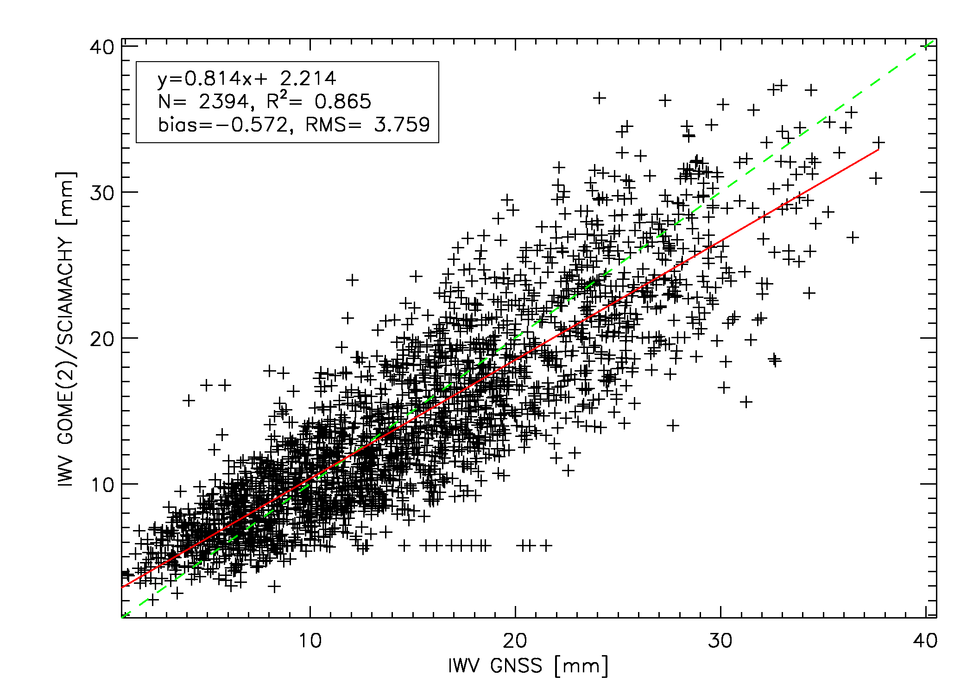
ROB
R² = 0.993
y = 0.984x
GPS-CIMEL
GPS-RS9x
Brussels
Impact of cloud cover???
GPS-AIRS
GPS-GOMESCIA
GNSS4SWEC, WG3
Valencia, Spain
16-17 October 2013
bias with GPS ranges between -0.6 mm and +0.6 mm
Techniques intercomparison

Slide 5
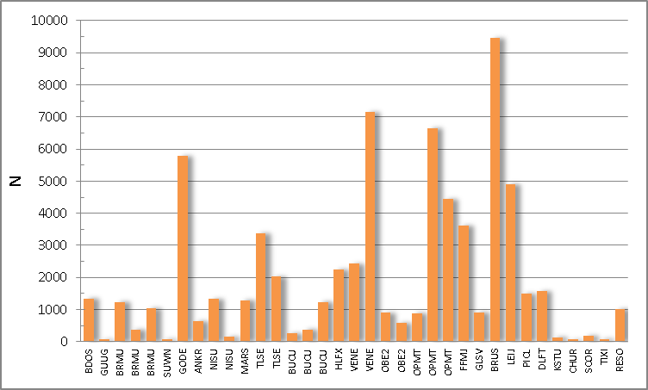
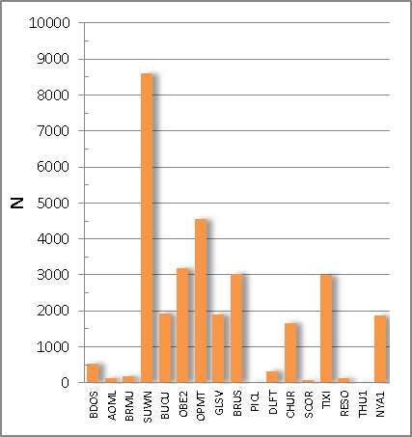
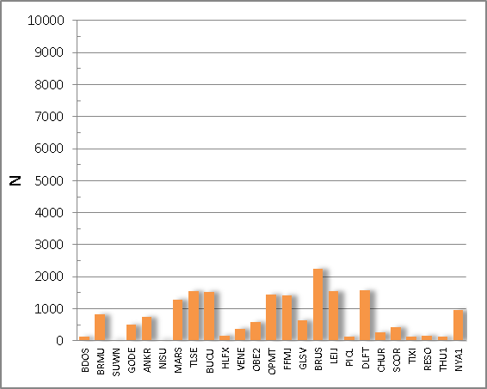
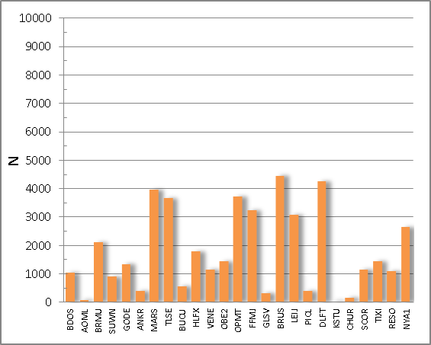
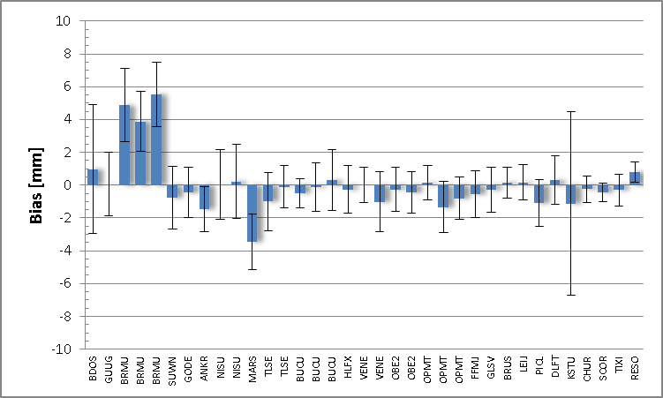
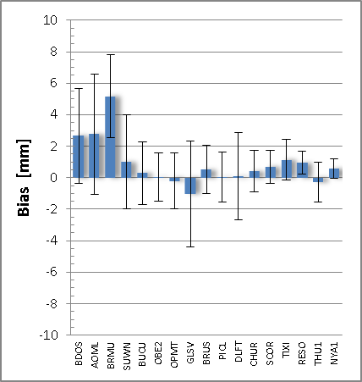
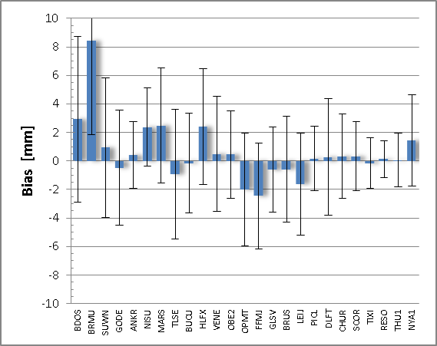
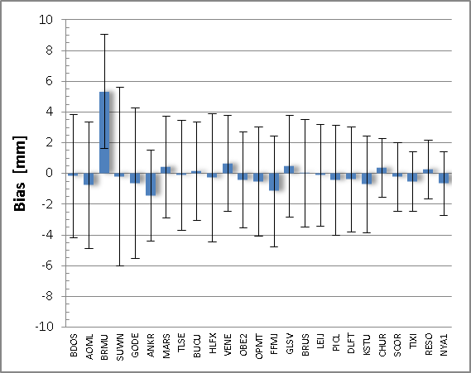
ROB
GPS - CIMEL
GPS - RS
GPS - GOMESCIA
GPS - AIRS
scatter plot properties for the 28 co-locations, ordered with increasing latitute from left to right
geographical dependency?
GNSS4SWEC, WG3
Valencia, Spain
16-17 October 2013
Techniques intercomparison

Slide 6
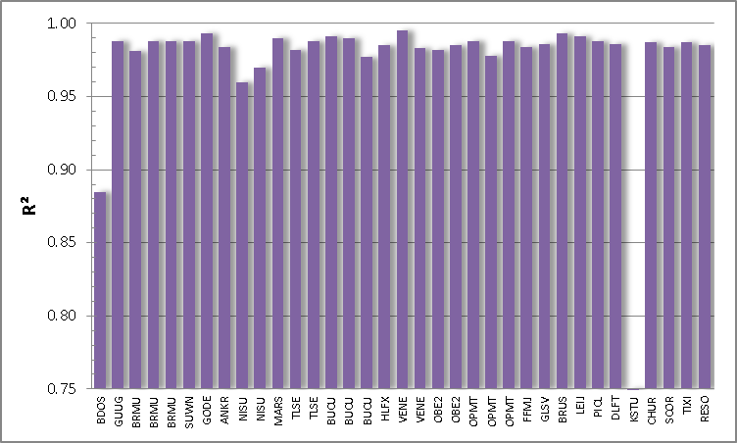
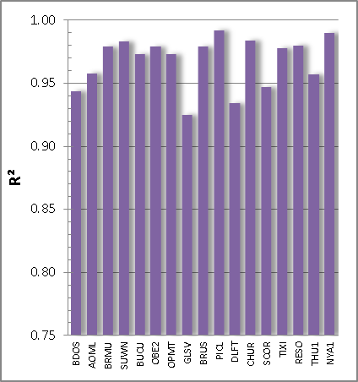
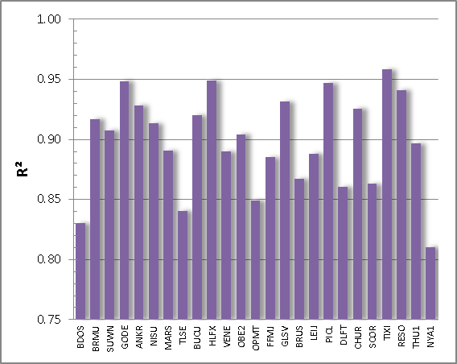
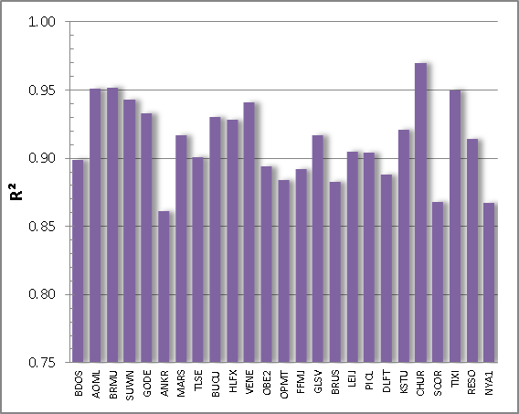
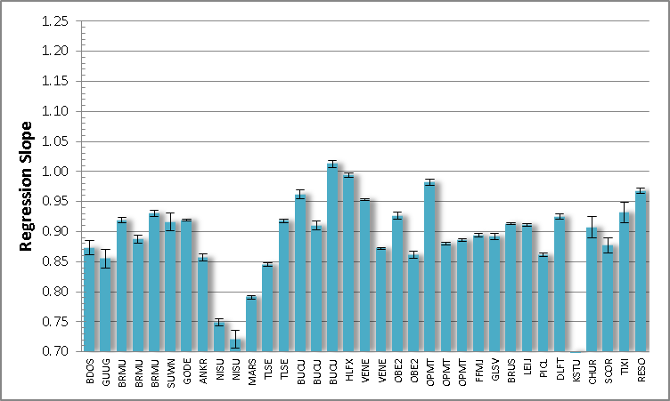
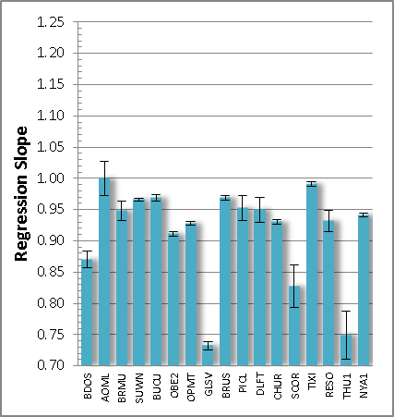
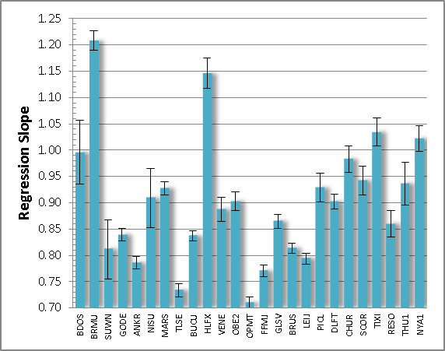
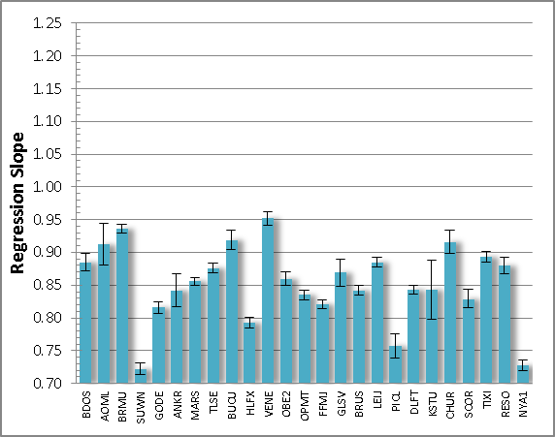
ROB
GPS - CIMEL
GPS - RS
GPS - GOMESCIA
GPS - AIRS
scatter plot properties for the 28 co-locations, ordered with increasing latitute from left to right
geographical dependency?
GNSS4SWEC, WG3
Valencia, Spain
16-17 October 2013
Techniques intercomparison

Slide 7
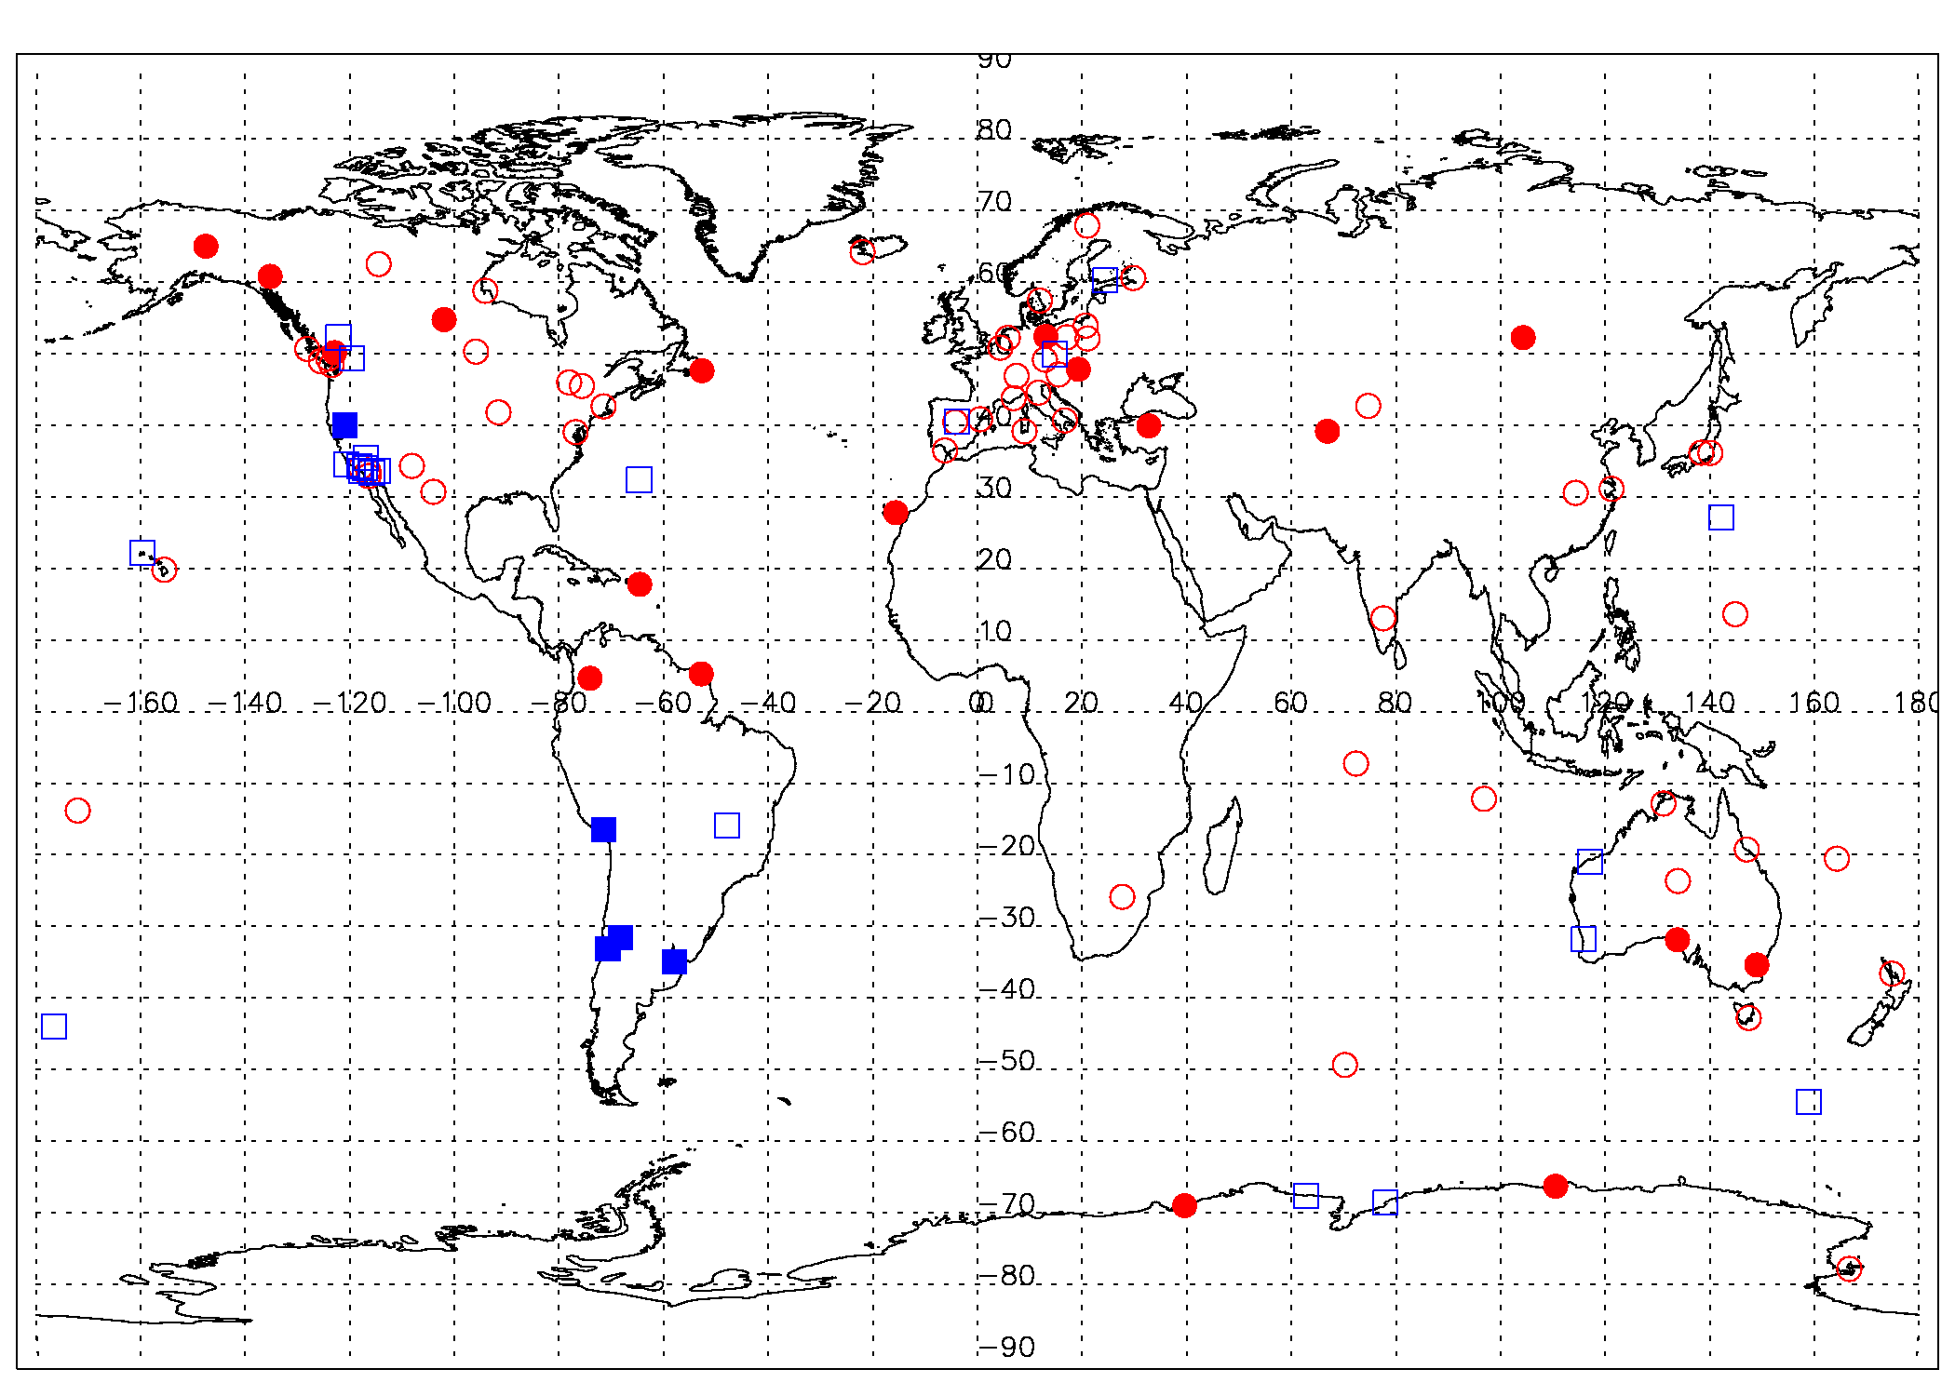
ROB
IWV trends for all IGS stations starting in 1995/1996
geographical inconsistencies
Are these related with the chosen database for meteorological parameters (NCEPDOE)?
What are the ERA-interim and GOME (2)/SCIAMACHY trends at these stations?
○
IWV ↗
□
IWV ↘
GNSS4SWEC, WG3
Valencia, Spain
16-17 October 2013
▪
●
IWV ↗ significantly
IWV ↘ significantly
Sensitivity analysis/trends

