Slide 1
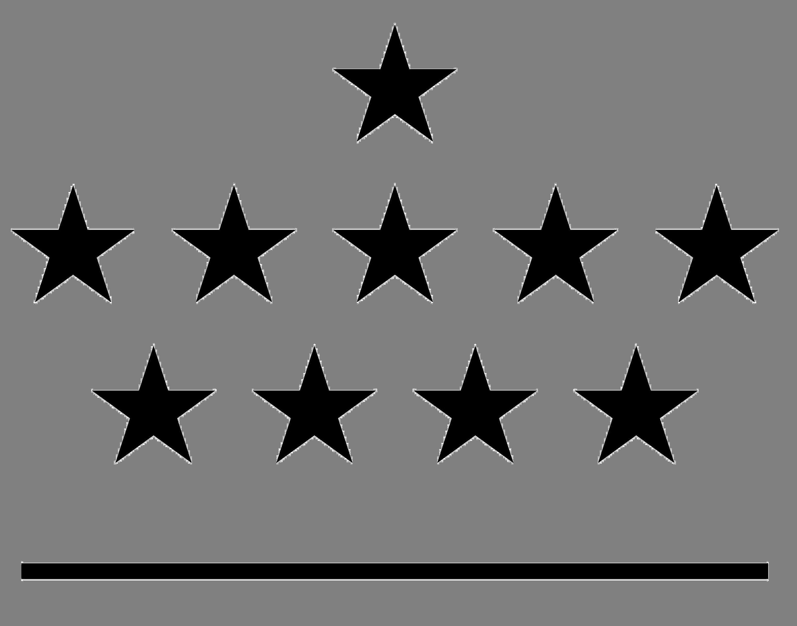



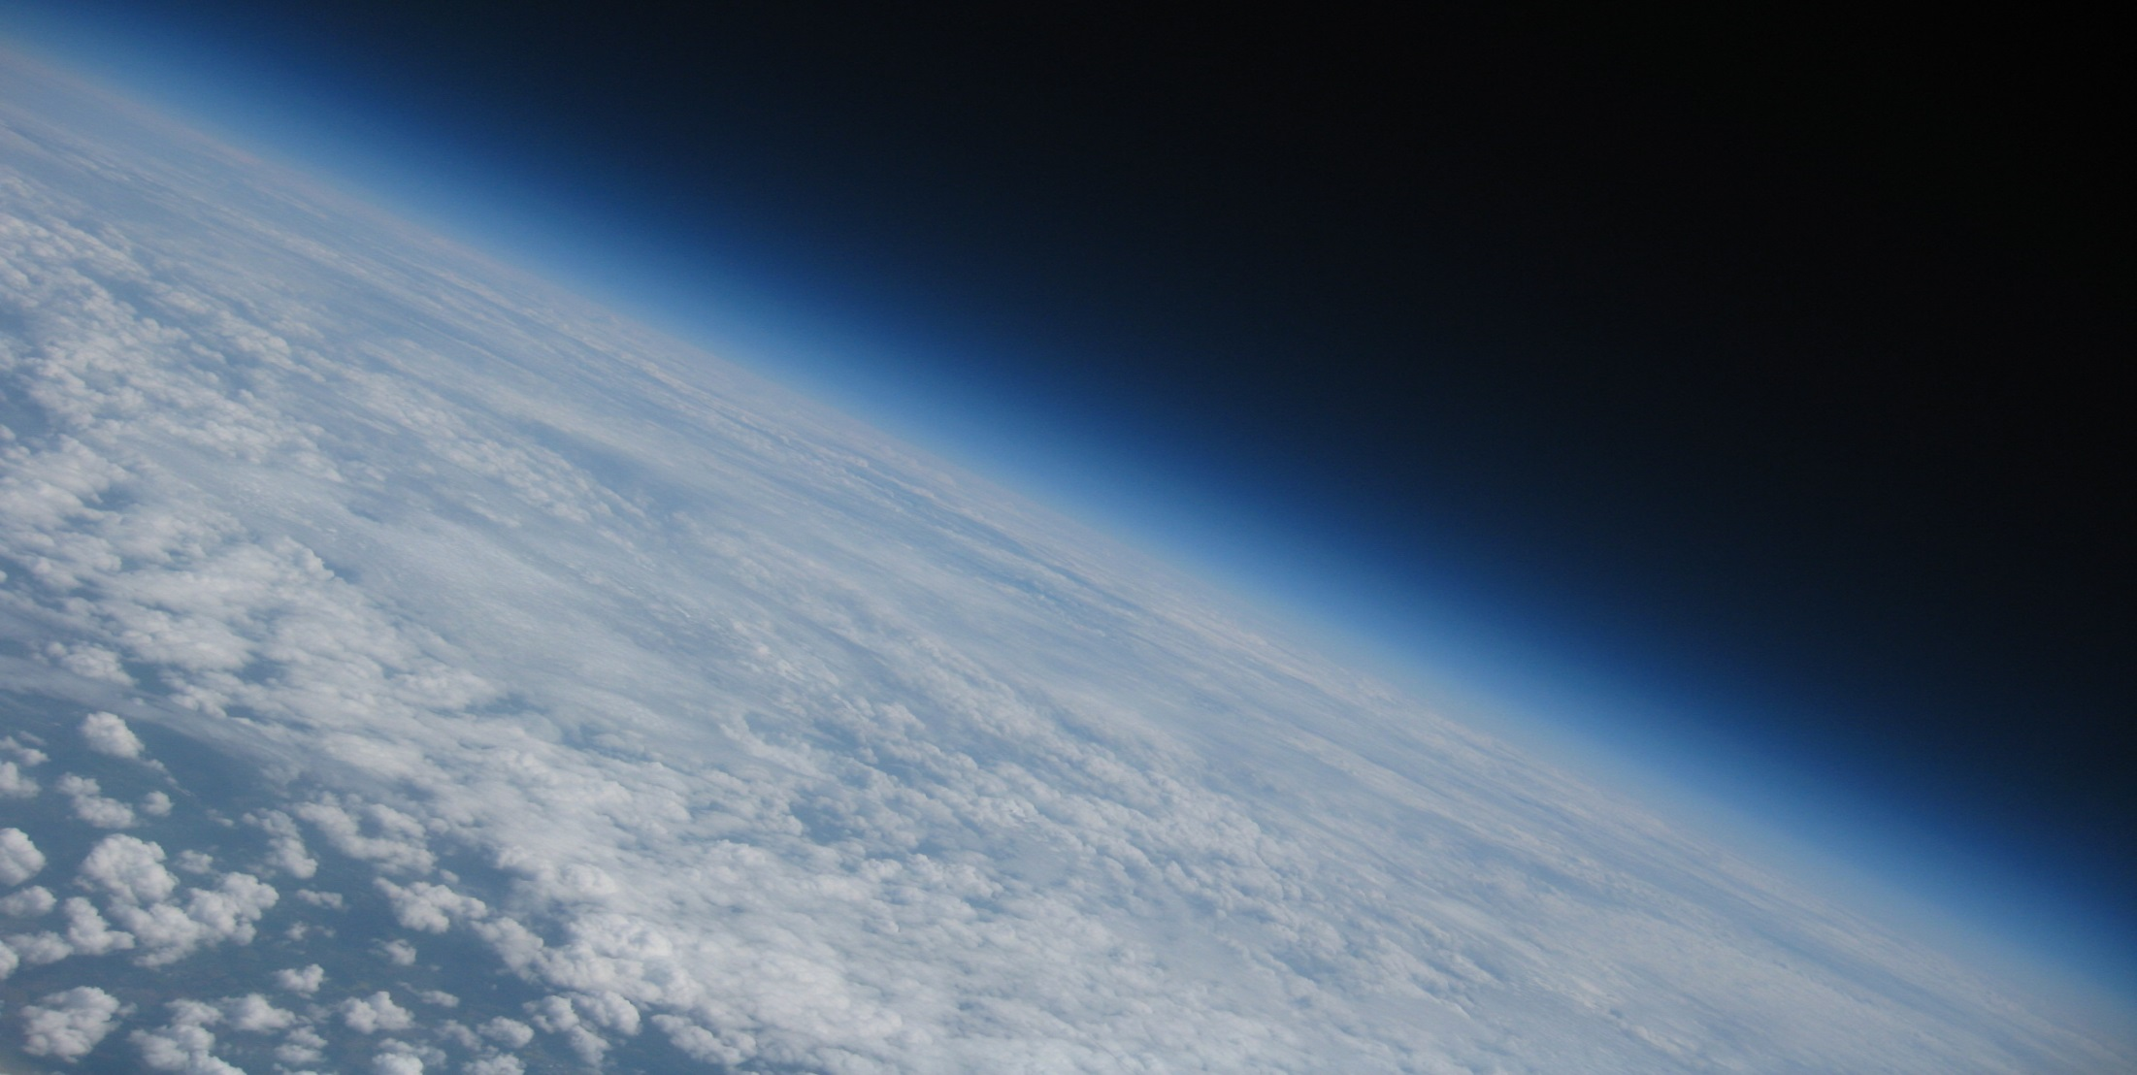
Royal Meteorological
Institute of Belgium
Royal Observatory of Belgium
Royal Belgian Institute
for Space Aeronomy
Max Planck Institute
for Chemistry
Solar-Terrestrial Centre of Excellence
1
2
3
4
5
A world-wide analysis of the time variability of Integrated Water Vapour, based on ground-based GNSS and GOMESCIA satellite retrievals, and with reanalyses as auxiliary tools
R. Van Malderen^{1,5}, E. Pottiaux^{2,5}, J. Legrand², H. Brenot^{3,5}, S. Beirle⁴, T. Wagner ⁴, H. De Backer¹, and C. Bruyninx^{2,5}
GNSS4SWEC workshop, ESTEC, 21-23/02/2017

Slide 2





ROB
Outline
Recapitulation & introduction
Model setup
Seasonal behaviour
Model performance
Conclusions & Perspectives
GNSS4SWEC workshop
ESTEC, Noordwijk (NL) 21-23 February 2017

Slide 3
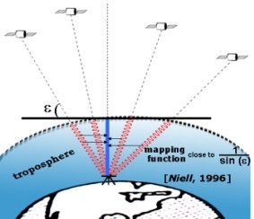

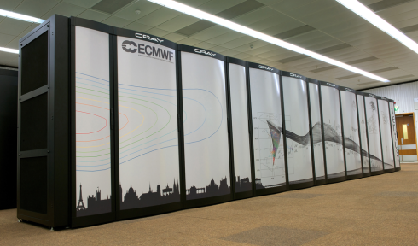
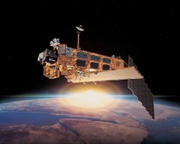
Recapitulation & introduction
Model setup
Seasonal behaviour
Model Performance
ROB
Datasets
IGS repro 1
  homogenous data processing from January 1995 to April 2011
  data taken at 0h & 12h (→ future: also at 6h & 18h)
  ZTD → IWV by means of ERA-interim/NCEPNCAR (P_{s} from surface, T_{m} from vertical levels)
  screening: STD < 5 mm (NOT O. Bock’s screening and outlier removal applied to reference IGS repro 1 dataset in homogenization activity)
  not homogenized
ERA-interim/NCEPNCAR reanalyses
  IWV from surface fields, corrected to IGS station height
  at 0h & 12h
GOMESCIA
  GOME/SCIAMACHY/GOME-2 satellite overpass measurements at IGS stations
  (1996 - ongoing)
  not homogenized product (→ new climate product will be evaluated)
GNSS4SWEC workshop
ESTEC, Noordwijk (NL) 21-23 February 2017

Slide 4
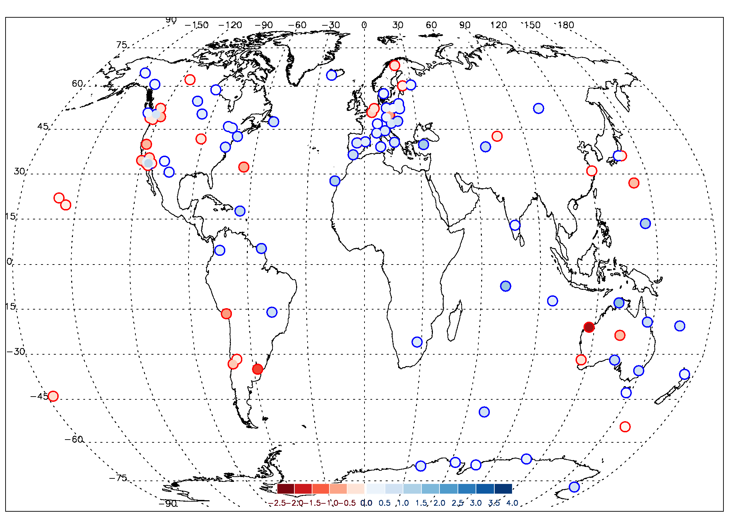
Recapitulation & introduction
Model setup
Seasonal behaviour
Model Performance
ROB
IWV trends [mm/dec] (January 1997-March 2011)
IGS, T_{m} ERAinterim

Slide 5
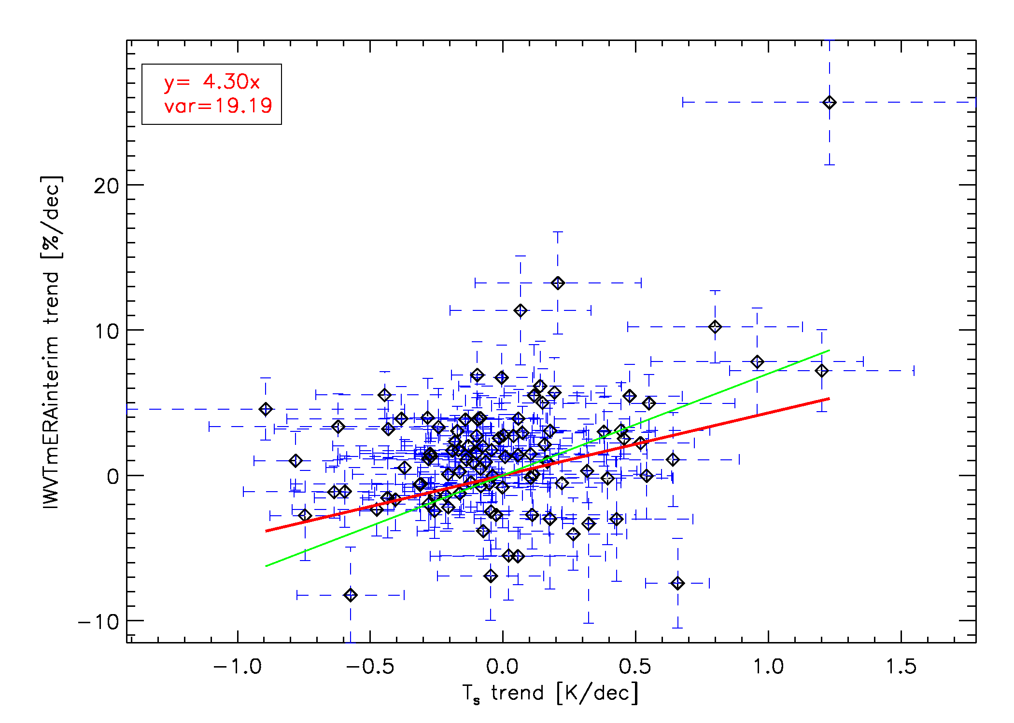
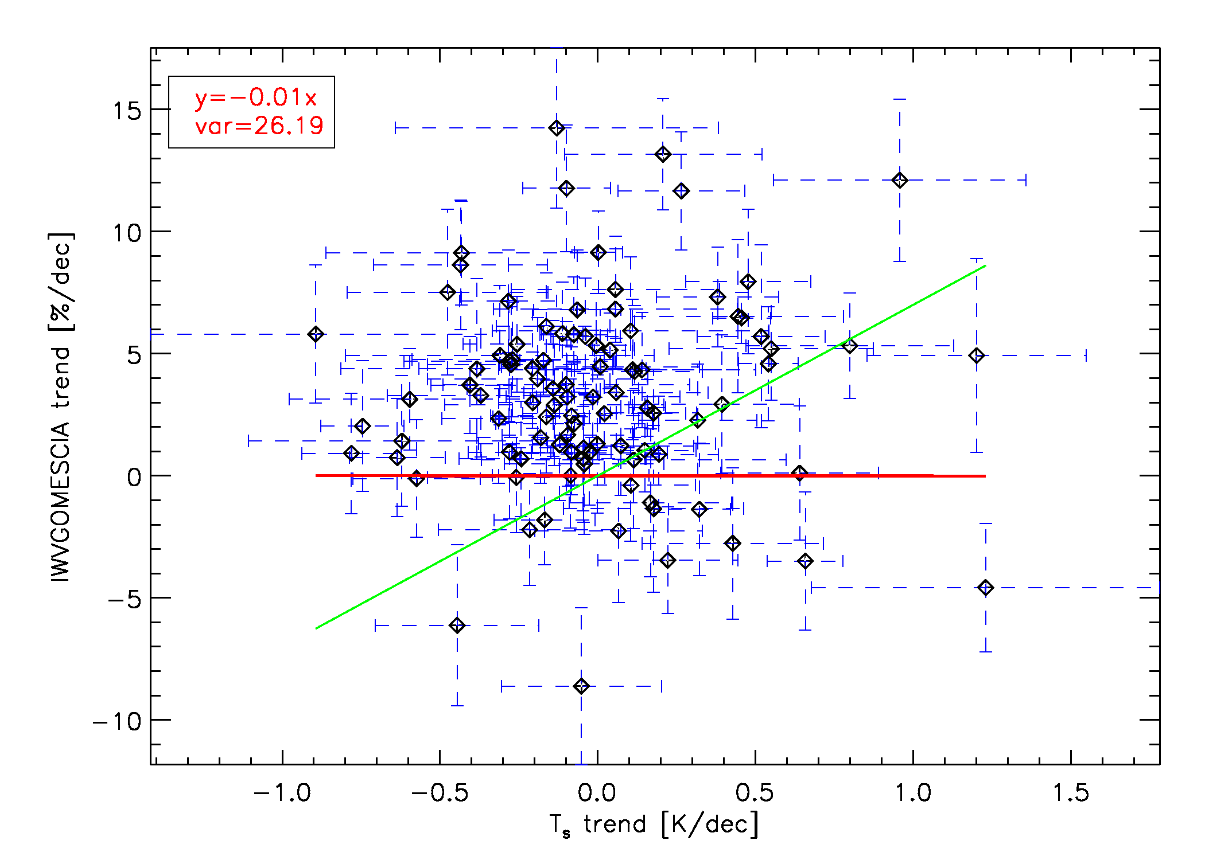
Recapitulation & introduction
Model setup
Seasonal behaviour
Model Performance
ROB
Trend correlations: between T_{s} and IWV
IGS
GOMESCIA
A physical law (the Clausius-Clapeyron equation) tells us that the water holding capacity of the atmosphere goes up at about 7% per degree Celsius/Kelvin increase in temperature.
This is not well established by our datasets, in particular for GOMESCIA!
GNSS4SWEC workshop
ESTEC, Noordwijk (NL) 21-23 February 2017

Slide 6
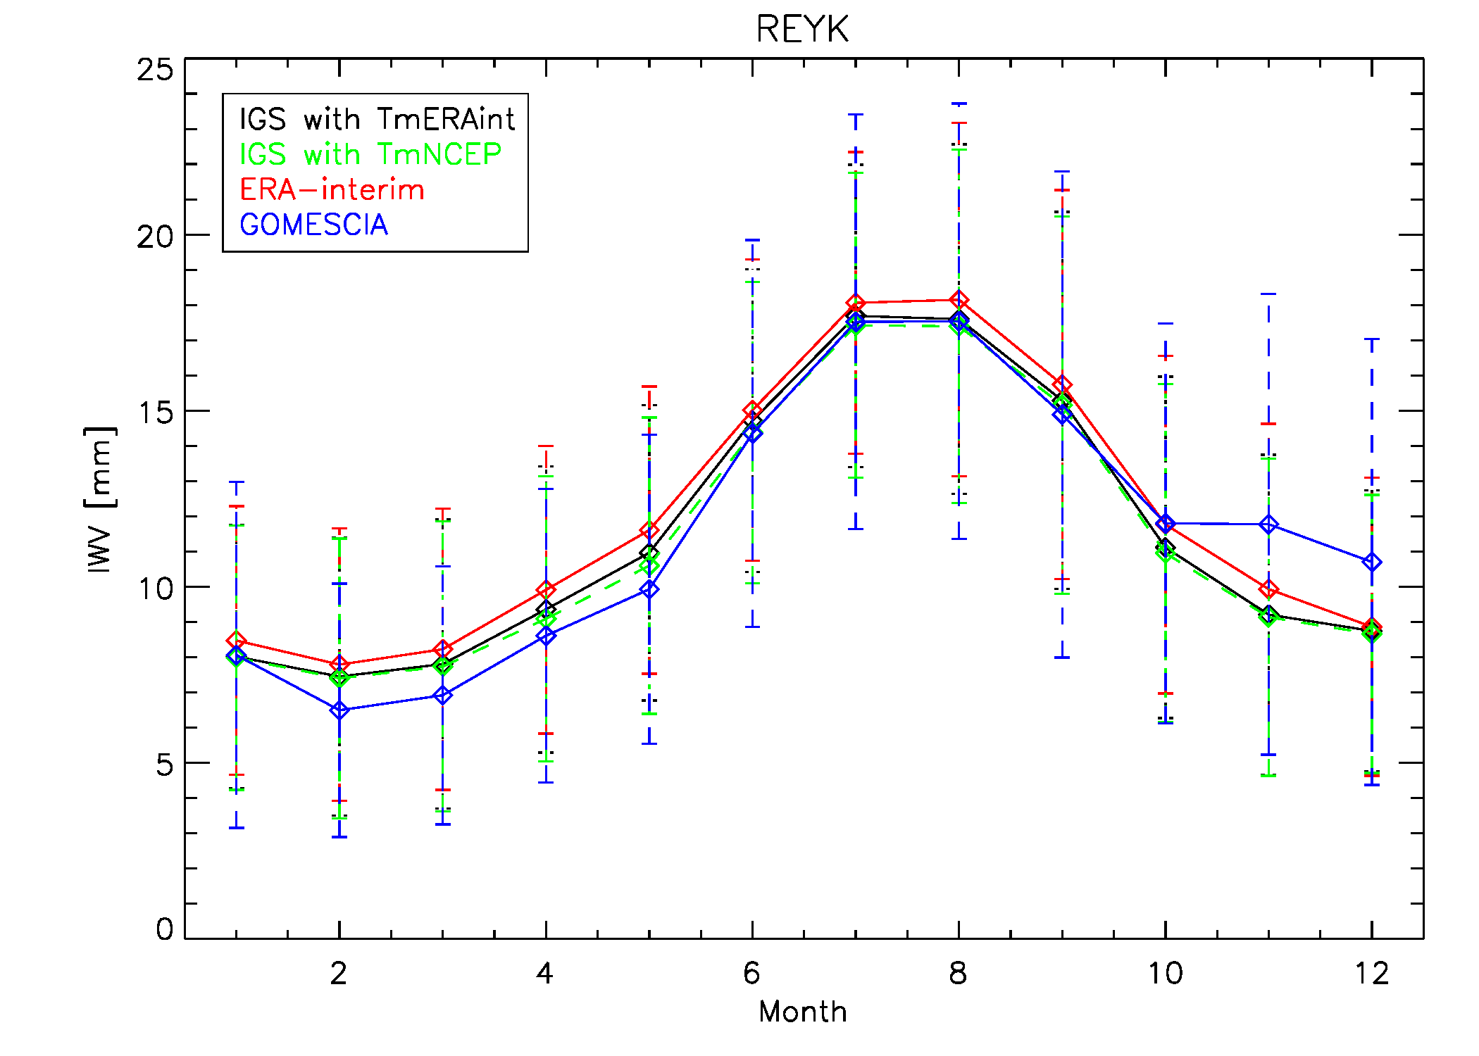
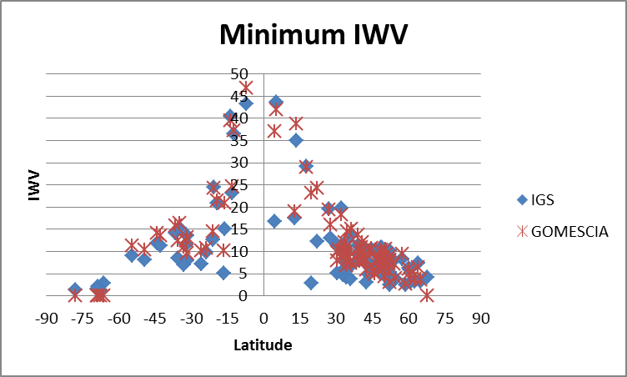
Recapitulation & introduction
Model setup
Seasonal behaviour
Model Performance
ROB
Seasonal cycle : between data sources
The global shape of the seasonal cycle is very similarly captured by all techniques/datasets.
GOMESCIA differs most from other devices w.r.t. seasonal cycle, especially at lower IWV values.
GNSS4SWEC workshop
ESTEC, Noordwijk (NL) 21-23 February 2017

Slide 7
Recapitulation & introduction
Model setup
Seasonal behaviour
Model Performance
ROB
Main focus in this presentation:
What are the main drivers of the seasonal variability and long-term time behaviour of the IWV time series?
How can this scientific question be assessed?
  running climate models and study the underlying processes (e.g. validation of climate models with GNSS IWV retrievals → see e.g. talk by Julie Berckmans)
  building empirical “models”, based on representations (=time series, in particular monthly means) of circulation patterns (e.g. ENSO) and lower-atmospheric oscillations (e.g. NAO)
GNSS4SWEC workshop
ESTEC, Noordwijk (NL) 21-23 February 2017

Slide 8
Recapitulation & introduction
Model setup
Seasonal behaviour
Model Performance
ROB
Main focus in this presentation:
What are the main drivers of the seasonal variability and long-term time behaviour of the IWV time series?
How can this scientific question be assessed?
  running climate models and study the underlying processes (e.g. validation of climate models with GNSS IWV retrievals → see e.g. talk by Julie Berckmans)
  building empirical “models”, based on representations (=time series, in particular monthly means) of circulation patterns (e.g. ENSO) and lower-atmospheric oscillations (e.g. NAO) → stepwise multiple linear regression
GNSS4SWEC workshop
ESTEC, Noordwijk (NL) 21-23 February 2017

Slide 9

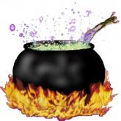

Recapitulation & introduction
Model setup
Seasonal behaviour
Model Performance
ROB
Stepwise multiple linear regression
So you start throwing some ingredients in a cooking pot…
explanatory variables
You have a nice picture of some tasty dish you want to make …
P_{surf}
...
P_{trop}
T_{surf}
teleconnection patterns =
recurrent, persistent, large scale patterns of pressure and circulation anomalies
means
or
hamonics
NAO
ENSO
QBO
IWV observations (Y)
… but you don’t know the ingredients.
First, you use all the ingredients you have, and you determine whose impact (correlation coefficient) is largest…
GNSS4SWEC workshop
ESTEC, Noordwijk (NL) 21-23 February 2017

Slide 10

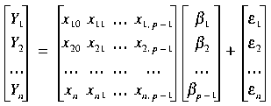
Recapitulation & introduction
Model setup
Seasonal behaviour
Model Performance
ROB
Stepwise multiple linear regression
You have a nice picture of some tasty dish you want to make …
At the end, this is the dish that you cooked:
P_{surf}
...
P_{trop}
T_{surf}
means
or
hamonics
NAO
ENSO
QBO
IWV observations (Y)
Y = β₀ + β₁x₁ + β₂x₂ + …+ β_{p-1} X_{p-1} + ε
… but you don’t know the ingredients
residuals
means
T_{surf}
Then you do it stepwise, starting with the largest impact ingredients and (statistically) testing if adding that ingredient leads to a closer agreement with the dish.
You possibly might to remove some of them
monthly means
GNSS4SWEC workshop
ESTEC, Noordwijk (NL) 21-23 February 2017

Slide 11
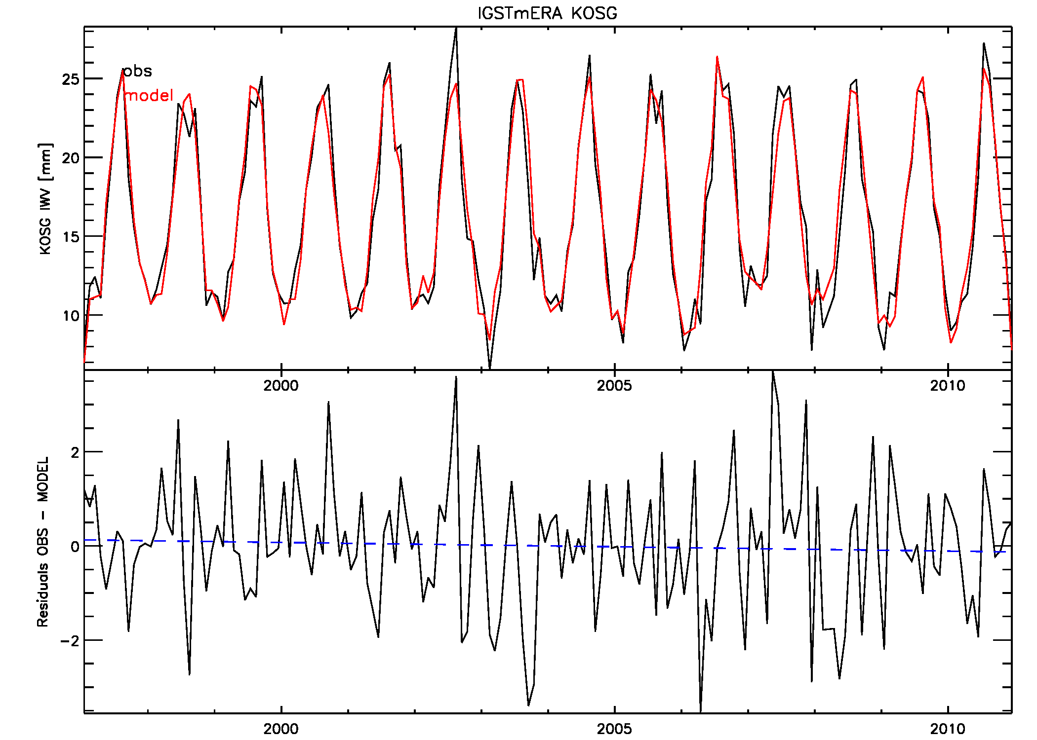
Recapitulation & introduction
Model setup
Seasonal behaviour
Model Performance
ROB
Example
IGS repro 1
explanatory variables used:
  means
  surface temperature
  AMO (Atlantic multidecadal oscillation)
  EP flux
  tropical/Northern Hemisphere pattern
  tropopause pressure
  east Atlantic pattern
94.1% of variability can be explained
correlation coefficient of 0.970
GNSS4SWEC workshop
ESTEC, Noordwijk (NL) 21-23 February 2017
KOSG (100 km to the east of ESTEC)

Slide 12
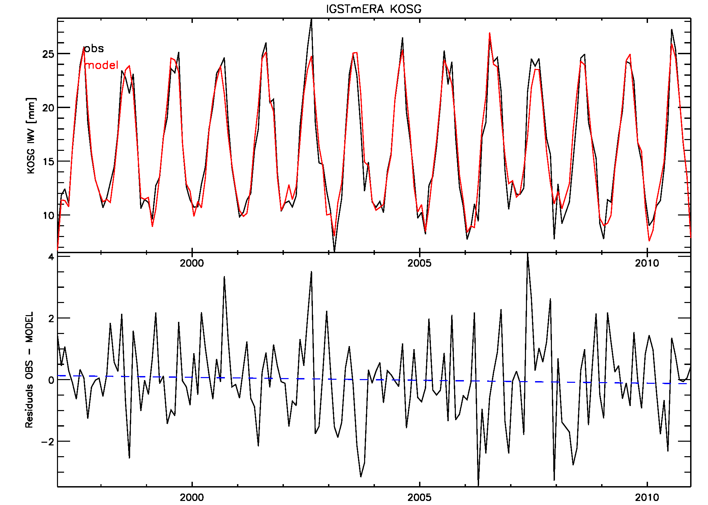
Recapitulation & introduction
Model setup
Seasonal behaviour
Model Performance
ROB
Example
IGS repro 1
explanatory variables used:
  surface temperature
  AMO (Atlantic multidecadal oscillation)
  tropopause pressure
  east Atlantic pattern
  cosine with semi-annual period
94.2% of variability can be explained
correlation coefficient of 0.970
GNSS4SWEC workshop
ESTEC, Noordwijk (NL) 21-23 February 2017
KOSG (100 km to the east of ESTEC)

Slide 13
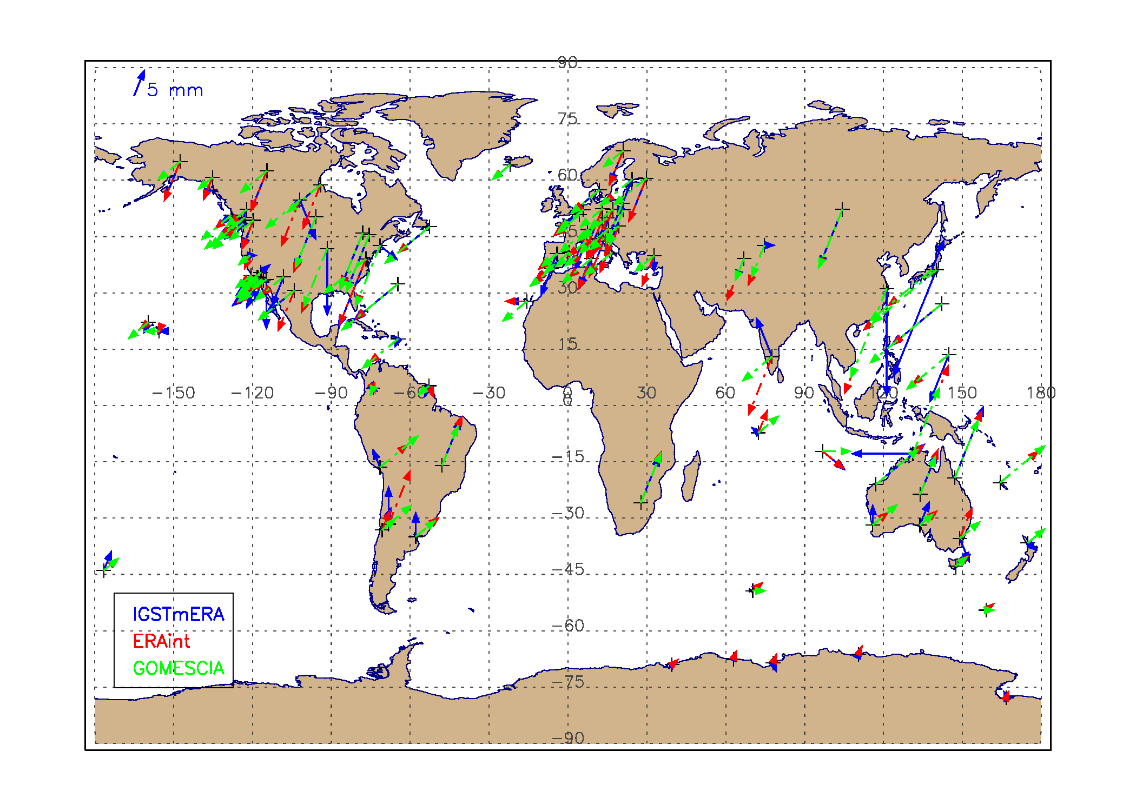
Recapitulation & introduction
Model setup
Seasonal behaviour
Model Performance
ROB
Seasonal cycle
explanatory variables: harmonics with annual, semi-annual, 3 & 4 months period.
Apart from some exceptions over east Asia, the amplitudes of the seasonal cycle are very similar between the three datasets.
GNSS4SWEC workshop
ESTEC, Noordwijk (NL) 21-23 February 2017

Slide 14
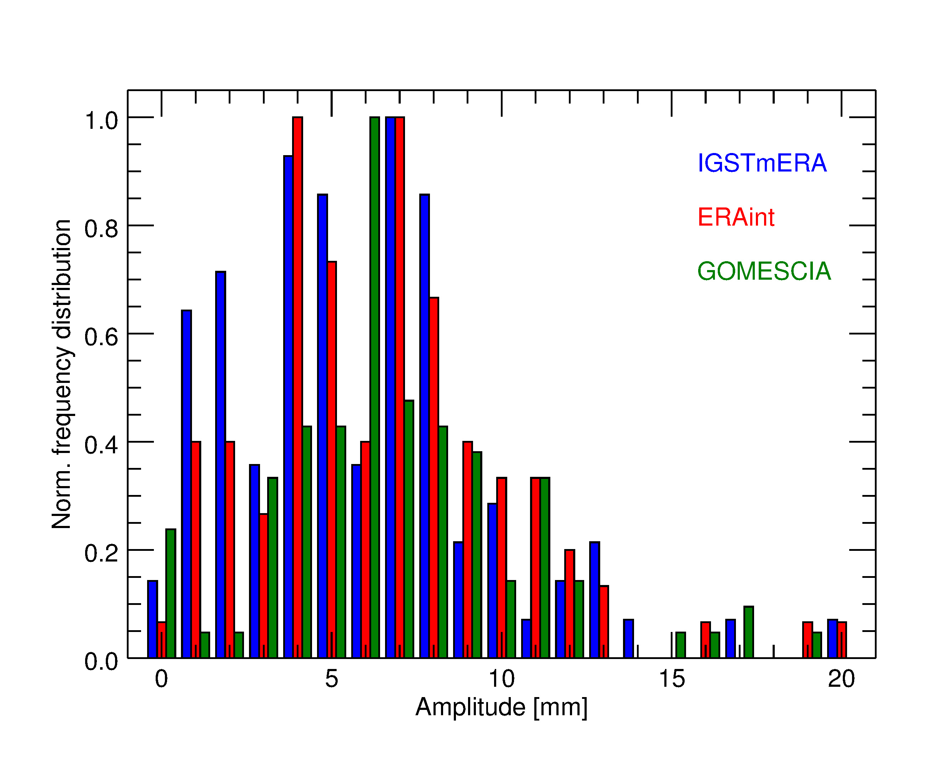
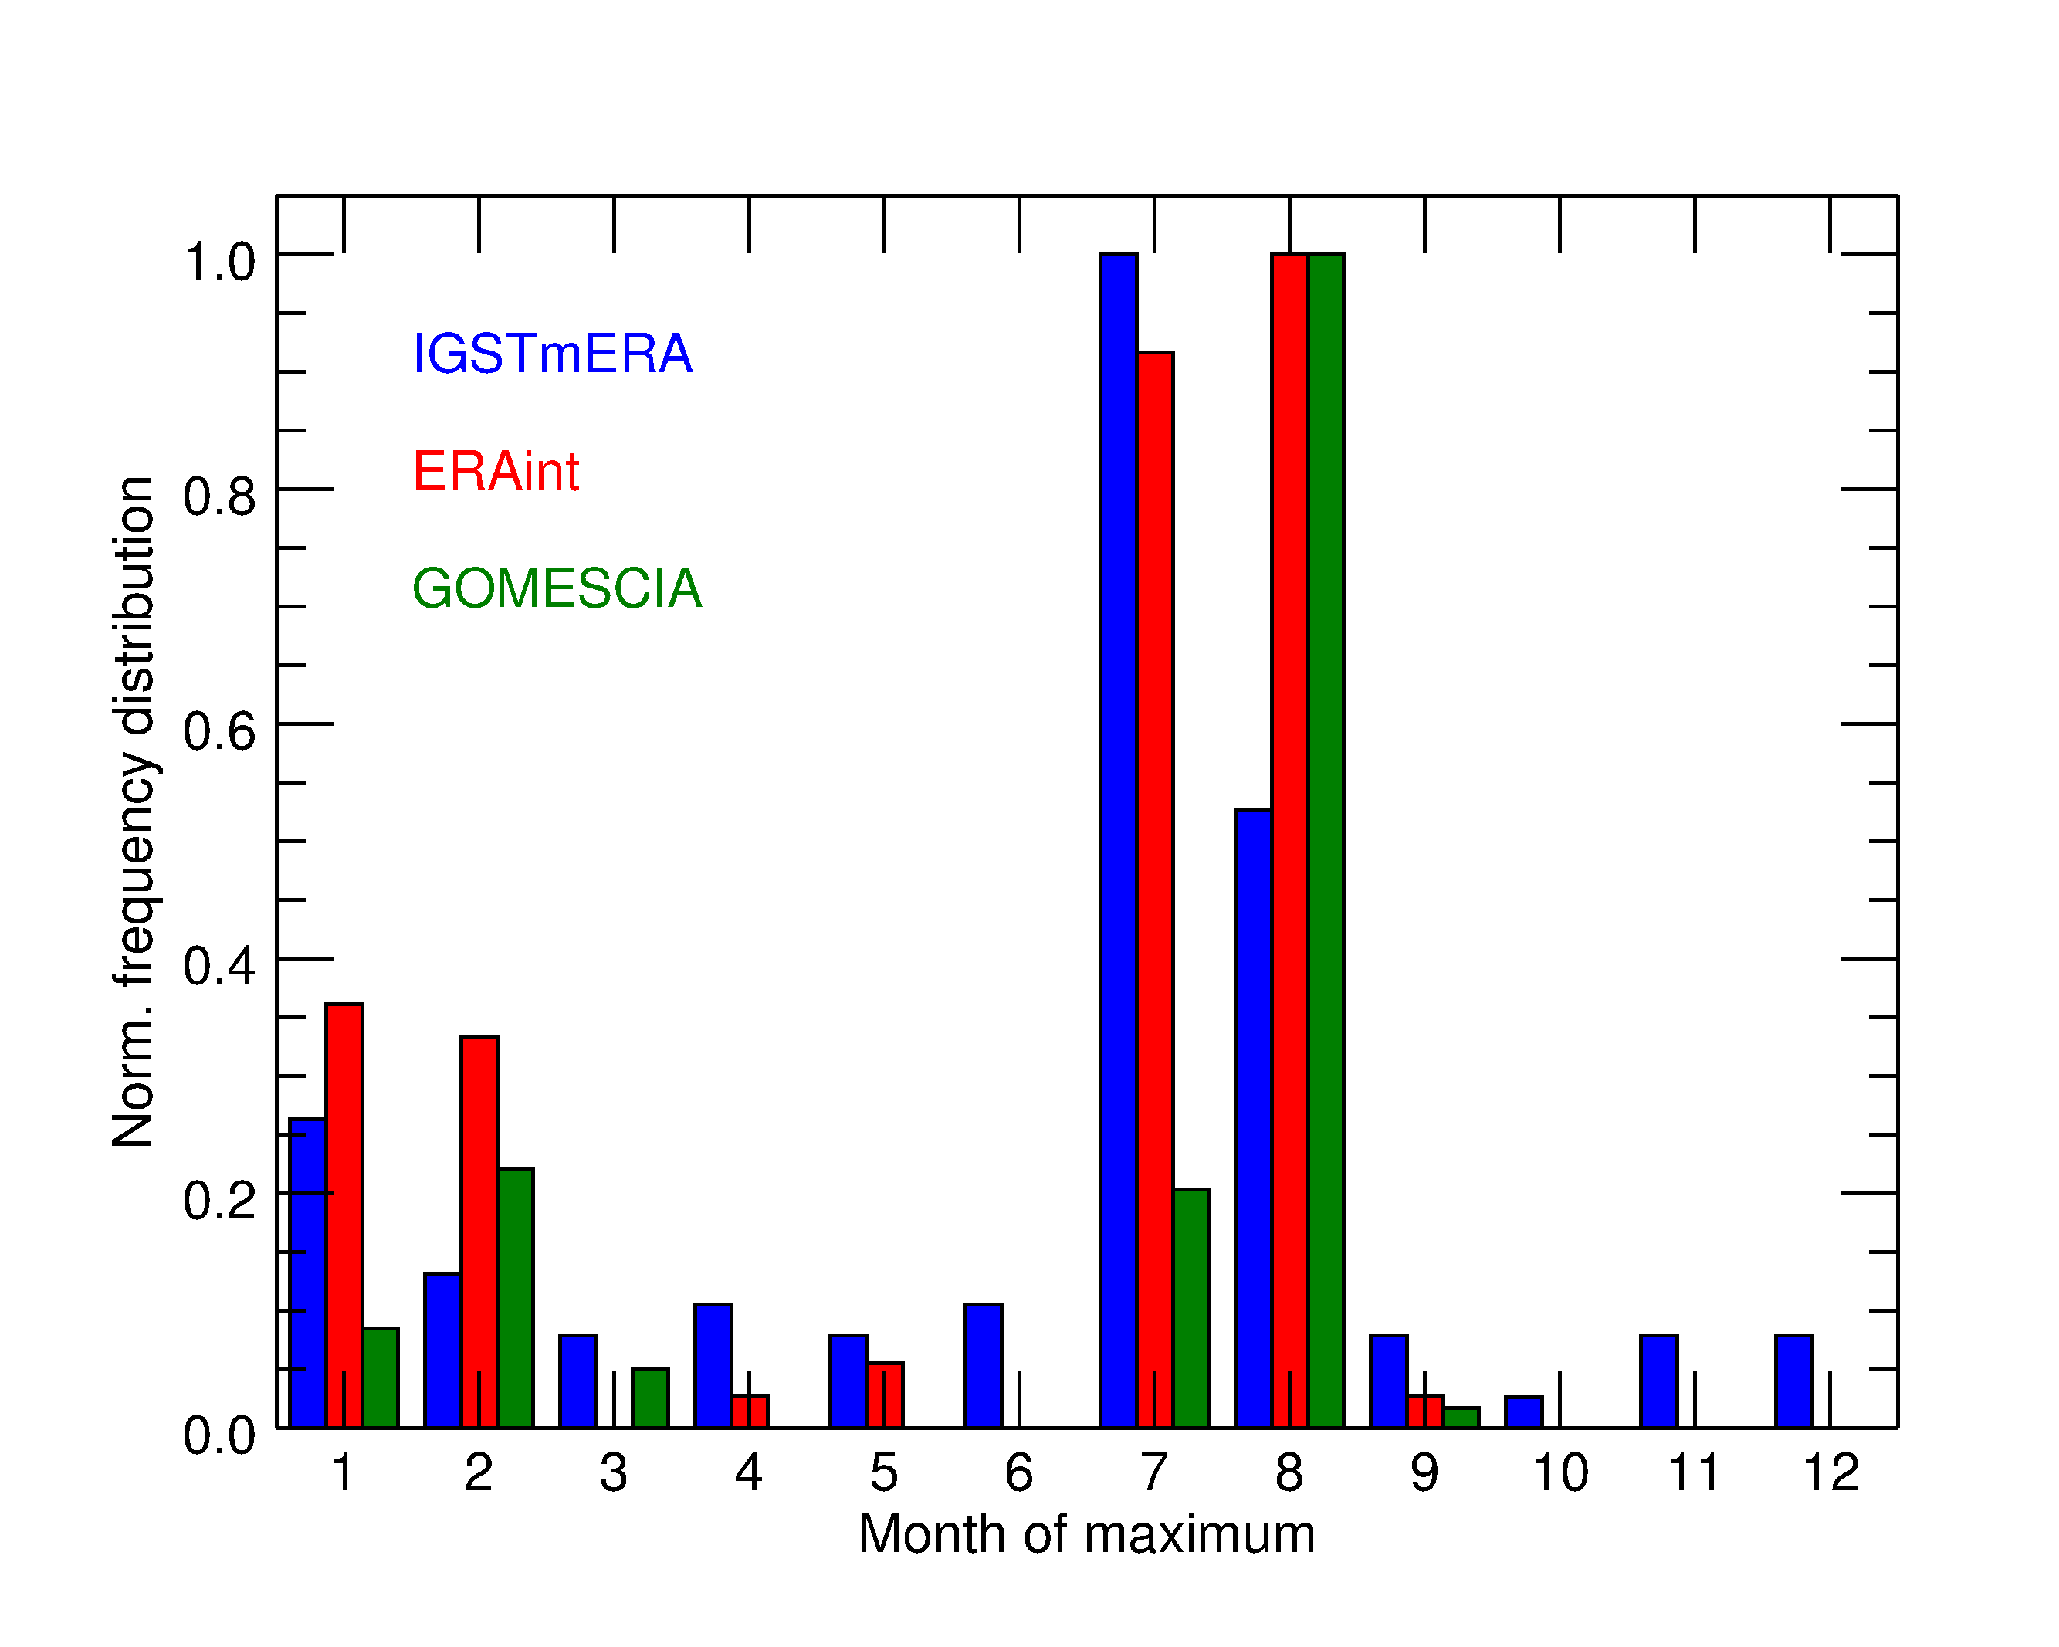
Recapitulation & introduction
Model setup
Seasonal behaviour
Model Performance
ROB
Seasonal cycle
GOMESCIA under-represents the lowest amplitudes (≤ 5 mm), IGS over-represents the lowest amplitudes?
The phase of the maximum amplitude is quite different between IGS & GOMESCIA; IGS have the largest spread over the different months.
GNSS4SWEC workshop
ESTEC, Noordwijk (NL) 21-23 February 2017

Slide 15
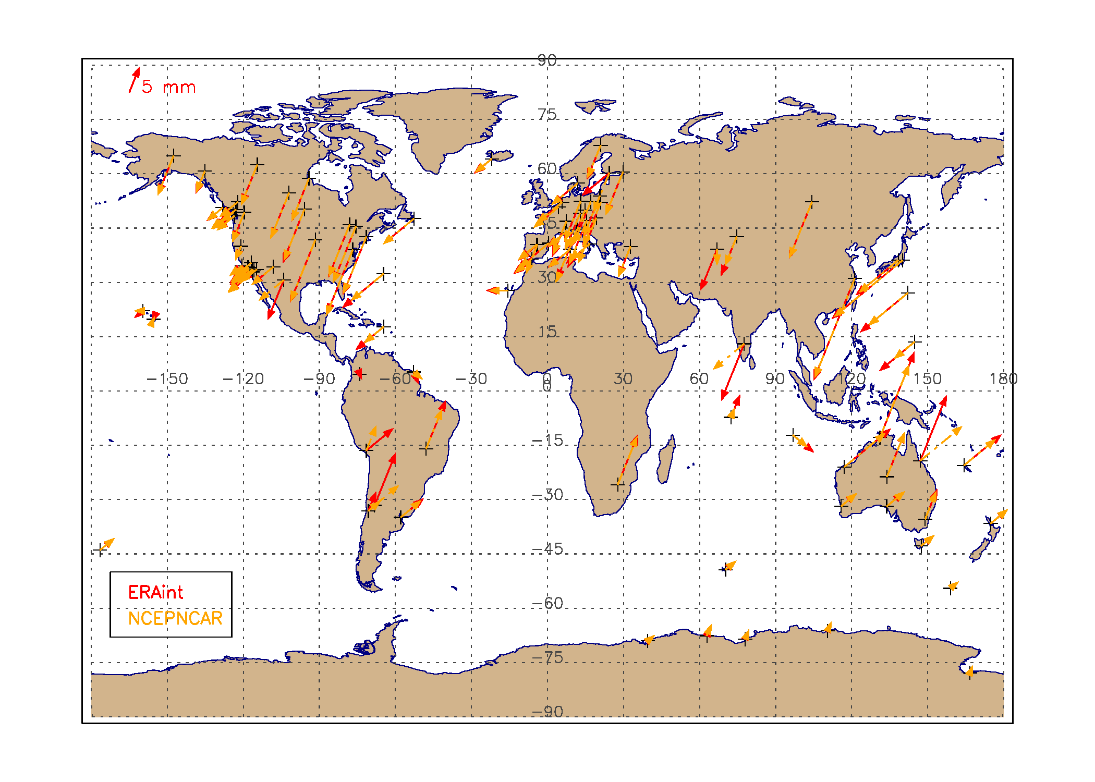
Recapitulation & introduction
Model setup
Seasonal behaviour
Model Performance
ROB
Seasonal cycle
nice agreement between both reanalyses, except at a handful of sites
GNSS4SWEC workshop
ESTEC, Noordwijk (NL) 21-23 February 2017

Slide 16
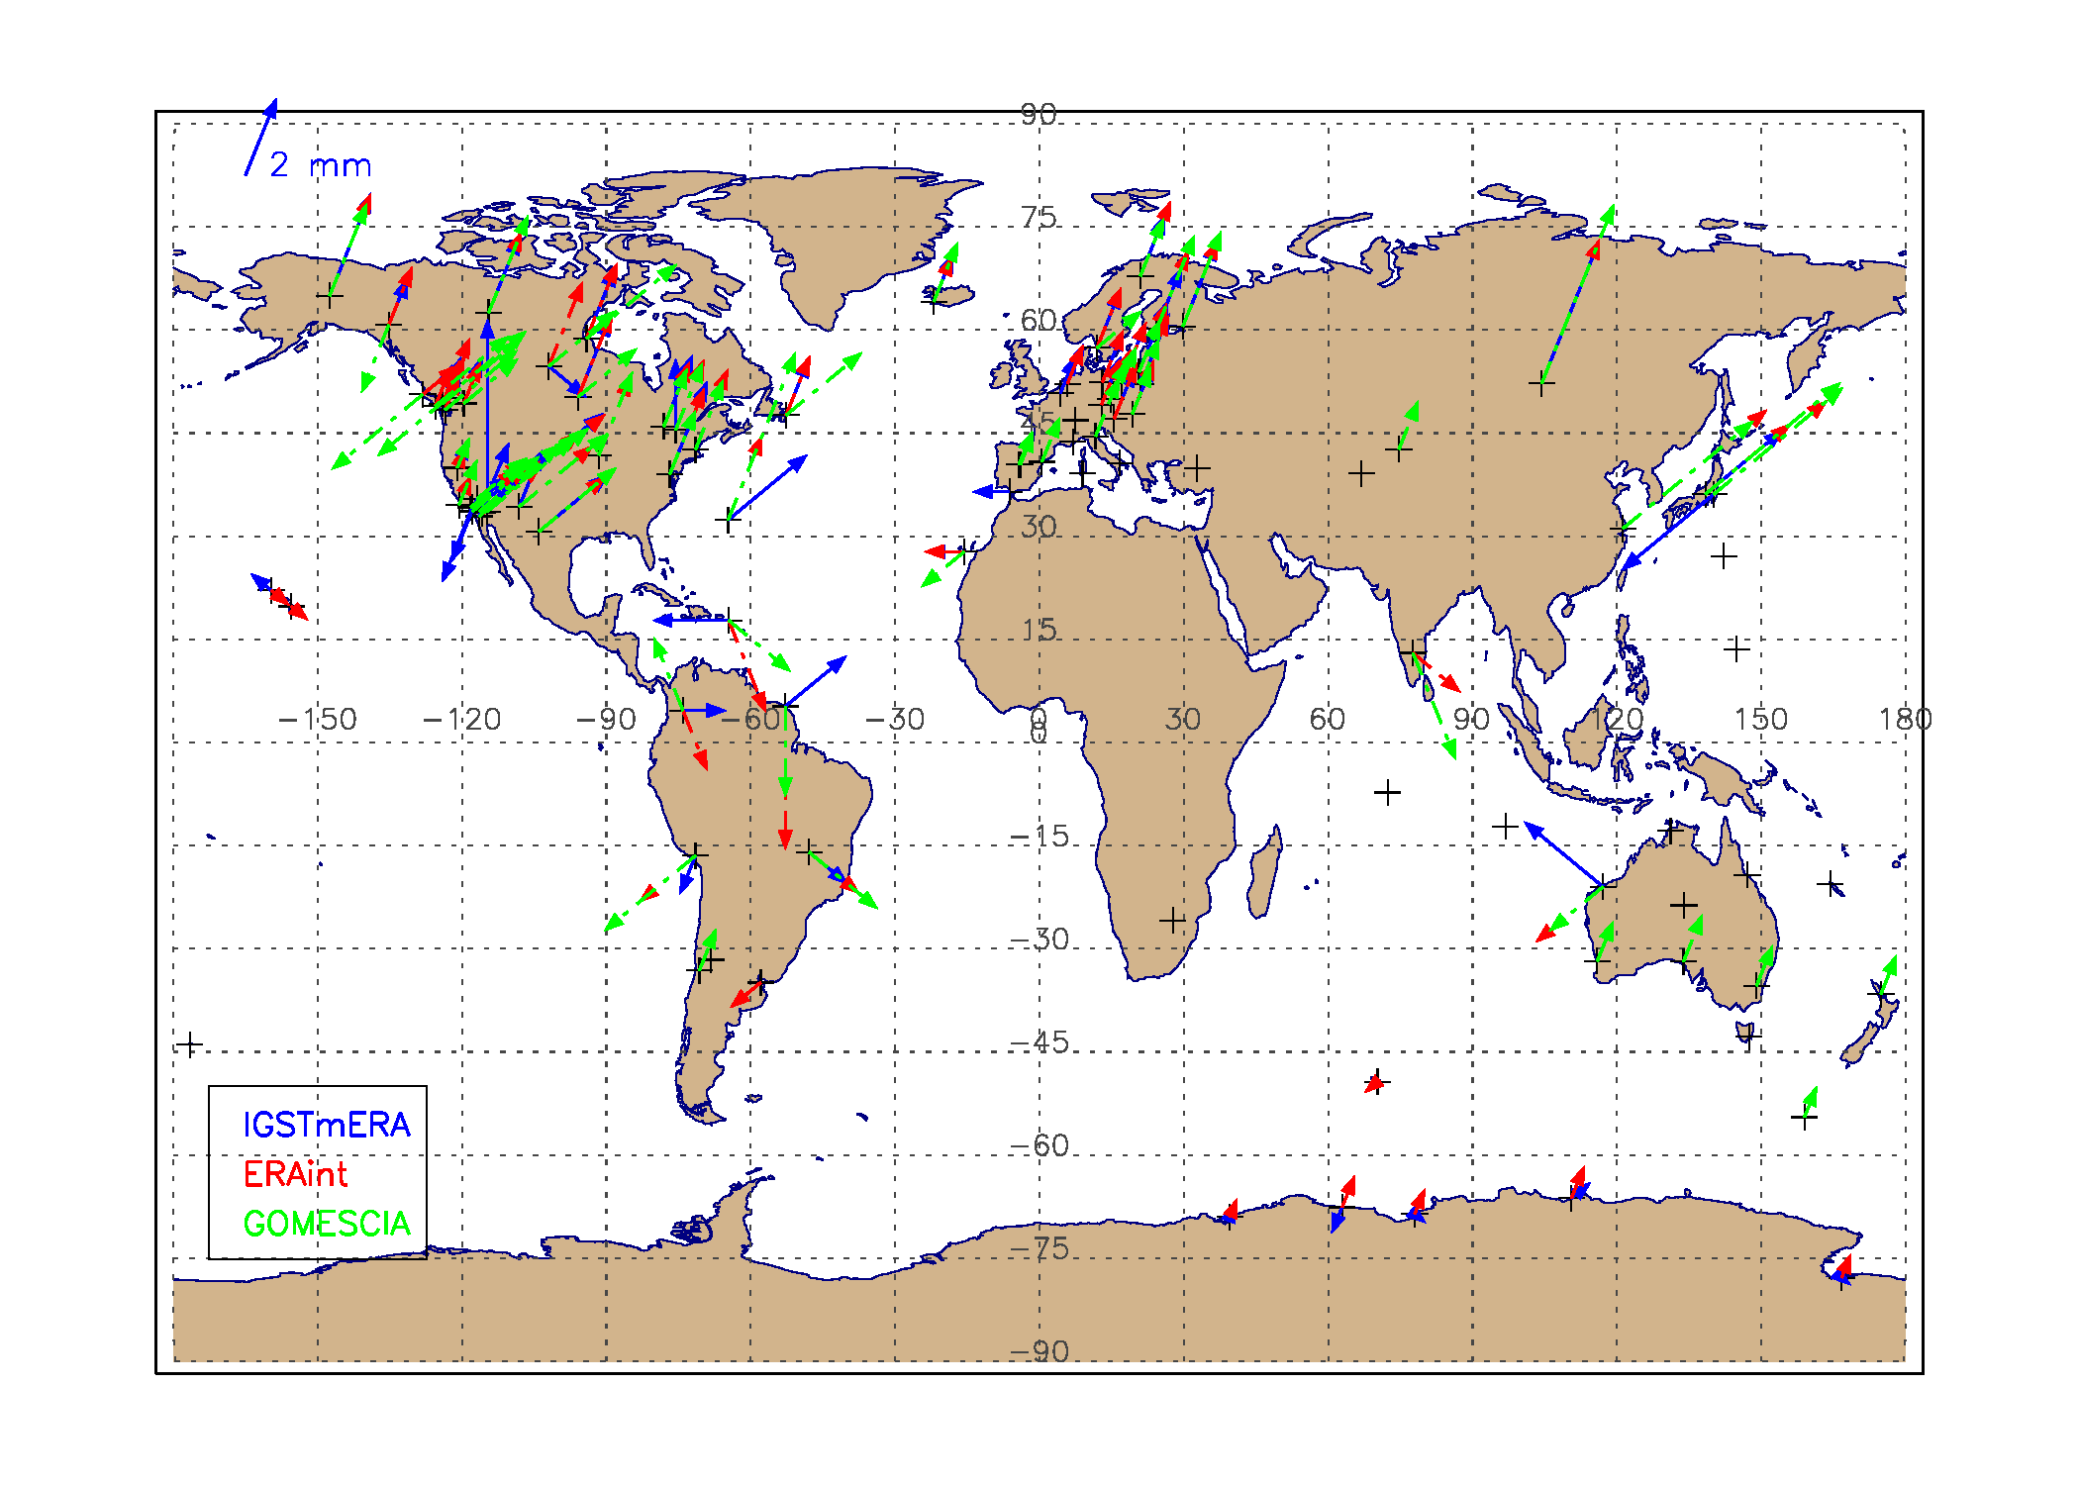
Recapitulation & introduction
Model setup
Seasonal behaviour
Model Performance
ROB
Semi-annual variability
The differences in the semi-annual variability between the 3 different datasets are more pronounced.
GNSS4SWEC workshop
ESTEC, Noordwijk (NL) 21-23 February 2017

Slide 17
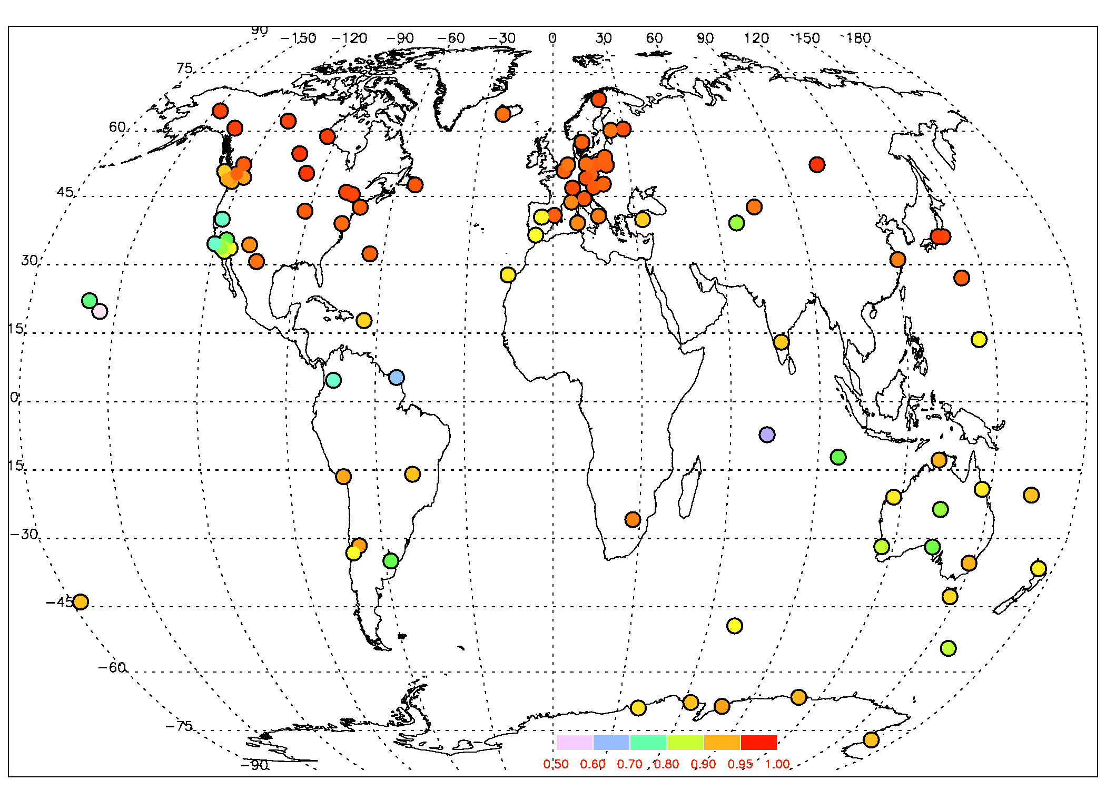
Recapitulation & introduction
Model setup
Seasonal behaviour
Model Performance
ROB
Correlation coefficients (means + all teleconnection patterns)
IGS repro 1
best representation by models, for all datasets, when using the long-term means and not the harmonics to describe the seasonal behaviour
models best (highest R²) in Europe and USA (except southern west coast)
due to the choice of proxies?
GNSS4SWEC workshop
ESTEC, Noordwijk (NL) 21-23 February 2017

Slide 18
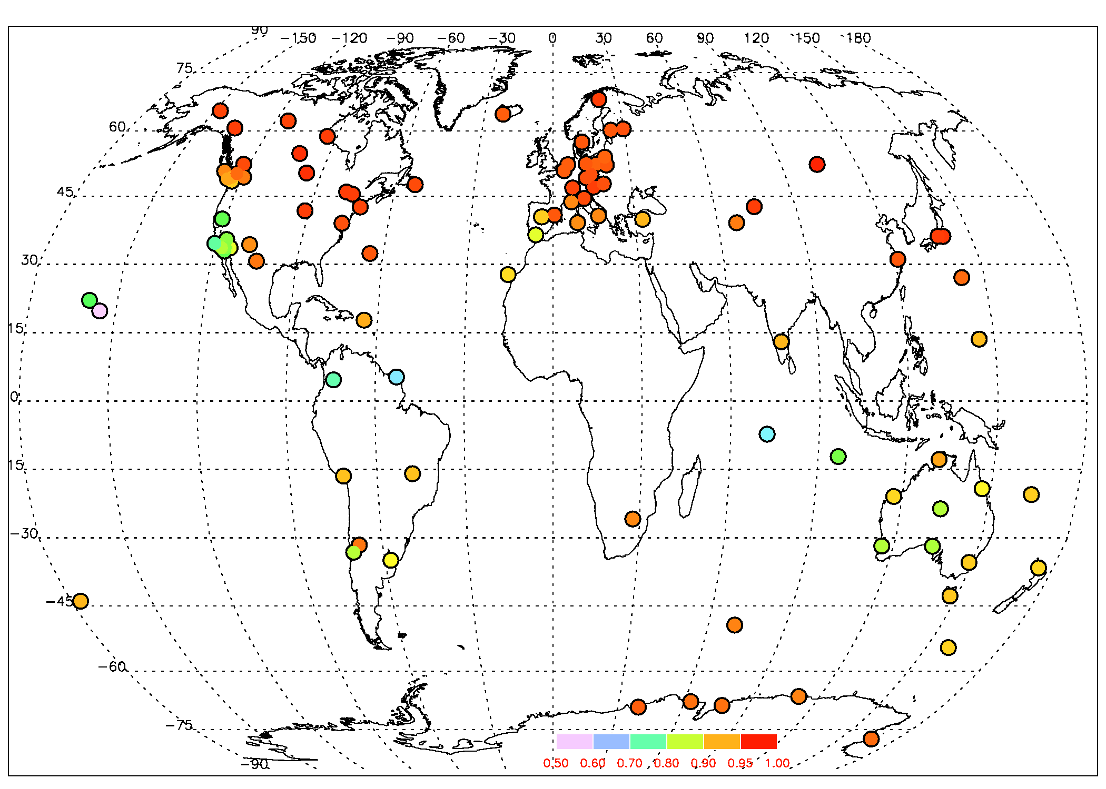
Recapitulation & introduction
Model setup
Seasonal behaviour
Model Performance
ROB
Correlation coefficients (means + all teleconnection patterns)
ERA-interim
best represen-tation of the models, compared to IGS time series (and GOMESCIA)
highest number of retained explana-tory variables
some of the proxies were calculated from ERA-interim (T_{surf} & P_{surf})
ERA-interim incorporates some of the proxies?
GNSS4SWEC workshop
ESTEC, Noordwijk (NL) 21-23 February 2017

Slide 19

Recapitulation & introduction
Model setup
Seasonal behaviour
Model Performance
ROB
Correlation coefficients (means + all teleconnection patterns)
GOMESCIA
overall, lower correlation coefficients
lowest number of kept proxies
GNSS4SWEC workshop
ESTEC, Noordwijk (NL) 21-23 February 2017

Slide 20
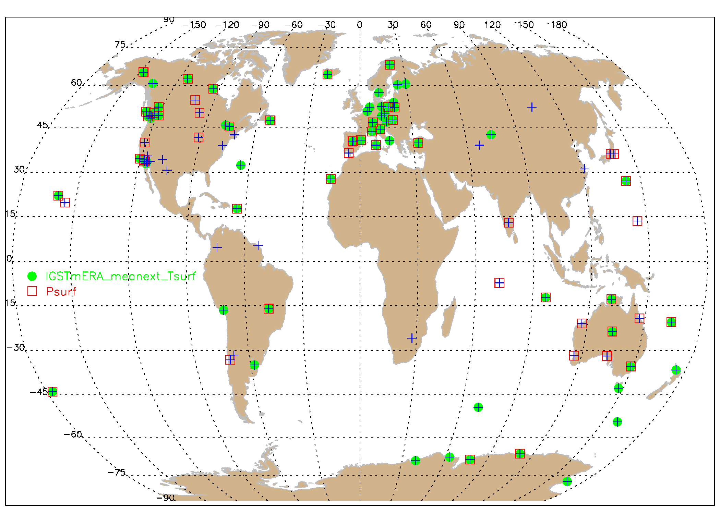
Recapitulation & introduction
Model setup
Seasonal behaviour
Model Performance
ROB
Explanatory variables (means + all teleconnection patterns)
IGS Tm ERA
+ : no T_{surf} & P_{surf}
● : T_{surf}
□ : P_{surf}
T_{surf} in 2/3 of stations (higher with harmonics)
T_{surf} explains highest portion of variability after the means
P_{surf} in 55% of stations (less for GOMESCIA)
GNSS4SWEC workshop
ESTEC, Noordwijk (NL) 21-23 February 2017

Slide 21
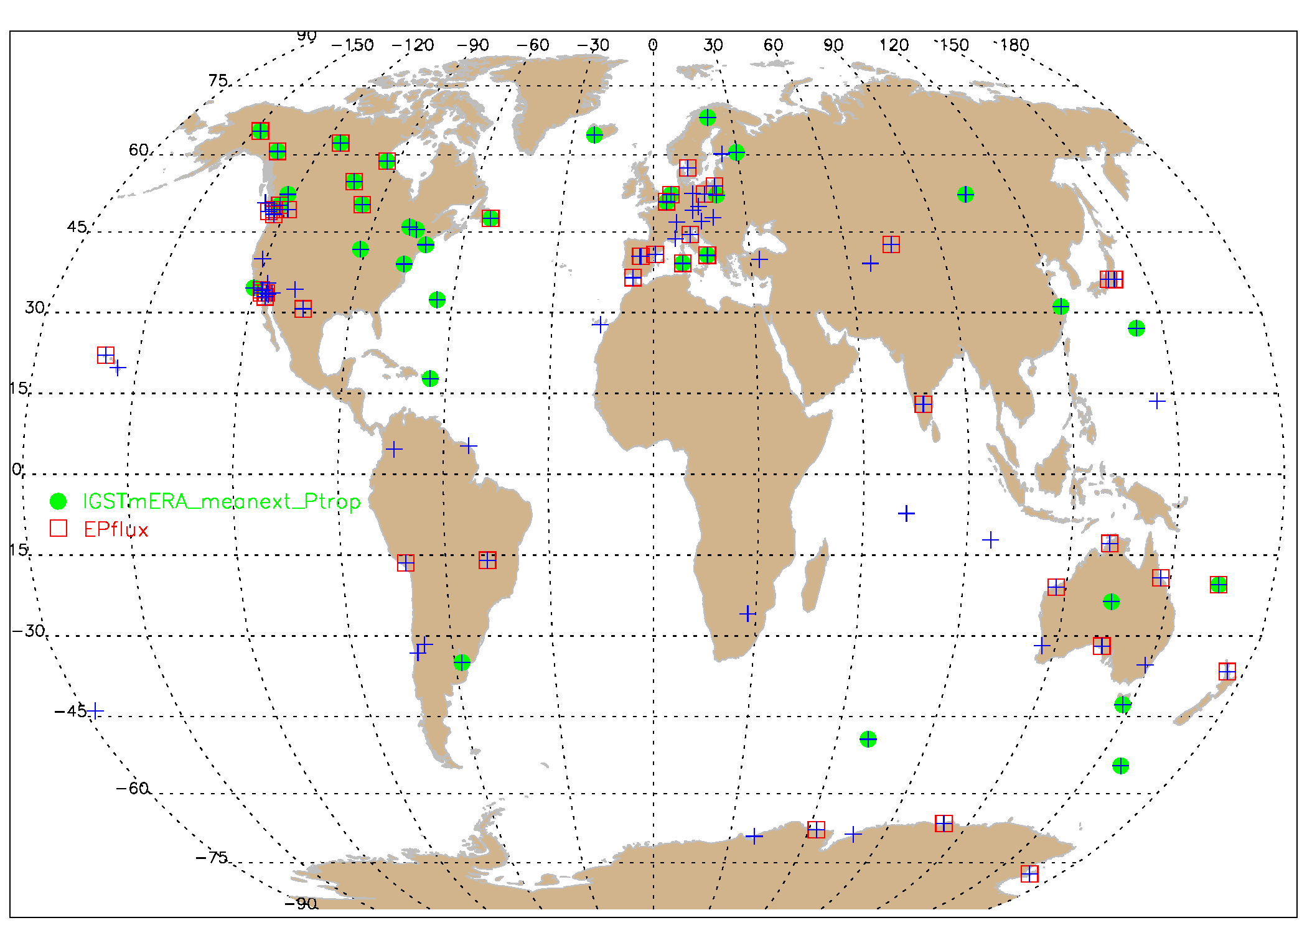
Recapitulation & introduction
Model setup
Seasonal behaviour
Model Performance
ROB
Explanatory variables (means + all teleconnection patterns)
IGS Tm ERA
+ : no P_{trop} & EPflux
● : P_{trop}
□ : EPflux
both are present in about 40% of the stations (most for GOMESCIA)
explain about 50% of remaining variability.
GNSS4SWEC workshop
ESTEC, Noordwijk (NL) 21-23 February 2017

Slide 22
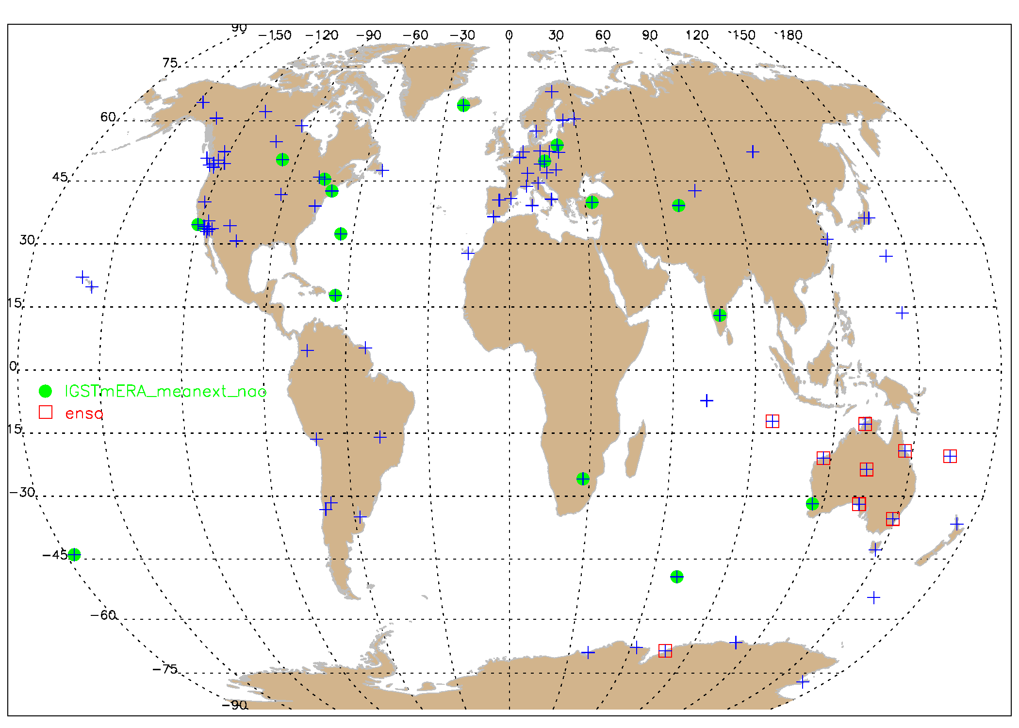
Recapitulation & introduction
Model setup
Seasonal behaviour
Model Performance
ROB
Explanatory variables (means + all teleconnection patterns)
IGS Tm ERA
+ : no NAO & ENSO
● : NAO
□ : ENSO
NAO =North Atlantic Oscillation, minor geographical consistency (Turkey!)
ENSO = El Niño – Southern Oscillation: very consistent!
GNSS4SWEC workshop
ESTEC, Noordwijk (NL) 21-23 February 2017

Slide 23
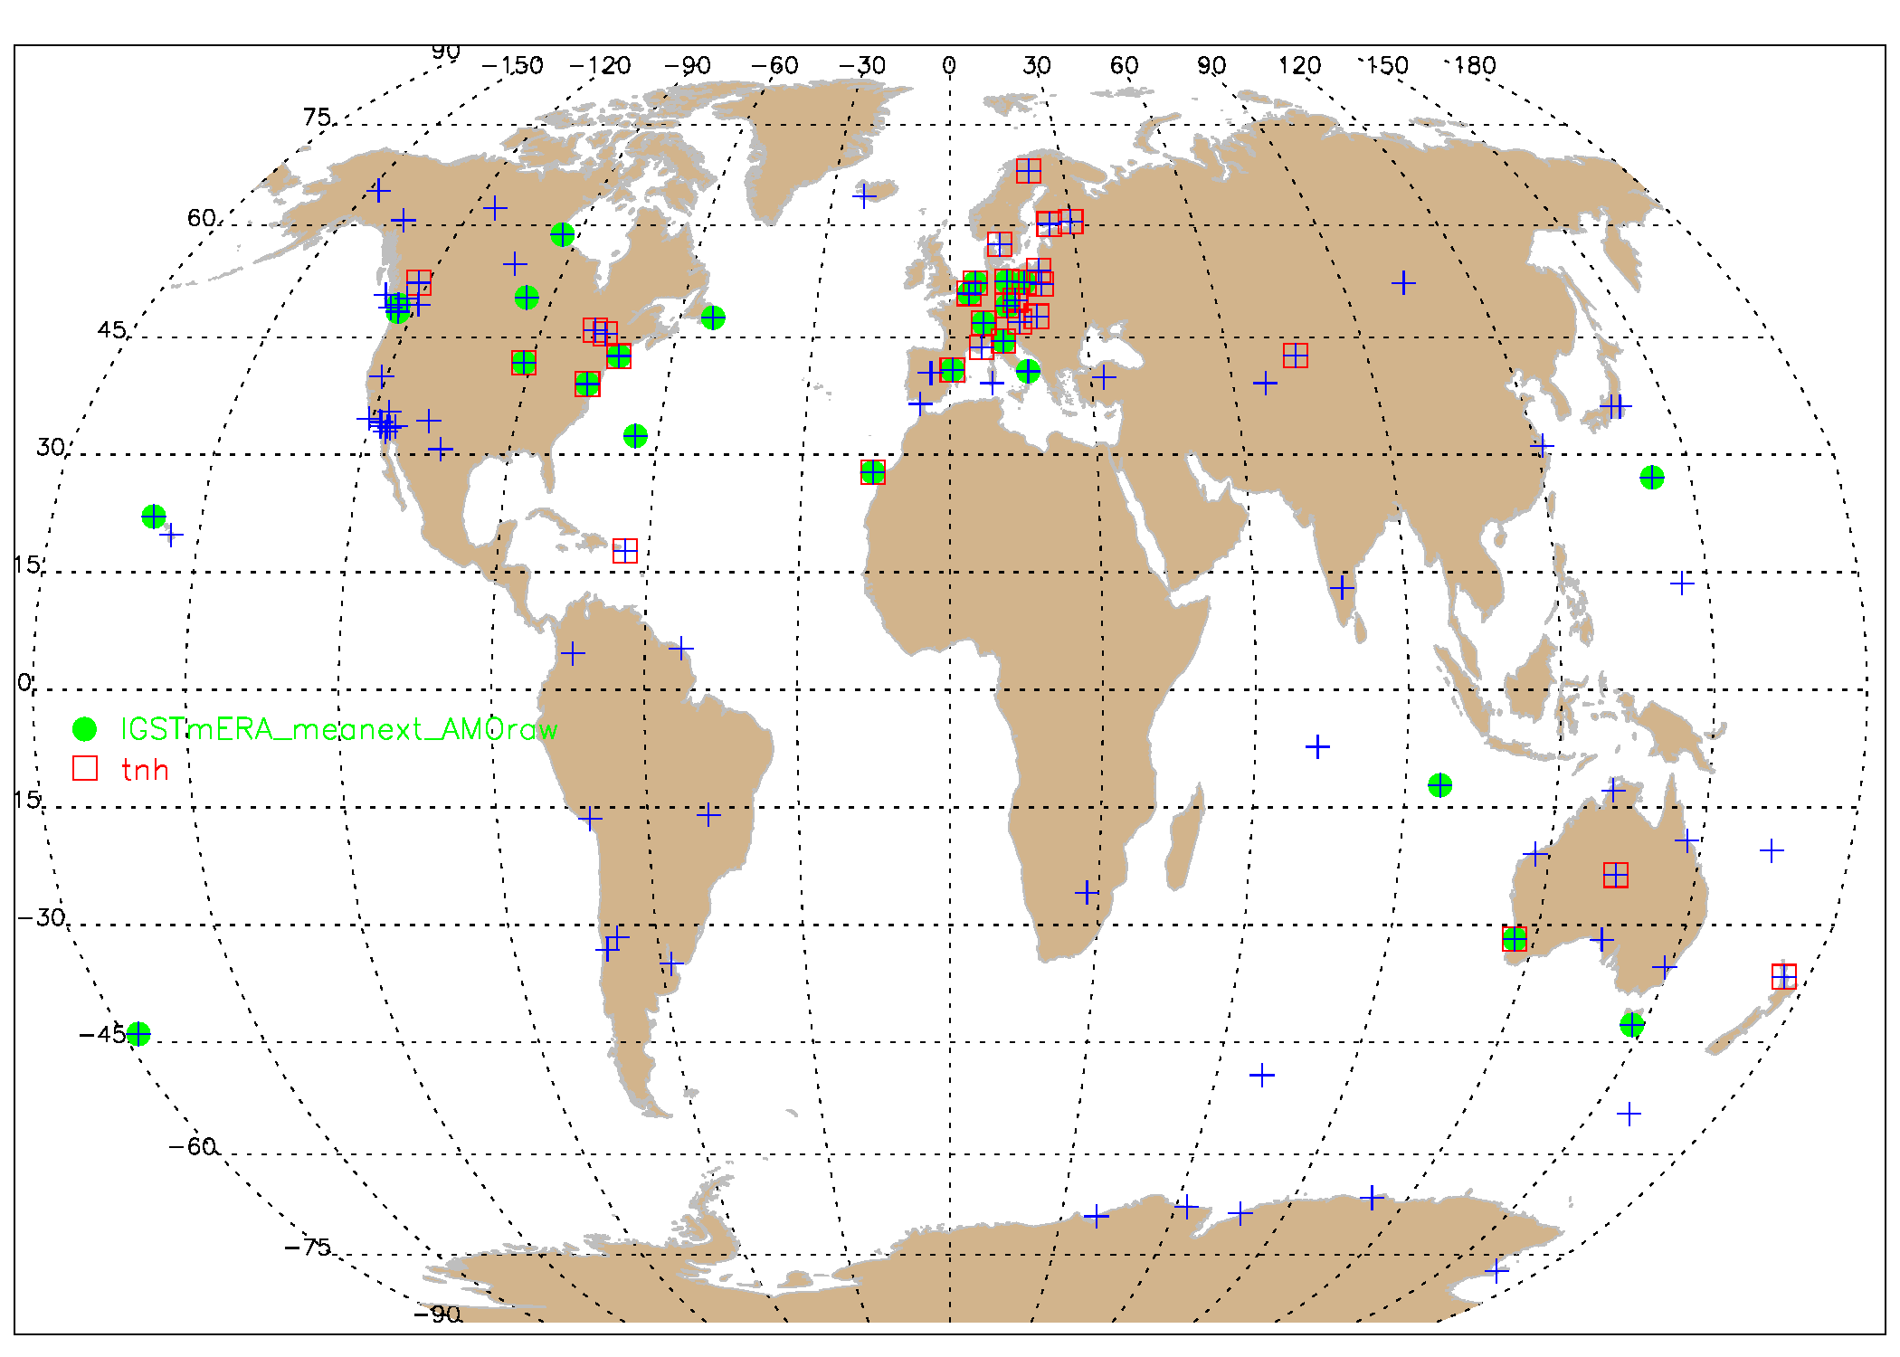
Recapitulation & introduction
Model setup
Seasonal behaviour
Model Performance
ROB
Explanatory variables (means + all teleconnection patterns)
IGS Tm ERA
+ : no AMO & tnh
● : AMO
□ : tnh
AMO = Atlantic multidecadal oscillation: in general consistent geographically
AMO: when present, explains large fraction of remaining variability
tnh = tropical – Northern Hemispheric pattern: : in general consistent geographically
GNSS4SWEC workshop
ESTEC, Noordwijk (NL) 21-23 February 2017

Slide 24
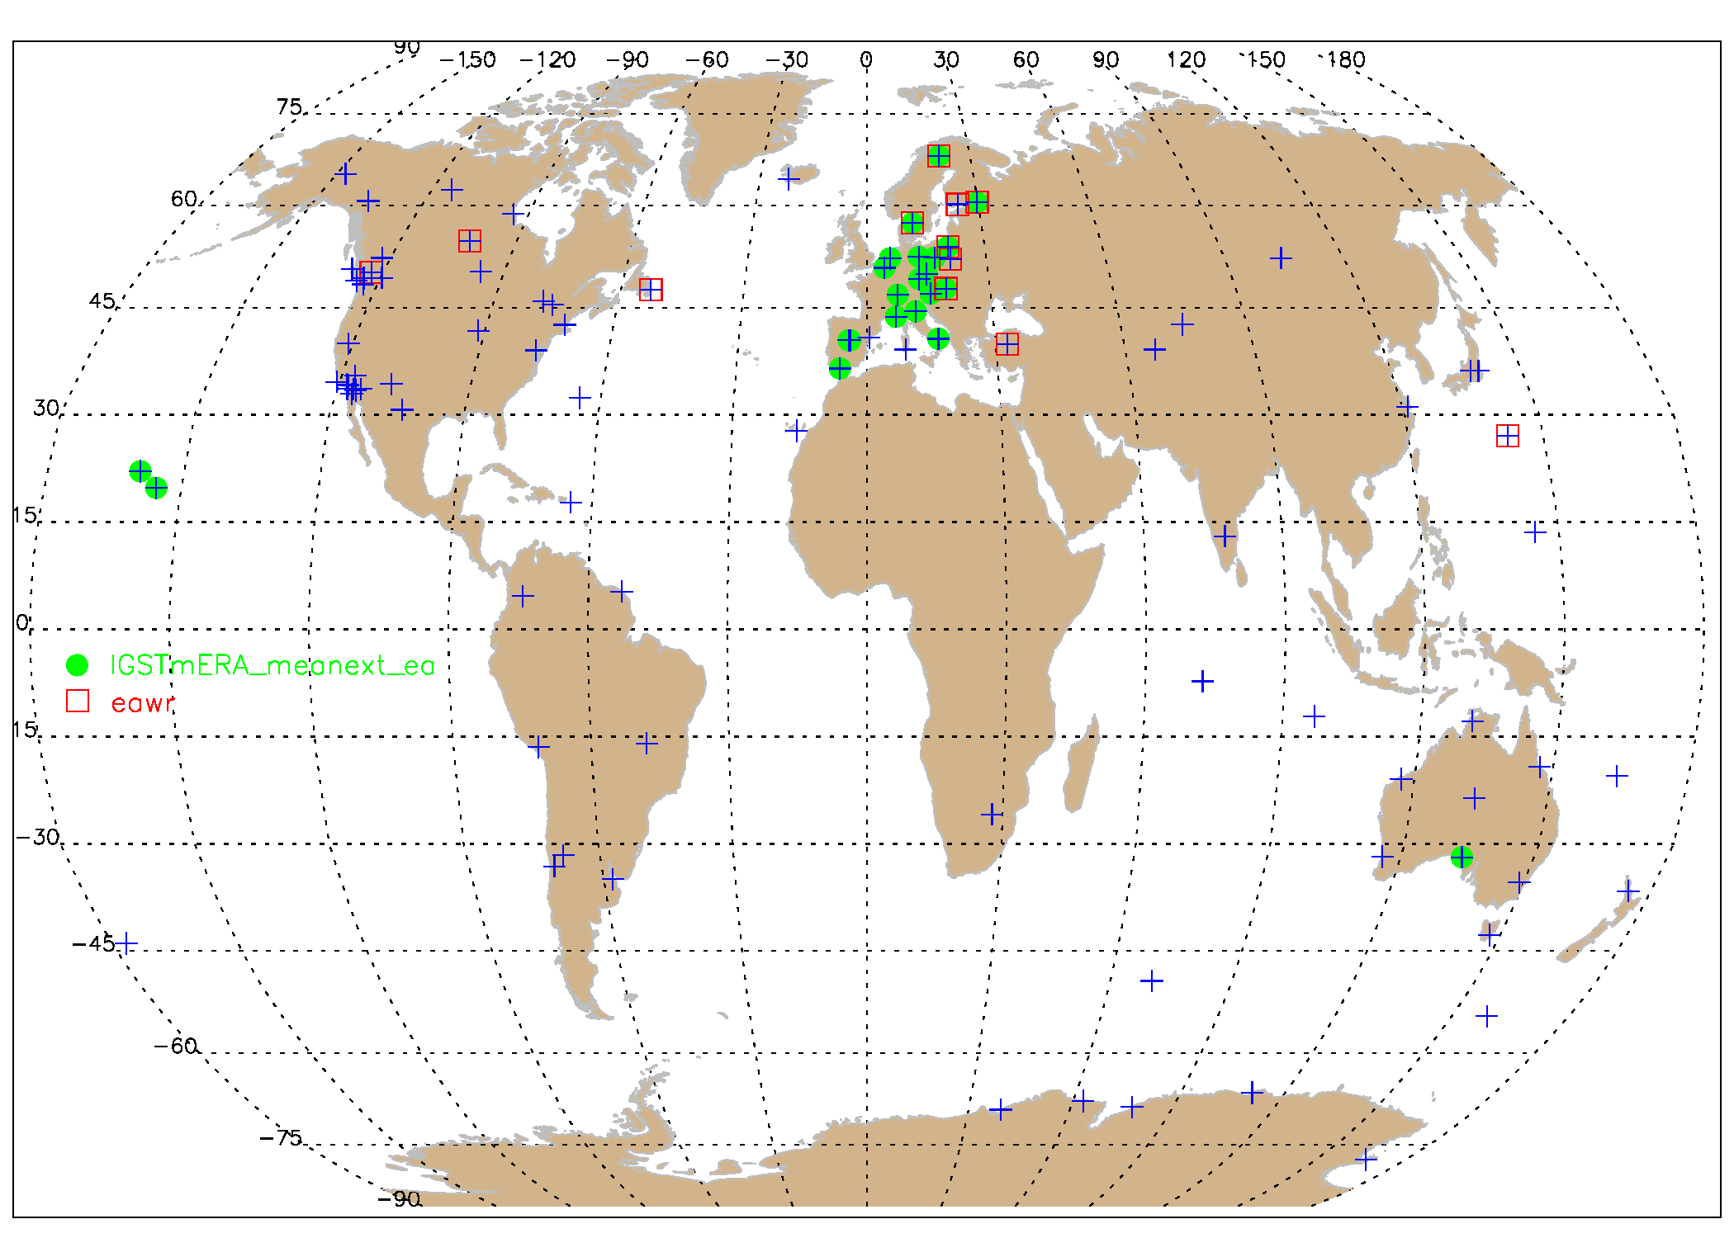
Recapitulation & introduction
Model setup
Seasonal behaviour
Model Performance
ROB
Explanatory variables (means + all teleconnection patterns)
IGS Tm ERA
+ : no EA & EAWR
● : EA
□ : EAWR
EA = east Atlantic pattern: very consistent (except for 3 sites)
EAWR = east Atlantic – west Russia pattern: very consistent (except for 4 sites)
GNSS4SWEC workshop
ESTEC, Noordwijk (NL) 21-23 February 2017

Slide 25

Recapitulation & introduction
Model setup
Seasonal behaviour
Model Performance
ROB
Explanatory variables (means + all teleconnection patterns)
IGS Tm ERA
+ : no EPNP & WP
● : EPNP
□ : WP
EPNP = east Pacific/ north Pacific pattern
WP = west Pacific pattern
not consistent for majority of the sites where these proxies are retained
GNSS4SWEC workshop
ESTEC, Noordwijk (NL) 21-23 February 2017

Slide 26

Recapitulation & introduction
Model setup
Seasonal behaviour
Model Performance
ROB
Explanatory variables (means + all teleconnection patterns)
IGS Tm ERA
ERA-interim
+ : no pacific
● : pacific in IGS
□ : pacific in ERAint
The Pacific teleconnection patterns arise throughout whole the globe in the models, for the different datasets.
GNSS4SWEC workshop
ESTEC, Noordwijk (NL) 21-23 February 2017

Slide 27
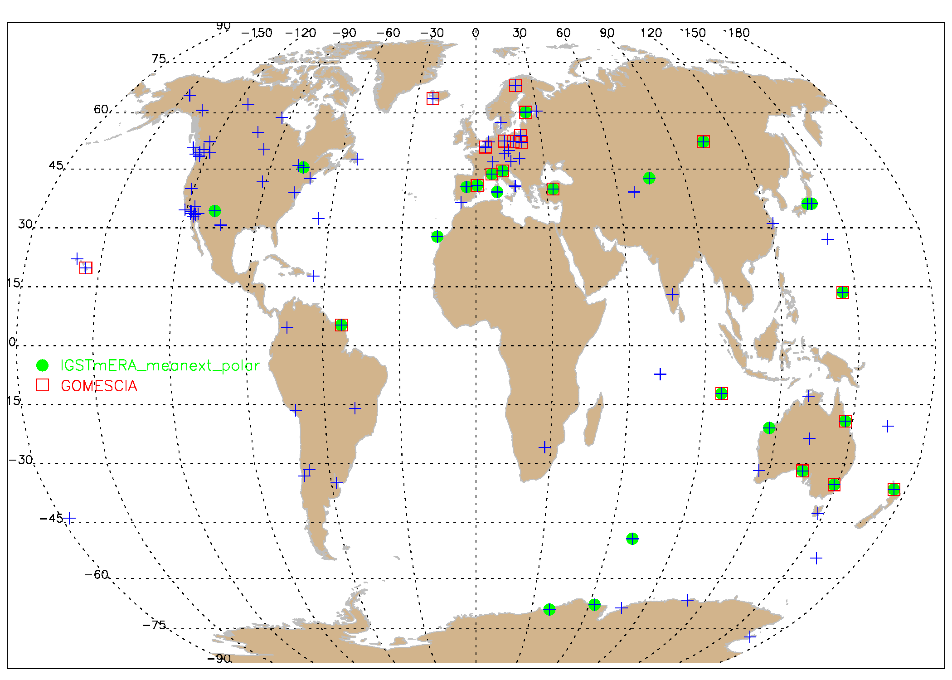
Recapitulation & introduction
Model setup
Seasonal behaviour
Model Performance
ROB
Explanatory variables (means + all teleconnection patterns)
IGS Tm ERA
GOMESCIA
+ : no polar
● : polar in IGS
□ : polar in GOME-
SCIA
Also the polar teleconnection patterns arise at tropical and mid-latitudes.
GNSS4SWEC workshop
ESTEC, Noordwijk (NL) 21-23 February 2017

Slide 28
ROB
Conclusions & Perspectives
This simple, empirical model, works well for the NH mid-latitude sites (high correlation coefficients, geographically consistent proxies used).
For other geographical regions (e.g. Australia, the Pacific), this approach is less successful (missing proxies?) or all time series have more problems.
The bulk of the variability is explained by the surface temperature (after accounting for the seasonal cycle by the long term means or the harmonics) → long term variability (Claussius-Clapeyron) and/or remaining seasonality?
A linear trend was retained as explanatory variable only for few sites. The residuals only show for a small number of sites significant trends, with the exception of GOMESCIA, where 20 to 30% show significant positive trends. So, there might be a clear homogenization issue in this dataset.
future work:
  upgrade of the datasets used (ERA-interim 6h & 18h, GOMESCIA climate)
  monthly → daily?
  publication in SI in prep.
GNSS4SWEC workshop
ESTEC, Noordwijk (NL) 21-23 February 2017

Slide 29
painting by Jess Sutton
Thank you!
GNSS4SWEC workshop
ESTEC, Noordwijk (NL) 21-23 February 2017

Slide 30
Recapitulation & introduction
Model setup
Seasonal behaviour
Model Performance
ROB
Teleconnection patterns
recurring and persistent, large-scale patterns of pressure and circulation anomalies that spans vast geographical areas
Although these patterns typically last for several weeks to several months, they can sometimes be prominent for several consecutive years, thus reflecting an important part of both the interannual and interdecadal variability of the atmospheric circulation.
Many of the teleconnection patterns are also planetary-scale in nature, and span entire ocean basins and continents.
a naturally occurring aspect of our chaotic atmospheric system, reflect large-scale changes in the atmospheric wave and jet stream patterns, and influence temperature, rainfall, storm tracks, and jet stream location/ intensity over vast areas → seasonal weather forecast
e.g. NAO = difference of atmospheric pressure at sea level between the Icelandic low and the Azores high.
GNSS4SWEC workshop
ESTEC, Noordwijk (NL) 21-23 February 2017

Slide 31
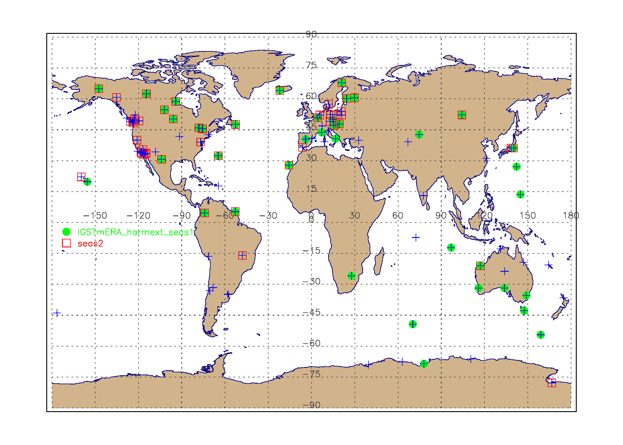
Recapitulation & introduction
Model setup
Seasonal behaviour
Model Performance
ROB
Annual and semi-annual cycle (means + all teleconnection patterns)
IGS repro 1
+ : no harmonics
● : annual cycle
□ : semi-annual cycle
A lot of sites do not need harmonics with annual period to describe their seasonal behaviour (e.g. west coast of the Americas).
Overall, there is a geographical consistency of sites needing the first or second harmonics to represent their annual and semi-annual variability.
GNSS4SWEC workshop
ESTEC, Noordwijk (NL) 21-23 February 2017
Notes:
Add legend

