Slide 1

Water Vapour, Meteorology, and Climate
Solar-Terrestrial Centre of Excellence
Roeland Van Malderen, Eric Pottiaux, Hugues Brenot

Slide 2

Introduction
Meteorology
Antarctica
Climate
workshop held on 26 November, 2012
about 20 participants, from BISA, ROB, RMI, KUL, (and ULB )
11 (12) oral presentations, 7 poster presentations
rather than giving a report/summary, we will focus here on ongoing activities and opportunities in this field!
STCE Annual Meeting Meridian room, 7 June 2013

Slide 3
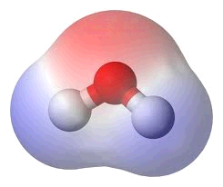
Introduction
Meteorology
Antarctica
Climate
Meteorology
Climate
clouds/precipitation
weather forecast
nowcasting
extreme events: floods, thunderstorms
H₂O = most important greenhouse gas
water vapour feedback mechanism
to be included in climate models!
water vapour trends?
what about stratospheric H₂O?
Water vapour
special focus on Antarctica!
STCE Annual Meeting Meridian room, 7 June 2013

Slide 4
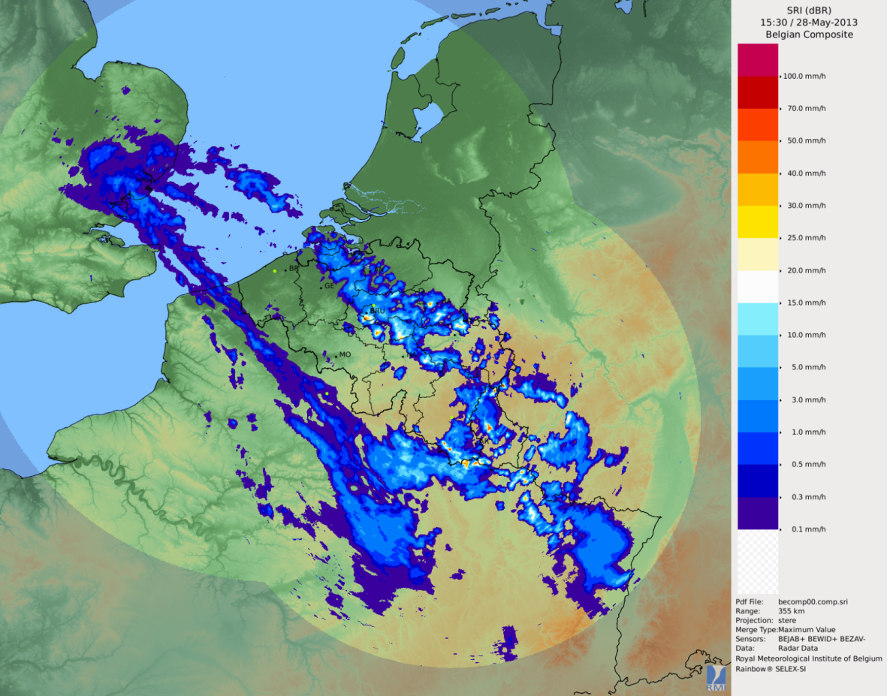
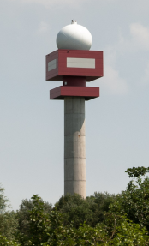
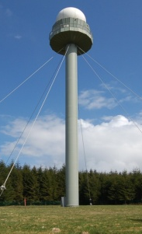
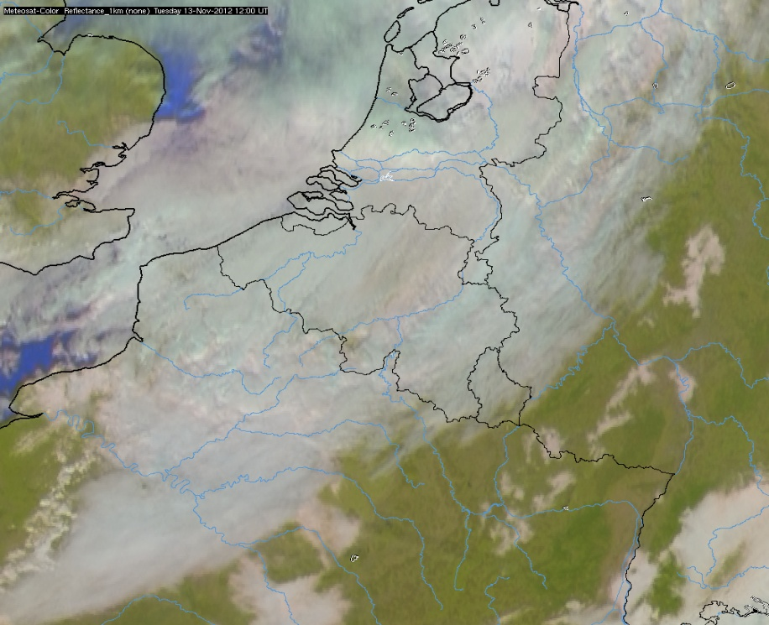
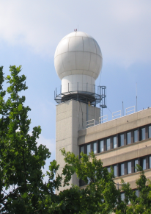
Introduction
Meteorology
Antarctica
Climate
Clouds/precipitation
Jabbeke
RMI
Wideumont
RMI
Zaventem
Belgocontrol
clouds → Meteosat images
clouds → precipitation?
precipitation → radars
precipitation type (hydrometeor classification) → dual polarization radar (Jabbeke)
STCE Annual Meeting Meridian room, 7 June 2013
Jean Neméghaire (RMI)
Laurent Delobbe (RMI)

Slide 5
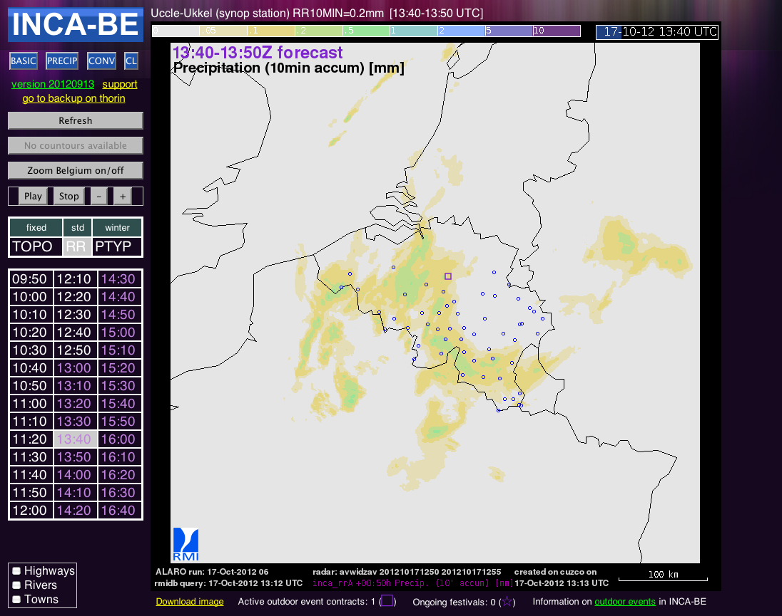
Introduction
Meteorology
Antarctica
Climate
Nowcasting
http://intrarmi.oma.be/metpro/inca-be/
RMI’s nowcasting system: INCA
CE collaboration
several meteorological fields: precipitation (type), cloudiness, visibility, etc.
input: radar, elevation data, weather stations, rain gauges, satellite data, NWP
forecast for convective cells could be improved
Maarten Reyniers (RMI)
STCE Annual Meeting Meridian room, 7 June 2013

Slide 6
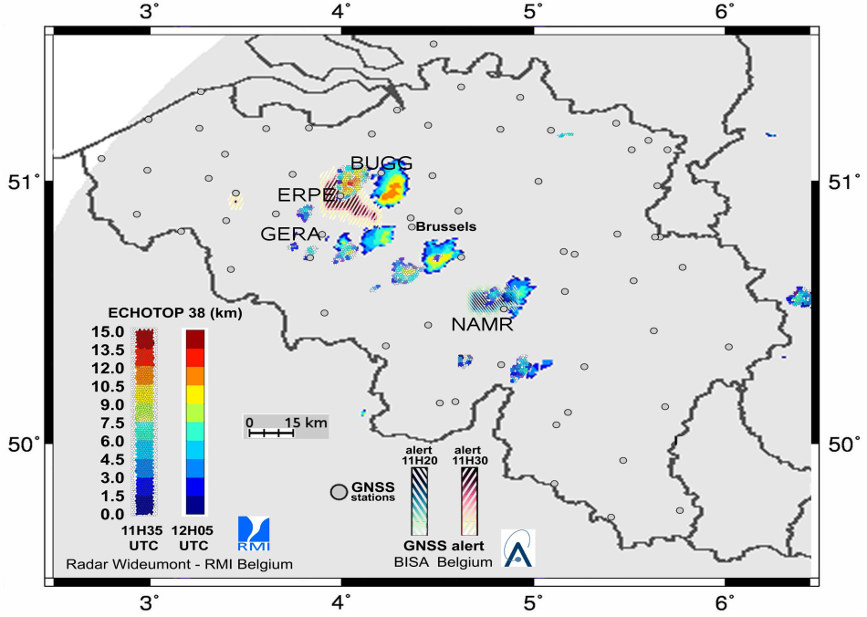
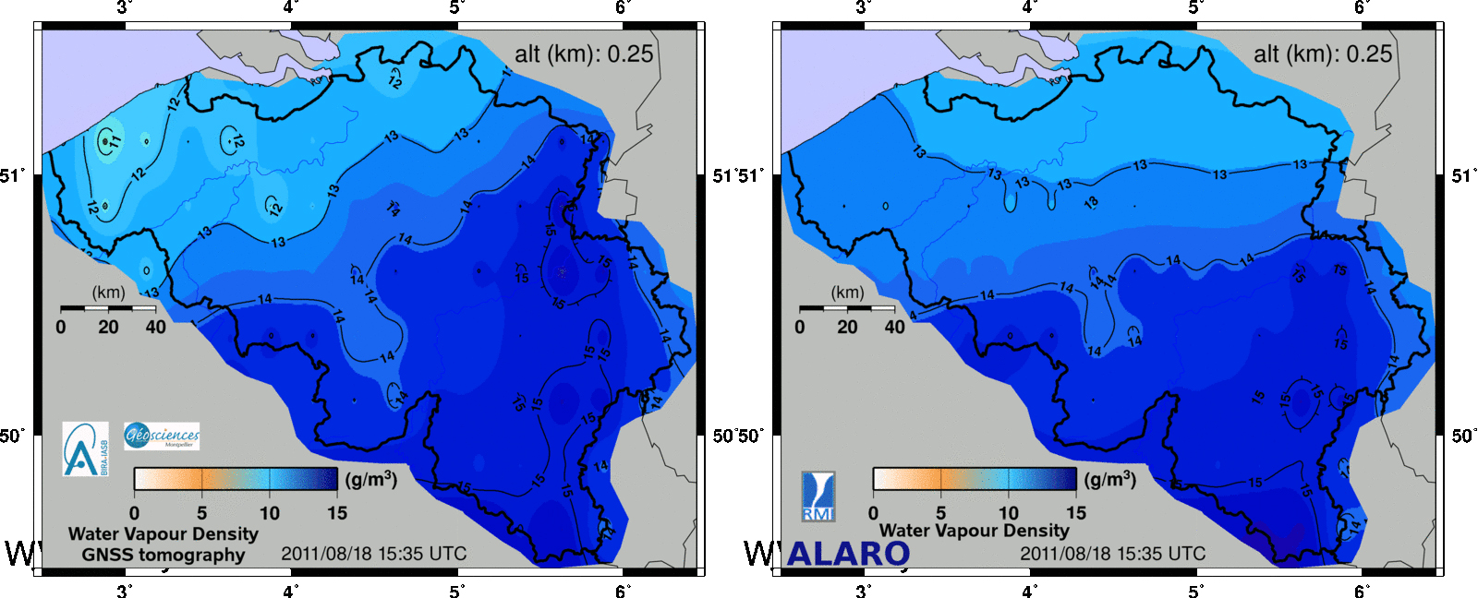
Introduction
Meteorology
Antarctica
Climate
Nowcasting: Global Navigation Satellite System (GNSS) stations
GNSS H₂O alert based on Zenith Total Delay (ZTD) data and gradients
GNSS tomography (using gradients)
Hugues Brenot (BISA, STCE)

Slide 7
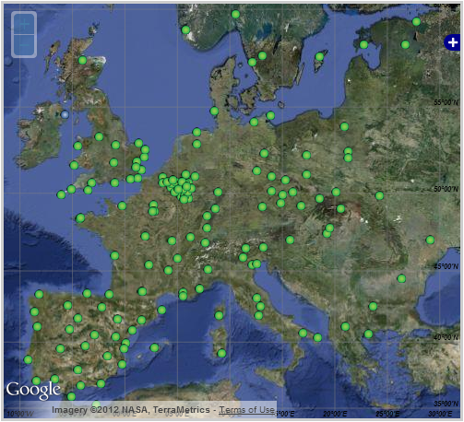

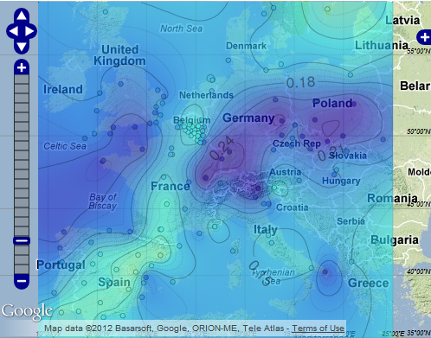


Introduction
Meteorology
Antarctica
Climate
Nowcasting: Global Navigation Satellite System (GNSS) stations
Status: November 2012
2nd July 2012 at 13:00 UTC.
Nowcasting Domain
(Several stations are located outside the represented domain).
ROB’s web portal to GNSS-meteorology and nowcasting
STCE Annual Meeting Meridian room, 7 June 2013
Eric Pottiaux (ROB, STCE)

Slide 8
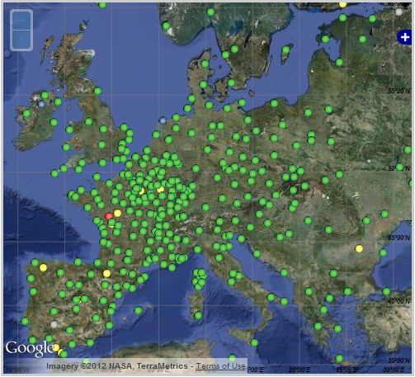

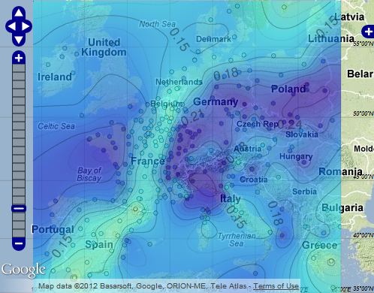

Introduction
Meteorology
Antarctica
Climate
NWP: Numerical Weather Prediction (NWP)
Status: November 2012
2nd July 2012 at 13:00 UTC.
Nowcasting Domain
(Several stations are located outside the represented domain).
This hourly-updated solution is assimilated operationally by several national meteorological services through E-GVAP, but not directly by RMI (assimilation within ALARO)!
STCE Annual Meeting Meridian room, 7 June 2013
Eric Pottiaux (ROB, STCE)

Slide 9
Introduction
Meteorology
Antarctica
Climate
Opportunities
assimilation of radar and GNSS data in ALARO
use of GNSS data for the detection of the build-up of convective cells
EU COST action “GNSS Tropospheric products for the Monitoring of Severe Weather Events and Climate (GNSS4SWEC)” → interested? Please contact Eric Pottiaux, Hugues Brenot or me.
STCE Annual Meeting Meridian room, 7 June 2013

Slide 10
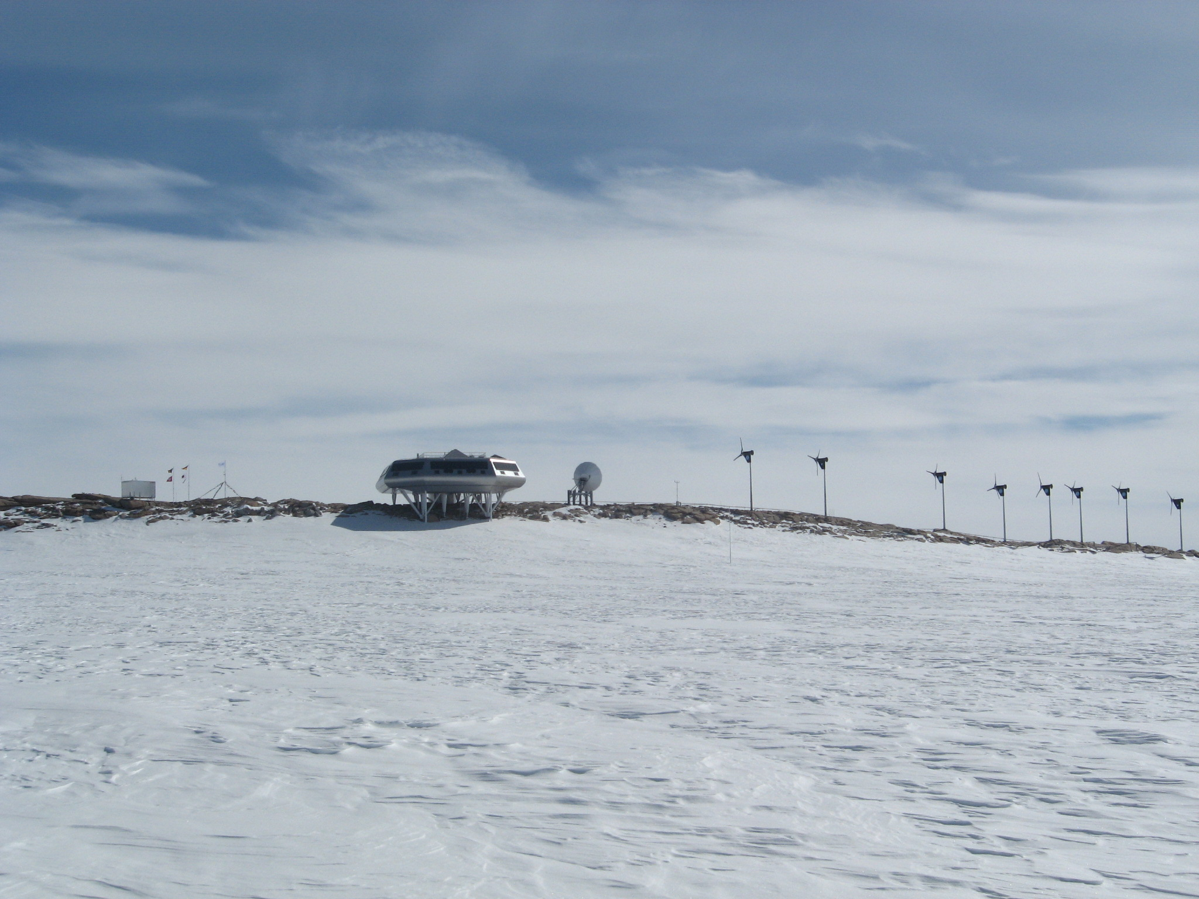

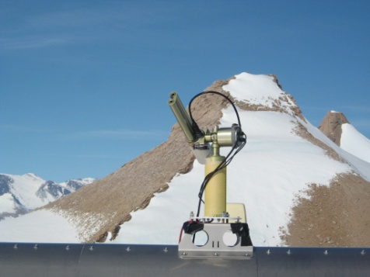
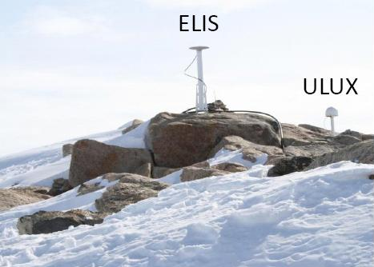
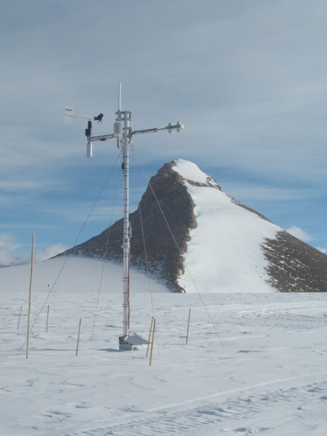
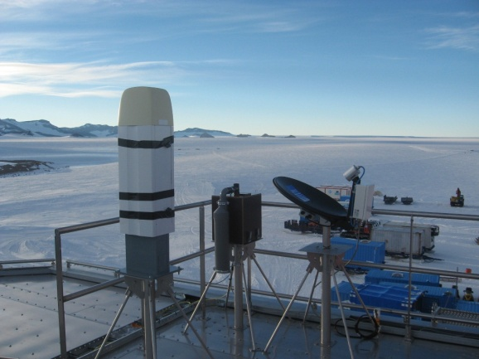
Introduction
Meteorology
Antarctica
Climate
Antarctica: reserach on aerosol-clouds-precipitation interaction at Princess Elisabeth Station
HYDRANT, BELATMOS, GIANT projects
KUL / RMI / BISA / UGent / ROB / Univ. Cologne / Univ. Luxembourg
Cimel Sunphotometer
→ integrated water vapour
2 GPS stations at PES
→ integrated water vapour
automatic weather station
ceilometer, pyrometer, micro-rain radar
→ cloud base height, cloud type
→ cloud base temperature
→ snowfall rate, vertical profile
STCE Annual Meeting Meridian room, 7 June 2013
Alexander Mangold (RMI), Irina Gorodetskaya (KUL), Nicolas Bergeot (ROB, STCE)

Slide 11
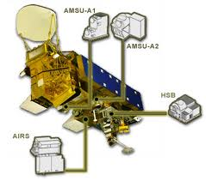


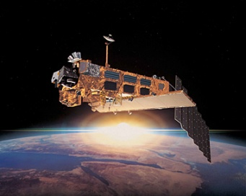


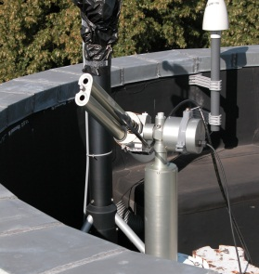
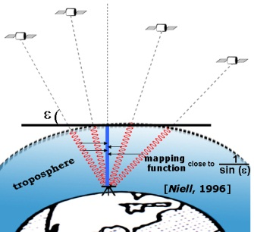
Introduction
Meteorology
Antarctica
Climate
H₂O trends: 1st ) techniques inter-comparison 2nd) trends analysis
GOME/SCIAMACHY/GOME-2
satellite
AIRS
total column water vapour
ground-based
CIMEL sun photometer
GPS
radiosondes
STCE Annual Meeting Meridian room, 7 June 2013
Roeland Van Malderen (RMI, STCE)

Slide 12
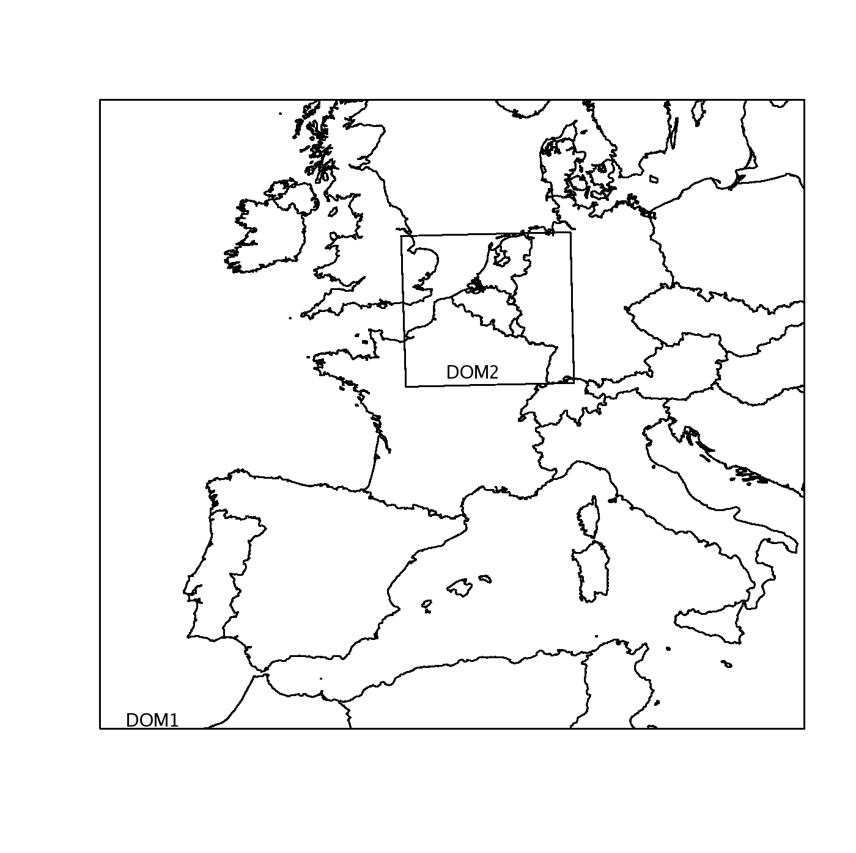

Introduction
Meteorology
Antarctica
Climate
(Regional) Climate models
to develop very high resolution climate/air quality simulations for Belgium region,…
improved understanding of the precipitation/temperature extremes, large scale circulation and its influence on Belgium region
the role of the urbanization in future climate simulations
ALARO-CLIM model at 4 km grid size resolution over Belgium with sophisticated cloud and precipitation parametrization and using a new land surface scheme called SURFEX.
evaluation of the model with ERA-40 and Belgian climatological network of stations
STCE Annual Meeting Meridian room, 7 June 2013
Sajjad Saeed (KUL)
Rafiq Hamdi (RMI)

Slide 13
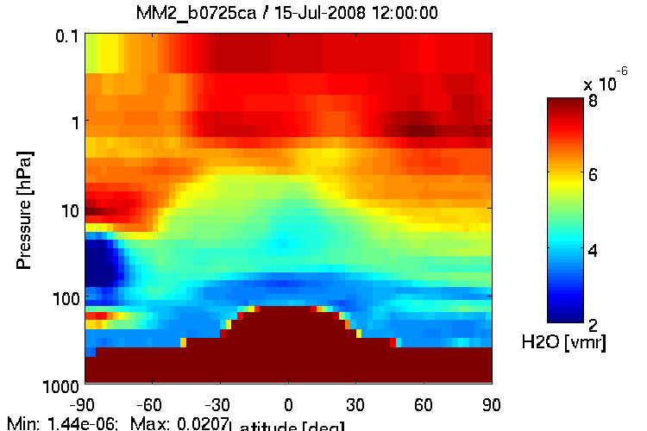
Introduction
Meteorology
Antarctica
Climate
Stratospheric water vapour
Stratospheric Chemical Data Assimilation at BIRA-IASB: the Belgian Assimilation System for Chemical ObsErvations (BASCOE)
4D-Var system dedicated to stratospheric chemical observations
Chemistry Transport Model (CTM) including 57 species (including H₂O), 200 chemical reactions
dynamics (u,v,T,p₀) taken from ECMWF
PSC parameterization to account for the effect of PSC on denitrification and dehydration and on the activation of chlorines
BASCOE H20 on Jul. 15, 2008 from Aura MLS assimilation
Quentin Errera (BISA)
STCE Annual Meeting Meridian room, 7 June 2013

Slide 14
Introduction
Meteorology
Antarctica
Climate
Opportunities
compare observed trends in water vapour with climate model simulations
compare for Belgium, the regional climate model output of the two groups
coupling of ALARO & BASCOE for climate simulations (e.g. investigate stratosphere-troposphere exchange events like extra-tropical cyclones over the North Atlantic and Europe, Brain.be proposal)
Thank you for your attention!
STCE Annual Meeting Meridian room, 7 June 2013

