Slide 1

History of 50 years ozone soundings:
Change from BM to ECC sonde type
Hugo De Backer

Slide 2
Situation in the 1990s
Existing long time series with Brewer-Mast Sondes (> 20 years) important for trend analyses and process studies. Lots of efforts were done to remove artefacts (SO₂ correction, correction for radio sonde changes, …)
Known issues with BM sondes:
Loss of ozone by non-Teflon parts in the pump
Uncertainty in correction for pump efficiency
Alternative: Electrochemical Concentration Cells (ECC):
Seem to perform better (lower correction when integrated column is compared to spectrophotometer measurements)
Easier to prepare
Better reproducibility

Slide 3
Dilemma
Continue with BM:
Homogeneous time series
Problems during preparation
Lower quality
Few users left around the world
Change to ECC:
Higher quality (better reproducibility)
More generally used world wide
Easier preparation
Loss of homogeneity of the time series

Slide 4
Action: research
Better characterisation of the BM sondes:
Measurement of the pump efficiency at low pressure in a simulation chamber
Pressure dependence is higher, especially at low pressures (high altitudes)
Develop new pressure (PRESTO) dependent correction procedure based on:
Calibration at ground level
Comparison of integrated ozone column with spectrophotometer measurement

Slide 5
Results
Pump correction for BM sensors is generally higher that what was used as standard
Pump correction highly variable between individual sensors
Correction with standard procedure (linear correction for total ozone column) is too high in the troposphere and much too low in the higher stratosphere
With the new correction procedure less variability is seen in the comparison with satellite data

Slide 6
Curiosity
What about the ECC sondes?
Same tests but different result:
The measured pump efficiencies for ECC sondes are less variable than with BM sensors,
The pressure dependence is closer to the proposed standard correction for ECC sondes

Slide 7
Decision & new doubt
We changed to ECC type of sensor in 1997
Do we introduce a jump in the time series?
To remove doubt:
Double soundings about once in two weeks during one year
Comparison with satellite data over the transition period

Slide 8
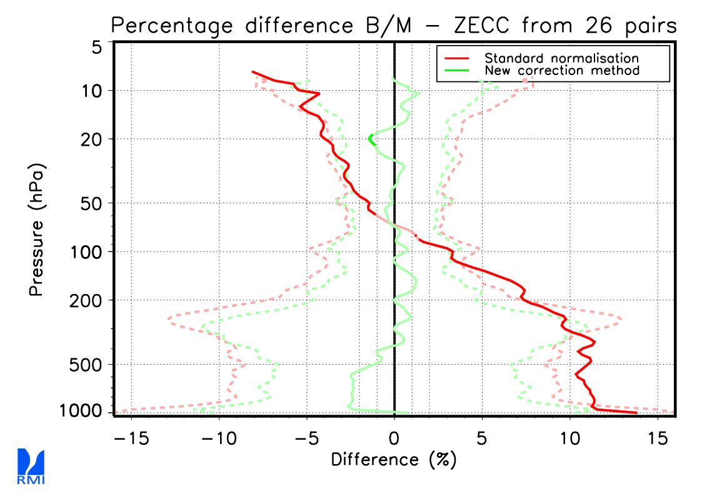
Results of double soundings
Good comparison when using RMI developed pressure dependent (PRESTO) correction!

Slide 9
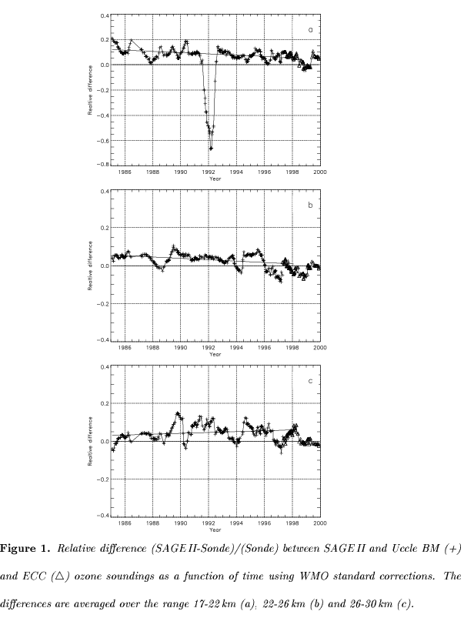
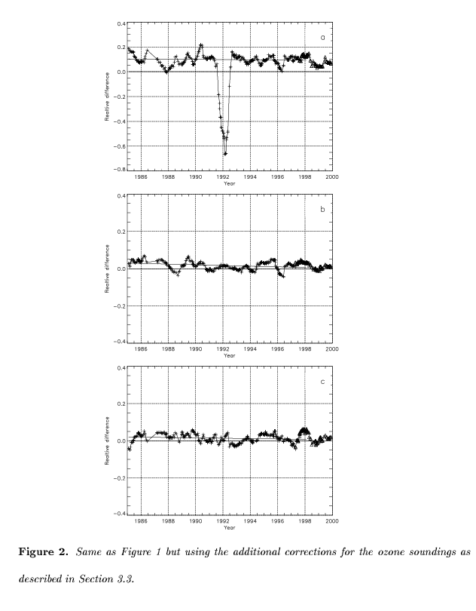
Comparison with SAGE-II satellite
No trend visible in the differences with satellite data when the RMI developed correction (PRESTO) is applied

Slide 10
Conclusion
Due to the scientific efforts we could change to the modern ECC-type of sensor without introducing a break in the time series.
This improved the quality of the measurements
Made the preparation more easy
Combined time series can be used for trend and process studies and validation of new observational data
However also the ECC sondes have some issues and continued efforts are made to decrease the uncertainty in the measurements

Slide 11
Thank you

