Slide 1
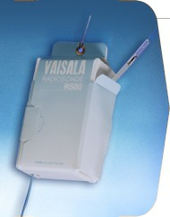
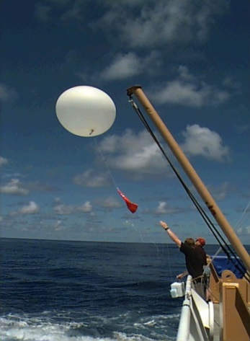
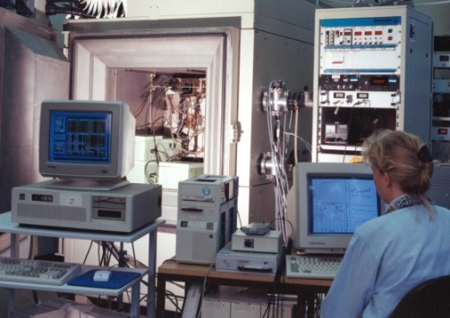
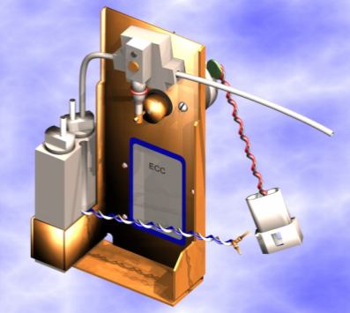






Achievements and Future CHALLENGES FOR THE WCCOS
Ozonesondes in the Global Observing System and their long term Quality Assurance
Herman Smit
Institute of Energy and Climate Research: Troposphere (IEK-8)
Forschungszentrum Jülich
Contact: h.smit@fz-juelich.de
Achievements and Future Challenges for the WCCOS

Slide 2

Performance of an Ozone Sonde
Height Z=0-35 km ; Ascent rate=5 m/s ; Height resolution=100 m ;
All weather instrument ; Precision = +/-3% ; Uncertainty = 5-20%;
One-way instrument; Carefull preparation and handling necessary
Achievements and Future Challenges for the WCCOS
Notes:
=

Slide 3
Global GAW-NDACC-SHADOZ O₃S Network
Nowadays more then 95% of global stations use ECC-sondes
Achievements and Future Challenges for the WCCOS

Slide 4
1994 WMO/UNEP Assessment of
Ozone Depletion:
“The state of knowledge regarding long term trends of (free) tropospheric as well as stratospheric ozone is still very limited due to limited quality of long term ozone data”
Urgent need for improved data quality:
In 1995 the establishment of the environmental simulation facility at Juelich as World Calibration Centre for Ozone Sondes (WCCOS) as part of the Quality Assurance (QA) plan for ozone sondes that are in routine use in the GAW (=Global Atmosphere Watch) program of the WMO
Achievements and Future Challenges for the WCCOS

Slide 5

World Calibration Centre for Ozone Sonde
(WCCOS at FZJ/IEK-8 at Jülich, Germany)
The Environmental Simulation Facility (ESF):
Enables control of pressure, temperature and ozone concentration
Simulate quasi realistic flight conditions of ozone soundings from surface to Z=35 km
Dual beam UV-photometer (OPM) serves as the reference (uncertainty better than 3-5 %)
JOSIE = Juelich Ozone Sonde Intercomparison Experiment
Achievements and Future Challenges for the WCCOS

Slide 6
ECC
JOSIE-1996
Overview Comparison Different Ozone Sonde Types
Against UV-Photometer
(GAW-Report#130)
Brewer-
Mast (BM)
ECC
ECC
INDIAN
BM-
Hybrid
ECC
ECC
Japanese KC79
ECC sondes better precision & accuracy compared to other ozone sonde types, particularly in the troposphere
Small changes of operating procedures can have large impact on data quality (~5-20%)

Slide 7

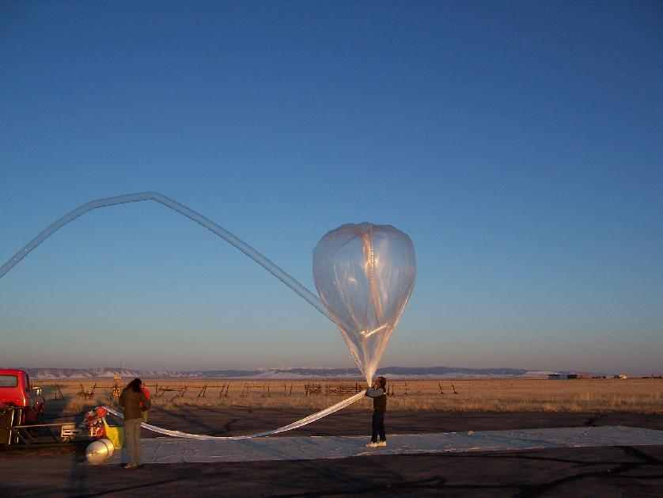
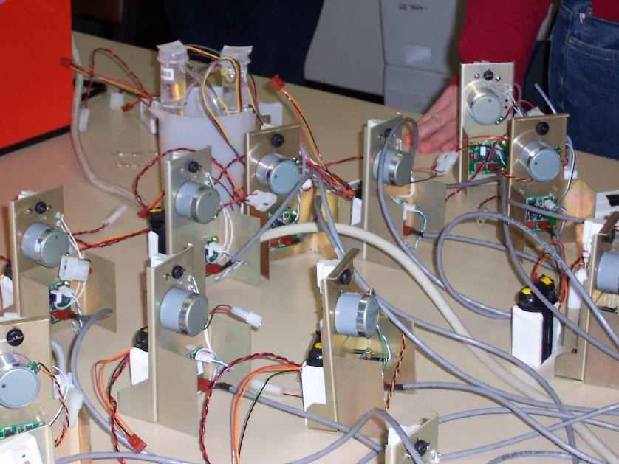
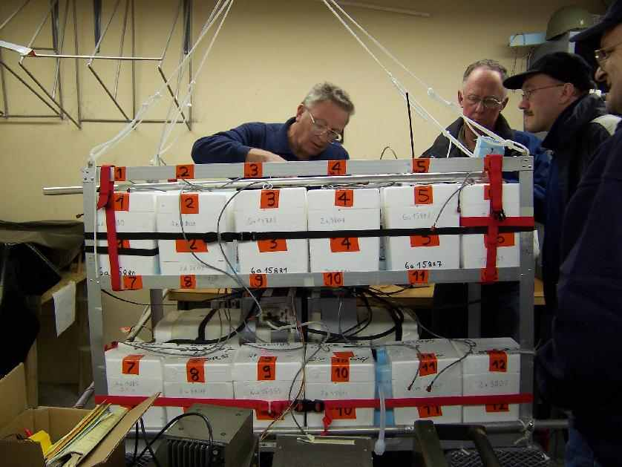
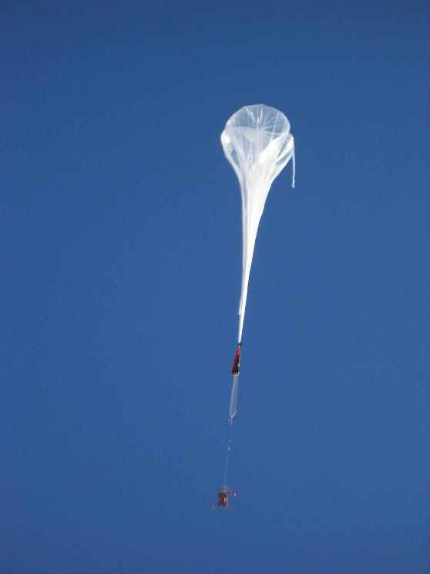
April 2004:
Laramie, Wyoming, USA
Achievements and Future Challenges for the WCCOS
Notes:
:

Slide 8
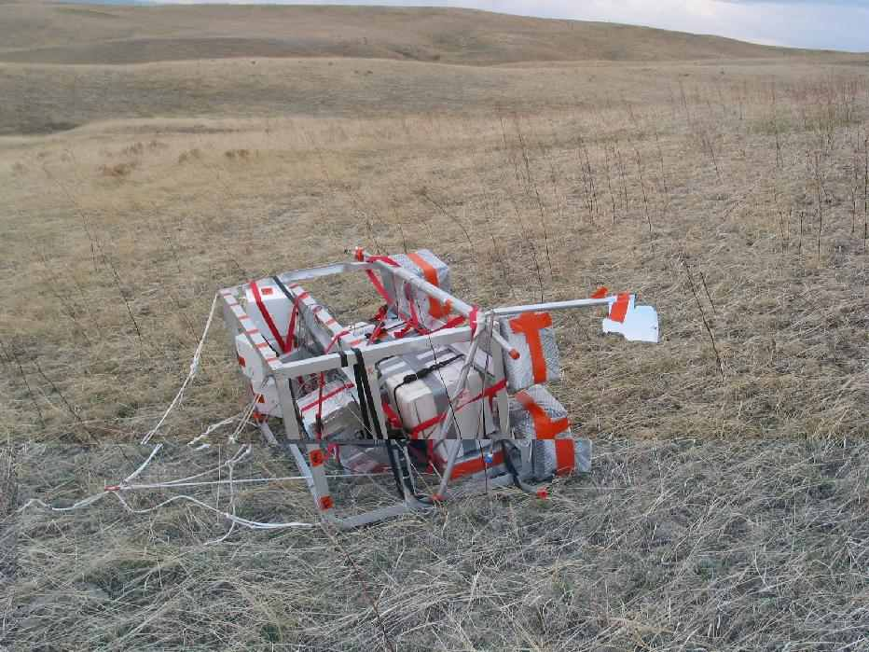
Achievements and Future Challenges for the WCCOS

Slide 9
JOSIE-ASOPOS-BESOS
Sources: JOSIE [Smit et al., J.Geophys.Res., 2007]
BESOS [Deshler et al., J.Geophys.Res., 2008]
Achievements and Future Challenges for the WCCOS

Slide 10
QA/QC Report on Ozonesondes 2011
http://www.wmo.int/pages/prog/arep/gaw/documents/GAW_201_30_Sept.pdf
Achievements and Future Challenges for the WCCOS

Slide 11
JOSIE 2000 (Lab.) versus BESOS (Field)
Comparison SPC-6A & ENSCI-Z @ SST1.0 & SST0.5
BESOS= Balloon Experiment
on Standards for Ozone Sondes
JOSIE
2000
BESOS
2004
(Smit et al.,
JGR 2007)
(Deshler et al.,
JGR 2008)
Rel. Differences minimal (< 1-3 %) for SPC-6A & SST1.0 and ENSCI-Z & SST0.5
BESOS: Precision of ECC-O3 sondes can be 3 % when same SOP’s used
JOSIE 2000: when not same SOP’s then precision in troposphere may be only 5-10 %

Slide 12
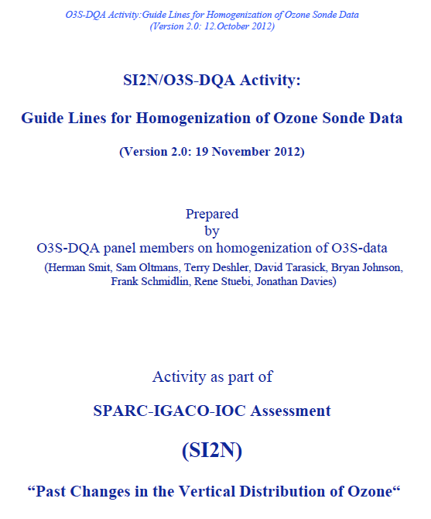

O3S-DQA: Homogenisation
“Ozone Sonde Data Quality Assessment (O3S-DQA)” activity started in 2012 and achieved three major outcomes:
Resolving after established guidelines all known inhomogeneities in ozone sonde data records to improve the uncertainty from 10-20% down to 5-10 %
Documentation of the homogenization process including quantification of the uncertainty of each ozone sonde measurement
Storage of additional raw data of O3S included the overall uncertainty of each O3S-measurement
Status 2018: About 30 out of 50 O3S station their O3S-records have been homogenised
Achievements and Future Challenges for the WCCOS

Slide 13
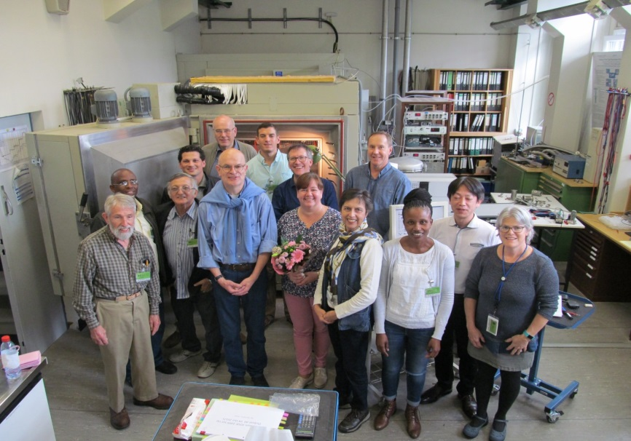
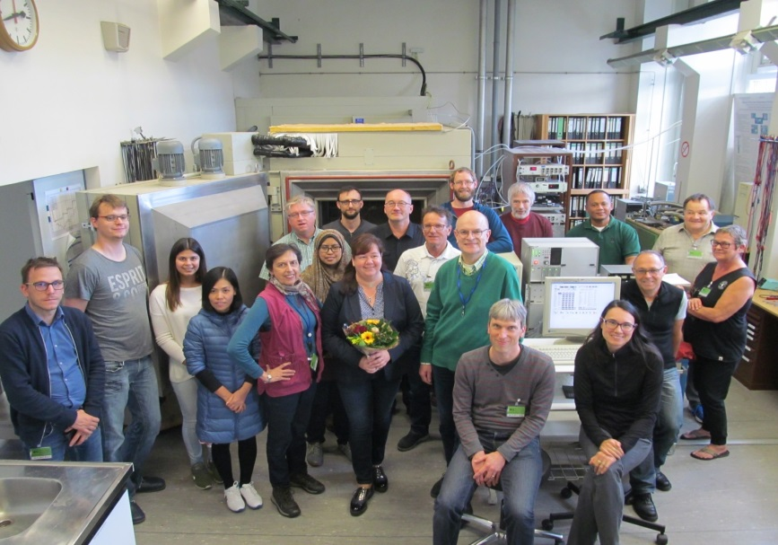
JOSIE 2017 –SHADOZ Campaign
Session 1: 09-20 October 2017
Capacity Building:
8 Operators from 5 Continents for training & testing ozonesondes.
What was tested?
QA Manufacturing
QA Prepairing Procedures
QA Tropical Profiling Capabilities
Session 2: 23 October-03 November 2017
Achievements and Future Challenges for the WCCOS

Slide 14
25 Years of QA-Activities of the WCCOS
JOSIE 1996: QA-O3S Types (GAW Report #130)
>> Small changes/differences of instruments
or operating procedures can have significant
impact on data quality!!!!
JOSIE 1998: QA-Manufacturers (GAW Report #157)
>> Differences between manufacturers
JOSIE 2000: QA-Procedures (GAW Report #158)
>> Differences between sensing solutions
ASOPOS 2001: Evaluation of JOSIE 2000 (Smit et al, JGR 2007)
>> Definition of provisional SOP‘s
BESOS 2004: Testing of provisional SOP‘s
in the field (Deshler et al., JGR 2008)
ASOPOS 2004: Evaluation JOSIE & BESOS
>> Unanimous agreement on SOP‘s
ASOPOS 2009: Approval SOP’s by WMO
>> GAW Report #201
JOSIE 2009-2010: QA-Manufacturers
O3S-DQA Activity 2011-2017:
>> Homogenisation long term O3S records
JOSIE 2017-SHADOZ (Thompson et al., BAMS 2019)
>> QA-Tropical profiling capabilities
ASOPOS 2.0 (2018-2020):
>> Upgrade of SOP’s to achieve overal uncertainty
in the O3S-networks better than 5%
10-20%
Uncertainty Sonde
Target: 5%

Slide 15
Future of WCCOS-Activities
Challenge :
Uniform Uncertainty of 5% in the Global Ozonesonde Network
More Strict Standardization Required:
  Groundequipment to prepare Ozonesonde
  Operating Procedures
  Capacity Building (Training & Motivation)
Achievements and Future Challenges for the WCCOS

Slide 16
Lessons We Learned With ECC‘s
Again and Again
At the first sight it seems all fine and not to worry, because
from Design, Components and Type all ECC Types look the Same
But:
Small changes of instrument or operating procedures or changing manufacturers can have large impact on data quality (e.g. JOSIE & BESOS)
Warning:
Cautious with regard to any changes
(Remind, that the devil is always hiding himself in the details)
Achievements and Future Challenges for the WCCOS

