Slide 1
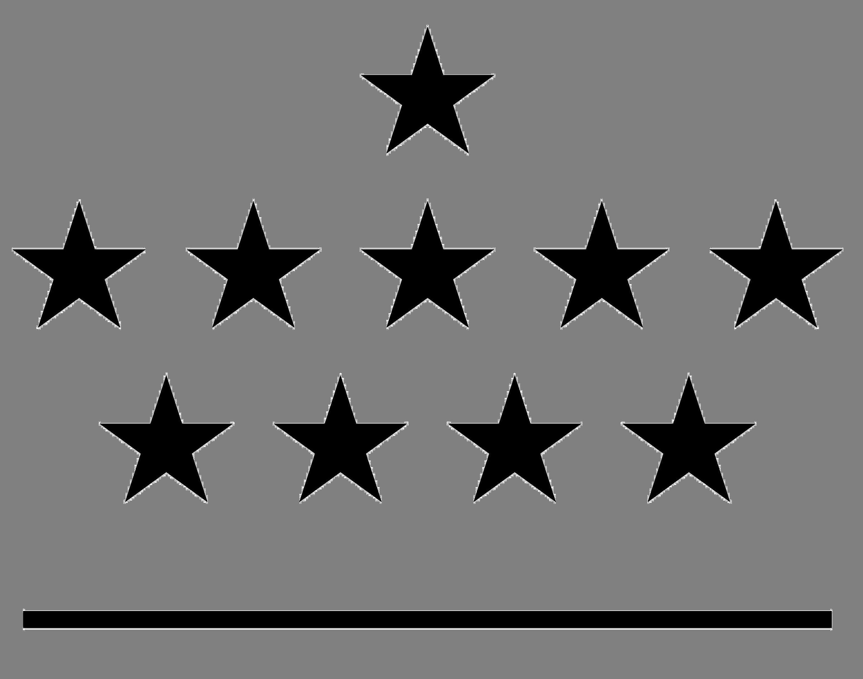





Using GNSS ZTD retrievals for climate
Roeland Van Malderen
with contributions from Eric Pottiaux, Olivier Bock, Anna Klos, and Rosa Pacione
Royal Observatory of Belgium

Slide 2
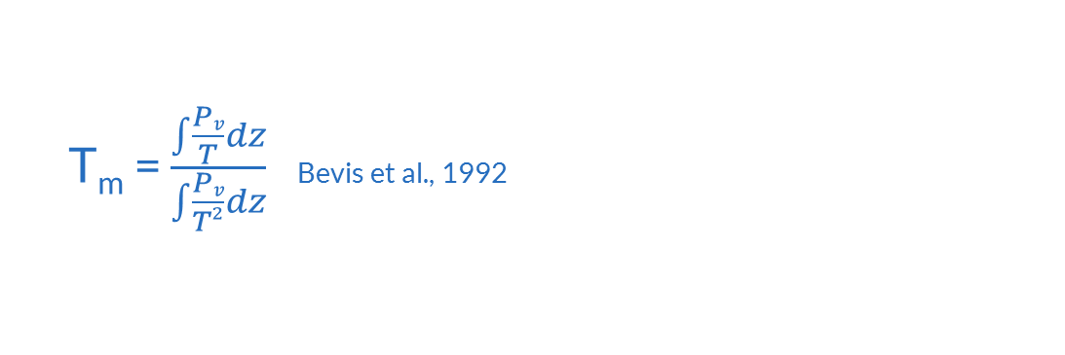
Introduction: from ZTD to IWV
P_{s}
Zenith Total Delay = Zenith Hydrostatic Delay + Zenith Wet Delay
Integrated Water Vapour = K(Tm) × ZWD
assume we know P_{s} & vertical distribution from P_{v} and T (or T_{s}) (→ models, obs)
in this talk: IWV (PW, CPW), most relevant for climate
T_{m} = $\frac{\int{\frac{Pv}{T}dz}}{\int{\frac{Pv}{T²}dz}}$ Bevis et al., 1992

Slide 3
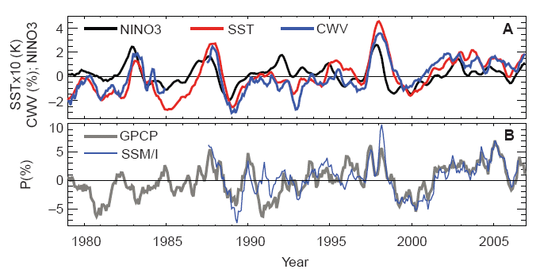
Introduction: IWV and climate
Water vapour (IWV)
important greenhouse gas (but amount not controlled by emissions)
amount controlled by air temperature through Clausius-Clapeyron: d ln IWV/dT ≈ 7% K⁻¹ → positive feedback mechanism
key role in the atmospheric hydrological cycle by allowing winds to move water around Earth and by providing the water source for the formation of clouds and precipitation (Trenberth et al., 2003)
key component in the global energy cycle through surface evaporation and atmospheric latent heating (Trenberth et al. 2009)
Temporal correlation
Allan and Soden, Science, 2008

Slide 4
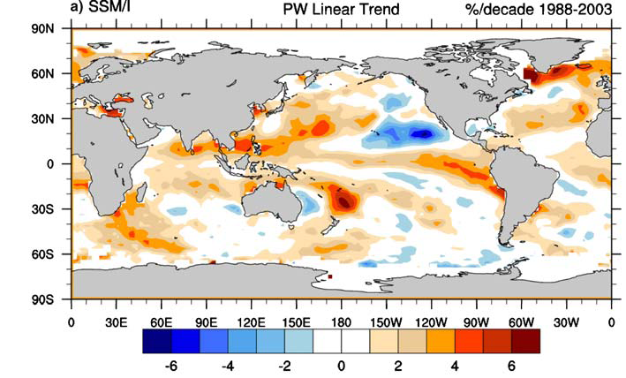
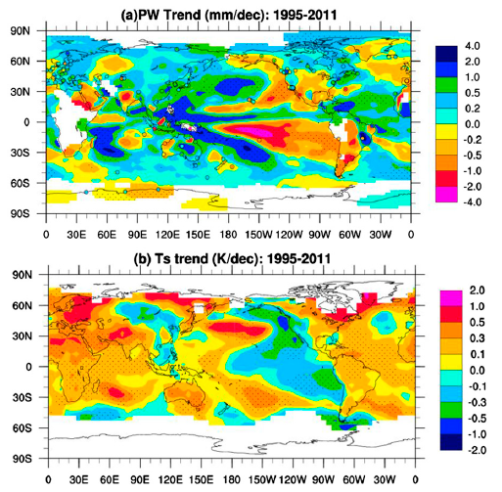
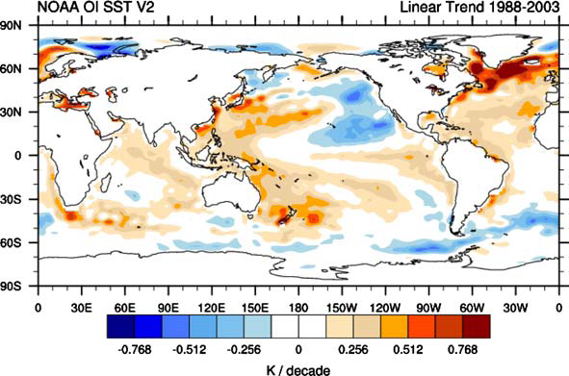
Introduction: IWV and climate
GPS stations!
Spatial correlation
Trenberth et al., Clim. Dyn, 2005
Wang et al., J. Clim, 2016

Slide 5
GNSS for climate
Applications
Requirements
validation tool for long-term IWV time series
  observations/models (reanalysis/climate)
  global/regional
  bias/variability
  seasonal behaviour
  trends
study the time/spatial variability of GNSS IWV datasets
using GNSS products for data assimilation in climate models (reanalyses) , e.g. UERRA
long-term time series (climatological = 30 yrs!)
global coverage/dense regional coverage
homogeneity
  processing options
  instrumentation
  auxiliary meteorological data

Slide 6
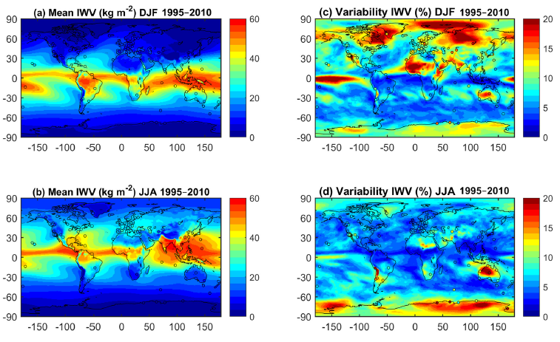
GNSS for climate: applications
Applications
validation tool for long-term IWV time series
  models (reanalysis)
  global
  bias/variability
study the time/spatial variability of GNSS IWV datasets
ERA-Interim reanalysis vs. IGS Repro 1 (circles)
IWV max at low latitudes
representativeness issues between those datasets (Bock et al., ACP, 2019)
Parracho et al., ACP, 2018

Slide 7
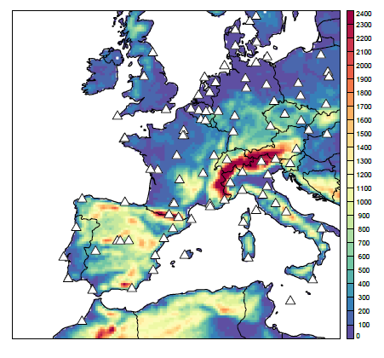
GNSS for climate: applications
Applications
validation tool for long-term IWV time series
  models (reanalysis+climate model)
  regional: Europe
  seasonal behaviour
EPN Repro 2
1996-2014
10+ years
15d+ /month
100 stations
ALARO
ALADIN atmos. model
land surface model
20 km horizontal resolution
Berckmans et al., ACPD, 2018

Slide 8
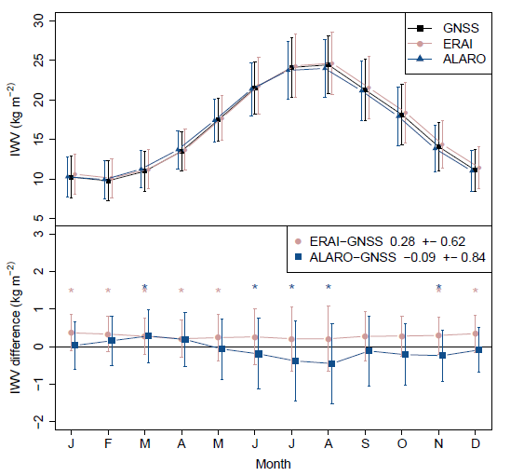
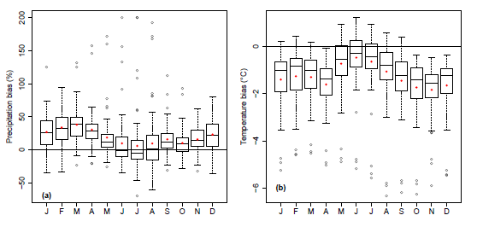
GNSS for climate: applications
Applications
validation tool for long-term IWV time series
  models (reanalysis+climate model)
  regional: Europe
  seasonal behaviour
Berckmans et al., ACPD, 2018
seasonal variability in the ALARO-GNSS IWV differences (not ERA-Interim-GNSS)
also seasonal variability in the ALARO-OBS differences for T, precipitation!
evaporation? lack of data assimilation? (Ning et al., JGR, 2013)

Slide 9
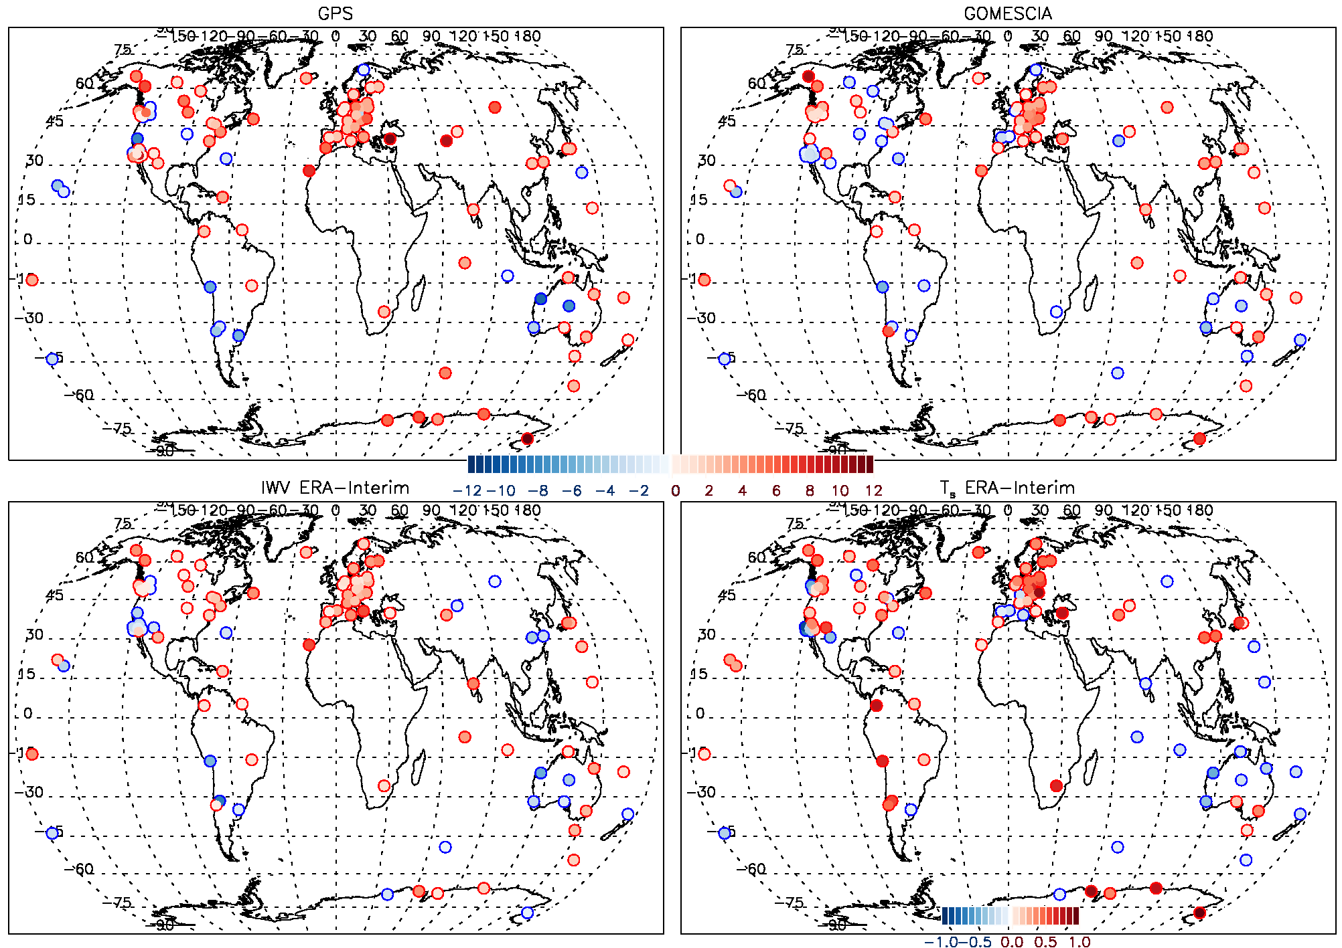
GNSS for climate: applications
Applications
validation tool for long-term IWV time series
  observations: sat & models: reanalysis
  global
  trends
study the time/spatial variability of GNSS IWV datasets
1996-2010
more or less geographically consistent between the 3 datasets (+ : EU, AUS; -- : USA)
follows T trend
Van Malderen et al., ACPD, 2018

Slide 10
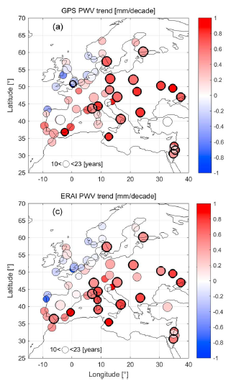
GNSS for climate: applications
Applications
validation tool for long-term IWV time series
  models: reanalysis
  regional: EU
  trends
study the time/spatial variability of GNSS IWV datasets
strong correlation (86%) between trends
treatment of gaps, inhomogeneities, stochastic part (AR(1))
gradient in trends from west to east/north to south?
Alshawaf et al., JGR, 2018

Slide 11
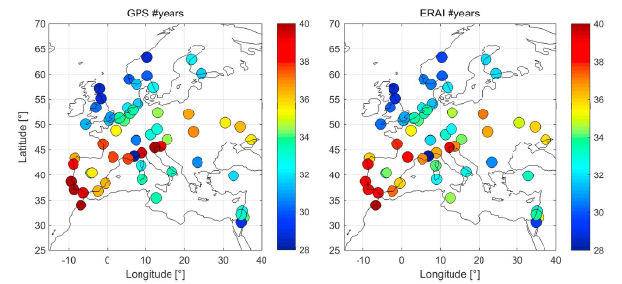
GNSS for climate: requirements
Requirements
long-term time series (climatological = 30 yrs!)
between 30 and 40 years of daily data are required to detect a significant trend of 0.3 mm/decade in the PWV data (e.g. Wang et al., J. Clim, 2016), considering the presence of autocorrelation.
Alshawaf et al., JGR, 2018

Slide 12
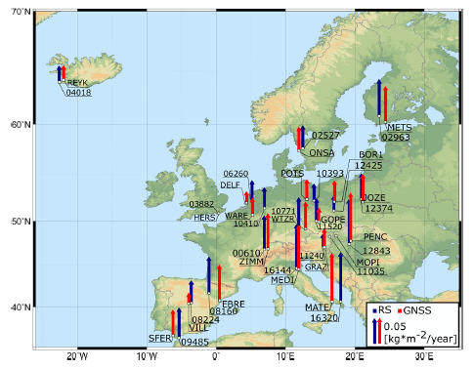
GNSS for climate: applications
Applications
validation tool for long-term IWV time series
  observations: RS
  regional: EU
  trends
all trends are positive (1996-2015)
figures shows best agreement of different processing strategies
Baldysz et al., Remote Sensing, 2019

Slide 13
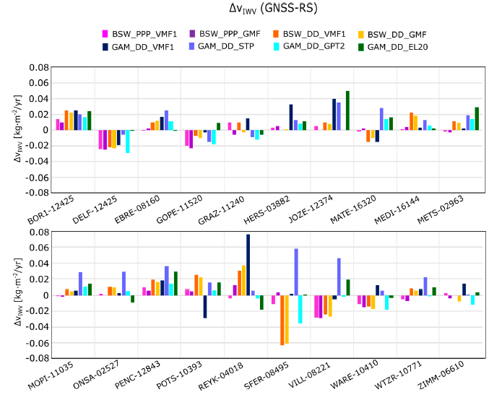
GNSS for climate: requirements
Requirements
homogeneity
  processing options
different softwares, methods (PPP/DD), a priori ZHD models, tropospheric mapping functions
trend differences between solutions (0.015-0.121 mm/yr) larger than trend estimation errors (0.006-0.008 mm/yr)
highest consistency for PPP solutions: DD method may introduce to the troposphere solutions errors that affect the proper investigation of long term changes.
Baldysz et al., Remote Sensing, 2019

Slide 14
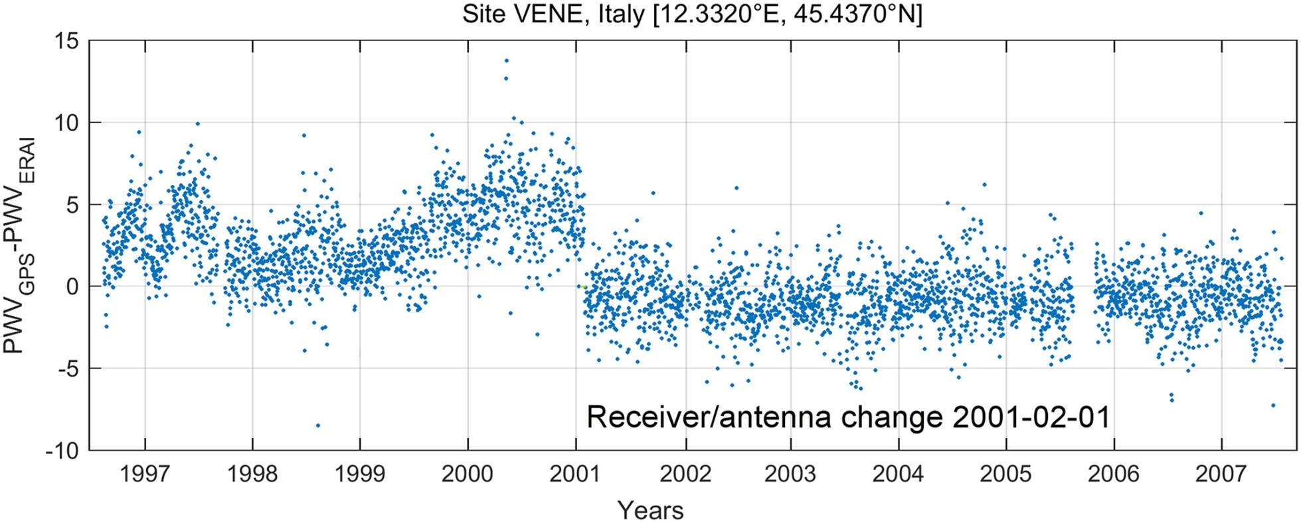
GNSS for climate: requirements
Requirements
homogeneity
  processing options
  instrumentation
as the GPS networks are not very dense, using neighbouring stations as reference is difficult
most often: calculate IWV differences between GPS and ERA-interim at the stations
run breakpoint detection tool on those differences
Alshawaf et al., JGR, 2018

Slide 15
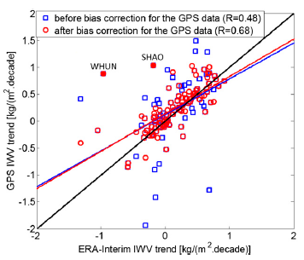
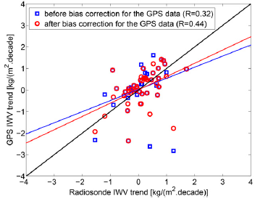
GNSS for climate: requirements
Requirements
homogeneity
  processing options
  instrumentation
after correcting for biases detected with PMTred in GPS-ERA-interim IWVs: better consistency between trends
also better consistency between IWV trends at co-located GPS an RS stations
Ning et al., J. Clim, 2016

Slide 16
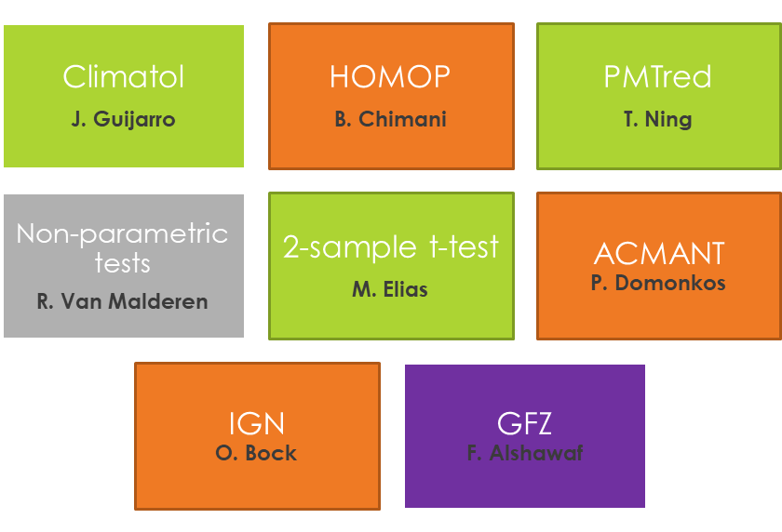

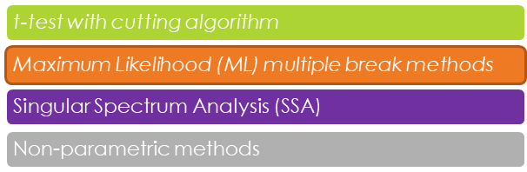
GNSS for climate: requirements
benchmark IWV differences time series, with known offsets
3 different sets, including seasonal signals + WN (easy) + AR(1) (less complicated) + gaps & non-climatic trend (fully complicated)
methods:
Requirements
homogeneity
  processing options
  instrumentation

Slide 17
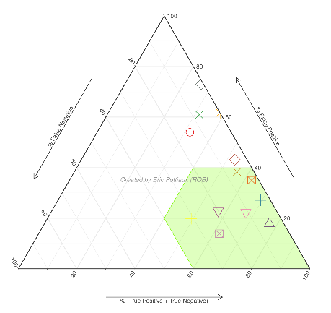
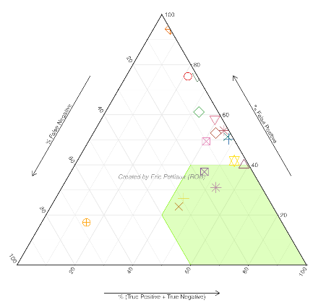
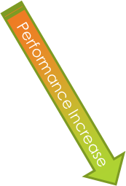

GNSS for climate: requirements
Results:
Requirements
+ gaps and trend
homogeneity
  processing options
  Instrumentation
  auxiliary meteorological data
performance decreases drastically for almost all the tools when adding gaps and a trend in the benchmark time series
no successful break detection → no reliable trend estimations
problem far from being solved!

Slide 18
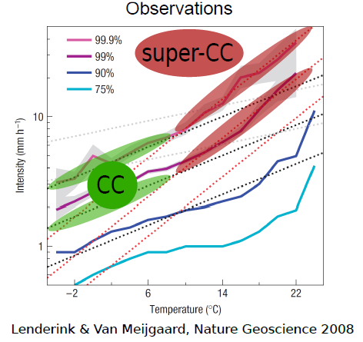
GNSS for climate: challenges
Applications
use of GNSS IWV for validation of more complex (regional) climate models (high resolution, convection permitting models)
validation tool for long-term IWV time series
  observations/models (reanalysis/climate)
  global/regional
  bias/variability
  seasonal behaviour
  trends

Slide 19
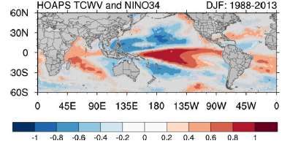
GNSS for climate: challenges
Applications
validation tool for long-term IWV time series
  observations/models (reanalysis/climate)
  global/regional
  bias/variability
  seasonal behaviour
  trends
study the time/spatial variability of GNSS IWV datasets
combine different datasets of IWV (global/regional, ocean/land) to study the time and spatial variability of IWV and its relationship with atmospheric and oceanic circulations.
Shi et al., Remote Sens., 2018

Slide 20
GNSS for climate: take home messages
provide long, dense GNSS networks
whenever you change the instruments, document and make a paired comparison (and correct for the possible break)
be consistent in your processing and in which processing you provide to possible users (satellite & climate community)
exploit your datasets yourself, but having one or two independent references is always a good idea!

