Slide 1
Status of the homogenization activity of the global ozonesonde network
R. Van Malderen, H.G.J. Smit, A.M. Thompson, R. Stauffer, D. Kollonige, D. Tarasick, B. Johnson, and ASOPOS panel

Slide 2

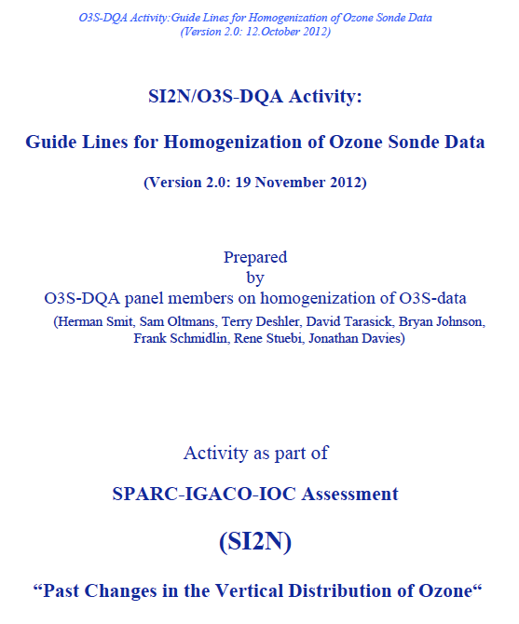
Evolution of improving QA/QC for Ozone Sondes
ASOPOS 1.0: Establishing SOP 1.0 (GAW Report#201)
  The “old” SOP’s pre-formulated after JOSIE 2000, which have been tested in BESOS in 2004, and formulated and unanimously agreed by ASOPOS 1.0 Panel in September 2004 at FZJ, Juelich (Germany)
  Achievement: 10 % uncertainty in the global network
O3S_DQA: Homogenisation of the long term O3S-Data of the global network (2012……)
  JOSIE 2000 and BESOS 2004 clearly shown that the global (O3S) network is suffering bias effects e.g. through the use of different ECC sonde types together with different sensing solution types (SST’s)
  Achievement: Reduction uncertainty in global network over 1980-2015 from 10-20% down to 5-10%
Tarasick et al, AMT, 2016; Van Malderen et al., AMT, 2016, Witte et al., JGR 2017, 2018 A&B, 2019; Sterling et al., AMT, 2018
2004
2012

Slide 3
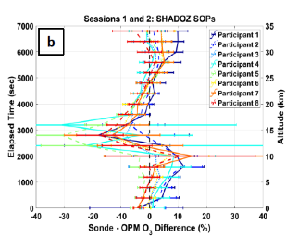
Evolution of improving QA/QC for Ozone Sondes
  JOSIE 2017 SHADOZ: QA on Tropical O3S Capabilities + New SST + SOP’s
  Achievement:
    Confirmation of overal uncertainty 5-10%, but better homogenized SOP’s are necessary for an uncertainty of 5% (claimed by satellite data community)
    Better time response resolving and correction of background evolution in course of the sounding
  Thompson & Smit et al., BAMS, 2019
2017

Slide 4
Evolution of improving QA/QC for Ozone Sondes
ASOPOS 2.0: Establishing new SOP’s 2.0
  Goal:
  Uncertainty of 5 % in the global network through the use of a single coherent set of SOP’s on preparation, meta-data & data-processing at all ozonesounding stations in the global network
  To establish a more effective QA-system on data quality control through quasi-continuous data screening and alerting on sudden artifacts in the global network
Time Line ASOPOS 2.0 Report:
Ready for review : July 2020
Access WMO-Public Server: Fall 2020
Printed: Beginning of 2021
2020

Slide 5
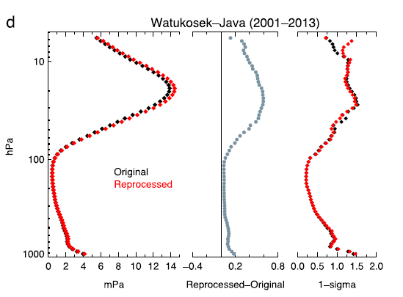
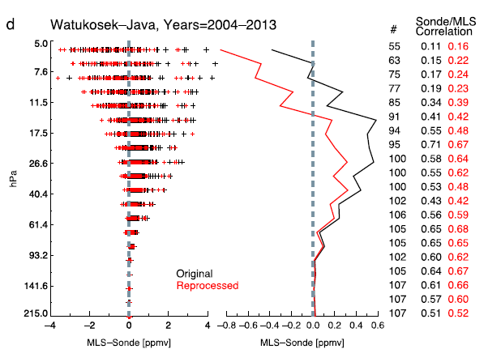
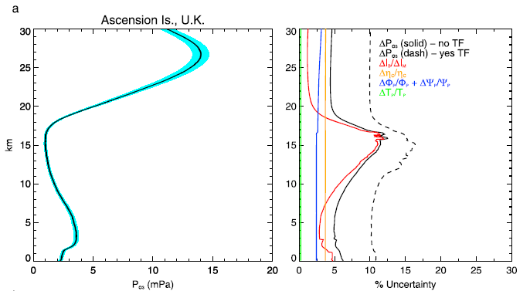
O3S-DQA: principles
Witte et al., JGR, 2017
correcting for changes in …
  ECC ozonesonde type (SPC, EN-SCI)
  sensing solution strength/volume
  “pump” temperature measurements
  pre-flight procedures (background current, pump flow rate)
  post-processing (pump efficiency correction tables, total ozone normalization, etc.)
estimation of uncertainties for every ozone partial pressure measurement
➔ reduce uncertainty from 10-20% to 5-10%
Witte et al., JGR, 2018

Slide 6
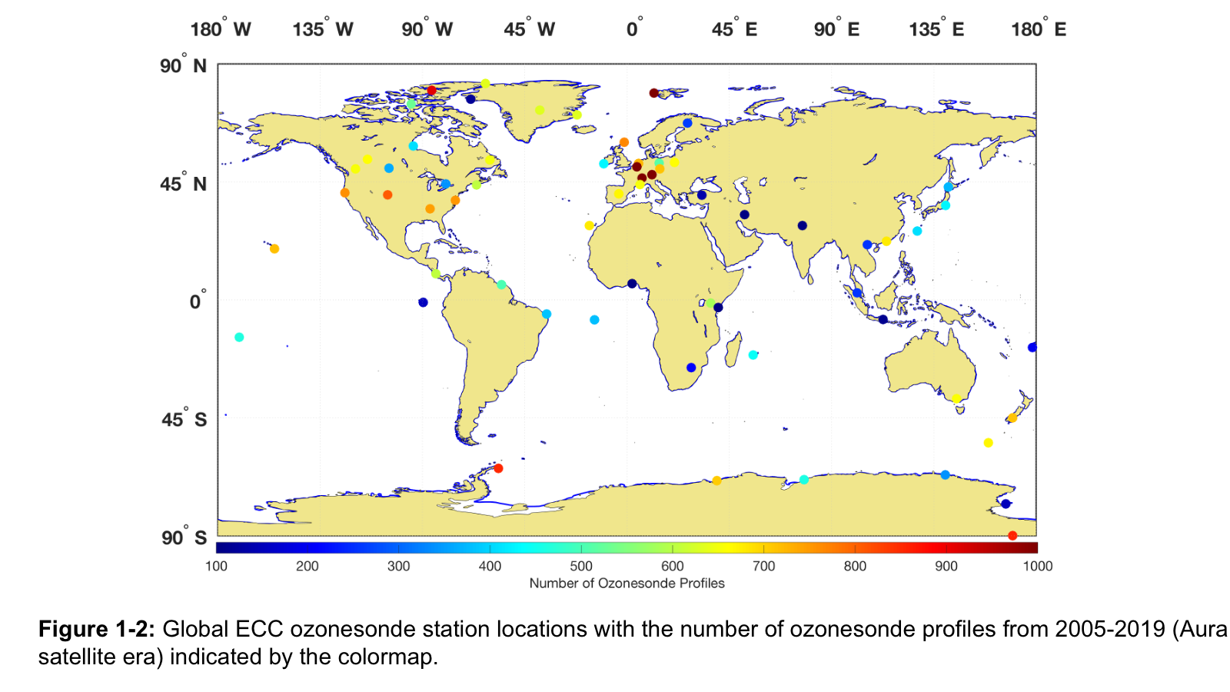
O3S-DQA: status
Canadian network (10 sites) Tarasick et al., AMT, 2016
SHADOZ network (10 sites) Witte et al., JGR, 2017, 2018, Thompson et al., JGR, 2017
NOAA network (9 sites) Sterling et al., AMT, 2018
Individual sites (5): Uccle & De Bilt (Van Malderen et al. , AMT, 2016), Wallops Island (Witte et al., JGR, 2019), Lindenberg, Mc Murdo
➔ 34 homogenized sites
Fig. taken from the ASOPOS 2.0 report, courtesy of A. Thompson

Slide 7
O3S-DQA: status
homogenization
≠
correction for TCO drop-off at 14 sites
(see next talk by Ryan Stauffer)
Fig. taken from the ASOPOS 2.0 report, courtesy of A. Thompson

Slide 8

O3S-DQA: outlook
In the pipeline: Japanese sites, Syowa, Lauder, Observatoire Haute Provence, Izaňa (7 sites)
➔ 41 homogenized sites
Remaining: mostly EU sites (Payerne, Hohenpeissenberg, Legionovo, Praha, Madrid, Lerwick, Ny Alesund, Sodankyla, Scoresbysund), EU-affiliated (Marambio, Neumayer), and two Austrialan sites (LOTUS high/median priority 60°N-60°S sites) → some action will be taken here!
➔ 50-55 homogenized sites
Fig. taken from the ASOPOS 2.0 report, courtesy of A. Thompson

Slide 9
O3S-DQA: outlook
The already homogenized ozonesonde time series (34 sites) are available for the LOTUS community (e.g. SHADOZ, upon request at PIs) → at LOTUS server in one (ASOPOS 2.0 agreed) format (TBD, TBC) → same applies for OCTAV-UTLS
Homogenization activity continues!
  increase number of homogenized sites (especially EU) to 40 (1st step) & 50-55 (2nd step)
  correct for radiosonde pressure sensor biases
  alternative background current subtraction and sensor time lag response correction (e.g. Vömel et al., AMTD, 2020; Smit et al., in preparation)
  identification of origin of TCO drop-off and correction (see next talk by R. Stauffer)
Set up an operational validation tool for ozonesonde data (leasons learnt from TOC drop-off)

