Slide 1


Homogenizing GPS integrated water vapour time series: benchmarking break detection algorithms on synthetic datasets
R. Van Malderen, E. Pottiaux, A. Klos, P. Domonkos, M. Elias, T. Ning, O. Bock, J. Guijarro, F. Alshawaf, M. Hoseini, A. Quarello, E. Lebarbier, B. Chimani, V. Tornatore, S. Zengin Kazancı, and J. Bogusz

Slide 2
Outline
Introduction
Synthetic benchmark dataset generation
Break detection methods
Performance
  Accuracy of break point positions
  Centered RMSE
  Trend differences
Conclusions

Slide 3
Introduction
surface warming
warm air can contain more water vapour than cold air (Clausius Clapeyron)
Integrated Water Vapour (IWV) or Precipitable Water Vapour (PWV) amounts are increasing?
IGS “repro1” troposphere products is providing worldwide IWV dataset

Slide 4
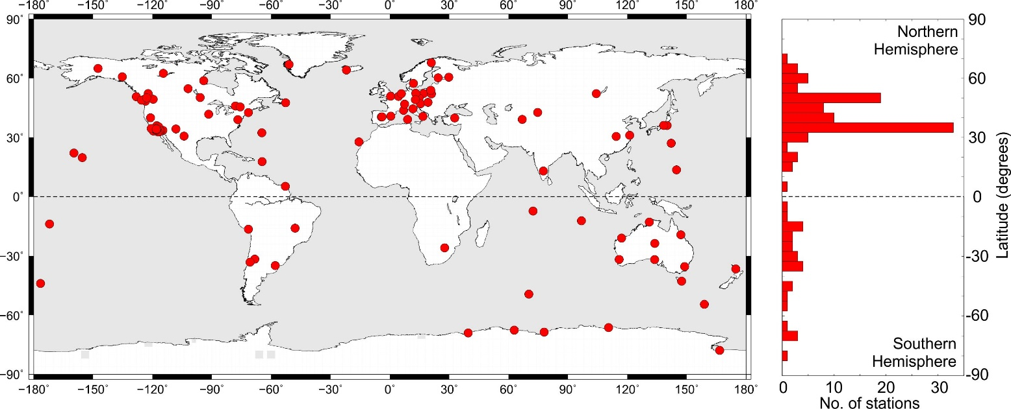
Introduction
ZTD → IWV
Daily Observations
120 Stations
Period: 1995-2010
Screened and converted to Integrated Water Vapor (IWV) by O. Bock.
Screened and converted to Integrated Water Vapor (IWV) by O. Bock.
From A. Klos

Slide 5
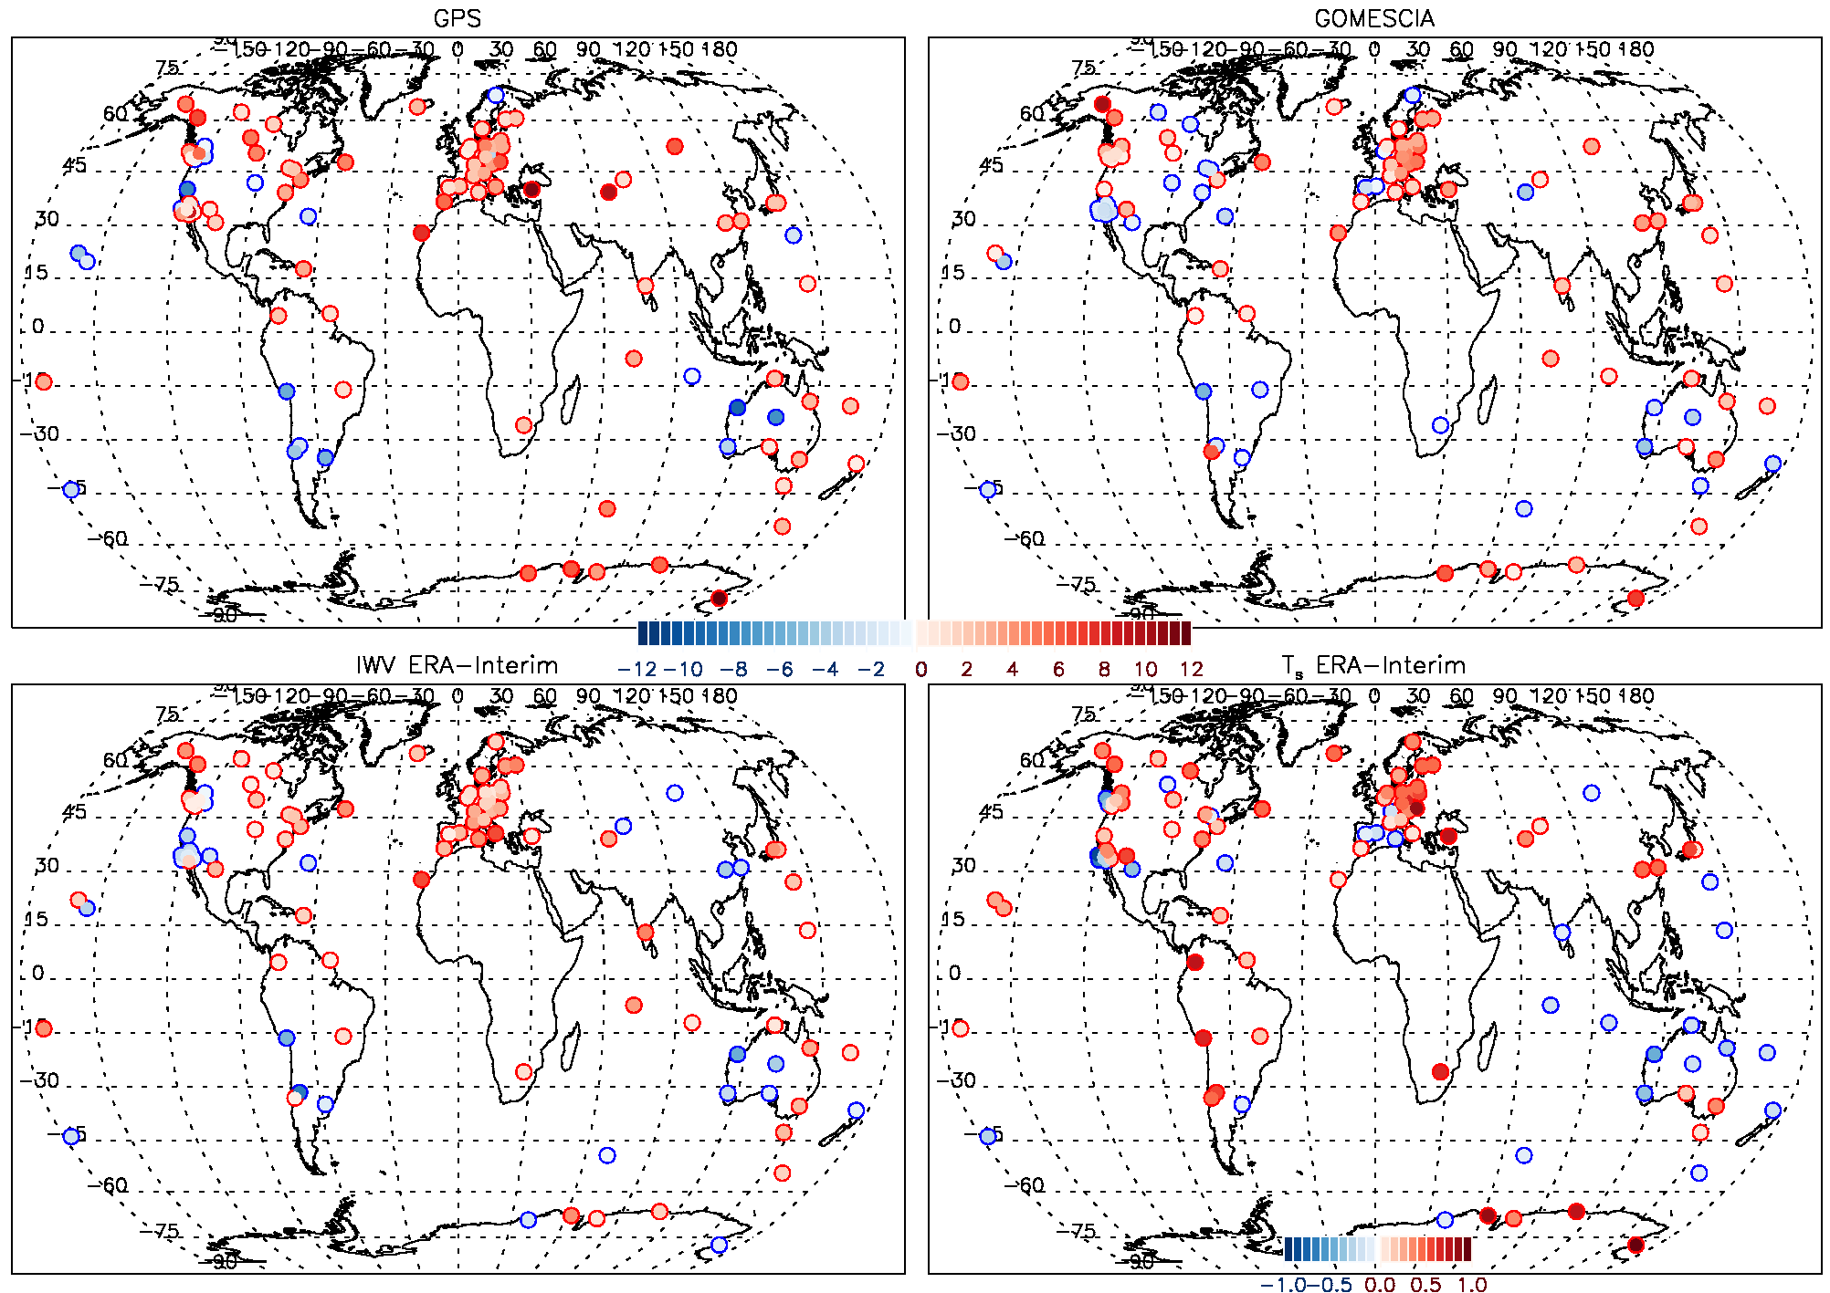

Introduction
Trends for 1996-2010
IGS Repro 1 IWV
IWV trends follow T_{s} trends globally
differences between different datasets (but GPS and ERA-Interim not too different)
due to inhomogeneities in datasets?
COST action :
Satellite IWV
IGS Repro 1 IWV
ERA-interim IWV
ERA-interim T_{s}

Slide 6
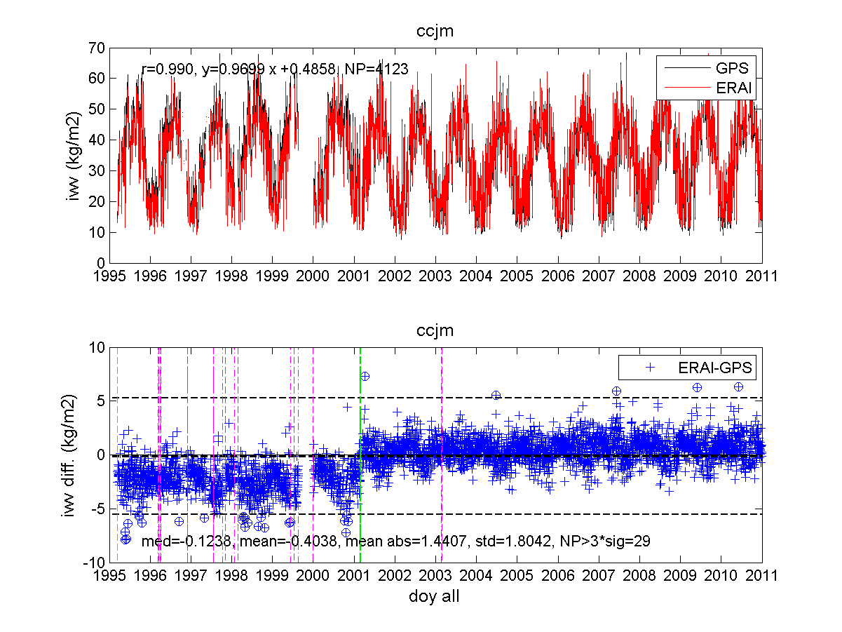
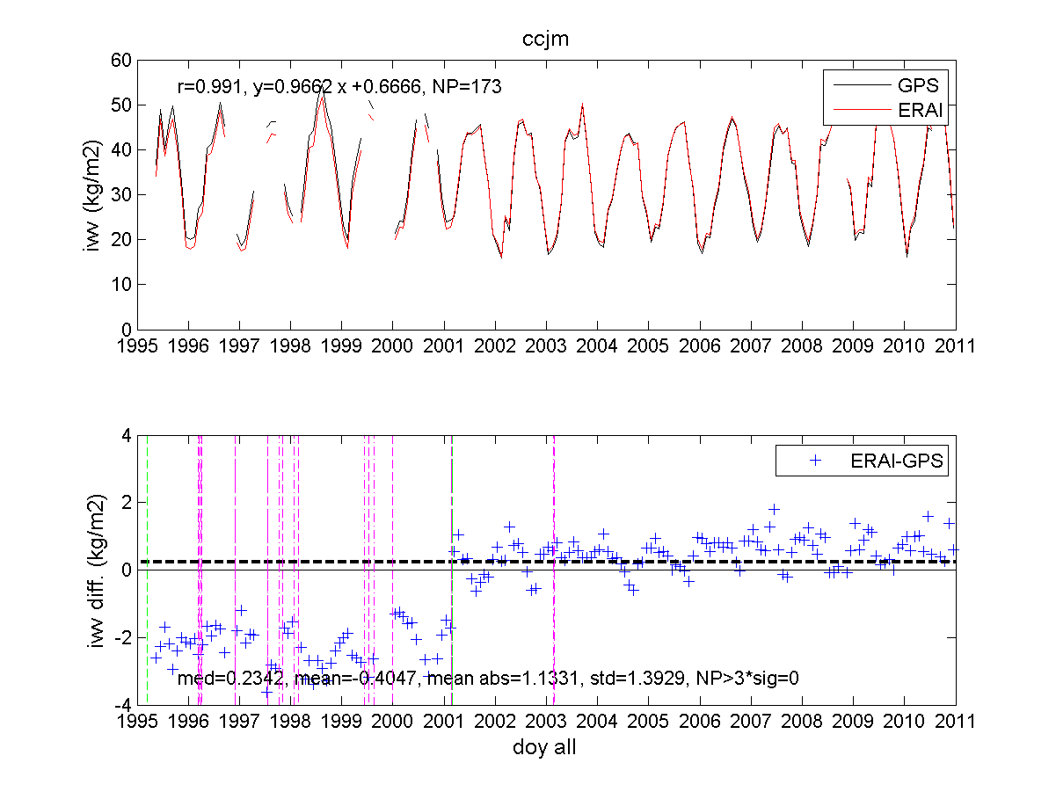
Introduction
Daily
Monthly
CCJM: Ogasawara, Japan
From O. Bock
→ We will look for break points in the ERA-interim-GPS IWV differences time series
ERA-interim IWV
IGS Repro 1 IWV

Slide 7
Synthetic benchmark dataset generation
Real IWV Diff. (ERAI-GPS)
Synthetic IWV Diff.
manual homogenization
IGS log files
power spectra density analysis
noise analysis
non-climatic trend analysis
characterization of the number and amplitude of breaks (randomly inserted)
significant frequencies (annual, semi-annual…)
noise model: AR(1) + WN
characterization of non-climatic trends (reference series)

Slide 8
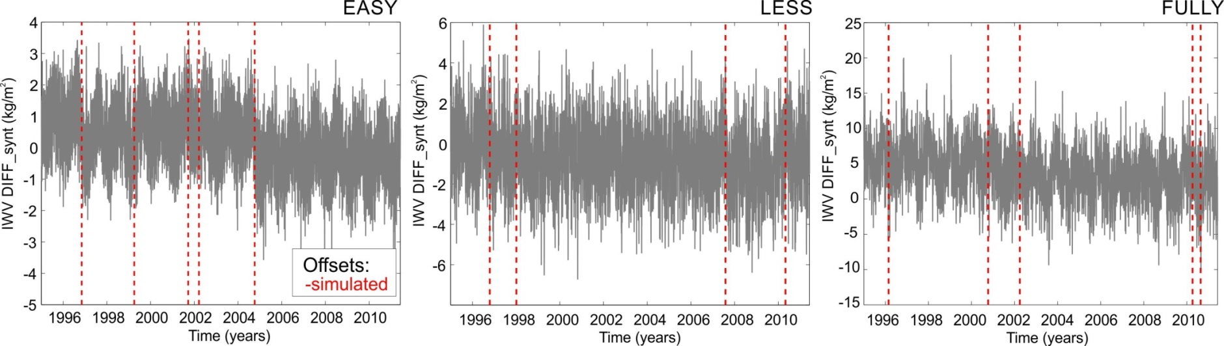
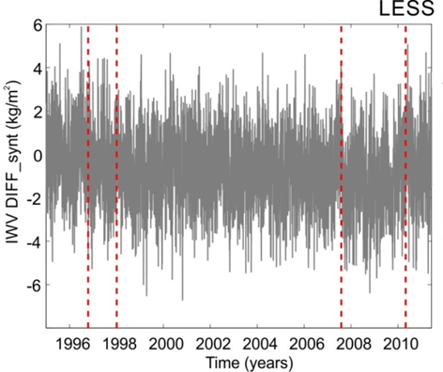
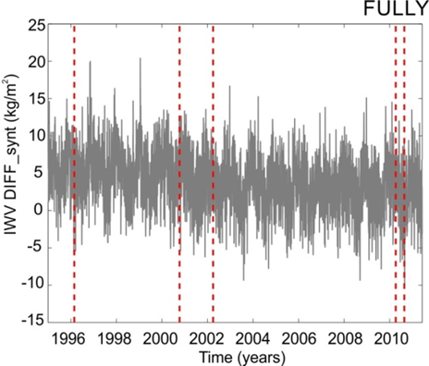
Synthetic benchmark dataset generation
3 variants: assess the performances of break detection methods w.r.t. dataset characteristics
EASY
MODERATE
COMPLEX
seasonal signals
breaks
white noise (WN)
= EASY but +
autoregressive process of the first order (noise model = AR(1)+WN)
= MODERATE but +
gaps (up to 20% of missing data)
non-climatic trend (Ref. Series)
Breaks:
simulated

Slide 9
Break detection methods
2 sample t-test
daily + monthly
IGN-AgroTech
daily
Climatol
daily + monthly
PMTred
daily + monthly
Mann-Whitney & CUSUM & Pettitt
daily + monthly
Zero difference
daily
ACMANT
daily
Pettitt
daily + monthly
8 break detection methods (7/8 different operators)
13 break detection methods (daily+monthly)
not all of them applied on EASY/MODERATE/COMPLEX datasets
4 main types of break detection methods:
Standard Normal Homogeneity Test methods
Maximum Likelihood (ML) multiple break methods
Singular Spectrum Analysis (SSA)
Non-parametric methods

Slide 10
Performance: 1. Accuracy of break point positions
Number of detected breaks
Time window for break detection
except NP2d: methods find less breaks than inserted.
larger ratio of detected breakpoints for daily methods
a time window of 62 days seems appropriate

Slide 11

Performance: 1. Accuracy of break point positions
Skill scores
False Alarms
Matches
Misses
False Positive
True Positive
False Negative
True Negative
True Break
True Break
Estimated Break
Estimated Break
time
62 days
62 days
62 days
62 days

Slide 12
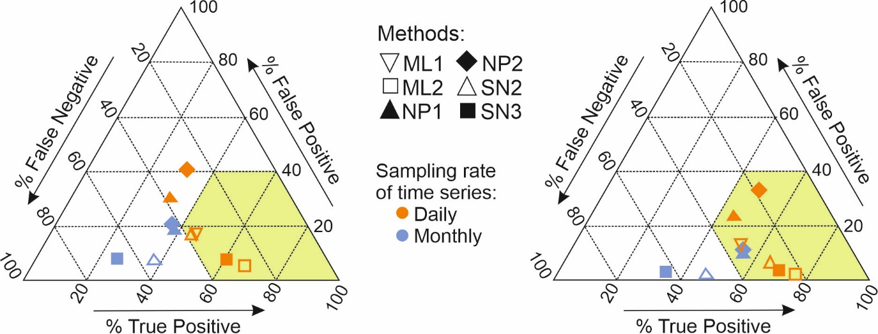
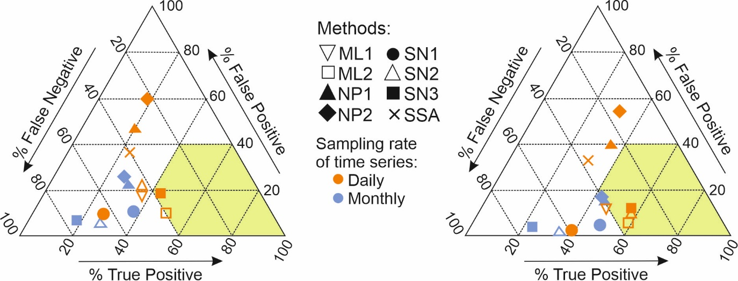
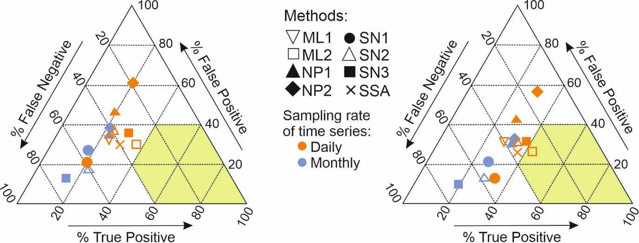
Performance: 1. Accuracy of break point positions
Skill scores
EASY
MODERATE
with 62d: large number of hits (TP) compensated by large number of false alarms (FP)
performance decreases with increasing complexity
best: ML2 and SN3
better scores for N=183 days
COMPLEX

Slide 13
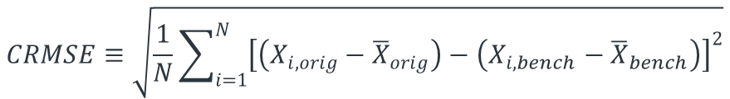
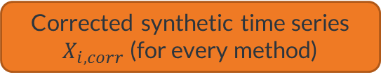


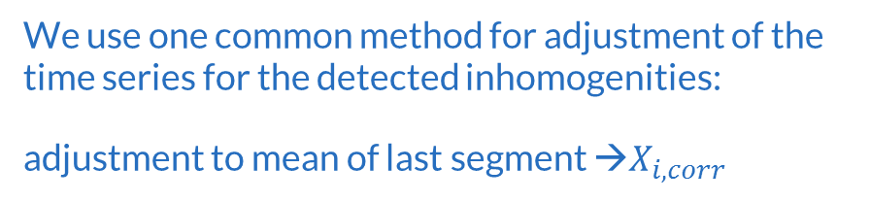
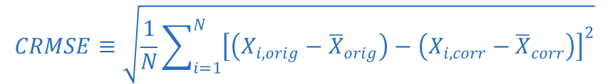
Performance: 2. Centered RMSE
We use one common method for adjustment of the time series for the detected inhomogenities:
adjustment to mean of last segment →$X_{i,corr}$
(Original) homogeneous synthetic time series $X_{i,orig}$
$$CRMSE≡\sqrt{\frac{1}{N}\sum_{i=1}^{N}{{\left[\left(X_{i,orig}−{\overline{X}}_{orig}\right)−\left(X_{i,bench}−{\overline{X}}_{bench}\right)\right]}^{2}}}$$
+ breaks
Inhomogeneous synthetic benchmark time series $X_{i,bench}$
$$CRMSE≡\sqrt{\frac{1}{N}\sum_{i=1}^{N}{{\left[\left(X_{i,orig}−{\overline{X}}_{orig}\right)−\left(X_{i,corr}−{\overline{X}}_{corr}\right)\right]}^{2}}}$$
improvement?
break adjustment
Corrected synthetic time series $X_{i,corr}$ (for every method)

Slide 14
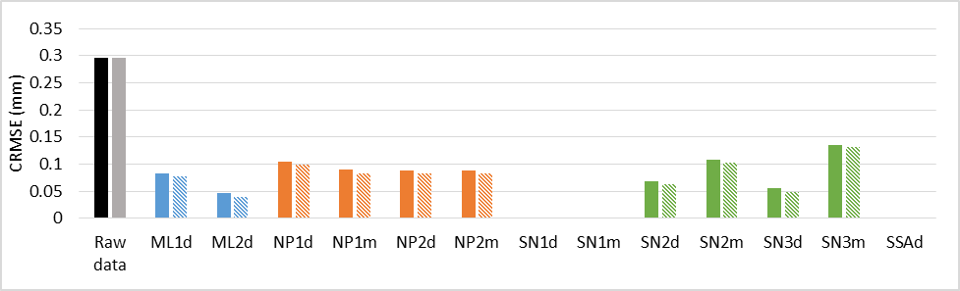
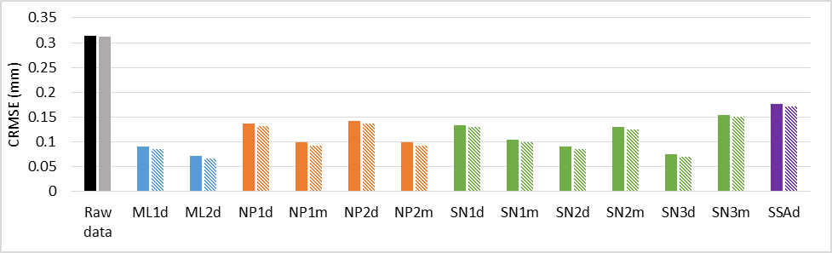
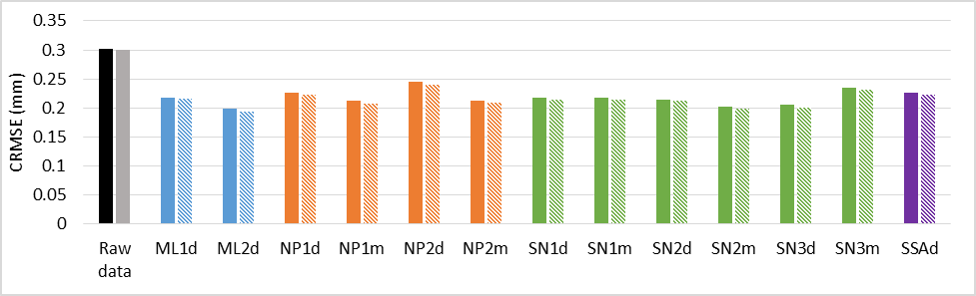
Performance: 2. Centered RMSE
EASY
all break detection methods (+ adjustment) give an improvement w.r.t. the inhomogeneous benchmark time series (“raw data”)!
improvement decreases with increasing complexity of the datasets
  Easy: 71% (55-85%)
  Moderate: 63% (45-75%)
  Complex: 28% (19-35%)
  largest decrease for Moderate→Complex
CRMSE (& improvements) very similar for adjusted daily and monthly time series for a given method
best methods remain ML2d and SN3d
MODERATE
COMPLEX

Slide 15
Performance: 3. Trend differences
We use one common method for adjustment of the time series for the detected inhomogenities:
adjustment to mean of last segment →$X_{i,corr}$
(Original) homogeneous synthetic time series $X_{i,orig}$
+ breaks
$$\text{Abs}\text{. }\text{Trend} \text{Bias}≡abs\left({Trend}_{orig}−{Trend}_{bench}\right)$$
Inhomogeneous synthetic benchmark time series $X_{i,bench}$
improvement?
$$\text{Abs}\text{. }\text{Trend} \text{Bias}≡abs\left({Trend}_{orig}−{Trend}_{corr}\right)$$
break adjustment
Corrected synthetic time series $X_{i,corr}$ (for every method)

Slide 16
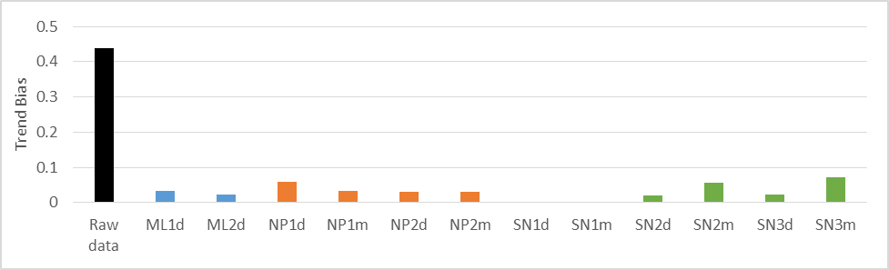
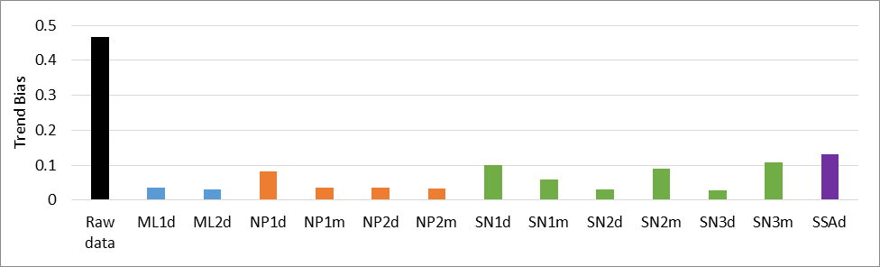
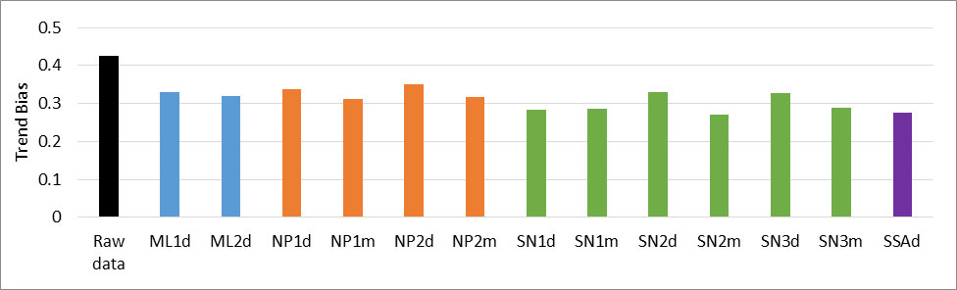
Performance: 3. Trend differences
EASY
all break detection methods (+ adjustment) give smaller trend biases as compared to the inhomogeneous benchmark time series (“raw data”)!
trend bias improvement decreases with increasing complexity of the datasets
  Easy: 91% (84-95%)
  Moderate: 87% (72-94%)
  Complex: 27% (17-36%)
  largest decrease for Moderate → Complex
different methods are best performing
MODERATE
COMPLEX

Slide 17
Conclusions
methods perform well in detecting the inserted breaks, but rather high number of false break detections (especially for Complex)
after adjustment, significant improvement in time series, both in terms of CRMSE and trend errors (especially for Easy + Moderate)
poorer performance for Complex due to gaps or trends?
Complex: closest to the real IWV homogenization task, but higher improvement expected in the real IWV homogenization due to
  both the ERAI trend bias and data gap problems are overshot in Complex
  the use of metadata in real IWV homogenization.

Slide 18
Conclusions
2 best methods represent 2 different classes of methods (ML and SNHT), so no best performing class
those 2 best methods have been applied on the daily series, but differences of efficiencies between daily and monthly versions of the same method is often surprisingly high.
This research has been submitted to Earth and Space Science (AGU journal).

